Slide 1
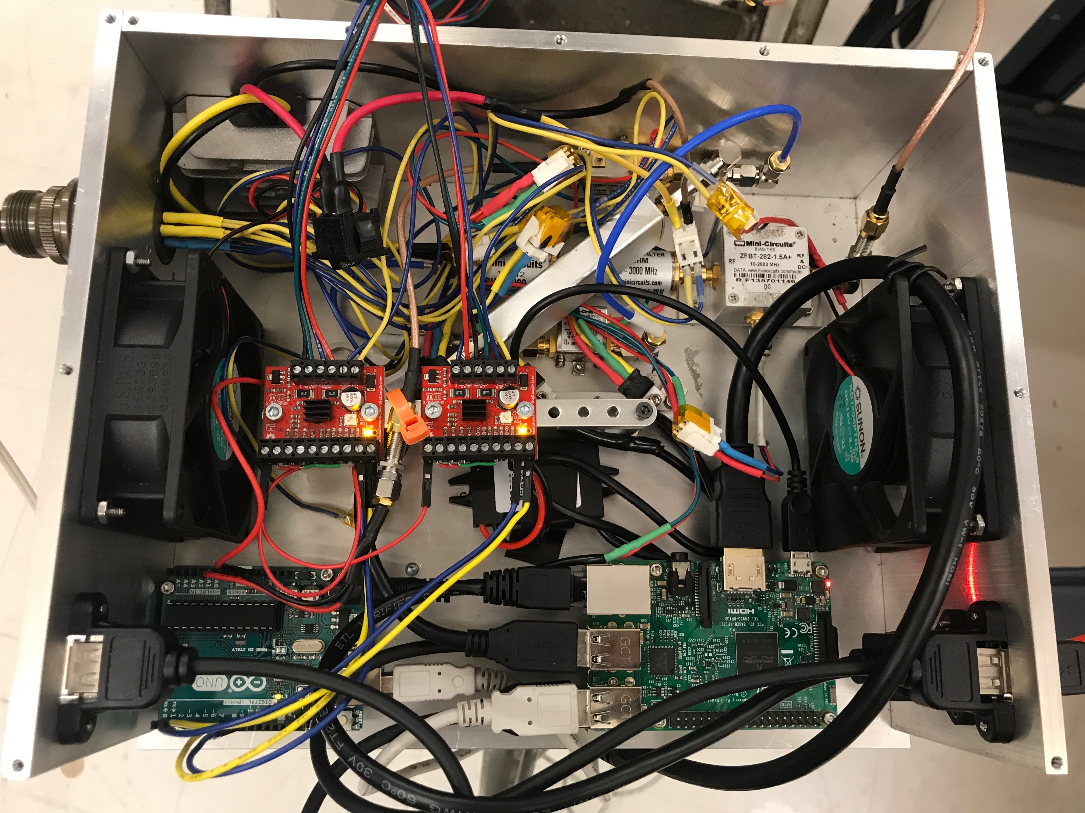
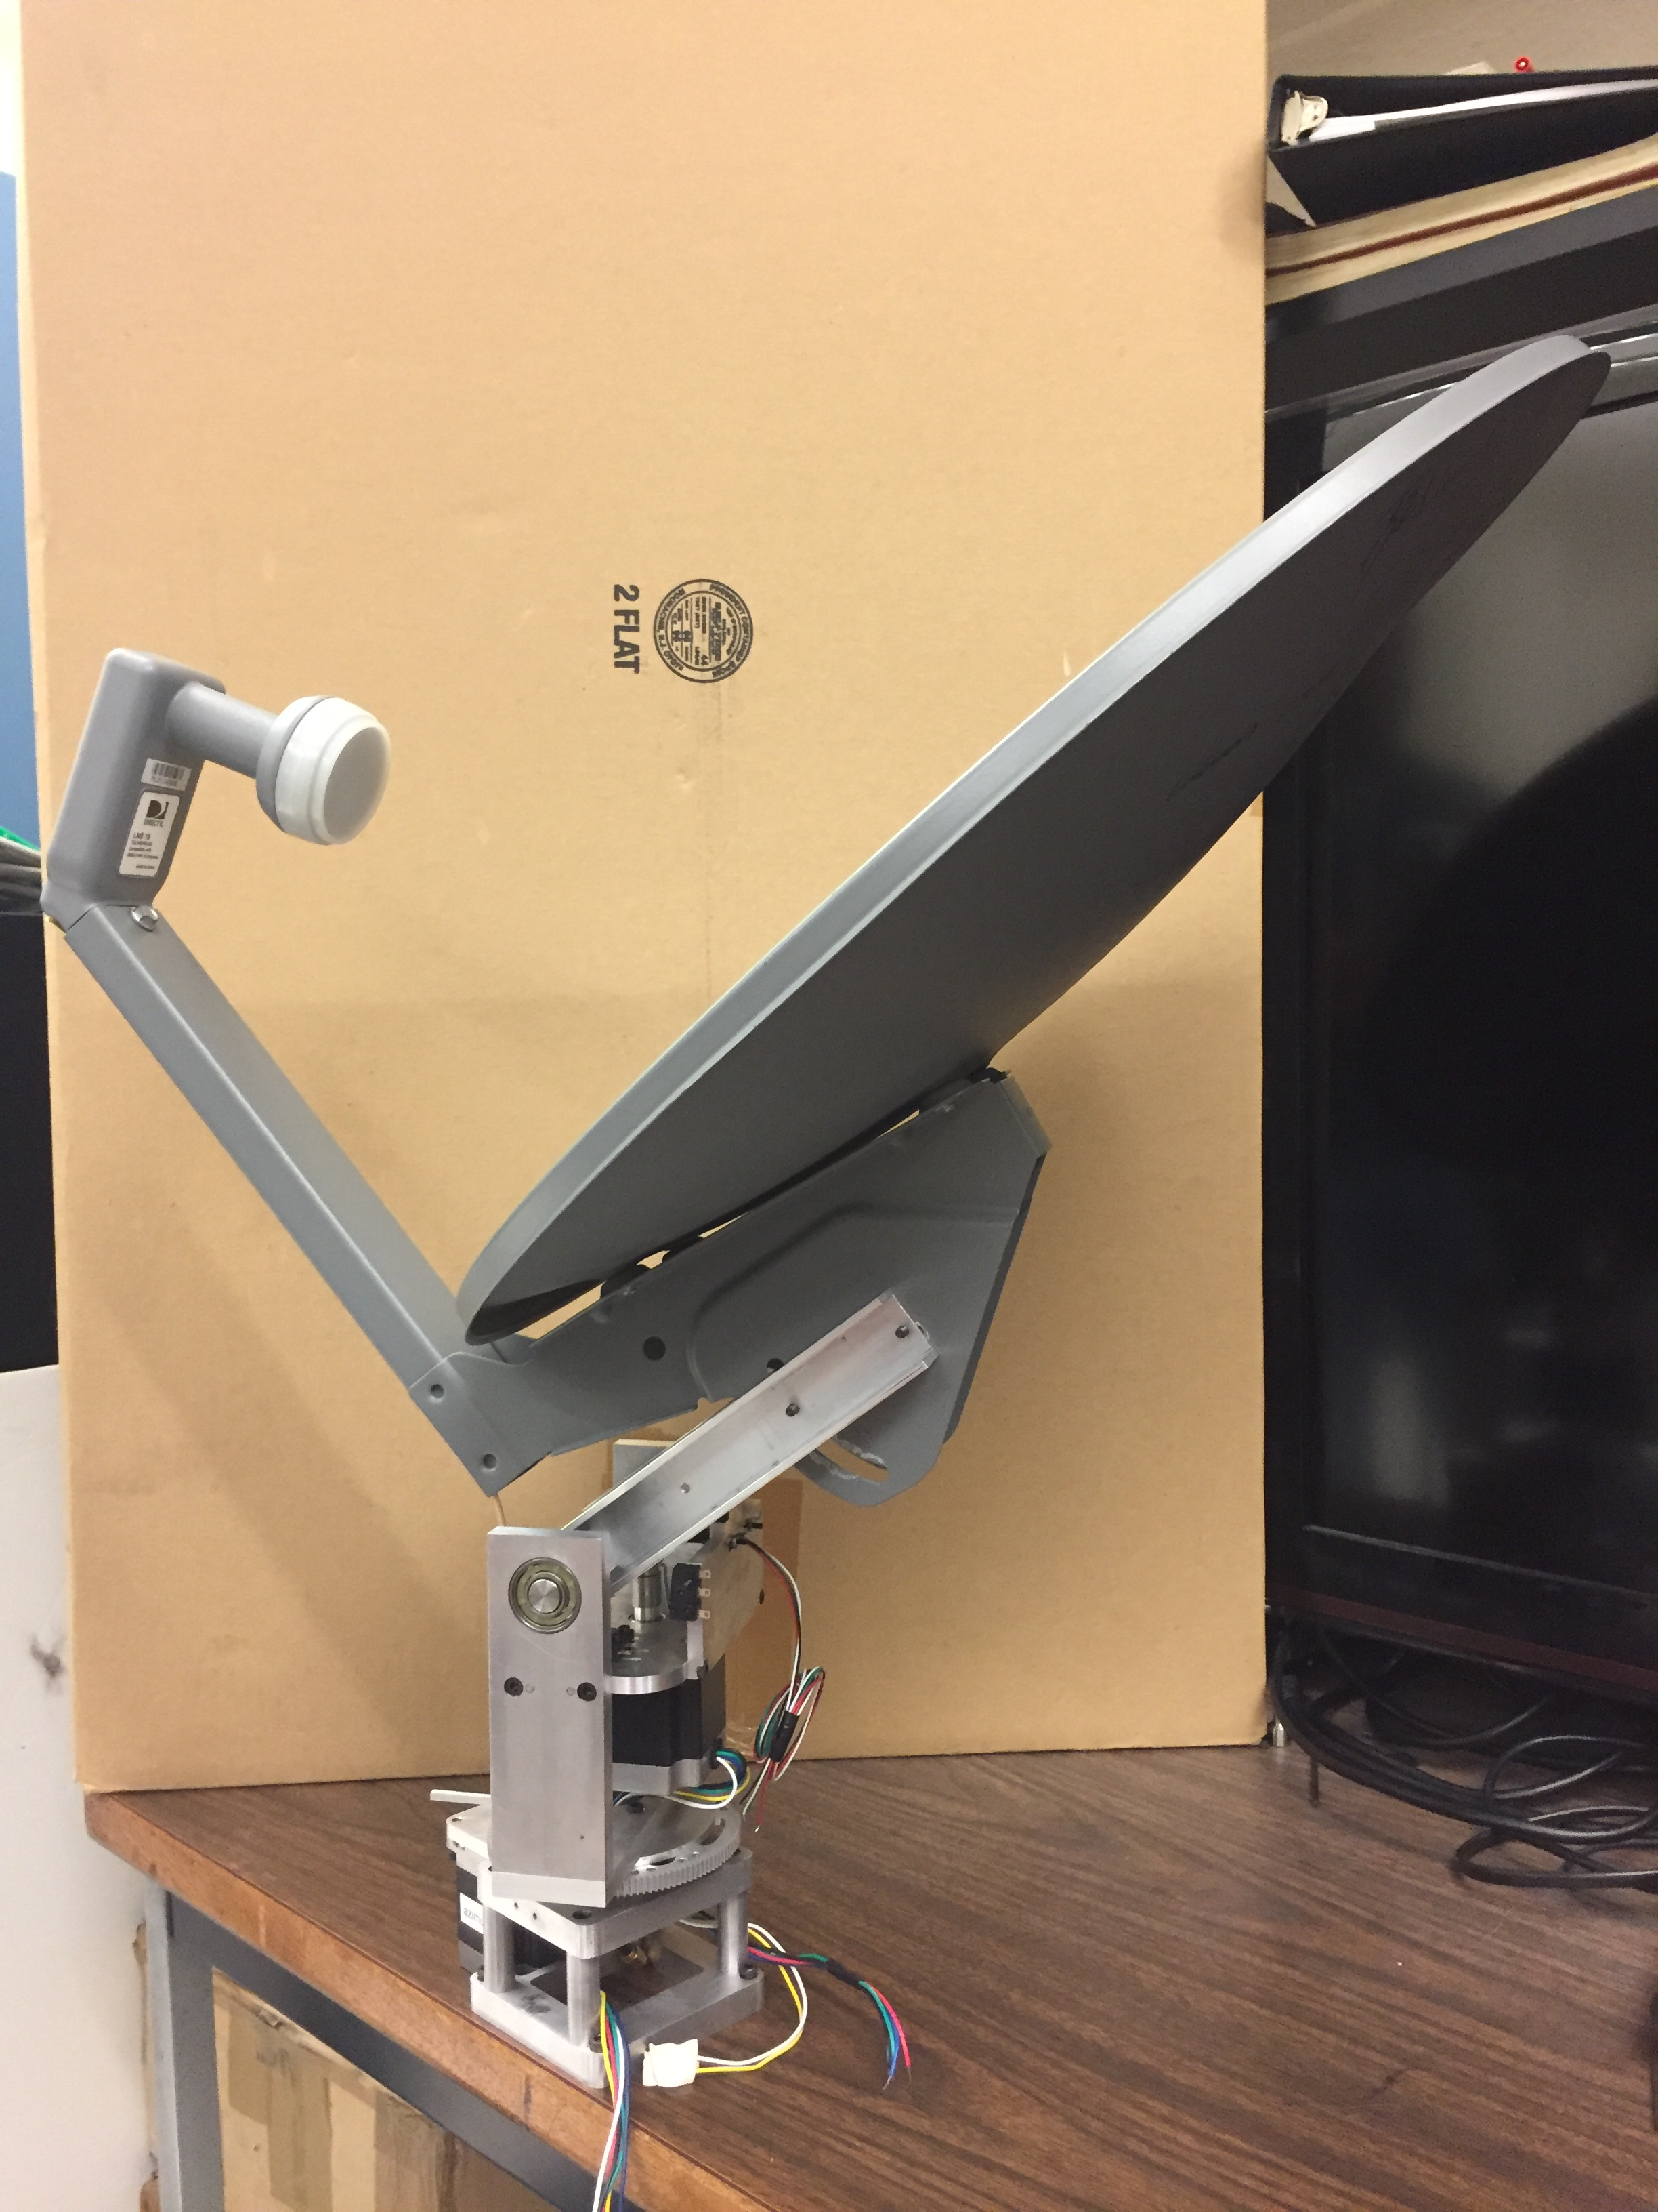
Mini Radio Telescope James Aguirre jaguirre@sas.upenn.edu Open source software at https://github.com/upenneor/miniradiotelescope
Raspberry Pi: runs the main control program and processes the data
Arduino: digitizes the signal from the radio receiver and communicates with the motor controllers to move the telescope
Radio filters and amplifiers: boost the signal from the commercial electronics and convert to a measurement of total power
Software defined radio (SDR): can make a spectrum of the received radio signal
Motor controllers: one for each axis of elevation and azimuth

