Slide 1


PAPYRUS TESTING FRAMEWORK
January 13, 2014 | Juan CADAVID

Slide 2
GOALS
Apply Test-Driven Development within Papyrus
Writing tests is long and cumbersome
  Papyrus is: 264 Eclipse plug-ins
  Papyrus Tests is: 70 Eclipse plug-ins/fragments
Many types of diagrams (and now tables!)
Requirement: Make it UML-based
  Good experiment for MDE with Papyrus
  Make use of UTP (UML Testing Profile)
Currently: Generate JUnit tests
  Test editors (diagrams and tables)
  Test infrastructure
  Test for performance
Nom événement | Nom Prénom

Slide 3
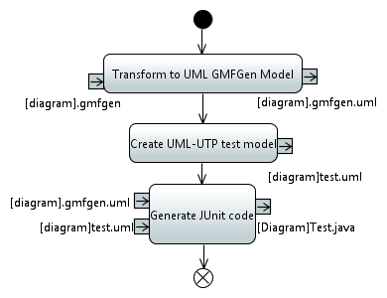
TEST CASE GENERATION WORKFLOW
QVTO
QVTO
Acceleo
Nom événement | Nom Prénom | <number>

Slide 4
How to generate tests for:
A new diagram type, new table type.
Demo: UML Component Diagram
Specify which edit parts (nodes and links) to test.
  Create QVTO script inheriting from the framework’s test generation script,
  ComponentDiagramTest.qvto
Set parameters in the generation workflow file
  Create GenerateComponentDiagramTests.mwe2
  Load ComponentDiagram.gmfgen
Run the workflow
  JUnit tests are generated
Nom événement | Nom Prénom | <number>

Slide 5
Canonical tests in modeling languages: rules for nodes and links
Test top nodes
Test child nodes
  Test edit policies for child nodes
Test links
  Test edit policies for links (source and target elements)
  For every link type
    N x N tests (where N = number of node edit parts)
Nom événement | Nom Prénom | <number>

Slide 6
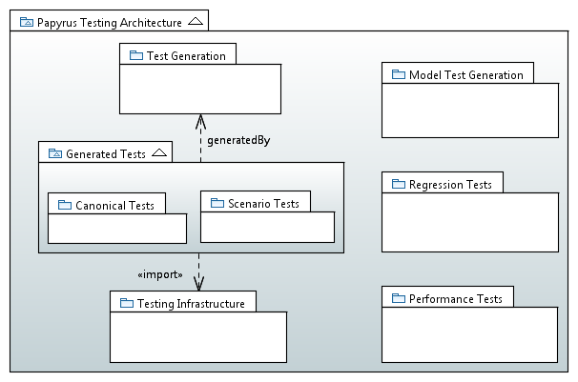
ARCHITECTURE
Generate test UML models for every diagram type
Support the creation of tests associated to bugs
Tests for Well-formedness rules given by the spec
Integration Tests, using SWTBot
Stress Testing
Nom événement | Nom Prénom | <number>

Slide 7
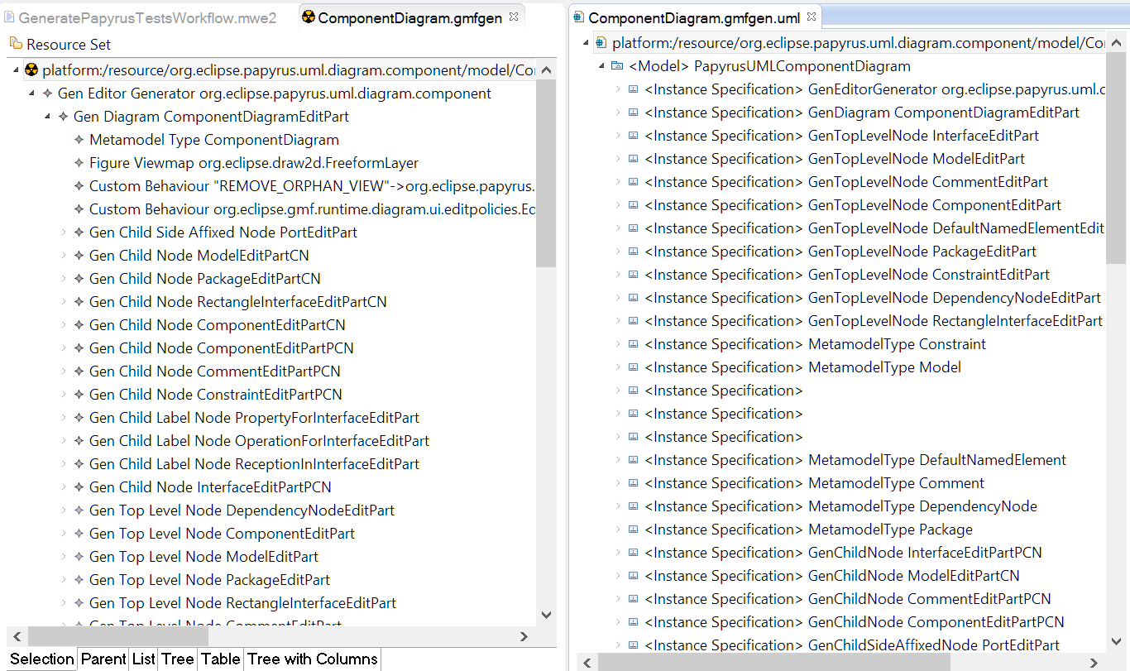
GMFGen: Ecore to UML
Nom événement | Nom Prénom | <number>

Slide 8
THANKS
Questions?

