Slide 1
PAPYRUS TESTING FRAMEWORK
Goals
  To enhance Test-driven development of Papyrus
  To automate generation of test cases and test data (models)
MBT approach, using UTP (UML Testing Profile)
  To describe tests using UML models
Ensure test-adequacy criteria
  Maximize coverage
Ensure quality criteria for Papyrus
  Compliance with user requirements (acceptance testing)
  Backwards compatibility (regression testing)
  Performance testing
Nom événement | Nom Prénom | <number>

Slide 2
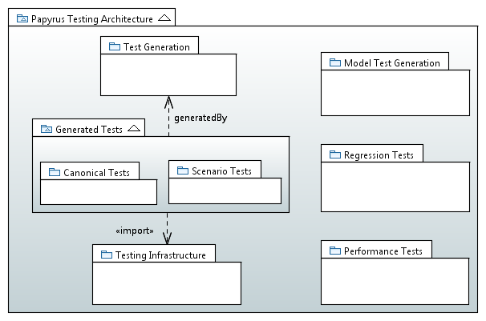
ARCHITECTURE
Generate test UML models for every diagram type
Support the creation of tests associated to bugs
Tests for Well-formedness rules given by the spec
Integration Tests, using SWTBot
Stress Testing
Nom événement | Nom Prénom | 2

Slide 3
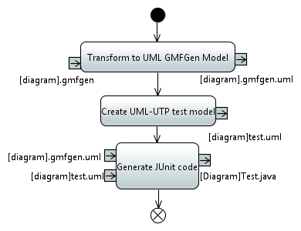
TEST CASE GENERATION WORKFLOW
QVTO
QVTO
Acceleo
Nom événement | Nom Prénom | <number>

Slide 4
PLANNING
Current status
  Fully implemented M2M and M2T transformation workflow
  Complete generation of canonical tests for three types of UML diagrams: Class, Component, Deployment
Upcoming tasks
  September 2013
    Finish generation of canonical tests for all types of diagrams
    Model and generate regression tests with UTP for UML Sequence diagrams
  October 2013
    Model-based specification of Papyrus use cases with Activity Diagrams
    Generation of SWTBot-based test cases
    (Possible) execution of UTP-based models with MOKA
  November 2013
    Generation of UML Test Models
    Model and generate performance tests
Nom événement | Nom Prénom | <number>

