Slide 1

Presented by
Dominic Panthiruvelil

Slide 2
Today’s Agenda
Introduction - Round across the room and phone
Go over the previous solution and answer questions
Discuss about Filters and Directives

Slide 3
AngularJS Directive
What are AngularJS Directives?
Reserved words in AngularJS that performs set of functions which starts with “ng” prefix.
Like server controls in .NET world
AngularJS has set of in build directives like
ng-App
ng-repeat ( used as repeater)
ng-click ( similar to onClick)

Slide 4
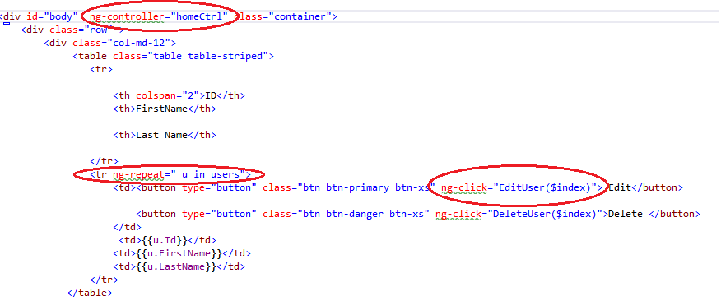
AngularJS Directive usage

Slide 5
AngularJS Custom Directive
Why Use Custom Directives
DOM manipulation should always be done in a directive
Similar to user controls
Situations where you need to improvise
Examples :Autocomplete textbox, datepicker
$( "#datepicker" ).datepicker();
$( "#textbox" ).autocomplete(
source:{}
);

Slide 6
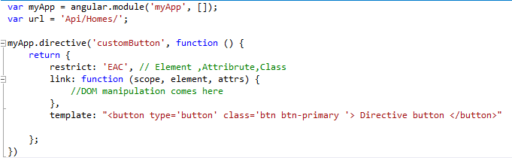
Custom Directive declaration
Syntax

Slide 7
Custom Directive declaration
Restrict options
E : Element
usage <div custom-button></div>
A : Attribute
usage <div custom-button></div>
C: Class
Usage <div class="custom-button"></div>

Slide 8
Custom Directive declaration
Template:
HTML that you want to manipulate or the output that needs to be declared from this directive

Slide 9
AngularJS Filters
Iterates through an array and selects the items in array to be modified
Usage
{{array | filter:expression }}
OR {{object| filter}}
AngularJS built in filters
AngularJS built in directives
Lowercase
Upper case
filter

Slide 10
AngularJS Filters
AngularJS Filters
AngularJS provides filters to transform data:
currency Format a number to a currency format.
date Format a date to a specified format.
filter Select a subset of items from an array.
json Format an object to a JSON string.
limitTo Limits an array/string, into a specified number of elements/characters.
lowercase Format a string to lower case.
number Format a number to a string.
orderBy Orders an array by an expression.
uppercase Format a string to upper case.
Source : w3 schools

Slide 11
AngularJS Custom Filters
Custom Filters declaration
myApp.filter(‘Filter', function () {
return function (X) {
//function comes here
});

Slide 12
Questions?

