Slide 1
Web Content Management (W.C.M)
Rajat Kumar
September 9, 2013

Slide 2
Agenda
What Is WCM
Basic Concept of WCM
Why do we need WCM
WCM Products
A brief description how it works.(Sitecore)

Slide 3
What is WCM
Web content management (WCM) is a stand-alone application used to create, manage, store and deploy content on Web pages. It enable companies to deliver compelling web experience to its users.
Empowers non technical users to create and publish their own web content without the need to understand the complexities of Web Design tools.

Slide 4


Content v/s Presentation
It’s not the consumer’s job
to know what they want.
-Steve Jobs

Slide 5
Basic Concept of WCM
Data
or
Content
Presentation
or
Template
Website

Slide 6
Why do we need WCM ?
Manage Complexity
It’s nice to be on the driver seat, saves time
Regionalization and Localization
Content Re- Usability
Presentation remain consistent throughout the website.
Website can have different graphical layout based on which device is making request.

Slide 7
WCM Products
Sitecore
Tridion
Wordpress
EMC - Web Publisher
IBM - File net Web site Manager
Interwoven - Teamsite
OpenText - RedDot Web Content Management
Oracle - Stellent

Slide 8
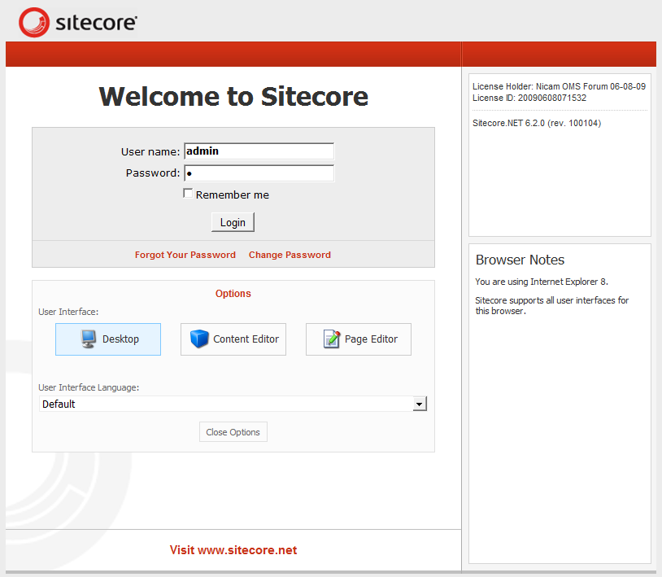
Sitecore, Brief description how to use WCM

Slide 9
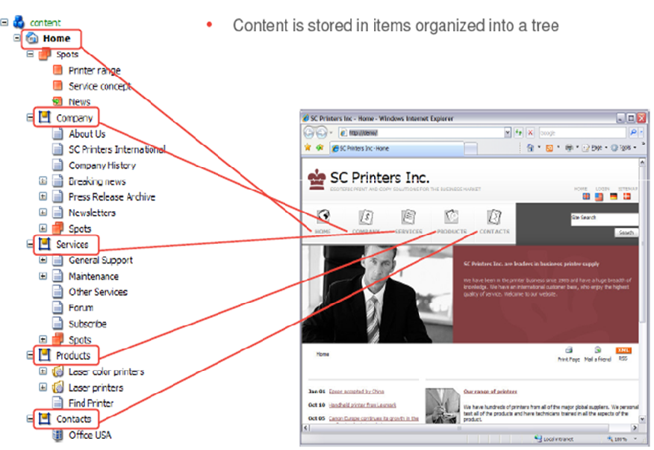
Sitecore, Content Tree

Slide 10
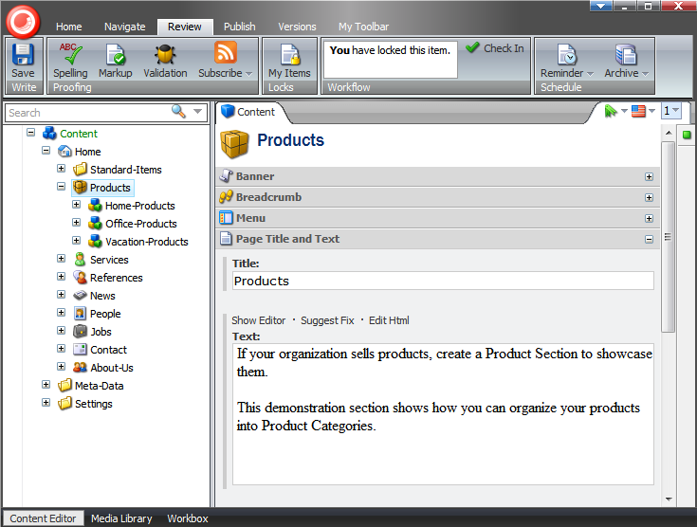
Sitecore, Content Editor

