Slide 1

CLINIC OPERATIONS PLATFORM
BUILT BY RECURSIVE FROG
One system from first visit to final entry in the books.
Website, bookings, CRM, till, stock, staff, payroll and accounting for a Philippine aesthetic clinic. Running on your own data, with your own brand.
Irish Aesthetics and Beauty Lounge
MAKATI · BGC · CEBU

Slide 2

THE PROBLEM
You already have the data. It is just in seven places.
Enquiries in a personal inbox
A paper diary for the chair
Takings counted at closing
You follow up from memory. The ones you forget were the ones ready to book.
A no-show is a hole in the day you cannot see until it is gone.
You learn how the month went days after you can act on it.
Stock that is a guess
Payroll in a spreadsheet
Books reconciled at year end
You find the expiry when you reach for the bottle, if you reach at all.
Every rate, deduction and adjustment retyped by hand, every run.
The month closes only when the numbers happen to agree.
None of this is your staff's fault. It is what happens when a clinic runs on six tools that were never designed to agree with each other.
IRISH AESTHETICS AND BEAUTY LOUNGE
irish.deskpulse.click

Slide 3
HOW IT FITS TOGETHER
One patient, one record, every step.
01
02
03
04
05
06
07
She finds you
She books
She arrives
She pays
Stock moves
Books balance
She comes back
A page that sells the treatment, the price and the branch.
A real slot, held for her, confirmed without a phone call.
Front desk sees the booking, the treatment and the notes.
Cash, card, GCash or Maya, receipted at the counter.
The bottle is drawn down and costed to that sale.
Revenue, cost and cash land in the ledger automatically.
The history is there, so the next visit needs no re-explaining.
The point is not seven features. It is that step seven is only possible because steps one to six already happened in the same system. Most clinic software stops at step four.
IRISH AESTHETICS AND BEAUTY LOUNGE
irish.deskpulse.click

Slide 4

DEMAND
A site that works while you sleep.
It is the only part of the system a patient sees, so it does the one job that matters: get the booking.
Treatments, prices, doctors and branches live in the database, so you edit them without a developer.
Live availability, so she books the slot she wants rather than the one you confirm by phone later.
Every enquiry becomes a tracked lead with its source attached, including the campaign that sent it.
Built to be found: local search markup, a sitemap, and pages that load fast on a phone.
IRISH AESTHETICS AND BEAUTY LOUNGE
irish.deskpulse.click

Slide 5
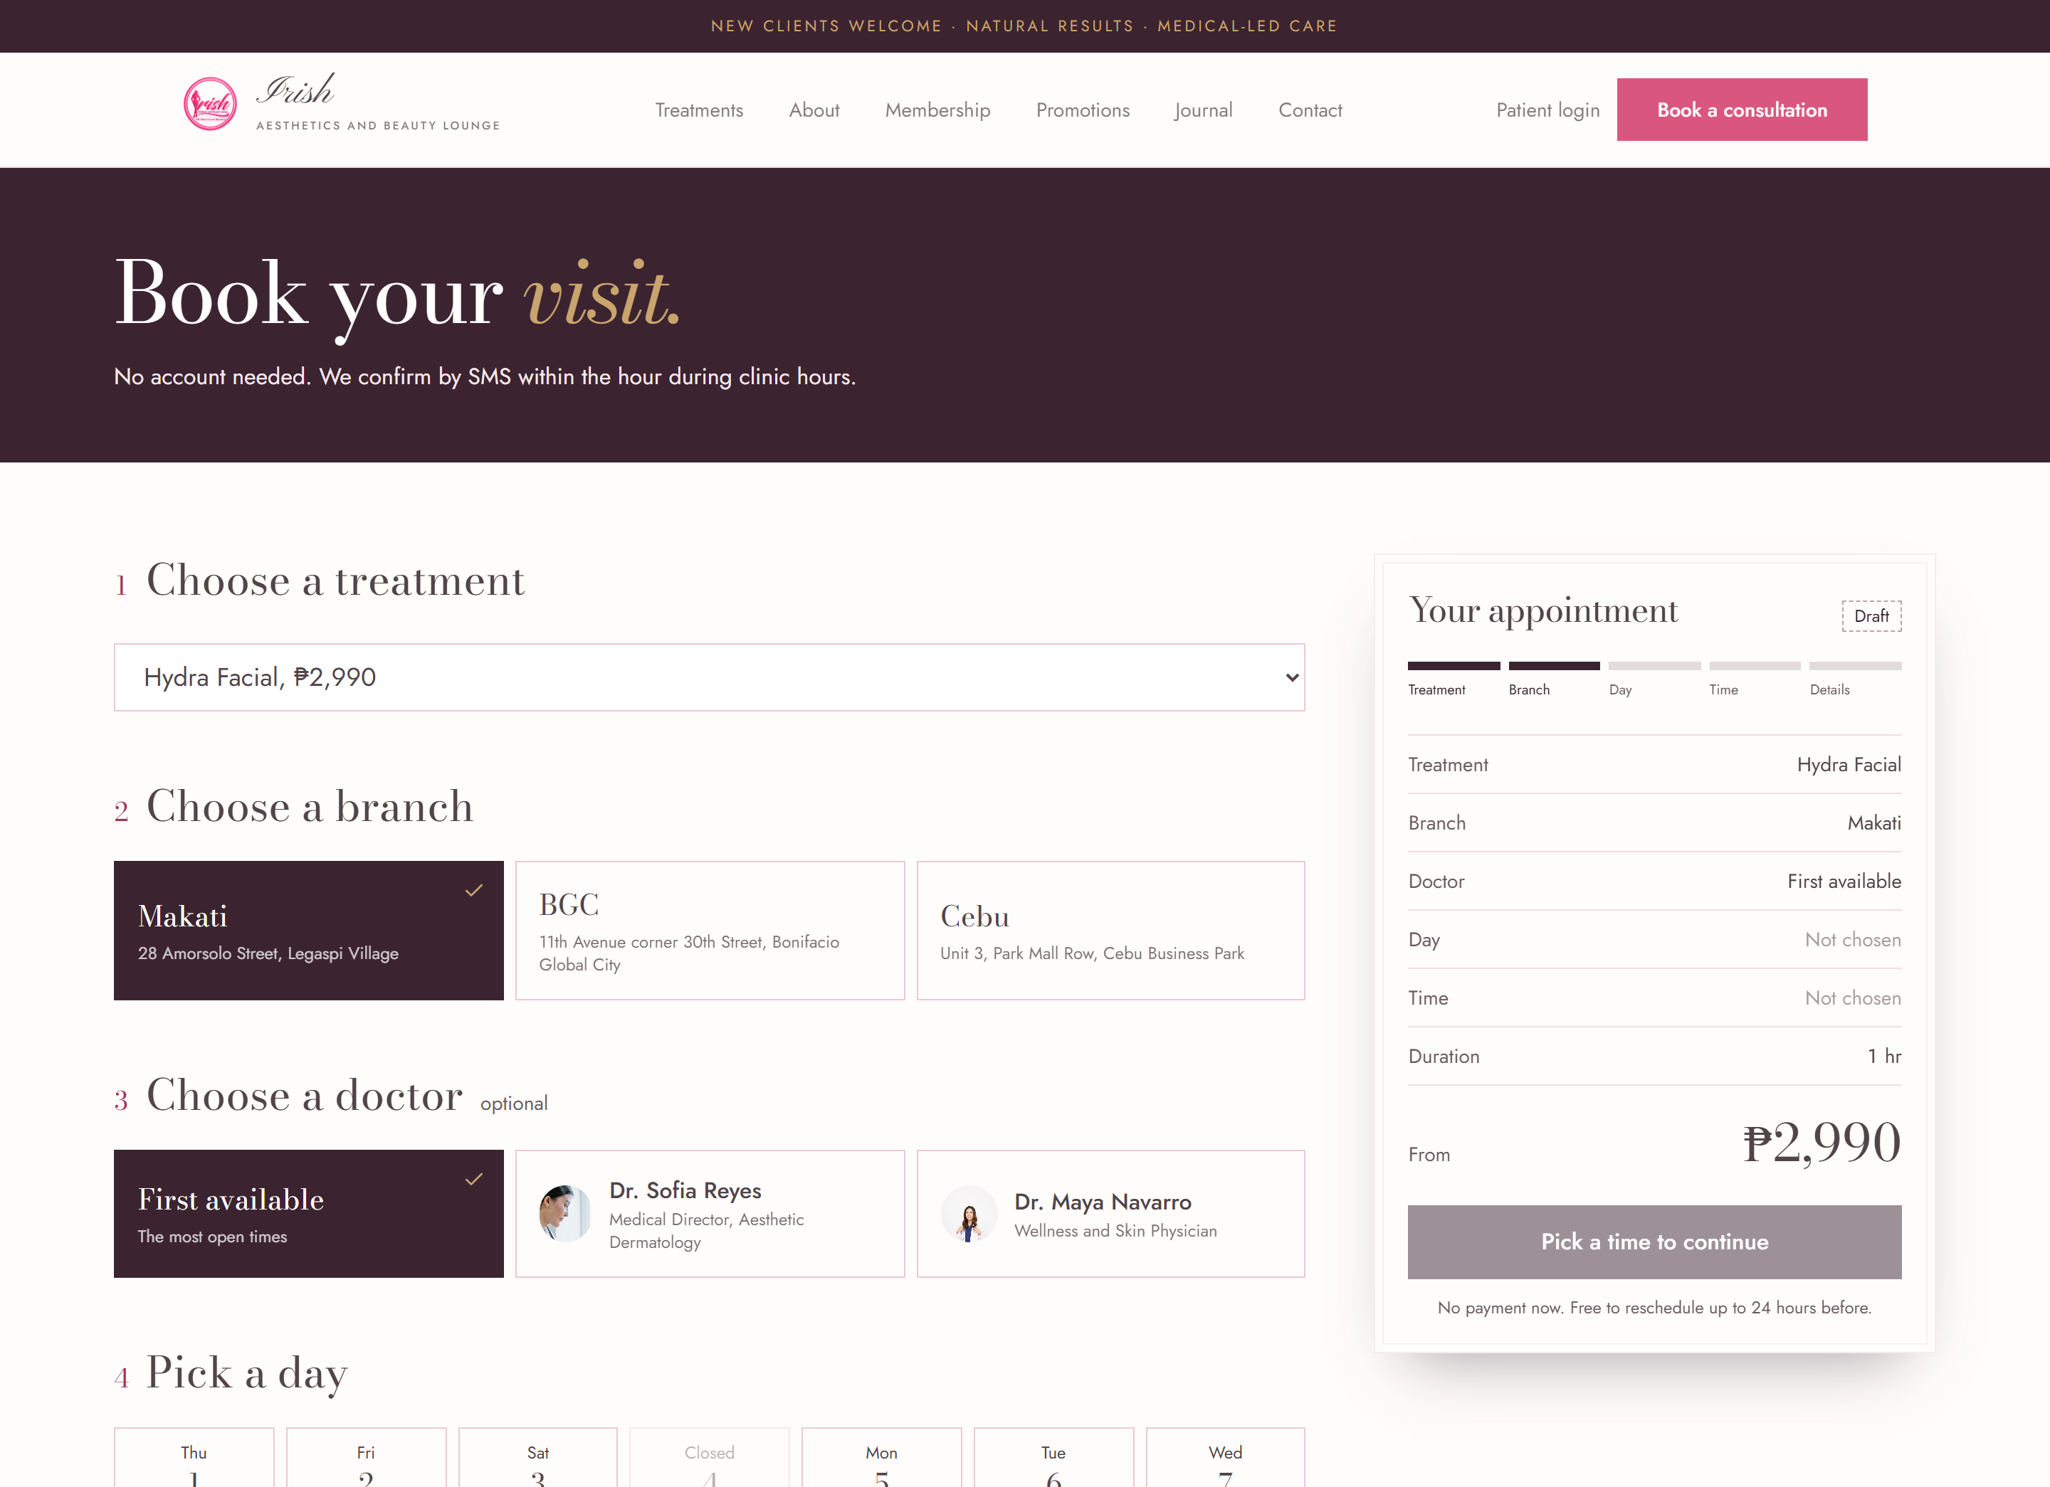

BOOKINGS
No phone tag. No double-booked chair.
Slots shown are genuinely free, per doctor and per branch.
Two staff cannot take the same chair at once.
Booked as a guest. No account to create before she can book.
Confirmation is a signed link she can reopen on her phone.
Most of your no-shows are not rudeness. They are a booking made in a hurry that nobody wrote down.
IRISH AESTHETICS AND BEAUTY LOUNGE
irish.deskpulse.click

Slide 6
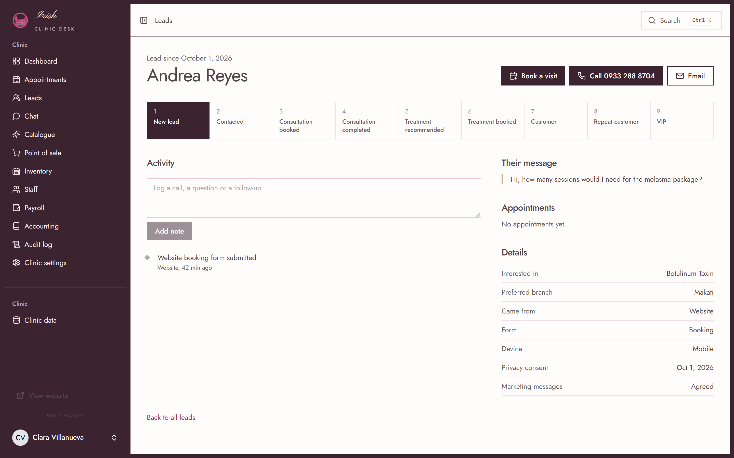
FRONT DESK
Nobody has to remember to call back.
One person, one page: where she came from, what she asked about, what she booked, and who said what.
A nine-stage pipeline, so a lead is never just a name in a list.
Every call and note is written down with the staff member who did it.
Appointments and history sit on the same record as the enquiry.
Know at a glance who is overdue for a follow-up.
Demo data shown. Names and conversations are fictional.
IRISH AESTHETICS AND BEAUTY LOUNGE
irish.deskpulse.click

Slide 7
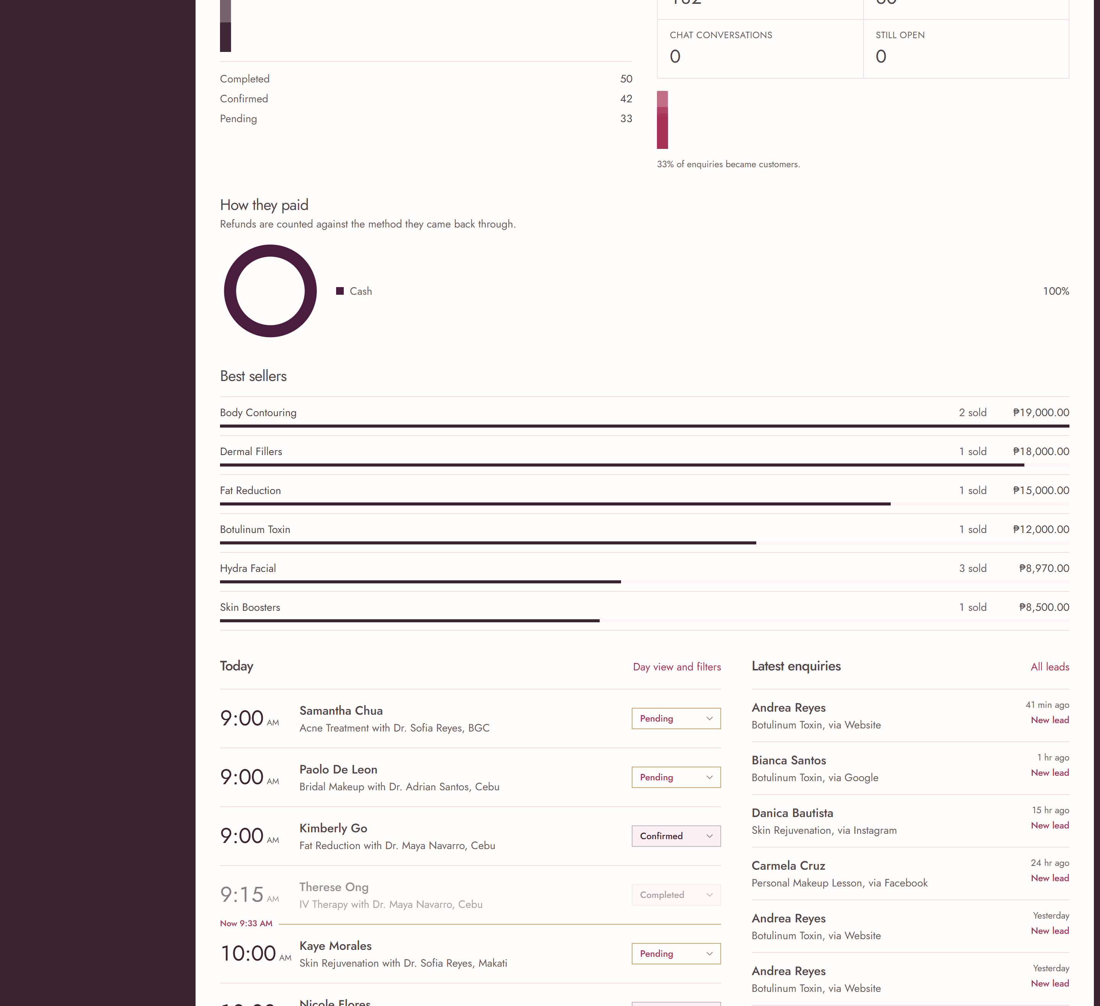
THE DAY AT A GLANCE
Open the screen and know where the day stands.
Revenue, gross profit, average sale, how people paid and what is best selling, against the same stretch last period.
The day's bookings first, with the current time marked on the list.
Confirmed, done, pending and no-shows counted as you read.
Changes to a booking status take effect immediately, no refresh.
A payment mix of one method is shown as one method, not dressed up as a trend.
Gross profit here is revenue less the cost of goods only. It is not what is left after payroll. The screen says so.
IRISH AESTHETICS AND BEAUTY LOUNGE
irish.deskpulse.click

Slide 8
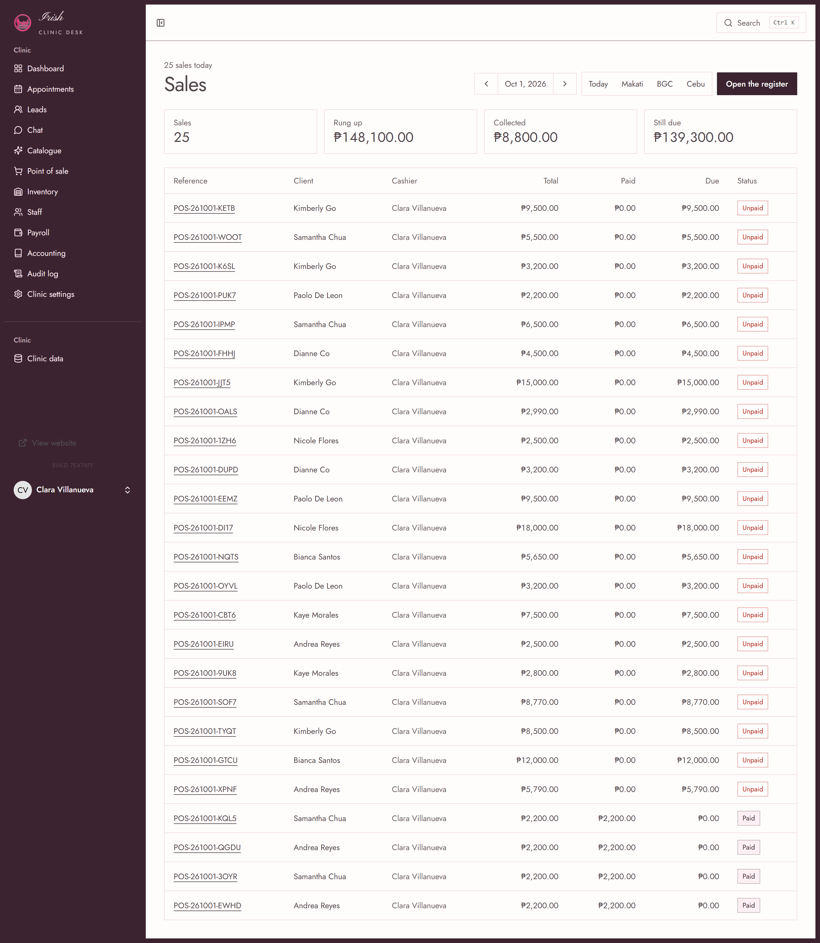
POINT OF SALE
The sale is already a sale.
Treatments and retail on one screen, priced by the system, not by whoever is on the till.
Cash, card, bank transfer, GCash and Maya, with change given for cash only.
A deposit leaves the balance open, so the front desk can chase it.
Refunds return the stock and the money, and never exceed what was taken.
A printable receipt per sale, with the client's details on it.
A cashier cannot change a price. The catalogue decides.
IRISH AESTHETICS AND BEAUTY LOUNGE
irish.deskpulse.click

Slide 9
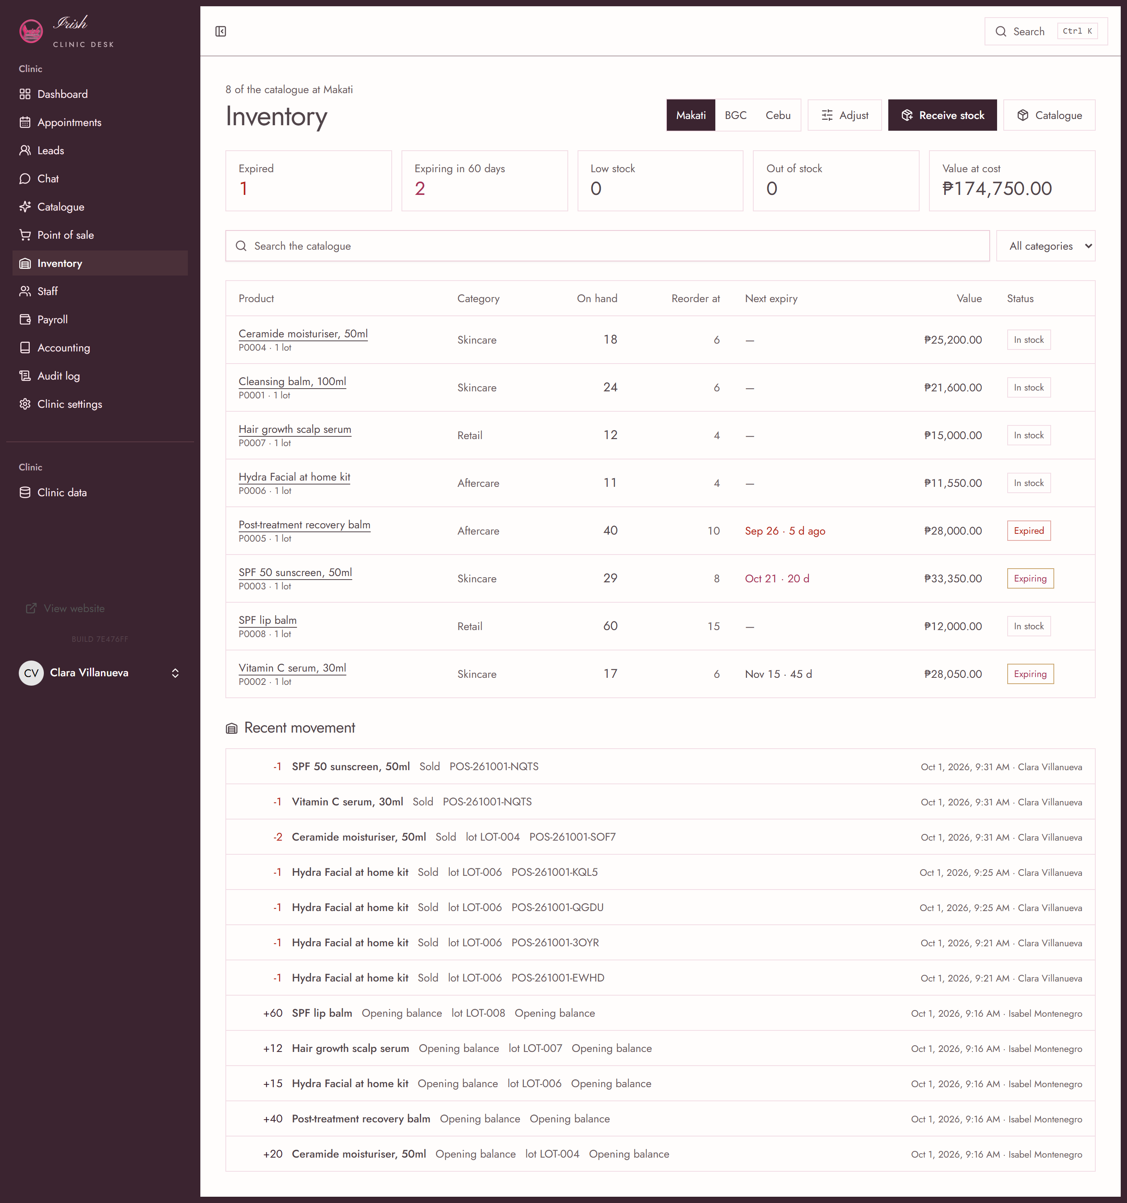
INVENTORY
Know what is on the shelf, per branch.
Batches and expiry dates are the record. The count is kept in step with them.
Soonest expiry is used first, automatically.
Expired, expiring soon, low and out are flagged before they cost you.
Stock valued at cost, per branch, not one blended total.
A sale cannot take the last unit while another till is selling it.
Every movement is a dated line, so a discrepancy has a name and a reason attached.
IRISH AESTHETICS AND BEAUTY LOUNGE
irish.deskpulse.click

Slide 10
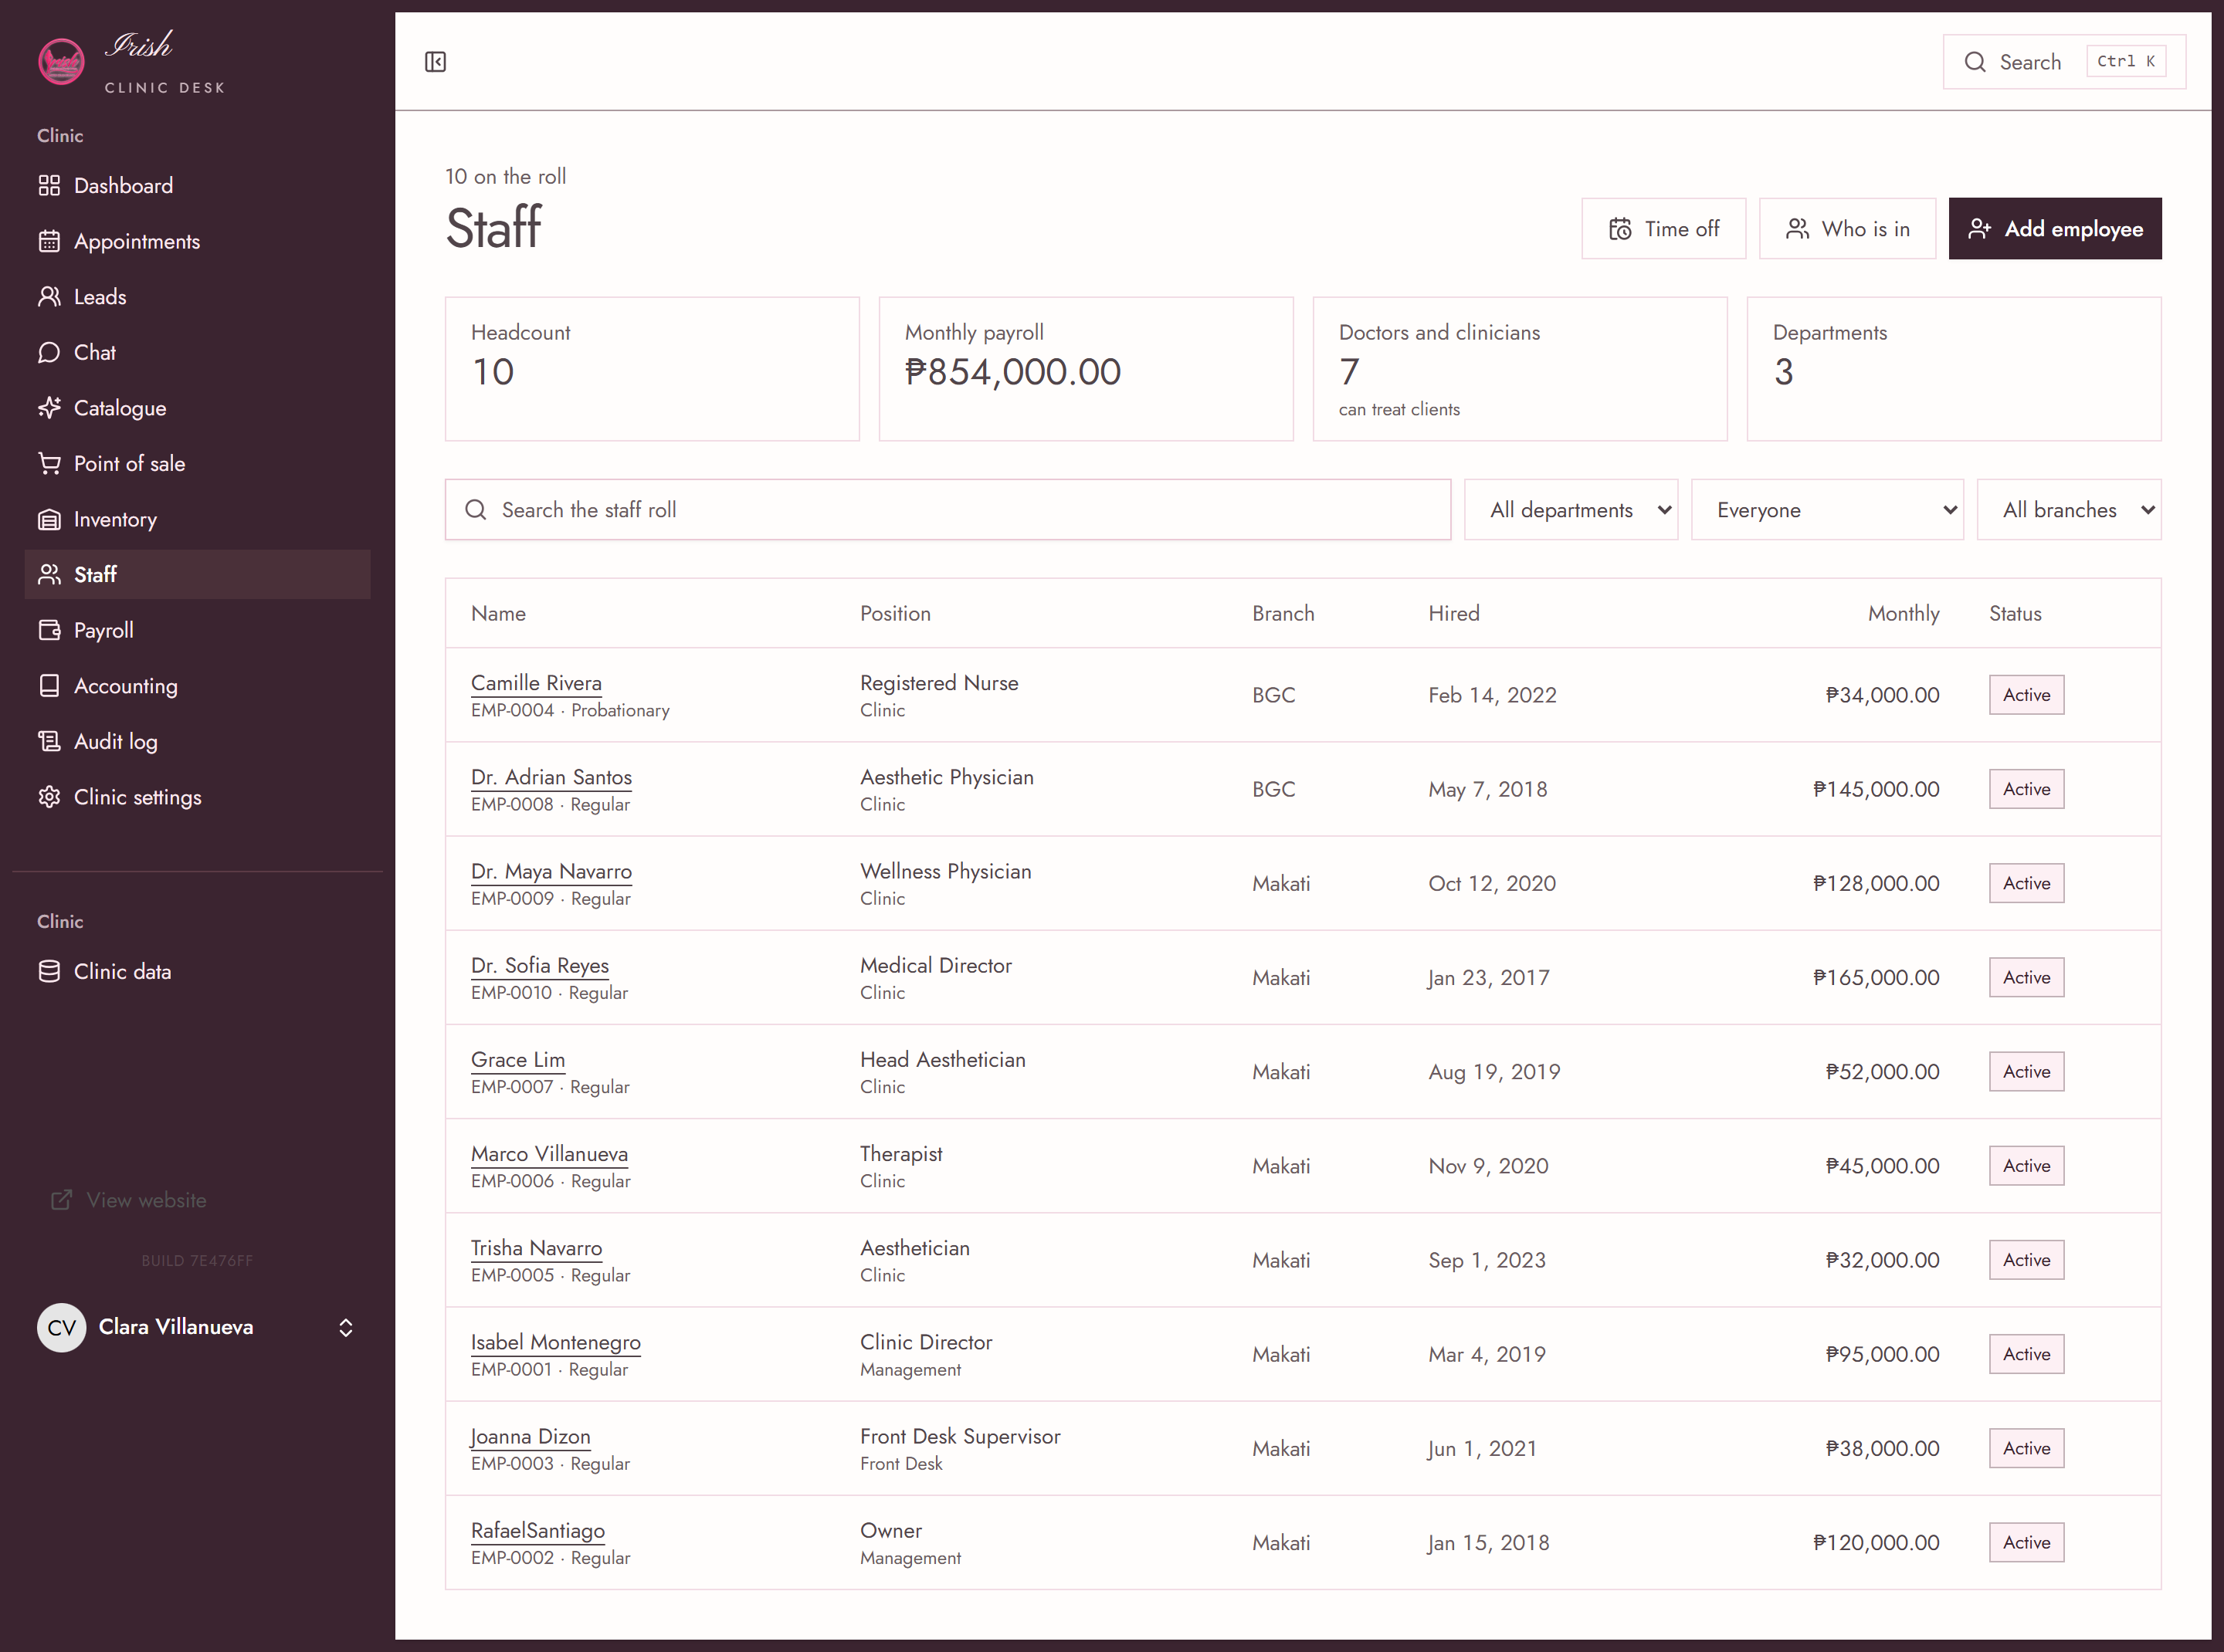
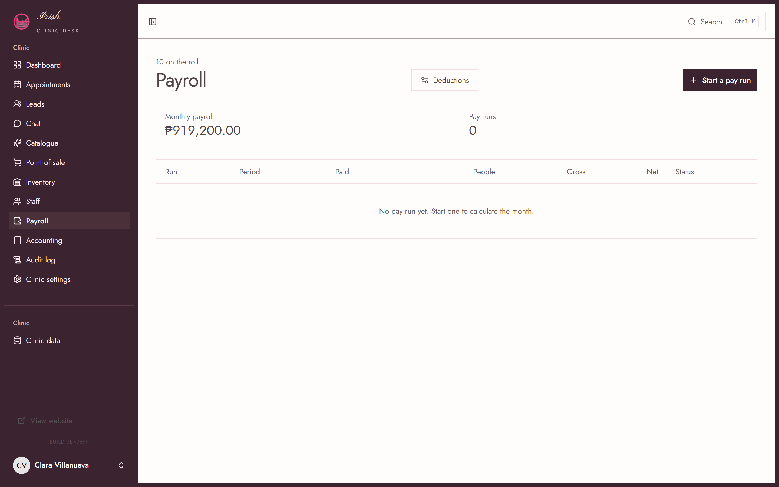
PEOPLE
Your team's month, worked out for you.
Attendance, leave and the schedule in one place per person.
Payroll built from the rates you set, with SSS, PhilHealth and Pag-IBIG handled as configured.
Loans and one-off deductions carried against a run until cleared, so nothing is retyped twice.
Payroll posts to the books, so the wage is already an entry by the time you look.
IRISH AESTHETICS AND BEAUTY LOUNGE
irish.deskpulse.click

Slide 11
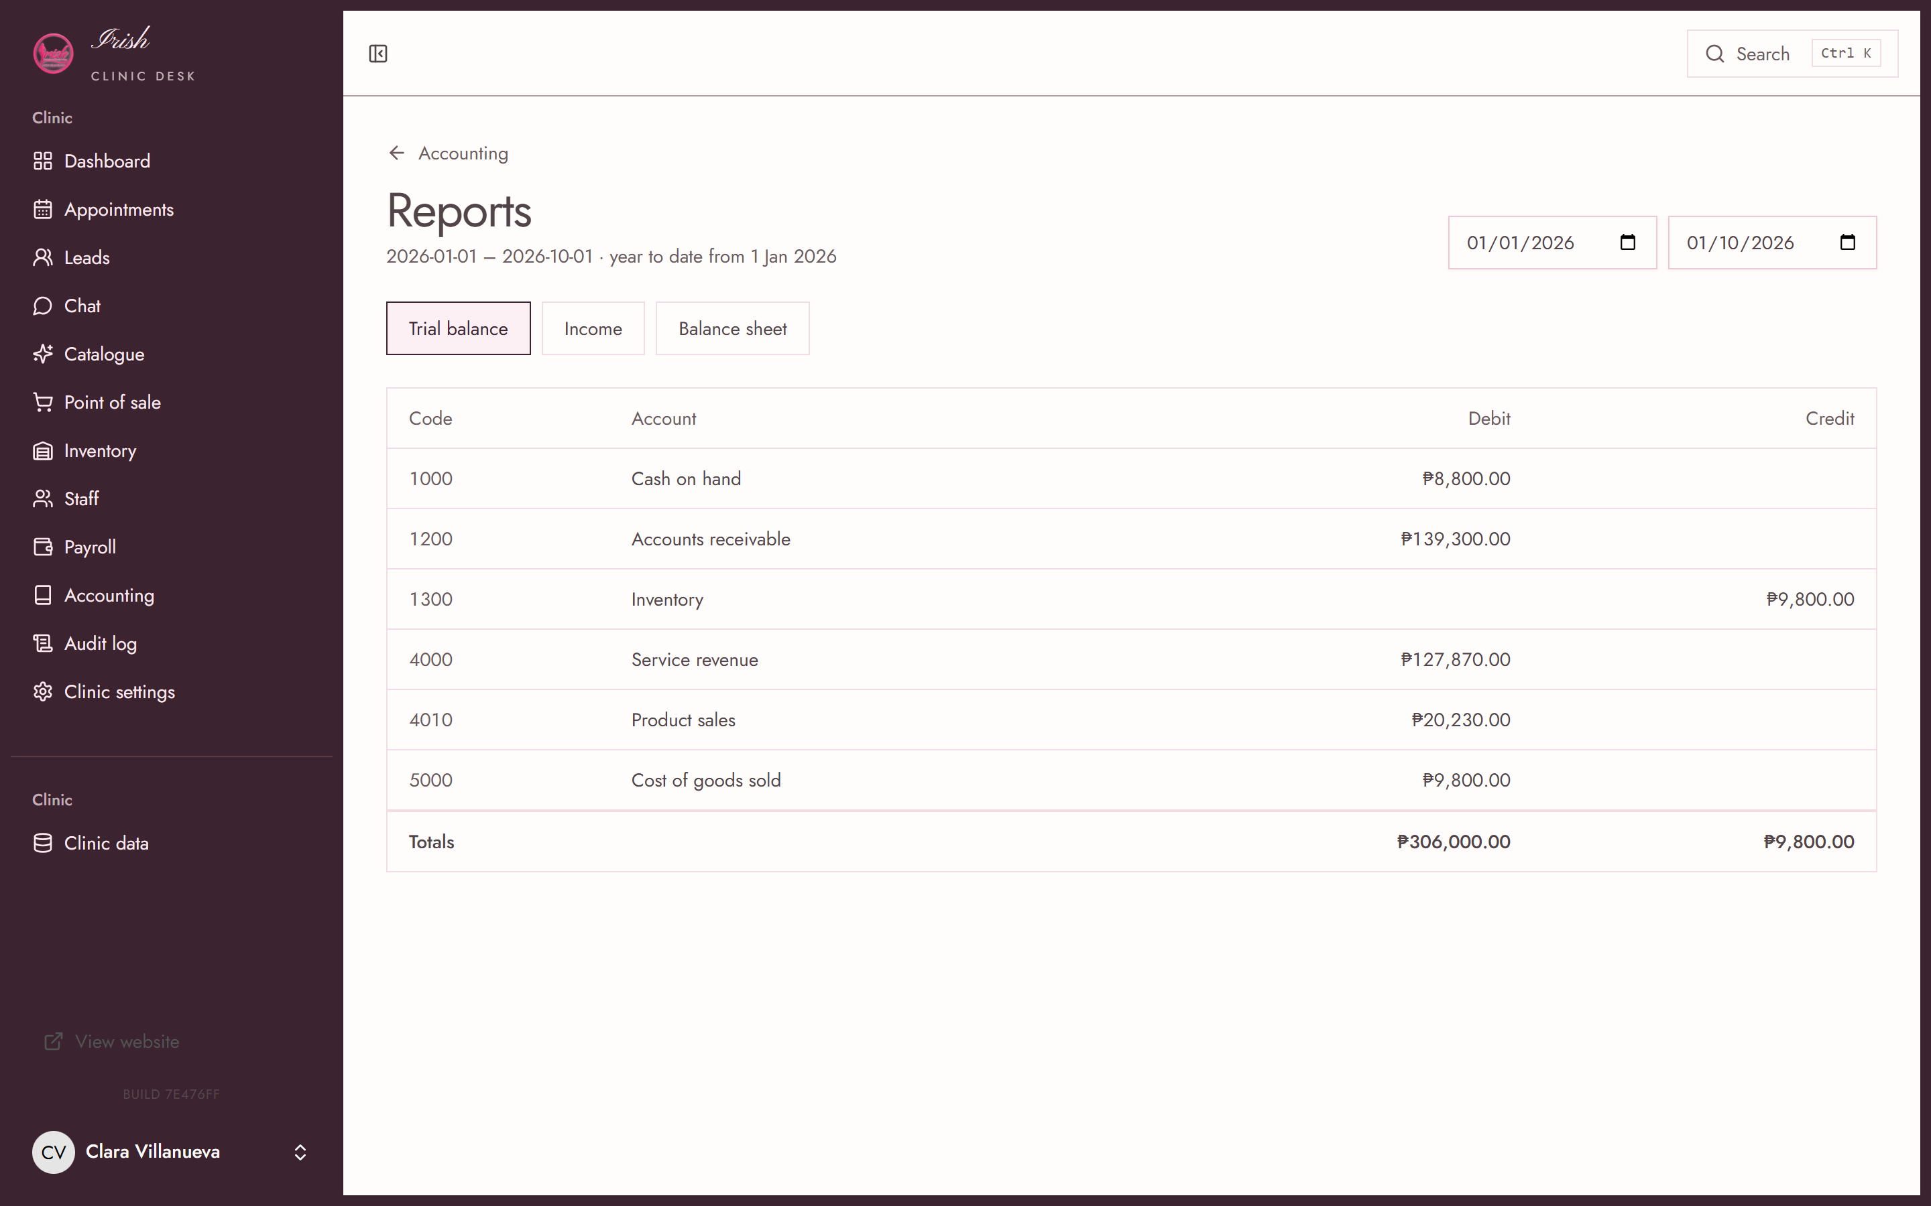
ACCOUNTING
The books close because they balance.
Every sale, stock draw and payroll run writes its own balanced entry. Nothing is keyed twice.
Trial balance, income statement and balance sheet, all from the same journal.
An entry that does not balance is refused before it is saved.
A closed month cannot be posted into until you reopen it.
A wrong entry is voided with a reason, never quietly edited.
If the books do not balance, the screen says so in plain words instead of showing you a tidy table.
IRISH AESTHETICS AND BEAUTY LOUNGE
irish.deskpulse.click

Slide 12
CONTROL
Your receptionist does not need to see your margin.
Access is granted by role, screen by screen. A cashier works the till. A branch manager moves stock. A payroll officer runs pay. The owner's books stay with the owner.
WHO SEES WHAT
Reception
Bookings and enquiries. No takings, no payroll.
Cashier
The till, refunds and stock on hand.
Branch manager
Adjustments, transfers, the branch's numbers.
Every sensitive action is written to an audit trail with who and when.
Payroll
Runs and payslips. Not the revenue report.
Health information is kept out of the marketing records entirely.
Owner
Everything, including the trial balance.
Consent is captured at the point of enquiry and visible on the record.
Role names are yours to set. This is the default shape.

Slide 13
STRAIGHT WITH YOU
What this system does not do.
It makes no medical claims
No guaranteed results, no safety promises. It manages a clinic; it does not treat one.
It is not a bookkeeping certificate
We will not call it BIR compliant. It keeps clean books; your accountant signs them.
It does not replace your bookkeeper
It produces the ledger and the statements. A professional reviews and files them.
The demo data is not your revenue
Figures in this deck come from a seeded demo clinic, not from a real clinic.
Before and after images are illustrations
Stock photography. They are not patient results and are labelled as such.
We would rather lose the sale than win it with a claim you cannot defend.
IRISH AESTHETICS AND BEAUTY LOUNGE
irish.deskpulse.click

Slide 14
IS THIS YOU?
This fits if three of these are true today.
You have more than one branch, or plan to.
AND IT DOES NOT FIT IF
You sell treatments and retail from the same counter.
You want a website and nothing else.
You want the owner, the receptionist and the accountant seeing one set of numbers.
Clinical notes are the priority. This is the clinic around them, not the chart.
You are tired of exporting to a spreadsheet to find out how the month went.
You need it working offline in a rural branch today.
You want to add a location without buying a second system.
Better to say this now than after you have paid for it.
IRISH AESTHETICS AND BEAUTY LOUNGE
irish.deskpulse.click

Slide 15
WHERE THIS GOES NEXT
Bring your own numbers.
The demo runs on a fictional clinic. The fastest way to judge this is to load your real treatments, prices and staff, then look at your own month on it.
1
See it running
2
Load your catalogue
A walkthrough on your own branch data. Half an hour, no slides.
Treatments, prices, doctors and stock imported, then checked by you.
3
Run one month alongside
4
Then decide
Keep your current process live while this settles in.
If it has not earned its place by month two, that is a fair reason to stop.
BUILT BY RECURSIVE FROG
Live demo: irish.deskpulse.click · 28 Amorsolo Street, Legaspi Village, Makati City

