Slide 1
Basic Customizable PhD Dissertation
Infographics
Slidesgo 2022
Here is where this template begins

Slide 2
Basic customizable PhD dissertation infographics
This template contains an assortment of complementary infographic resources for the Basic Customizable PhD Dissertation presentation.
These infographics are adapted to the style of the aforementioned presentation, so you can insert them easily and have them completely integrated at once. You just need to do the following:
  Select the element that you want to copy
  Right-click and choose “Copy”
  Go to the slide where you want the element to appear
  Right-click and choose “Paste”

Slide 3
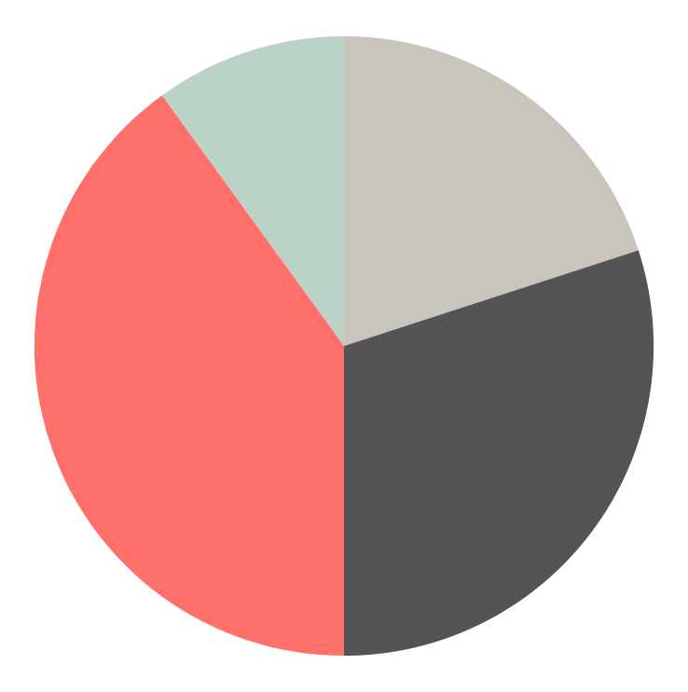
Basic customizable PhD dissertation infographics
Mercury 10%
Earth 20%
Mercury is the closest planet to the Sun
Earth is the third planet from the Sun
Mars 40%
Saturn 30%
Mars is actually a very cold place
It’s composed of hydrogen and helium
Follow the link in the graph to modify its data and then paste the new one here. For more info, click here

Slide 4

Basic customizable PhD dissertation infographics
Personal profile
Name
About me
Jenna Doe
Venus has a beautiful name and is the second planet from the Sun. It’s terribly hot, even hotter than Mercury, and its atmosphere is extremely poisonous
Age
55
Skill 1
80%
Location
Skill 2
30%
Malaga, Spain
Skill 3
50%
Job
Chemistry
Skill 4
75%

Slide 5
Basic customizable PhD dissertation infographics
75%
50%
25%
10%
Mercury
Venus
Earth
Mars
It's the closest planet to the Sun
It’s the second planet from the Sun
Earth is the third planet from the Sun
Mars is actually a very cold place

Slide 6
Basic customizable PhD dissertation infographics
Tasklist
You can write here a task to do
You can write here a task to do and you can check the box with color when it will be done
You can write here a task to do
Write a task to do and you and highlight it in gray to mark it as important
You can write here a task to do
Write a task to do and highlight it in red to mark it as the most important thing to do
Task done
Important tasks
Very important tasks

Slide 7
Basic customizable PhD dissertation infographics
Mercury
1
2
Venus
It's the closest planet to the Sun
Venus is the second planet from the Sun
Earth
3
4
Mars
Earth is the third planet from the Sun
Mars is actually a very cold place
Jupiter
5
6
Saturn
Jupiter is the biggest planet of them all
It’s composed of hydrogen and helium

Slide 8
Basic customizable PhD dissertation infographics
Low
Medium
High
Top
Topic 1
Medium-high level
Topic 2
Medium level
Topic 3
Almost top level
Topic 4
Low level

Slide 9
Basic customizable PhD dissertation infographics
It's the closest planet to the Sun and the smallest one in the Solar System
Venus has a beautiful name and is the second planet from the Sun
Earth is the third planet from the Sun and the only one that harbors life
Mercury
Venus
Earth
Main topic
Mars
Jupiter
Saturn
Despite being red, Mars is actually a cold place. It's full of iron oxide dust
Jupiter is a gas giant and the biggest planet in the Solar System
It’s giant and has rings. It's composed mostly of hydrogen and helium

Slide 10
Basic customizable PhD dissertation infographics
Place 1
You can write something interesting about this place here
Place 2
You can write something interesting about this place here
Place 3
You can write something interesting about this place here

Slide 11
Basic customizable PhD dissertation infographics
Main topic
Saturn is a gas giant and has several rings
Topic 1
Topic 2
Mercury
Venus
Earth
Mars
Jupiter
Mercury is the closest planet to the Sun
Venus is the second planet from the Sun
Earth is the third planet from the Sun
Mars is actually a very cold place
Jupiter is the biggest planet of them all

Slide 12
Basic customizable PhD dissertation infographics
100
90%
75
75%
50
50%
25
25%
0
Mercury
Venus
Earth
Mars
It's the closest planet to the Sun
It’s the second planet from the Sun
Earth is the third planet from the Sun
Mars is actually a very cold place

Slide 13
Basic customizable PhD dissertation infographics
Main topic
Mercury
Venus
Earth
It's the closest planet to the Sun
It has a beautiful name and is the second planet from the Sun. It’s terribly hot and its atmosphere is extremely poisonous
Earth is the third planet from the Sun
Mars
Saturn
Mars is actually a very cold place
It’s composed of hydrogen and helium

Slide 14
Basic customizable PhD dissertation infographics
Place 1
Place 2
Mercury is the closest planet to the Sun. This planet's name has nothing to do with the liquid metal, since Mercury was named after the Roman messenger god
Jupiter is a gas giant, the biggest planet in the Solar System and the fourth-brightest object in the night sky. It was named after the Roman god of the skies

Slide 15
Basic customizable PhD dissertation infographics
 | Mon | Tue | Wed | Thu | Fri
9:00 | Task to do
10:00 |  |  | Task to do
11:00 |  | Task to do
12:00 |  |  |  | Task to do
13:00 |  |  |  |  | Task to do
14:00 | L | U | N | C | H
15:00
16:00 |  | Task to do

Slide 16
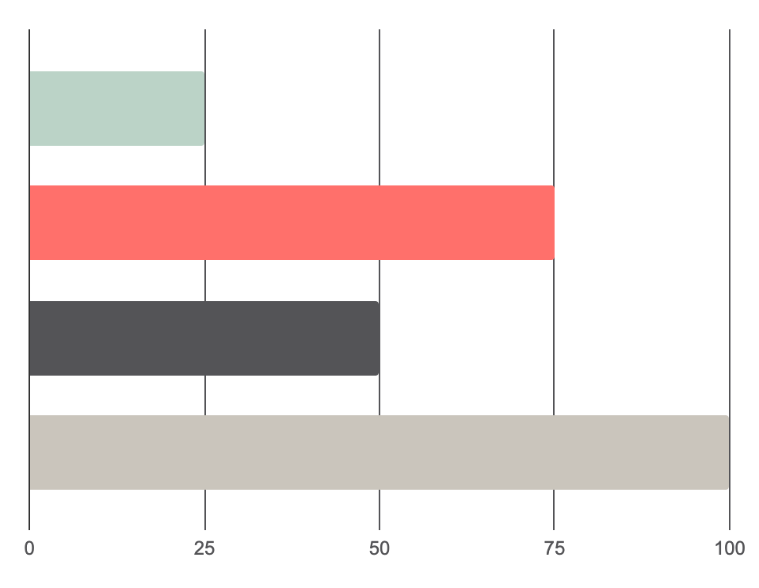
Basic customizable PhD dissertation infographics
Mercury
This is a 25%
Venus
This is a 75%
Earth
This is a 50%
Mars
This is a 100%
Follow the link in the graph to modify its data and then paste the new one here. For more info, click here

Slide 17
Basic customizable PhD dissertation infographics
Mon | Tue | Wed | Thu | Fri | Sat | Sun
 | 1 | 2 | 3 | 4 | 5 | 6
7 | 8 | 9 | 10 | 11 | 12 | 13
14 | 15 | 16 | 17 | 18 | 19 | 20
21 | 22 | 23 | 24 | 25 | 26 | 27
28 | 29 | 30 | 31
Task to do
Task to do

Slide 18
Basic customizable PhD dissertation infographics
Write something about this topic
Topic 2
Topic 1
Topic 3
Write something about this topic
Write something about this topic
Topic 4
Write something about this topic

Slide 19
Basic customizable PhD dissertation infographics
2023 1/2
January
Mo | Tu | We | Th | Fr | Sa | Su
 |  |  |  |  |  | 1
2 | 3 | 4 | 5 | 6 | 7 | 8
9 | 10 | 11 | 12 | 13 | 14 | 15
16 | 17 | 18 | 19 | 20 | 21 | 22
23/30 | 24/31 | 25 | 26 | 27 | 28 | 29
February
Mo | Tu | We | Th | Fr | Sa | Su
 |  | 1 | 2 | 3 | 4 | 5
6 | 7 | 8 | 9 | 10 | 11 | 12
13 | 14 | 15 | 16 | 17 | 18 | 19
20 | 21 | 22 | 23 | 24 | 25 | 26
27 | 28
March
Mo | Tu | We | Th | Fr | Sa | Su
 |  | 1 | 2 | 3 | 4 | 5
6 | 7 | 8 | 9 | 10 | 11 | 12
13 | 14 | 15 | 16 | 17 | 18 | 19
20 | 21 | 22 | 23 | 24 | 25 | 26
27 | 28 | 29 | 30 | 31
April
Mo | Tu | We | Th | Fr | Sa | Su
 |  |  |  |  | 1 | 2
3 | 4 | 5 | 6 | 7 | 8 | 9
10 | 11 | 12 | 13 | 14 | 15 | 16
17 | 18 | 19 | 20 | 21 | 22 | 23
24 | 25 | 26 | 27 | 28 | 29 | 30
May
Mo | Tu | We | Th | Fr | Sa | Su
1 | 2 | 3 | 4 | 5 | 6 | 7
8 | 9 | 10 | 11 | 12 | 13 | 14
15 | 16 | 17 | 18 | 19 | 20 | 21
22 | 23 | 24 | 25 | 26 | 27 | 28
29 | 30 | 31
June
Mo | Tu | We | Th | Fr | Sa | Su
 |  |  | 1 | 2 | 3 | 4
5 | 6 | 7 | 8 | 9 | 10 | 11
12 | 13 | 14 | 15 | 16 | 17 | 18
19 | 20 | 21 | 22 | 23 | 24 | 25
26 | 27 | 28 | 29 | 30

Slide 20
Basic customizable PhD dissertation infographics
2023 2/2
July
Mo | Tu | We | Th | Fr | Sa | Su
 |  |  |  |  | 1 | 2
3 | 4 | 5 | 6 | 7 | 8 | 9
10 | 11 | 12 | 13 | 14 | 15 | 16
17 | 18 | 19 | 20 | 21 | 22 | 23
24/31 | 25 | 26 | 27 | 28 | 29 | 39
August
Mo | Tu | We | Th | Fr | Sa | Su
 | 1 | 2 | 3 | 4 | 5 | 6
7 | 8 | 9 | 10 | 11 | 12 | 13
14 | 15 | 16 | 17 | 18 | 19 | 20
21 | 22 | 23 | 24 | 25 | 26 | 27
28 | 29 | 30 | 31
September
Mo | Tu | We | Th | Fr | Sa | Su
 |  |  |  | 1 | 2 | 3
4 | 5 | 6 | 7 | 8 | 9 | 10
11 | 12 | 13 | 14 | 15 | 16 | 17
18 | 19 | 20 | 21 | 22 | 23 | 24
25 | 26 | 27 | 28 | 29 | 30
October
Mo | Tu | We | Th | Fr | Sa | Su
 |  |  |  |  |  | 1
2 | 3 | 4 | 5 | 6 | 7 | 8
9 | 10 | 11 | 12 | 13 | 14 | 15
16 | 17 | 18 | 19 | 20 | 21 | 22
23/30 | 24/31 | 25 | 26 | 27 | 28 | 29
November
Mo | Tu | We | Th | Fr | Sa | Su
1 | 2 | 3 | 4 | 5 | 6 | 7
8 | 9 | 10 | 11 | 12 | 13 | 14
15 | 16 | 17 | 18 | 19 | 20 | 21
22 | 23 | 24 | 25 | 26 | 27 | 28
29 | 30
December
Mo | Tu | We | Th | Fr | Sa | Su
 |  |  |  | 1 | 2 | 3
4 | 5 | 6 | 7 | 8 | 9 | 10
11 | 12 | 13 | 14 | 15 | 16 | 17
18 | 19 | 20 | 21 | 22 | 23 | 24
25 | 26 | 27 | 28 | 29 | 30 | 31

Slide 21
Basic customizable PhD dissertation infographics
The Americas
Venus has a beautiful name and is the second planet from the Sun. It’s terribly hot, even hotter than Mercury, and its atmosphere is extremely poisonous. It’s the second-brightest natural object in the night sky after the Moon
North
South
Mercury is the closest planet to the Sun and the smallest one in the Solar System
Earth is the third planet from the Sun and the only one that harbors life in the Solar System

Slide 22
Basic customizable PhD dissertation infographics
2015
2016
2017
2018
1
2
3
4
Mercury
Venus
Earth
Mars
It's the closest planet to the Sun
It's the second planet from the Sun
Earth is the third planet from the Sun
Mars is actually a very cold place

Slide 23
Basic customizable PhD dissertation infographics
2019
2020
2021
2022
5
6
7
8
Jupiter
Saturn
Neptune
Pluto
It’s the biggest planet of them all
It's a gas giant and has several rings
It’s the farthest planet from the Sun
It’s now considered a dwarf planet

Slide 24
Basic customizable PhD dissertation infographics
References list
Title | Author | Source | Link
Title of the reference | Name Surname | Website name | www.website.com
Title of the reference | Name Surname | Book title | www.website.com
Title of the reference | Name Surname | Magazine title | www.website.com
Title of the reference | Name Surname | Article title | www.website.com
Title of the reference | Name Surname | Website name | www.website.com
Title of the reference | Name Surname | Book title | www.website.com

Slide 25
Basic customizable PhD dissertation infographics
Main topic
Mercury
Venus
Earth
It's the closest planet to the Sun and the smallest one in the Solar System
Venus has a beautiful name and is the second planet from the Sun
Earth is the third planet from the Sun and the only one that harbors life
50%
20%
80%

Slide 26
Basic customizable PhD dissertation infographics
1
Subject
6
Subject
You can enter a description here
You can enter a description here
2
Subject
7
Subject
You can enter a description here
You can enter a description here
3
Subject
8
Subject
You can enter a description here
You can enter a description here
4
Subject
9
Subject
You can enter a description here
You can enter a description here
5
Subject
10
Subject
You can enter a description here
You can enter a description here

Slide 27
Basic customizable PhD dissertation infographics
Venus is the second planet from the Sun
Venus
Mercury
Earth
It's the closest planet to the Sun
Earth is the third planet from the Sun
Mars
Saturn
Mars is actually a very cold place
It’s composed of hydrogen and helium

Slide 28
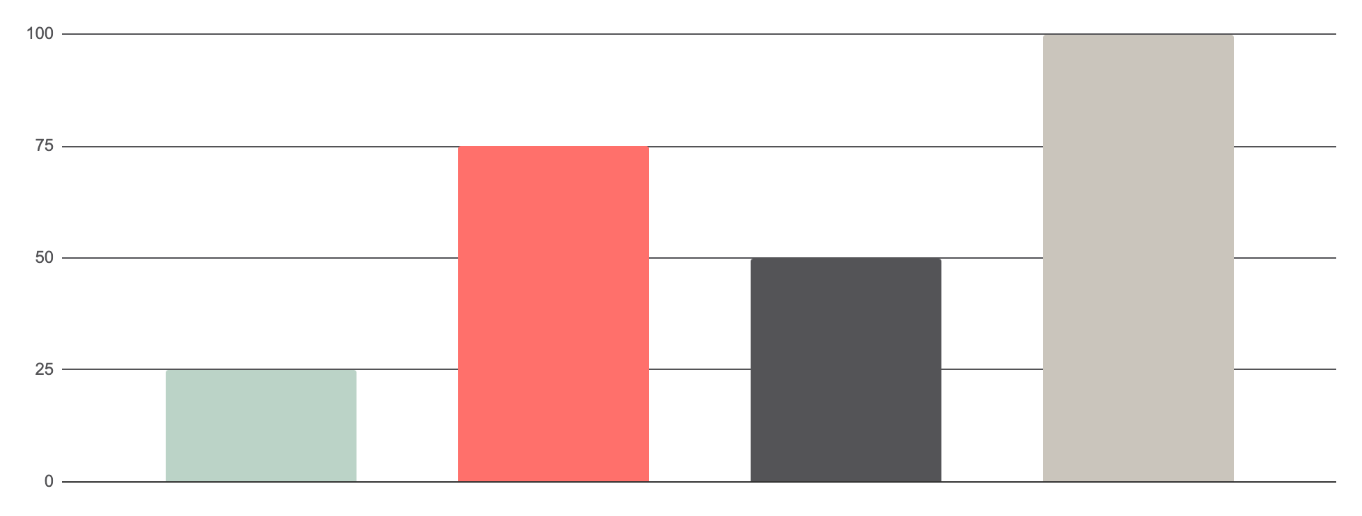
Basic customizable PhD dissertation infographics
Subject percentage
Mercury
Venus
Earth
Mars
This is a 25%
This is a 75%
This is a 50%
This is a 100%
Follow the link in the graph to modify its data and then paste the new one here. For more info, click here

Slide 29
Basic customizable PhD dissertation infographics
1
2
Mars
Earth
Main topic
Despite being red, Mars is actually a cold place. It's full of iron oxide dust, which gives the planet its reddish cast
Earth is the third planet from the Sun and the only one that harbors life in the Solar System. This is where we all live on

Slide 30
Basic customizable PhD dissertation infographics
Main topic
1
2
3
4
Mercury
Venus
Earth
Mars
It's the closest planet to the Sun
It's the second planet from the Sun
Earth is the third planet from the Sun
Mars is actually a very cold place

Slide 31
Basic customizable PhD dissertation infographics
Mercury
1
It's the closest planet to the Sun and the smallest one in the Solar System
Main point of the topic
Venus
2
Venus has a beautiful name and is the second planet from the Sun
Earth
3
Earth is the third planet from the Sun and the only one that harbors life

Slide 32
Instructions for use
If you have a free account, in order to use this template, you must credit Slidesgo in your final presentation. Please refer to the next slide to read the instructions for premium users.
As a Free user, you are allowed to:
- Modify this template.
- Use it for both personal and commercial projects.
You are not allowed to:
- Sublicense, sell or rent any of Slidesgo Content (or a modified version of Slidesgo Content).
- Distribute Slidesgo Content unless it has been expressly authorized by Slidesgo.
- Include Slidesgo Content in an online or offline database or file.
- Offer Slidesgo templates (or modified versions of Slidesgo templates) for download.
- Acquire the copyright of Slidesgo Content.
For more information about editing slides, please read our FAQs or visit Slidesgo School:
https://slidesgo.com/faqs and https://slidesgo.com/slidesgo-school

Slide 33
Instructions for use (premium users)
As a Premium user, you can use this template without attributing Slidesgo.
You are allowed to:
Modify this template.
Use it for both personal and commercial purposes.
Share this template in an editable format with people who are not part of your team.
You are not allowed to:
Sublicense, sell or rent this Slidesgo Template (or a modified version of this Slidesgo Template).
Distribute this Slidesgo Template (or a modified version of this Slidesgo Template) or include it in a database or in any other product or service that offers downloadable images, icons or presentations that may be subject to distribution or resale.
Use any of the elements that are part of this Slidesgo Template in an isolated and separated way from this Template.
Register any of the elements that are part of this template as a trademark or logo, or register it as a work in an intellectual property registry or similar.
For more information about editing slides, please read our FAQs or visit Slidesgo School:
https://slidesgo.com/faqs and https://slidesgo.com/slidesgo-school

Slide 34
Infographics
You can add and edit some infographics to your presentation to present your data in a visual way.
Choose your favourite infographic and insert it in your presentation using Ctrl C + Ctrl V or Cmd C + Cmd V in Mac.
Select one of the parts and ungroup it by right-clicking and choosing “Ungroup”.
Change the color by clicking on the paint bucket.
Then resize the element by clicking and dragging one of the square-shaped points of its bounding box (the cursor should look like a double-headed arrow). Remember to hold Shift while dragging to keep the proportions.
Group the elements again by selecting them, right-clicking and choosing “Group”.
Repeat the steps above with the other parts and when you’re done editing, copy the end result and paste it into your presentation.
Remember to choose the “Keep source formatting” option so that it keeps the design. For more info, please visit Slidesgo School.

