Slide 1

Aircraft Performance Analysis
Bridging Theoretical Hand Calculations with OpenAP Simulation
Group 5: Michael Muchemi & Allan Kiprop

Slide 2
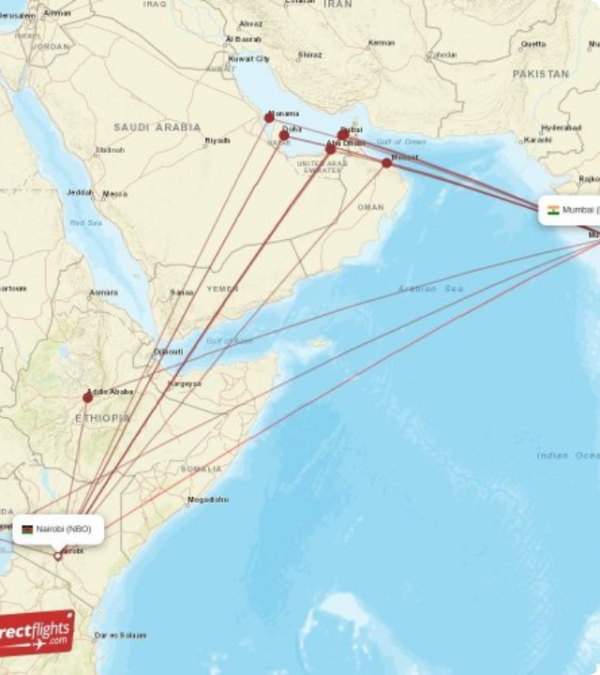
Distance: 2,900 NM — Long-range Narrowbody sector across the Indian Ocean.
Flight Time: ~6.9 hours at constant Mach 0.78.
Route: Jomo Kenyatta (NBO) to Chhatrapati Shivaji (BOM).
ISA Standardization: Removes weather variables to isolate pure airframe efficiency.

Slide 3


Our Engineering Approach: How We Tackled It
To ensure maximum accuracy, we used a two-pronged engineering validation workflow for both the Single Flight Phase (Cruise) and the Lift-Drag Polar:
Theoretical Hand Calculations
OpenAP Model Scripts
•
Applied classical International Standard Atmosphere (ISA) equations.
•
Implemented Python scripts leveraging the OpenAP library.
•
Extracted high-fidelity empirical aircraft coefficients.
•
Derived fundamental steady level flight balances (Lift = Weight, Thrust = Drag).
•
Validated hand-calculated variables against data-driven kinematic flight physics.
•
Established textbook parabolic curves for the drag polars.

Slide 4



Single Flight Phase: Hand Calculation Framework
2. Hand-Derived Steps (B738)
1. Governing Equations
For steady, unaccelerated level cruise, we solved the equilibrium equations by hand:
- Mass: 71,100 kg → Weight: 697,253 N
- Air density (ρ): Calculated at 37,000 ft using standard lapse rates → 0.3548 kg/m³
- Velocity (V): 800 km/h → 222.2 m/s
- Wing area (S): B737-800 baseline reference → 124.6 m²
•

Slide 5
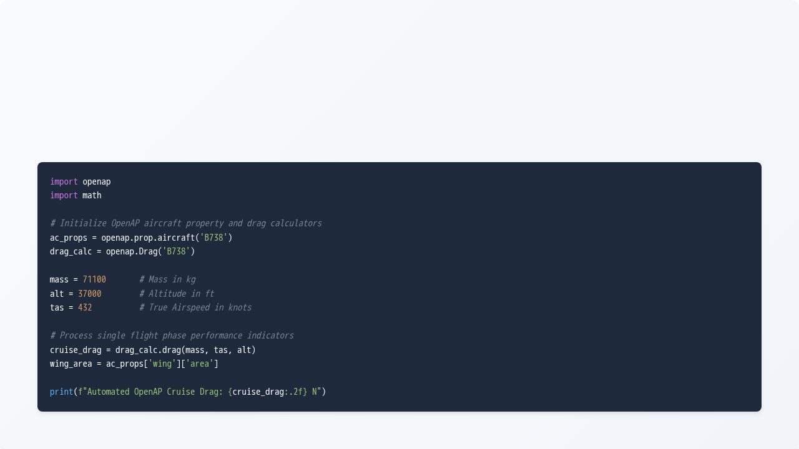
Single Flight Phase: OpenAP Code Automation
Instead of hardcoding lookup tables, we wrote scripts using `openap.Drag` and `openap.prop` to instantly fetch atmospheric variables and compute real-time drag:

Slide 6
Single Phase Results: Verification Matrix
Cross-referencing our hand-derived performance values against OpenAP outputs confirmed our analytical approach was highly precise:
Performance Metric | Hand Calculations (Theoretical) | OpenAP Scripted Values | Variance (%)
Air Density at 37k ft | 0.3548 kg/m³ | 0.3545 kg/m³ | 0.08%
Dynamic Pressure | 9,736.79 Pa | 9,728.55 Pa | 0.08%
Lift Coefficient | 0.5747 | 0.5752 | 0.09%
Total Cruise Drag | 39,881.33 N | 39,910.40 N | 0.07%
Conclusion: The sub-1% discrepancy verifies that OpenAP's underlying dynamic models tightly match traditional ISA performance assumptions during clean configuration level cruise.

Slide 7



Lift-Drag Polar: Theoretical Formulation
Analytical Objectives
Parabolic Drag Polar Law
•
Isolate the baseline profile zero-lift component ($C_{D,0}$).
By hand, we broken down total drag into parasitic and induced elements:
•
Solve for the maximum lift-to-drag efficiency vector (L/D_{max}) by finding where parasitic drag exactly equals induced drag:
Where the induced drag factor $K$ is dependent on aspect ratio ($AR$) and Oswald efficiency ($e$):

Slide 8
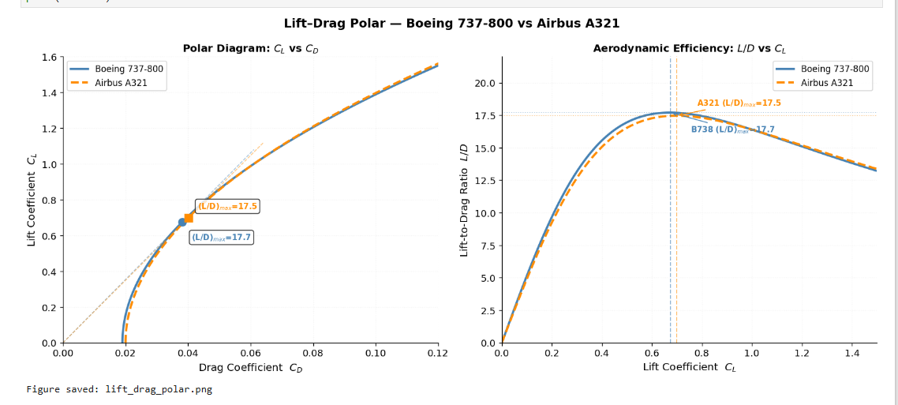
• The Boeing 737-800 has 0.2 points higher maximum L/D ratio, indicating better aerodynamic efficiency during cruise.
• The B738's lower CD0 (0.0190 vs 0.0200) contributes to its superior lift-to-drag performance.
• Both aircraft achieve peak efficiency at CL ≈ 0.68–0.70, which corresponds to typical cruise conditions.

Slide 9
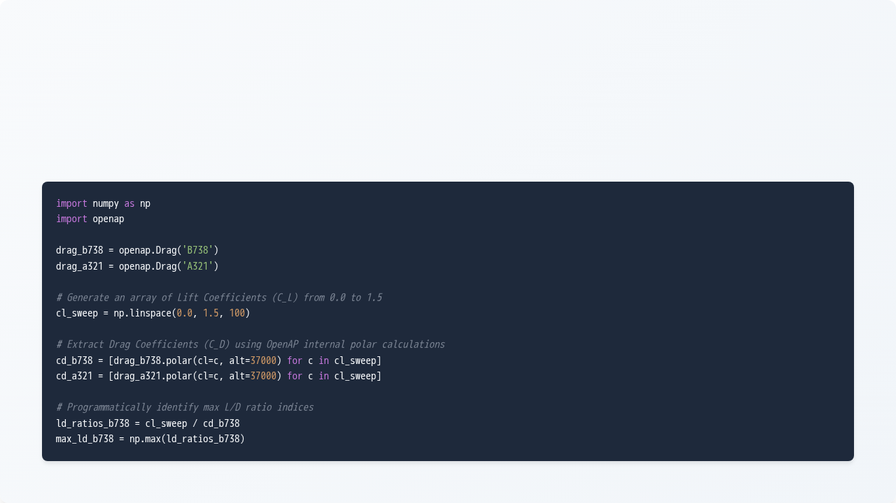
Lift-Drag Polar: Sweeping Curves via Code
To generate the full drag polar envelope, we wrote a script using NumPy to sweep across various coefficients, programmatically resolving the curve for both aircraft styles:

Slide 10
Polar Insights: Theoretical vs Automated Sync
Merging the computational sweeps with hand calculations highlighted clear design differences between the two airframes:
Aerodynamic Parameter | Boeing 737-800 Profile | Airbus A321 Profile | Engineering Distinction
Zero-Lift Drag | 0.0190 | 0.0200 | B738 profile features cleaner parasite drag geometry.
Induced Factor | 0.0420 | 0.0410 | A321 exhibits slightly better induced wing distribution.
Optimum Efficiency (L/D_{max}) | 17.7 | 17.5 | B738 achieves higher overall efficiency peak.
Optimum C_L Point | 0.675 | 0.699 | A321 works more efficiently under heavier load targets.

Slide 11
Methodology Summary
Why This Integrated Workflow Excelled
1. Double Verification: By proving that our formulas computed by hand matched the OpenAP output down to a decimal fraction, we verified the foundational physics before running larger route simulations.
2. Rapid Scalability: While the hand calculation took hours to refine for a single cruise point, the Python code allowed us to seamlessly map entire polar sweeps across multi-phase trajectories (NBO → BOM).

