Slide 1
lem-in
projects’ comparison
2020

Slide 2
chart

Slide 3
source
 | repo | school | pretzel | big | map50k-300m | map50k-1000m | map200k-m
1 | https://github.com/domurdoc/lem_in | 21 ru | true | 0.014 | 1.367 | 8.293 | 1.721
2 | https://github.com/liftchampion/lem_in | 21 ru | true | 0.033 | 16.328 | 51.697 | 12.055
3 | https://github.com/almayor/lem-in | 21 ru | true | 0.017 | 10.429 | 35.018 | 8.980
4 | https://github.com/elijahkash/lemin | 21 ru | true | 0.010 | 1.361 | 92.789 | 33.154
5 | https://github.com/nalysann/lem-in | 21 ru | true | 0.095 | 73.229 | 75.655 | over 5 min
6 | https://github.com/nikitinste/42_11_lem-in | 21 ru | true | 0.359 | over 5 min | over 5 min | over 5 min
7 | https://github.com/artemk1337/lem-in | 21 ru | true | 0.665 | over 5 min | over 5 min | over 5 min
8 | https://github.com/egiant/Lem_in | 21 ru | true | 3.303 | over 5 min | over 5 min | over 5 min
9 | https://github.com/daniiomir/lem-in | 21 ru | true | 3.483 | over 5 min | over 5 min | over 5 min
10 | https://github.com/maxencejded/lem-in | 42 usa | false | 0.017 | 3.863 | 20.374 | 17.856
11 | https://github.com/VBrazhnik/Lem_in | uf ua | false | 0.353 | over 5 min | over 5 min | over 5 min
12 | https://github.com/agelloz/42-Lem_in | 42 fr | false | 0.555 | over 5 min | over 5 min | over 5 min
13 | https://github.com/cnails/lem-in | 21 ru | false | 0.994 | over 5 min | over 5 min | over 5 min
*maps
https://github.com/domurdoc/lem_in/tree/vis_linux/resources/maps

Slide 4
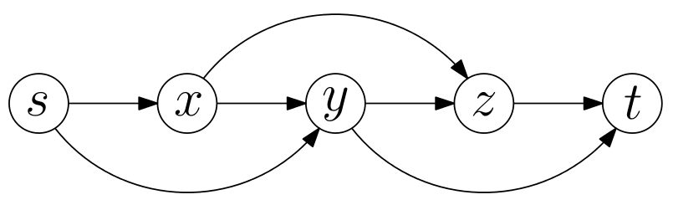
pretzel
*Edge- and Node-Disjoint Paths in P Systems - Michael J. Dinneen, Yun-Bum Kim, and Radu Nicolescu
https://arxiv.org/pdf/1011.0495.pdf

Slide 5
Thank you

