Slide 1
London Crime

Slide 2
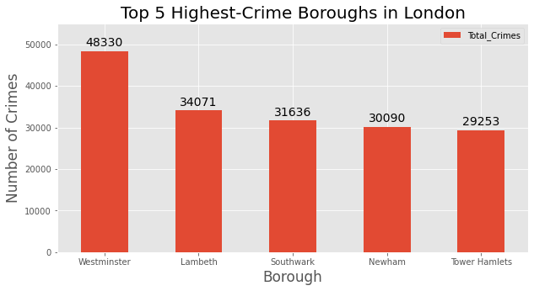
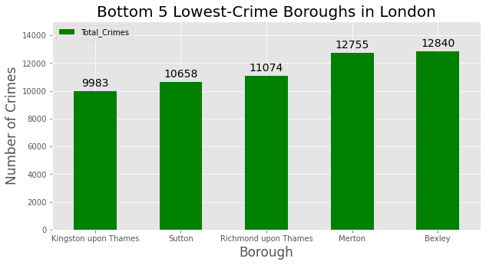
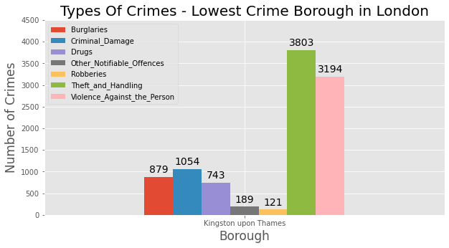

Slide 3

Map of Clusters

Slide 4

Cluster 1

Slide 5


Cluster 2
Cluster 3

Slide 6
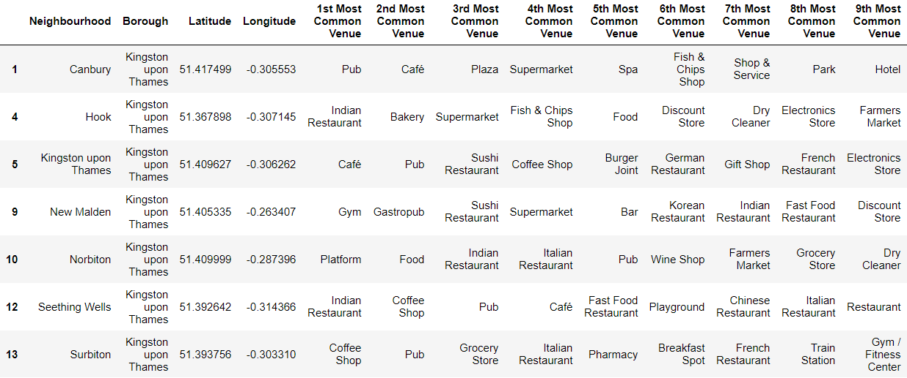
Cluster 4

Slide 7

Cluster 5

Slide 8
Thank you for listening!
Any questions?

