Slide 1

Spam detector: Roar-Katy Perry Team 5
Song Malisa Se(301233051), Matheus Teixeira (301236904), Viet Nguyen Hoang (301228010), Yi-Lin “Aaron” Lou (301226659), Yin-Siang Mao (301180968)
Notes:
Introduction

Slide 2
Overview
Spam detector for Katy Perry’s music video “Roar” on YouTube
Natural Language Processing
Bag of Words
Naïve Bayes Classifier
Spam = 1, non-spam = 0
Notes:
Overview of the project

Slide 3
Code Demo
Notes:
*Show the code

Slide 4
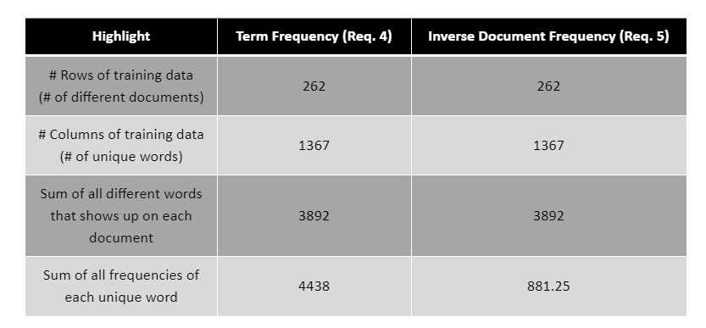
Findings: Requirements 4 and 5 - Highlights on the transformed data
Notes:
From requirements 4 and 5 we can notice that using the Term Frequency - Inverse Document Frequency does not change the number of documents, nor the number of unique words, but it downscales the data reducing the total frequency. This algorithm is also important because it takes into consideration the importance of each word on each document.
This is achieved by considering the weight of TF and IDF. A high weight in TF-IDF means that the term frequency is high in the given document and a low document frequency of the given term in all the other documents. This allowed us to rule out most of the common words while obtaining high weight, unique words and increase the model’s efficiency and accuracy.

Slide 5
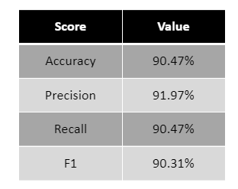
Findings: Requirement 9 - Cross-Validation (5-fold) and scoring
Notes:
From the cross-validation test, we can notice that the classifier model is very good; all its scores were higher than 90%

Slide 6
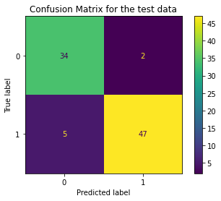
Findings: Requirement 10 - Confusion matrix, using test data
True positive: 34
False negative: 2
False Positive: 5
True negative: 47
Notes:
Here is the confusion matrix using the test data. As we can see, the number of False Negative is only 2, which indicates the model’s performance is optimal

Slide 7
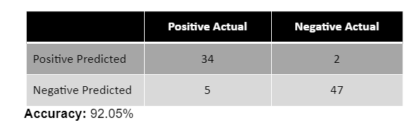
Findings: Requirement 10 - Confusion matrix, using test data
Notes:
From in fact, for the test data the accuracy was even higher and the confusion matrix supports the conclusion that the model is good. W

Slide 8
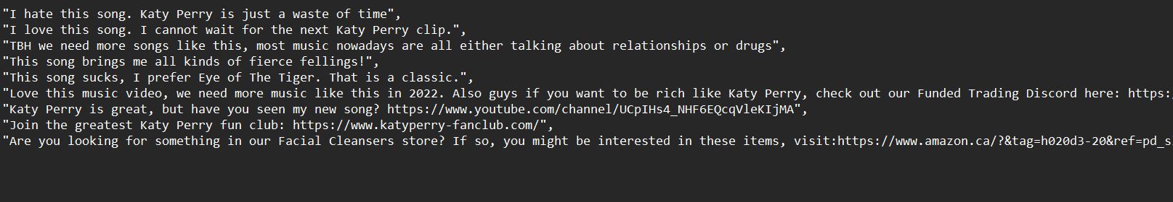
Production: New Comments to be Classified
Notes:
These are the example that we have came up with to test our model
*Proceeds to give an overview and the actual class (spam or not spam)

Slide 9
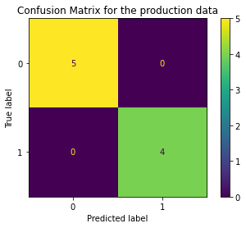
Findings: Requirement 11 - Production Test
True positive: 5
False negative: 0
False Positive: 0
True negative: 4
Notes:
This is the confusion matrix using the production data. We achieve an optimal performance when there’s no False Negative predictions.

Slide 10
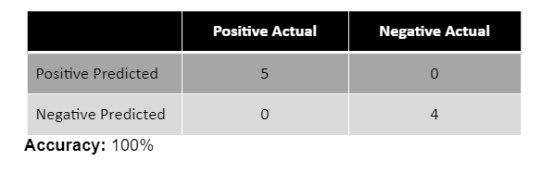
Findings: Requirement 11 - Production Test
Notes:
For the production test, with only a few pieces of data, the model was able to classify everything correctly, however, the results could vary as number of data input and the complexity increase.

Slide 11
Thank you! Questions?

