Slide 1
Predicting Used Car Prices in North America
Group - 6

Slide 2
Why?
Many websites in North America offer car price prediction services, but they require users to provide personal information and often use it to market products or services.
Our Solution:
Focus solely on accurately predicting car prices based on available data.
Address the issue of fluctuating market trends by ensuring the model adapts to provide accurate and reliable predictions.
Scope:
Develop CNN models for accurate predictions.
Explore autoencoders for feature extraction.
Evaluate performance with metrics like MAE, RMSE, and R².

Slide 3
Source:
Kaggle’s "Used Car Auction Prices" dataset.
Size and Features:
Size: 558,811 entries, 16 features.
Features:
Numerical: Year, odometer, selling price.
Categorical: Make, model, transmission.
The DataSet
Key Challenges:​
​
Missing values in key columns (e.g., 10,301 missing in make, 11,794 in condition).​
High variability in categorical data.

Slide 4
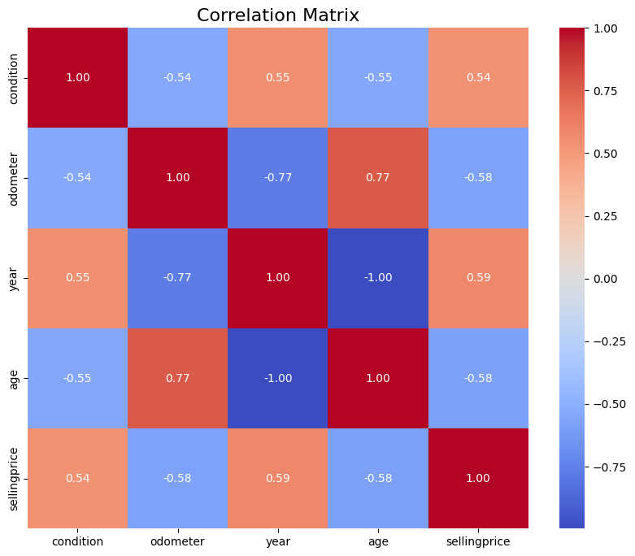
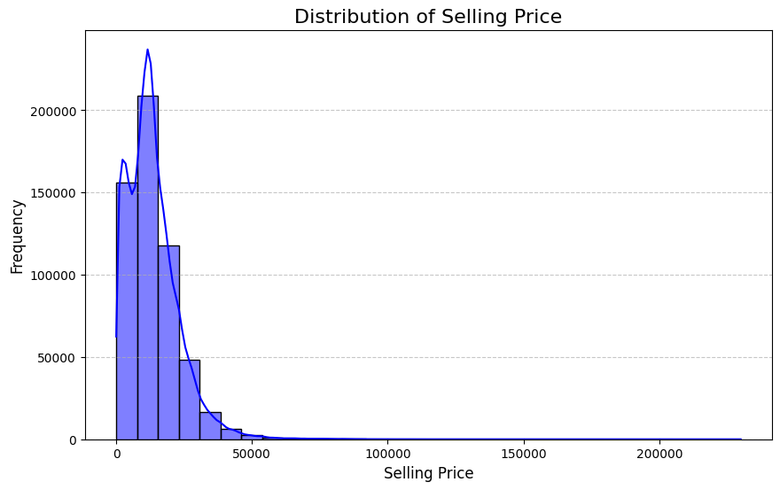
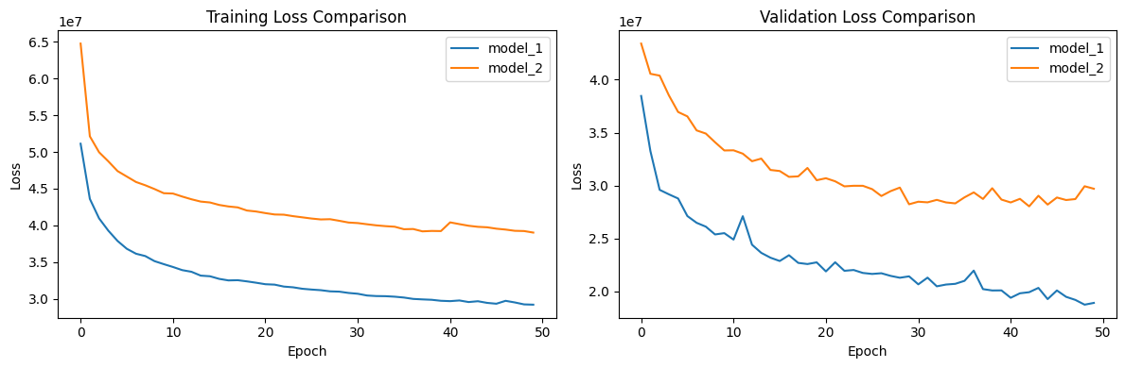

Slide 5
Methodology
Convolutional Neural Network (CNN):
Purpose: To predict car prices based on numerical and categorical data.
Architecture:
Convolutional layers for pattern extraction.
Dropout layers to prevent overfitting.
Dense layers for regression output.
Training Details:
Optimizer: Adam
Loss Function: Mean Squared Error (MSE)
Batch Size: 32
Epochs: 50 with early stopping (patience: 10 epochs).
Feature Extraction with Autoencoders:
Used autoencoders to extract hierarchical features for CNN input.
Architecture:
Filters: [32, 16, 8]
Kernel Size: 3
Encoded output reduced feature dimensions to one-third.
Training Details:
Learning Rate: 0.001
Epochs: 50 with early stopping.
Batch Size: 64
Metrics:
Compared CNN trained on original data vs. CNN using encoded features.
Observed that unsupervised feature extraction requires further fine-tuning to outperform direct training.

Slide 6
Configuration | MAPE | R² Score
Filters: 64, Kernel: 3, Dropout: 0.2, LR: 0.001 | 38.82% | 0.7961
Filters: 32, Kernel: 5, Dropout: 0.3, LR: 0.0005 | 45.95% | 0.6951
Filters: 128, Kernel: 3, Dropout: 0.1, LR: 0.001 | 36.24% | 0.7934
CNN Configurations and Performance:
Impact of Autoencoders:
R² Score with autoencoder features: 0.2322.
Compressed features retained less variance, reducing predictive performance.

Slide 7
CONCLUSION
CNN models performed well with proper parameter tuning.
Autoencoders offer potential for feature extraction but require optimization.
Insights highlight the importance of balancing feature reduction and retention.
Future Work:
Explore advanced architectures like Transformers.
Refine autoencoder designs for better feature extraction.
Investigate hybrid methods for improving predictions.

Slide 8

Thank you

