Slide 1

Bounce Rate Analysis Report Analyzing user engagement through session duration and bounce rates
Name: Daniel Omozojie .O.
Date: 15th May 2025

Slide 2
Overview
What is Bounce Rate?
Bounce rate is a crucial metric in web analytics that measures the percentage of visitors who land on a website and leave without engaging in any further interactions.
Why is this metric important?
Using this data point, we can determine how effective the contents of our website is effective in capturing and retaining the attention of its visitors. A high bounce rate indicates that users leave the website after landing on the first page, which may be due to problems like poor website design, too much ads, slow loading times etc.

Slide 3
Data Summary
Our dataset contains four (4) columns namely:
Client ID
Sessions
Average Session Duration
Bounce Rate

Slide 4
Insights into Bounce Rate
The average bounce rate for the website is 65.31% which is high. This indicates that a lot of visitors leave the website after landing on the first page.

Slide 5
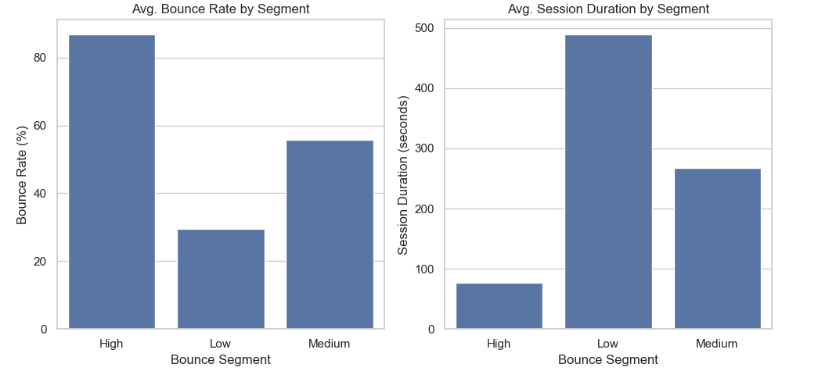
Bounce rate & session duration analysis

Slide 6
Key Insights
An inverse relationship exists between bounce rate and session duration — as bounce rate increases, average time spent decreases.
Users with Low Bounce Rates spend significantly more time on the site, indicating strong engagement.
Users with High Bounce Rates spend significantly less time on the site, indicating weak engagement.

Slide 7
Conclusion
In summary, the insights generated from our data reveals that the website has low user engagement.

