Slide 1
Application of Advanced Trace32 Script

Slide 2
Agenda
Practice Overview
What is Practice
Area of Use
Example
Grammar
Customized IDE
Multicore Debugging
Test Automation

Slide 3
Practice Overview
What is Practice
Area of Use
Example
Grammar
Macros
Comments
Commands
Labels

Slide 4

What is Practice?
Script Language of Lauterbach PowerView
First developed in 1984 for in-circuit emulators
Interpreted Language
Extended suffix *.cmm
Easy to use and write

Slide 5
Area of Use
Provide the proper start-up sequence for the development tool
Automate FLASH programming
Customize the user interface
Store and reactivate specific TRACE32 settings
Run automatic tests

Slide 6
Example
~~\demo\<CPU>\compiler\<compiler> //simple demos
~~\demo\<CPU>\kernel\<RTOS> //RTOS awareness
~~\demo\<CPU>\flash\<CPU> //flash scripts
~~\demo\<theme>\ //CPU independent

Slide 7
Create/Edit/Run/Debug Script
Create
Generate automatically
Convert TRACE32 Settings to a Script
STORE
CLIPSTORE
Command LOG
LOG.OPEN
LOG.CLOSE
LOG.OFF
LOG.ON
Command: History
Write a new one / Modify a existing one
See next page

Slide 8
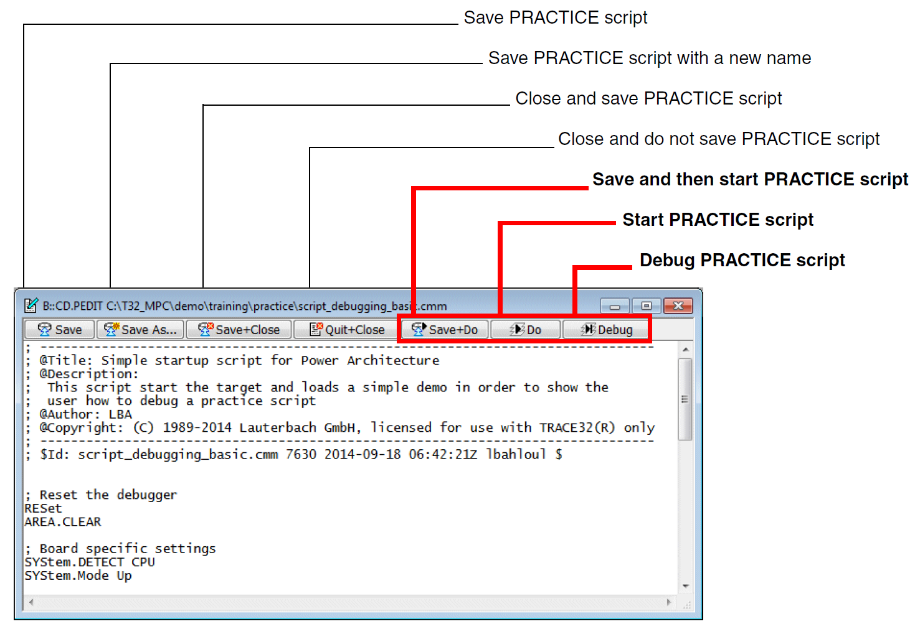
Create/Edit/Run/Debug Script
Edit
Choose your favorite editor, e.g. Notepad++, VIM, UltraEdit, …
Edit in PowerView:
EDIT <your_script.cmm>
PEDIT <your_script.cmm>
CD.PEDIT <your_script.cmm>

Slide 9
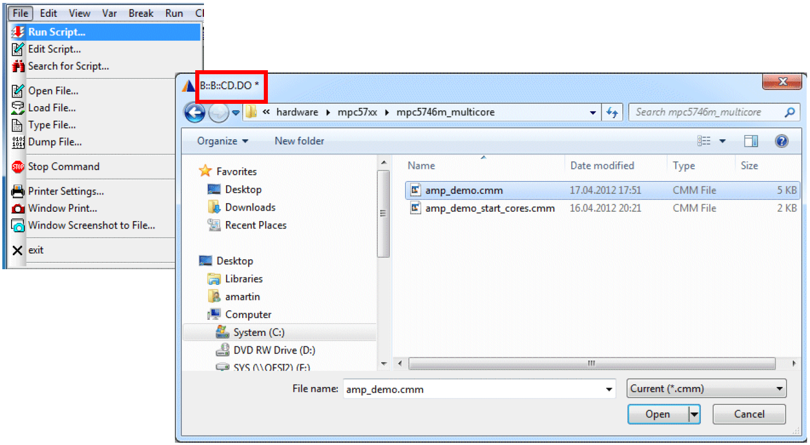
Create/Edit/Run/Debug Script
Run
Method A: In TRACE32, choose File menu → Run Script.
Method B: At the TRACE32 command line, type DO file.cmm .
Method C: Drag and drop the PRACTICE file into the command line.

Slide 10
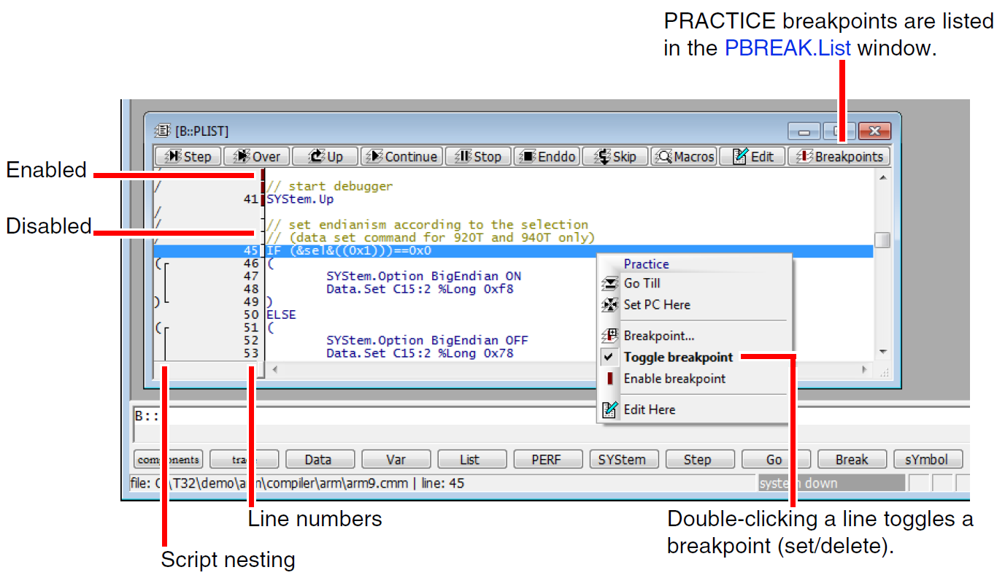
Create/Edit/Run/Debug Script
Debug
PEDIT Edit PRACTICE scripts
PLIST List PRACTICE script
PMACRO.list List PRACTICE script nesting and PRACTICE macros
PSTEP <script> Start script to be debugged in single step mode

Slide 11


Grammar--Macros
Macro names always start with an & sign, followed by a sequence of letters (a-z, A-Z) and numbers (0-9). e.g.&var1, &my_number
Macro names are case sensitive, so &a is different from &A
It is recommended not to use macro names which start with a number after the initial & sign. e.g. &2
It is recommended to avoid unnecessary blanks. Unnecessary blanks can lead to a misinterpretation of PRACTICE commands.
&var=5.
&var = 5.

Slide 12
Grammar--Macros
Types of Macros
STRING
&my_string="Hello World"
&my_range="0x40004000++0xfff"
&my_var=Var.STRing(cstr1)
&a=“Hello”
&b=“ World”
&c=“&a”+“&b”
&d=“&(a)big&(b)here I am”
NUMBER
// Hex, decimal, binary by TRACE32 syntax
&my_hex=0x7
&my_dec=22.
&my_bin=0y1110
// Hex, decimal, binary as expression result
&add1=&my_bin+&my_hex
&add2=&my_hex+&my_dec
// Hex, decimal, binary as return value
&my_stringlength=STRing.LENgth("0123456789012345")
&my_sizeof=sYmbol.SIZEOF(sieve)
// Hex, decimal, binary by CONVERT function
&convert1=CONVERT.HEXTOINT(&my_bin)
&convert2=CONVERT.HEXTOINT(&my_hex)

Slide 13
Grammar--Macros
脚本变量结构
BOOLEAN
&my_boolean=TRUE()
&my_boolean_result=STATE.RUN()
More Complex Data Structure
//Create a global TRACE32-internal variable
Var.NEWGLOBAL <type> \<name>
//Create a local TRACE32-internal variable
Var.NEWLOCAL <type> \<name>
e.g.
Var.NEWLOCAL char[5][40] \typeresult
Var.Assign \typeresult[0]="Symbol does not exist"
Var.Assign \typeresult[1]="Symbol is label"
Var.Assign \typeresult[2]="Symbol is function"
Var.Assign \typeresult[3]="Symbol is variable"
Var.Assign \typeresult[4]="Undefined"

Slide 14
Grammar--Macro Handling
The PRACTICE interpreter executes a script line by line. Each line is (conceptually) processed in three steps:
1. All macros are replaced by their corresponding character sequence.
2. All expressions are evaluated.
3. The resulting command is executed.

Slide 15

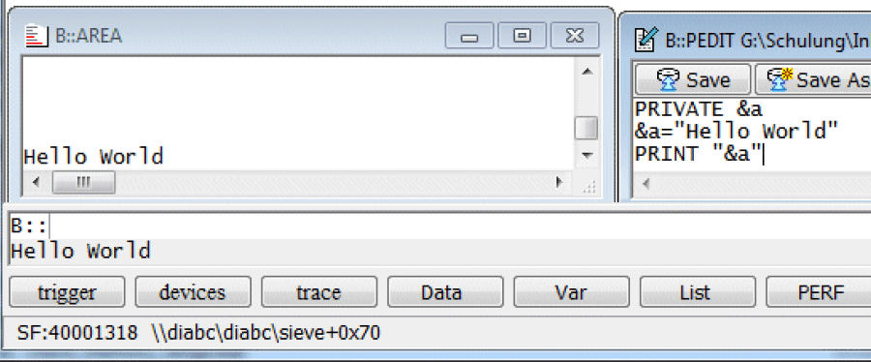
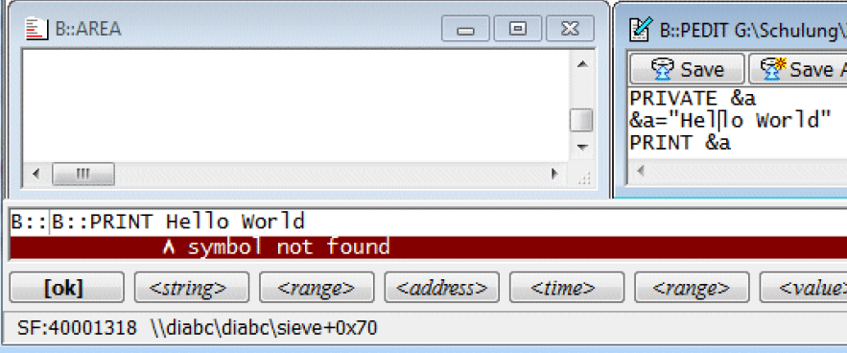
Grammar--Macros
Example 1： Print String
PRIVATE &a
&a=“Hello World”
PRINT “&a”
PRIVATE &a
&a=“Hello World”
PRINT &a

Slide 16
Grammar--Macros
Example 2：Check the value change of register
LOCAL &reg_var1 &reg_var2
&reg_var1=“Register(R5)”
Go
Wait 3.
Break
&reg_var2=“Register(R5)”
IF &reg_var1==&reg_var2
(
PRINT “Not Changed!”
)
LOCAL &reg_var1 &reg_var2
&reg_var1=Register(R5)
Go
Wait 3.
Break
&reg_var2=Register(R5)
IF &reg_var1==&reg_var2
(
PRINT “Not Changed!”
)

Slide 17
Grammar--Scope of Macros
PRIVATE
visible in the script, subroutine or block in which they are created.
visible in nested blocks
Not visible in called subroutines and called scripts.
LOCAL
visible in the script, subroutine or block in which they are created.
visible in nested blocks, in called subroutines and called scripts.
GLOBAL
Visible to all scripts, subroutines and blocks until
They are explicitly removed by the command PMACRO.RESet.
They can only be removed if no script is running.

Slide 18
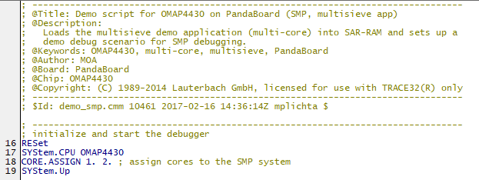
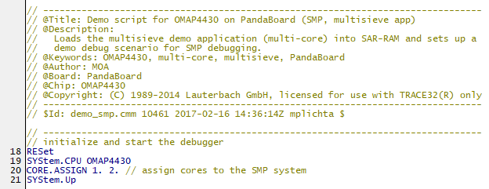

Grammar--Comments
; (Deprecated)
Since the TRACE32 hll expression grammar allows ; to end an hll expression, ; has a special meaning for the Var command group.
E.g. Var.View flags[3];ast.count;i
// (Recommended)

Slide 19
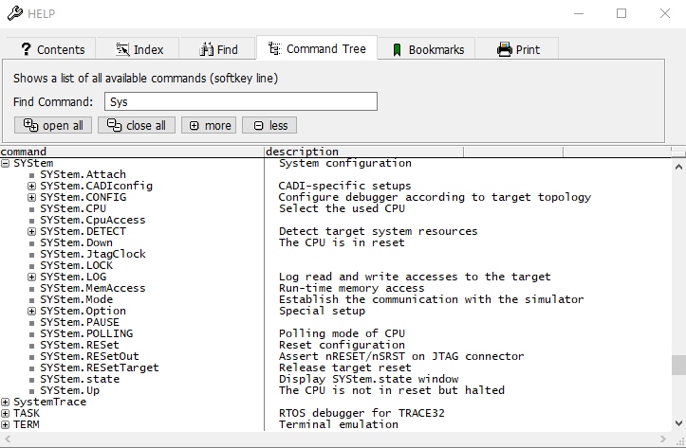
Grammar--Command
All TRACE32 commands can be used in a PRACTICE script
E.g.
SYSTEM.UP
Data.List
More and Detailed
F1 Help→Command Tree

Slide 20
Grammar-Commands
e.g.
Conditional Program Execution
IF <condition>
(
<if_block>
)
ELSE
(
<else_block>
)
IF Var.value(flags[0])==Var.value(flags[5])
PRINT "Values are equal."
ELSE
PRINT "Values do not match."
ENDDO
Var.IF <hll_condition>
(
<if_block>
)
ELSE
(
<if_block>
)
Var.IF (flags[0]==flags[5])
PRINT "Values are equal."
ELSE
PRINT "Values do not match."
ENDDO

Slide 21
Grammar-Commands
e.g.
Loop
WHILE <condition>
(
<block>
)
//Set a Write breakpoint to array
Var.Break.Set flags /Write;flags
//Repeat the following 10 times
//Start the program and wait until the target halts //at the breakpoint.
//Then export the contents of array flags to file //flags_export.csv in CSV format.
RePeaT 10.
(
Go
WAIT !STATE.RUN()
Var.EXPORT "flags_export.csv" flags /Append
)
Var.WHILE <condition>
(
<block>
)
RePeaT <count> <command>
RePeaT <count>
(
<block>
)
RePeaT
(
<block>
)WHILE <condition>

Slide 22
Grammar-Commands
Subroutine Calls
GOSUB <label> [<parameter_list>]
…
ENDDO
<label>
(
<block>
RETURN
)
GOTO <label>
JUMPTO <label>

Slide 23
Grammar-Commands
File Manipulation
e.g.
• Open file
OPEN #<buffer> <filename> / Read | Write | Create | BINARY
&filename="~~~~\t32_tmp_log.txt"
IF !OS.file(&filename)
(
open #1 &filename /create
)
ELSE
(
open #1 &filename /write
)
write #1 DATE.TIME() "flags[2]= " v.value(flags[2])
close #1
• Read data from an open file
READ #<buffer> [ %LINE ] <parlist>
• Write data to an open file
WRITE #<buffer> <parlist>
• Close file
CLOSE #<buffer>

Slide 24
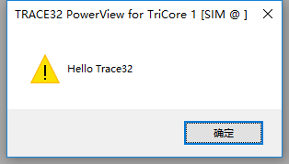
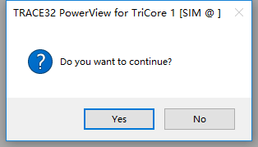
Grammar-Commands
I/O Commands
PRINT <format> <parlist>
DIALOG.OK <message>
ENTER <parlist> //Window based input
INKEY [<par>] //Input command (character)
DIALOG.YESNO <message> //Create a standard dialog
DIALOG.File <message> //Read a filename via a dialog

Slide 25
Grammar-Commands
Window
To open and assign an AREA window:
1.Create an AREA window
AREA.Create [<area> ]
2. Select an AREA window for PRACTICE I/O.
AREA.Select [<area>]
3. Select the screen position of the AREA window.
WinPOS [<pos>] [<size>] [<scale>] [<name>] [<state>] [<header>]
4. Display AREA window
AREA.view [<area>]

Slide 26
Grammar-Commands
Window
To remove AREA window:
1. Resets the AREA window settings to the default settings: the message area (AREA A000) is
used for error and system messages. No other AREA window is active.
AREA.RESet
2. Delete a specific window.
WinCLEAR [<pagename> | <windowname> | TOP]

Slide 27
Grammar-Commands
Event Control
//Perform commands on PRACTICE runtime error
ON ERROR <command>
//Perform commands when the communication between debugger and CPU is established
ON SYSUP <command>
//Perform commands on target power on
ON POWERUP <command>

Slide 28
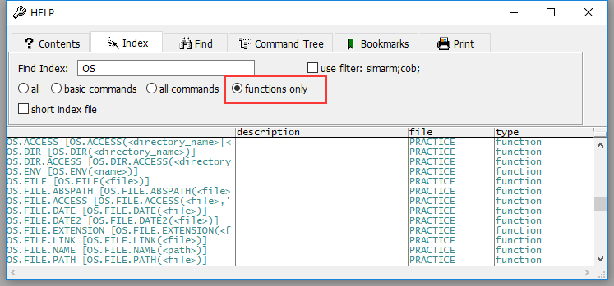
Grammar--Functions
retrieve information about the state of the target system / debugger
e.g.：
Register(R5) //Get the value of R5 register
STATE.RUN() //If the CPU is running, return TRUE
Var.VALUE(<hll expression>) //Get the value of C/C++ expression value
More…
Help → Index
Notes:
函数用于获取目标板或者调试器的一些状态信息

Slide 29
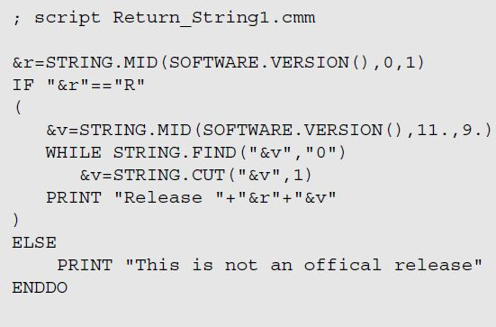
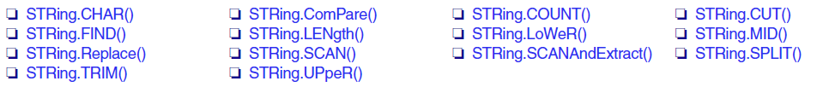
Grammar--Functions
String Handler Functions
e.g. Check the SW version
//Extracts a character at the given index position of the string.
STRing.CHAR("<string>",<index>)
//Returns TRUE if the string matches the wildcard pattern //containing '*' and '?'.
STRing.ComPare("<string>","<pattern>")
//Extracts a part of a string. The string starting at position <start_at> with the <length> is extracted. The
first element has the offset 0.
STRing.MID("<string>",<start_at>,<length>)
//More String Handler Functions in ide_func.pdf

Slide 30
Grammar--Functions
Value Formatting
example
//Numeric to binary value (leading spaces)
FORMAT.BINary(<width>,<number>)
//result "00010000"
PRINT FORMAT.BINARY(8.,0x10)
//result "10000" and not "0"
PRINT FORMAT.BINARY(1.,0x10)
//Numeric to string (leading spaces)
FORMAT.Decimal(<width>,<number>)
//Output string with fixed length
FORMAT.STRing(<source_string>,<width>,<fill_character>)
//result "a*********"
PRINT FORMAT.CHAR(0x61,10.,'*')
//result "*********a"
PRINT FORMAT.CHAR(0x61,-10.,'*')
//result " a"
PRINT FORMAT.CHAR(0x61,-10.,' ')
//More Value Formatting Functions in ide_func.pdf

Slide 31
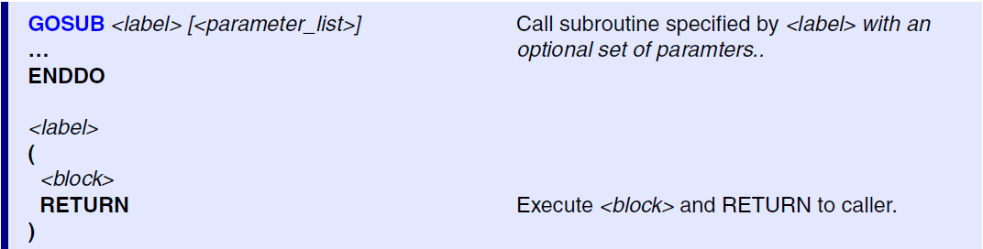
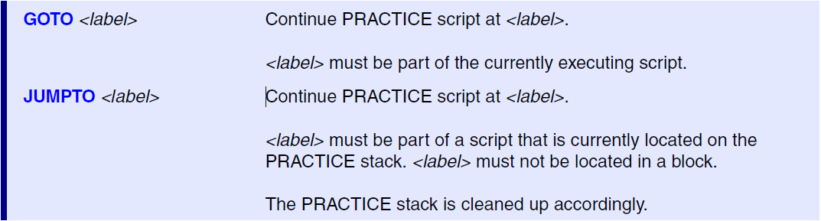
Grammar--Labels
Labels have to be entered in the first column and they end with “:”

Slide 32
Grammar--Parameter Passing
ENTRY <parlist>
Example 1: Call script with passing args.
Example 2: Gosub with passing args. /receiving rets.
; PRACTICE script patch.cmm
; DO patch.cmm 0x1000++0xff 0x01
ENTRY &address_range &data
IF "&address_range"==""
(
PRINT "Address range parameter is missing"
ENDDO
)
IF "&data"==""
(
PRINT "Old data parameter is missing"
ENDDO
)
; PRACTICE script param.cmm
GOSUB test sieve++0x20 0x01
ENTRY &found
PRINT "Data found at address " &found
ENDDO
test:
ENTRY &address_range &data
Data.Find &address_range &data
&result=ADDRESS.OFFSET(TRACK.ADDRESS())
RETURN &result

Slide 33
Grammar—Paths
Abbr. | Practice Function | Meaning | Configuration
./ | OS.PWD() | Current working directory
~/ | OS.PHD() | User’s HOME Path | $HOME
~~/ | OS.PSD() | Trace32 System Path | T32Start → Adavanced Settings → Paths → SystemPath
~~~/ | OS.PTD() | Trace32 Temp Path | T32Start → Adavanced Settings → Paths → TempPath
~~~~/ | OS.PPD() | Directory of current script
TRACE32 can handle forward slashes / on all operating systems
Refer Chapter. OS Functions in ide_func.pdf

Slide 34
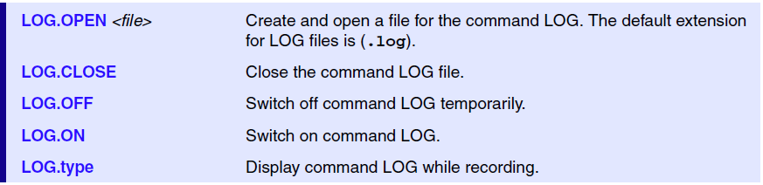
Application 1 ——Start-up Script
Methods to get scripts :
Find in your demo directory
~~\demo\<CPU>\hardware\<board>
e.g.
demo\tricore\hardware\triboard-tc3x7\tc397x-astep\demo.cmm
Get the latest from website
http://www.lauterbach.com/scripts.html
Generate scripts after manual configuration

Slide 35
Application 2 —— Flashing Script
Methods to get scripts :
Find in your demo directory
NorFlash
demo/<architecture>/flash/<CPU>.cmm
NandFlash
demo/<architecture>/flash/<cpu_name>-<nand_flash_code>.cmm
Get the latest scripts from official website
http://www.lauterbach.com/scripts.html
Write your own nandflash programming scripts
nandflash.pdf→Standard Approach→ If there is no script

Slide 36
Application 3 ——Customize User’s Interface
Custiomize Menu/Toolbar/Windows
e.g. Add new menu in PowerView
; MENU file interrupts
ADD
MENU
(
POPUP "&Interrupts"
(
MENUITEM "&Disable Int."
(
SETUP.IMASKASM ON
SETUP.IMASKHLL ON
)
MENUITEM "&Enable Int."
(
SETUP.IMASKASM OFF
SETUP.IMASKHLL OFF
)
)
)
More information in pdf\training_menu.pdf

Slide 37
Application 3 ——Customize User’s Interface
Dialog Programming
DIALOG.MESSAGE "This message is irrelevant"
DIALOG.OK "Test Succeeded!"

Slide 38
Application 3 ——Customize User’s Interface
Dialog Programming
LOCAL &result
DIALOG.YESNO "Program the FLASH?"
ENTRY &result
if &result
GOSUB prog_flash
ENDDO
More…
ide_user.pdf
Chapter: Dialog Programming

Slide 39
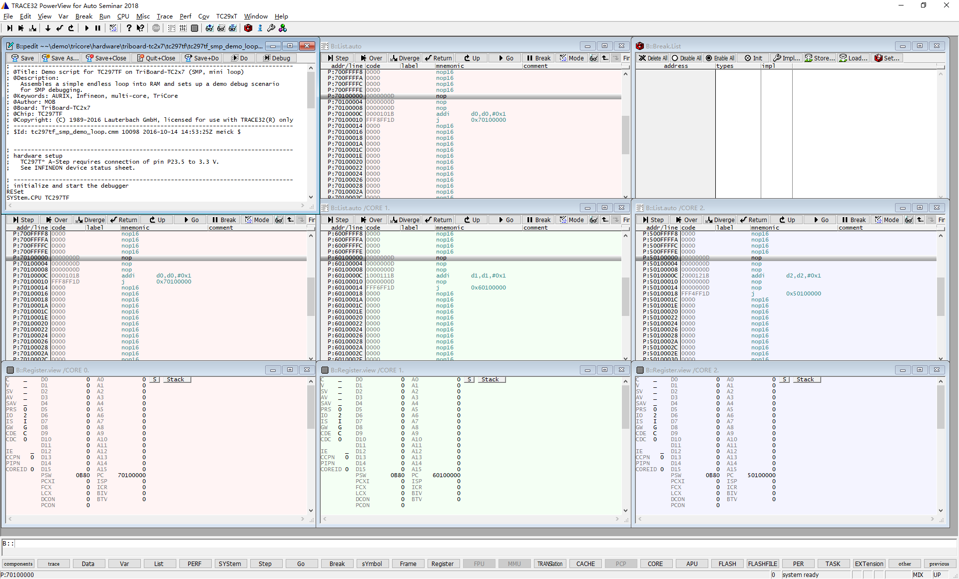
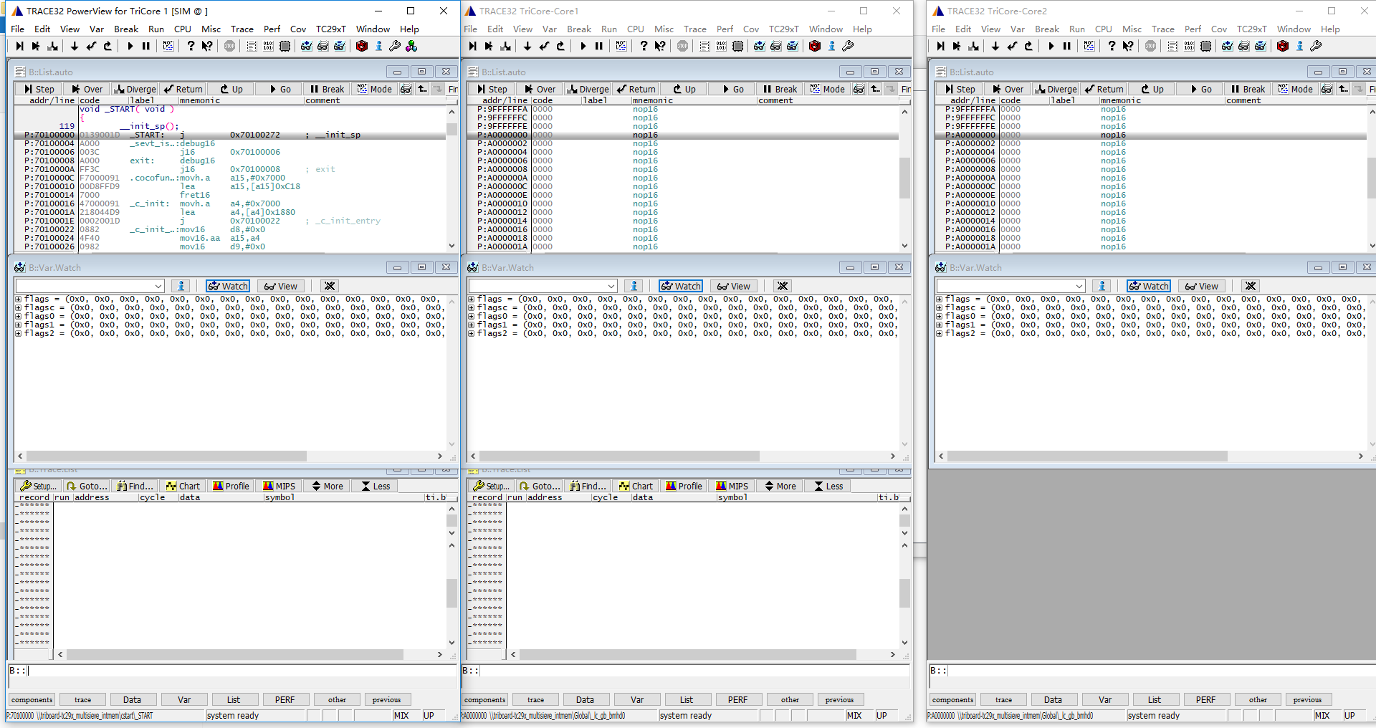
Application 3 ——Multicore Debugging
SMP configuration
AMP configuration

Slide 40





Application 4 —— Test Automation
Realize Automatic Test GUI
Based on event trigger
Based on complex breakpoints
Integrated with Python/Shell/Jenkins

Slide 41

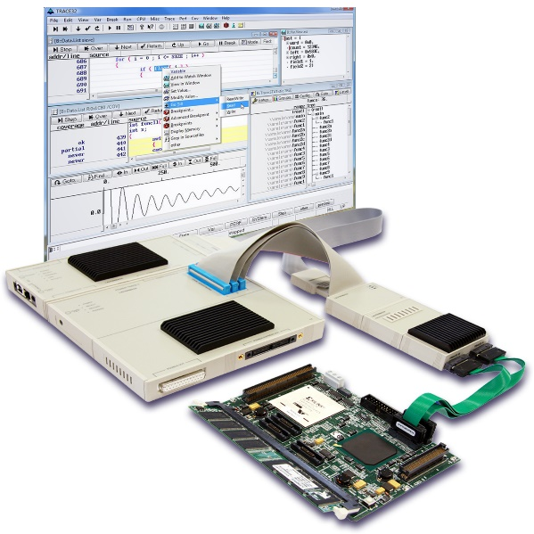
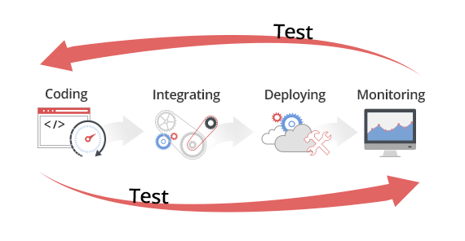

Scenario4 —— Test Automation

Slide 42
Scenario4 —— Test Automation
Jenkins CI
Step1
Check Repo
Step2
Pull
Step3
Trace32 Coverage Test
Compile
Step4
HTML&Email Feedback

