Slide 1
Biking Denver – Final Report
Dongdong Lu

Slide 2
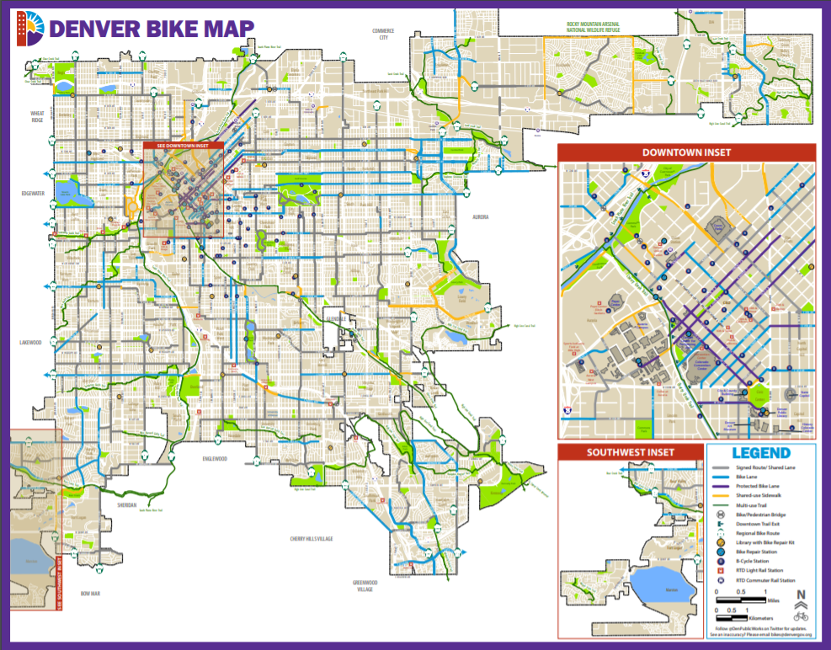
DENVER BIKE MAP

Slide 3
Background
Questions:
How many people in Denver ride bicycles on an average week?
What is the percentage of people who ride on designated trails?
What is the percentage of people who have heard Denver Bike Streets Project?
What are their average riding time?

Slide 4
Goals
Design the survey
Write the delivery methods of the survey
Create a simulated response set
Data analysis based on the simulated data set

Slide 5
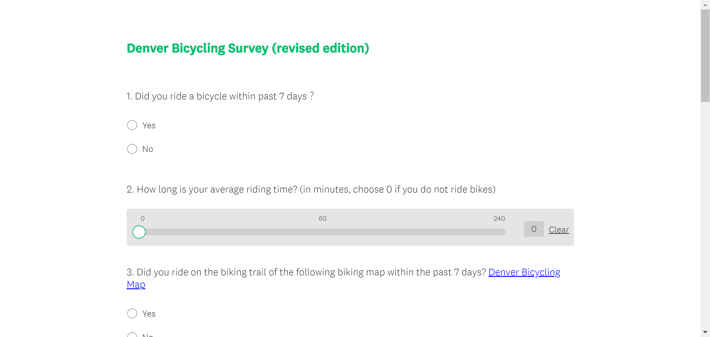
Products & Results - Survey

Slide 6
Products & Results - Ways of implementation
By Mail: May get a very low response rate
By house visiting: Senior Living’s house
By Volunteers’ distribution:
1. Social events where people have a little bit of time while waiting in lines: such as food pantry, exhibitions
2. Randomly select households in volunteers’ neighborhood
By Facebook advertisement: cause 20$ to reach 1000 people. May get a very low response rate.
By telephone/text messages

Slide 7
Products & Results
case_id | gender | race | age | ride | rideOT | Rtime | heard | weight
1 | female | white | under 18 | no | no | 62 | no | 0.305362
2 | male | black | 45-64 | yes | no | 65 | yes | 1.236772
3 | female | black | 45-64 | no | no | 45 | no | 0.297467
4 | male | white | 45-64 | no | no | 66 | no | 0.270115
5 | male | black | 45-64 | no | no | 81 | no | 1.042227
6 | female | black | 25-44 | no | no | 64 | no | 1.269597
7 | male | white | 25-44 | no | no | 60 | yes | 1.269597
8 | female | black | 25-44 | no | no | 53 | yes | 1.269597
9 | male | asian | 25-44 | no | no | 66 | yes | 0.270115
10 | male | asian | 45-64 | no | no | 47 | no | 1.269597
11 | female | asian | 25-44 | no | no | 42 | yes | 1.042227

Slide 8
Before “Raking”
Assumption of “Raking”: responses to the survey questions are reasonably correlated to those population demographics that you are raking on.
Pre-possessing: carefully explore the data and clean it up as necessary. Look for outliers, typos, and other errors and correct them as possible and appropriate.
Raking does not do anything for missing data. If you have missing data, you’ll need to do some sort of imputation first and then do the raking.

Slide 9
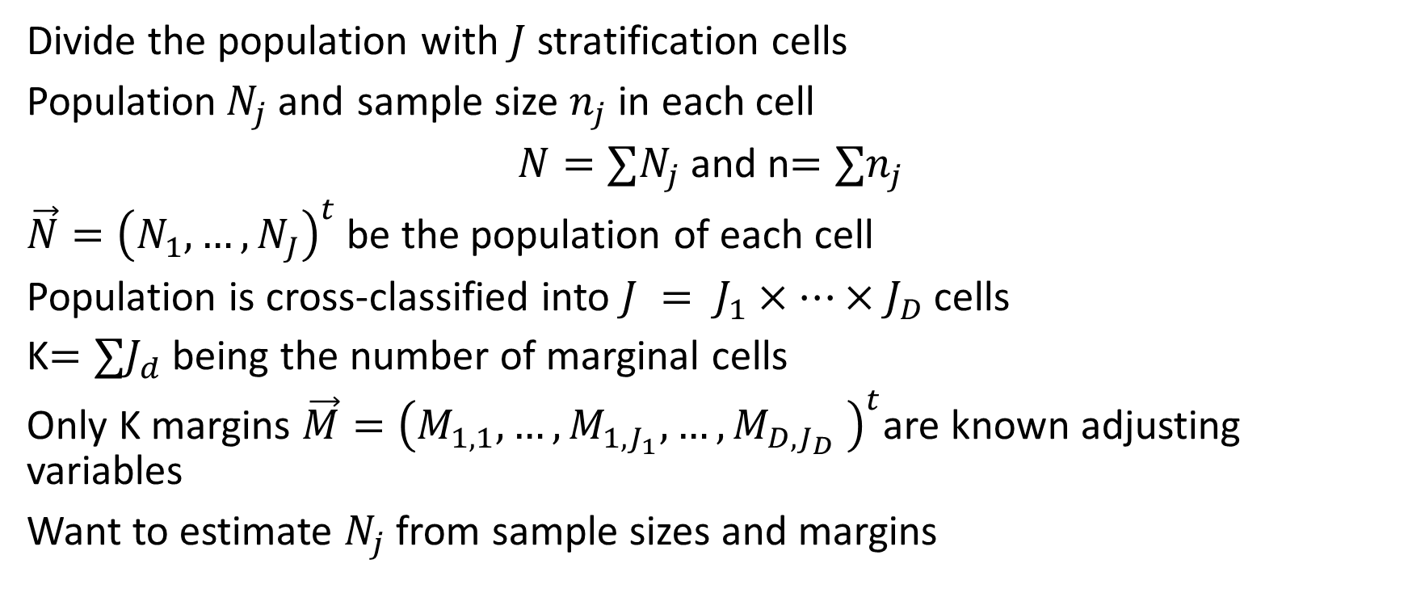
Mathematics of “Raking”
Divide the population with $J$ stratification cells
Population$N_{j}$and sample size $n_{j}$ in each cell
$N=∑N_{j}$and n$=∑n_{j}$
$\vec{N}={\left(N_{1}, …, N_{J}\right)}^{t}$ be the population of each cell
Population is cross-classified into $J = J_{1}×…×J_{D}$cells
K$=∑J_{d}$being the number of marginal cells
Only K margins $\vec{M}={\left(M_{1,1},…, M_{1,J_{1}},…, M_{D,J_{D}} \right)}^{t}$are known adjusting variables
Want to estimate $N_{j}$ from sample sizes and margins

Slide 10

Mathematics of “Raking”
Let $A$ be the $K×J$ indicator matrix that satisfies
$$A\vec{N}= \vec{M}$$
Write $A={\left(A_{1}, …, A_{D}\right)}^{t}$ here $A_{i}$ is a $J×J_{i}$ matrix
Define the vector of sample margins $\vec{m}={\left(m_{1,1},…, m_{1,J_{1}},…, m_{D,J_{D}} \right)}^{t}=A\vec{n}$
Here $\vec{n}={\left(n_{1},…, n_{J}\right)}^{t}$ is the vector of sample margins

Slide 11
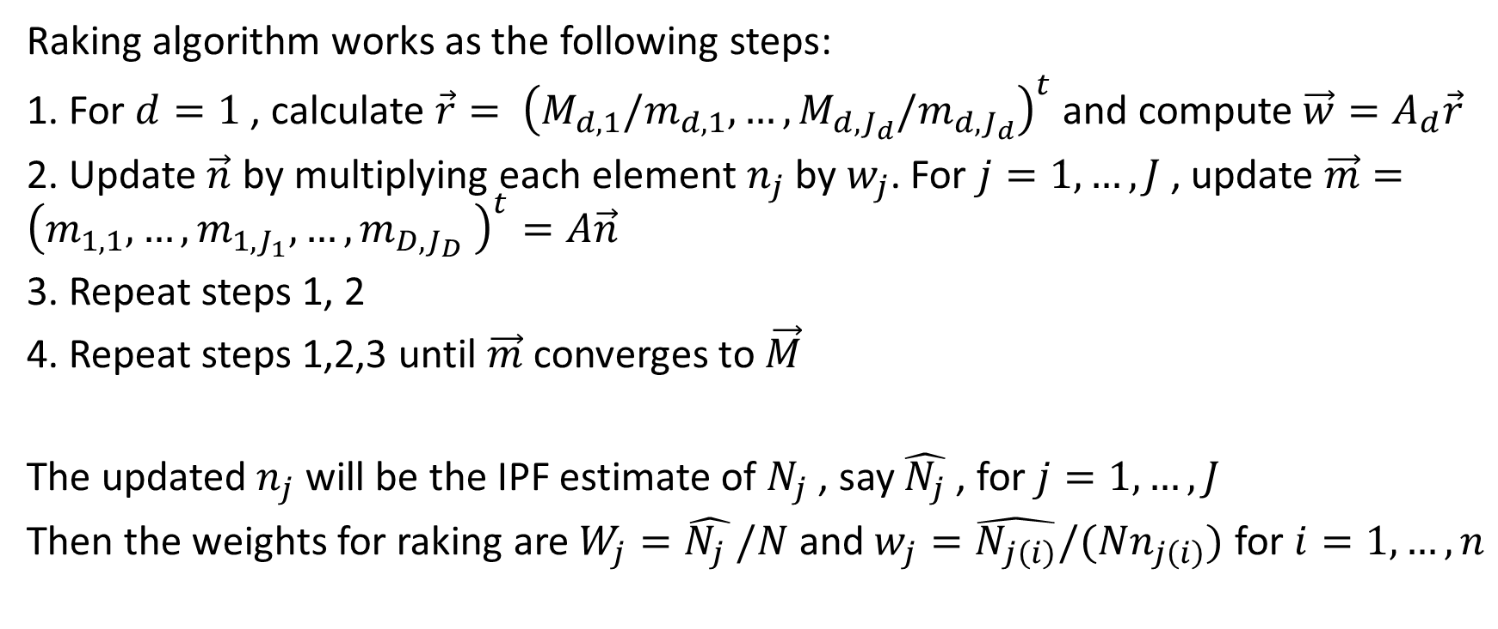
Mathematics of “Raking”
Raking algorithm works as the following steps:
1. For $d=1$ , calculate $\vec{r}= {\left(M_{d,1}/m_{d,1},…,M_{d,J_{d}}/m_{d,J_{d}}\right)}^{t}$ and compute $\vec{w}=A_{d}\vec{r}$
2. Update $\vec{n}$ by multiplying each element $n_{j}$ by $w_{j}$. For $j=1,…, J$, update $\vec{m}={\left(m_{1,1},…, m_{1,J_{1}},…, m_{D,J_{D}} \right)}^{t}=A\vec{n}$
3. Repeat steps 1, 2
4. Repeat steps 1,2,3 until $\vec{m}$ converges to $\vec{M}$
The updated$n_{j}$ will be the IPF estimate of $N_{j}$ , say $\hat{N_{j}}$ , for $j=1,…,J$
Then the weights for raking are $W_{j}=\hat{N_{j} }/N$ and $w_{j}=\hat{N_{j\left(i\right)}}/(Nn_{j\left(i\right)})$ for $i=1,…,n$

Slide 12
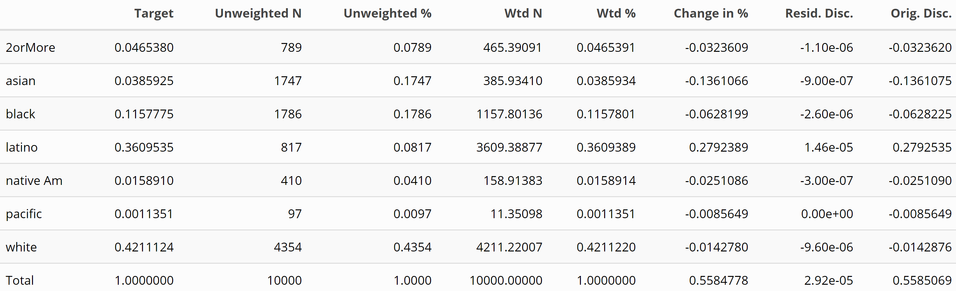
Survey Results – After raking
Adjusting Variables used: “race” and “age”

Slide 13
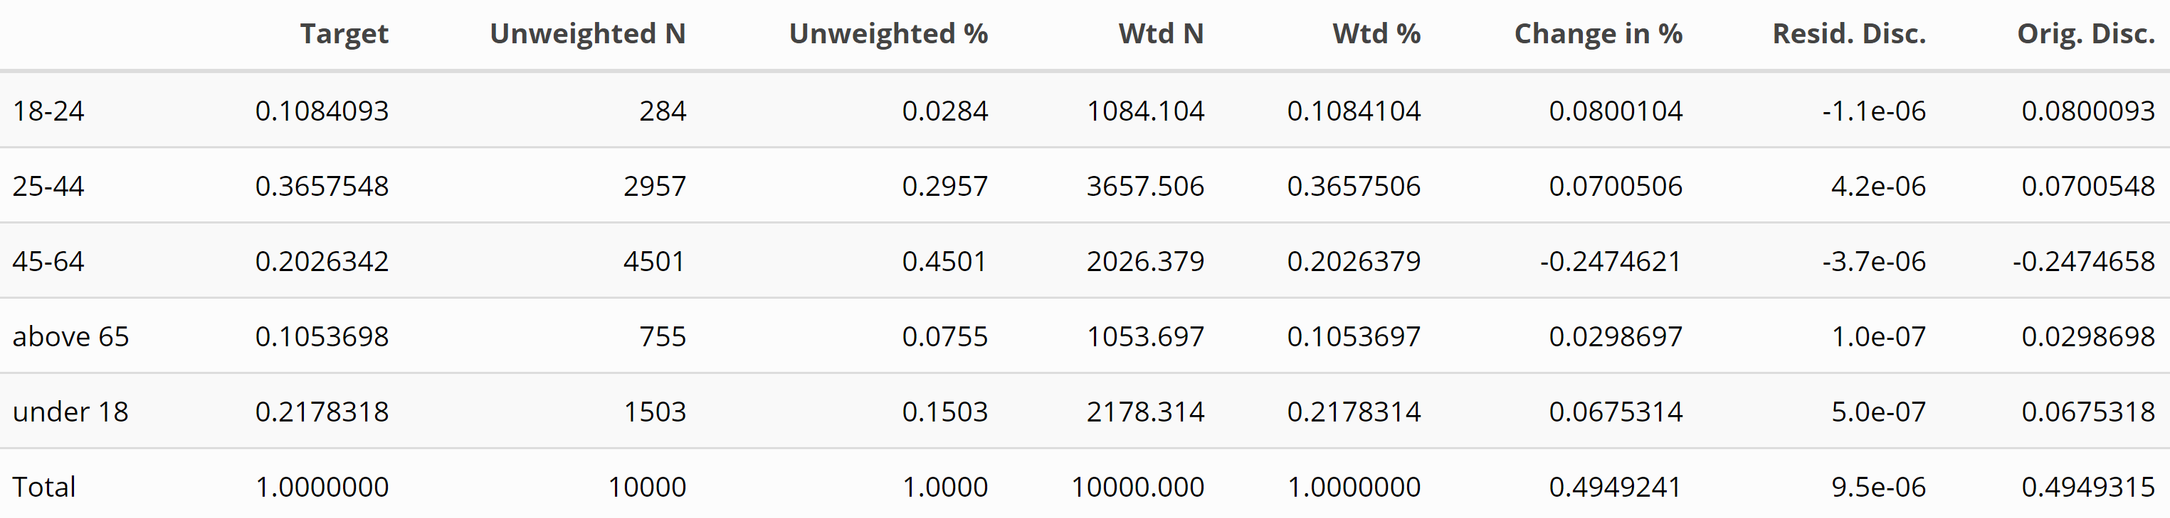
Survey Results – After raking
Adjusting Variables used: “race” and “age”

Slide 14
Survey Results – Before and After raking

Slide 15
Survey Results – After raking
Weights Range
Min. | 1st Qu. | Median | Mean | 3rd Qu. | Max.
0.03323 | 0.26336 | 0.36357 | 1.0000 | 1.17139 | 5.00009

Slide 16
Survey Results – After raking
Ride a bike?
General Design Effect (Variance Ratio)
2.603833
Before | After
18.17 % | 21.39628 %

Slide 17
Discussion
All major goals achieved
Discuss results
Explain design effect
Caveats: even the best bias adjusting method would not eliminate the bias
Recommended resources

Slide 18
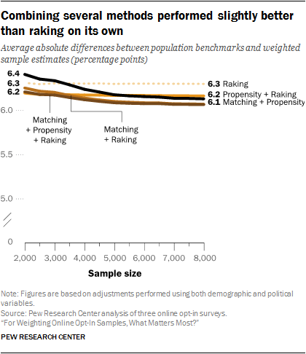
Discussion

Slide 19
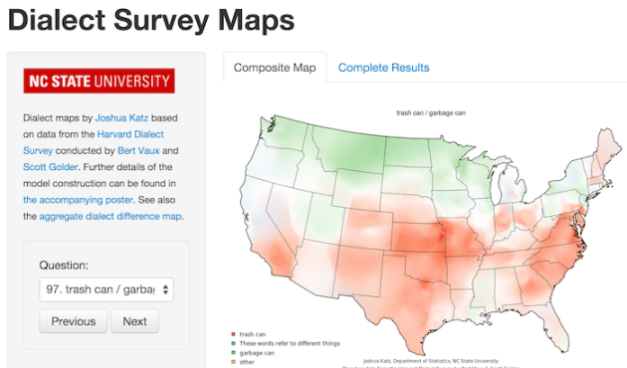
Next Steps
Update census data
Make a machine-readable questionnaire
Make a shiny app

Slide 20
Reference
Fricker, Ron & Anderson, Lew. (2015). Raking: An Important Often Overlooked Survey Analysis Tool. Phalanx. 36-42.
Lu, H. and Gelman, A. (2003). A method for estimating design-based sampling variances for surveys with weighting, poststratification and raking. J. Official Statistics 19 133—151
Lumley, Thomas. Complex surveys: a guide to analysis using R. Vol. 565. John Wiley & Sons, 2011.
Pew Research Center, January, 2018, “For Weighting Online Opt-In Samples, What Matters Most?
Survey Raking: An Illustration - Andrew Collier - https://datawookie.netlify.app/blog/2018/12/survey-raking-an-illustration/
Fricker, Ronald. “Re: Ask questions about “raking”.” Message to Dongdong Lu. 26 April 2020. E-mail.
Statistics Category • Peopleforbikes
https://peopleforbikes.org/our-work/statistics/statistics-category/?cat=participation-statistics

Slide 21
Thank you!

