Slide 1
MOZILLA HACKATHON 3.0
Team name : _init_
Team members : Rohit kumar
Aditya shekhar
Sarthak jha
Supriya kumari

Slide 2


Going From Formal To Casual
Traditional methods to learn code are boring for kids. Hence , we are providing some interesting games helping them to learn in an easy way.
Notes:
NOTE: To change images on this slide, select a picture and delete it. Then click the Insert Picture icon in the placeholder to insert your own image.

Slide 3
Idea Description
We propose an idea to create a child friendly Website that will be teaching children to code in such way that they won’t feel any overhead involved in the Coding. In Our Website the Children would be learning the basic concepts of Coding through playing Games without any prior knowledge. We will teaching them basics about looping, Control & Flow Statements, Loop Statements through some interacting games like a maze game .

Slide 4
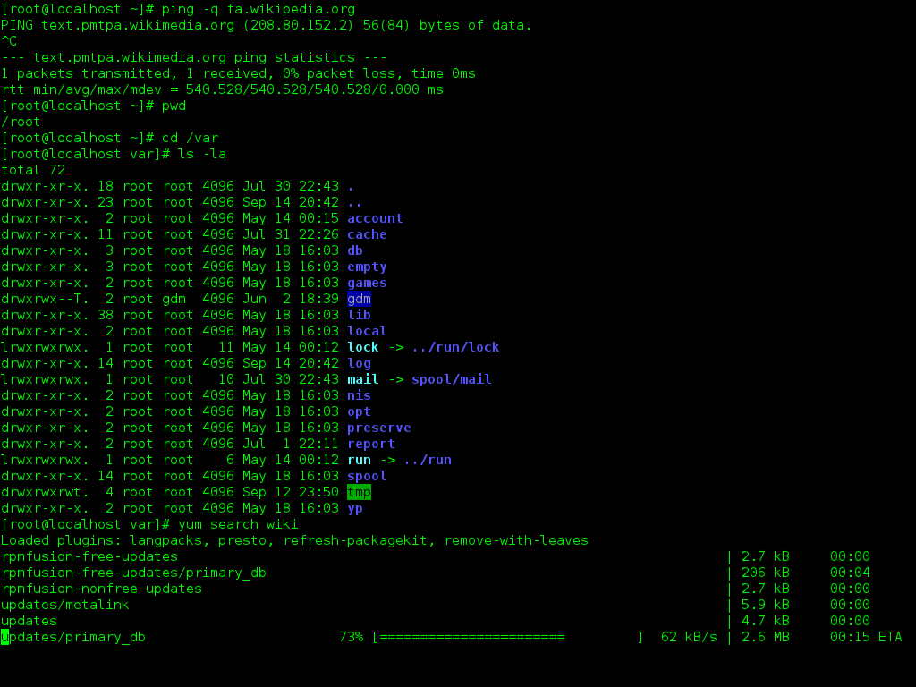
Objective
In the Age o Information Coding is one of the trendiest and most interesting field.
Gone are the days when children dream only of becoming astronauts, pilots, military and doctor.
Coding as we all know is not Child friendly.
As mostly the editor consists of Black window with a set of instructions without any GUI.

Slide 5
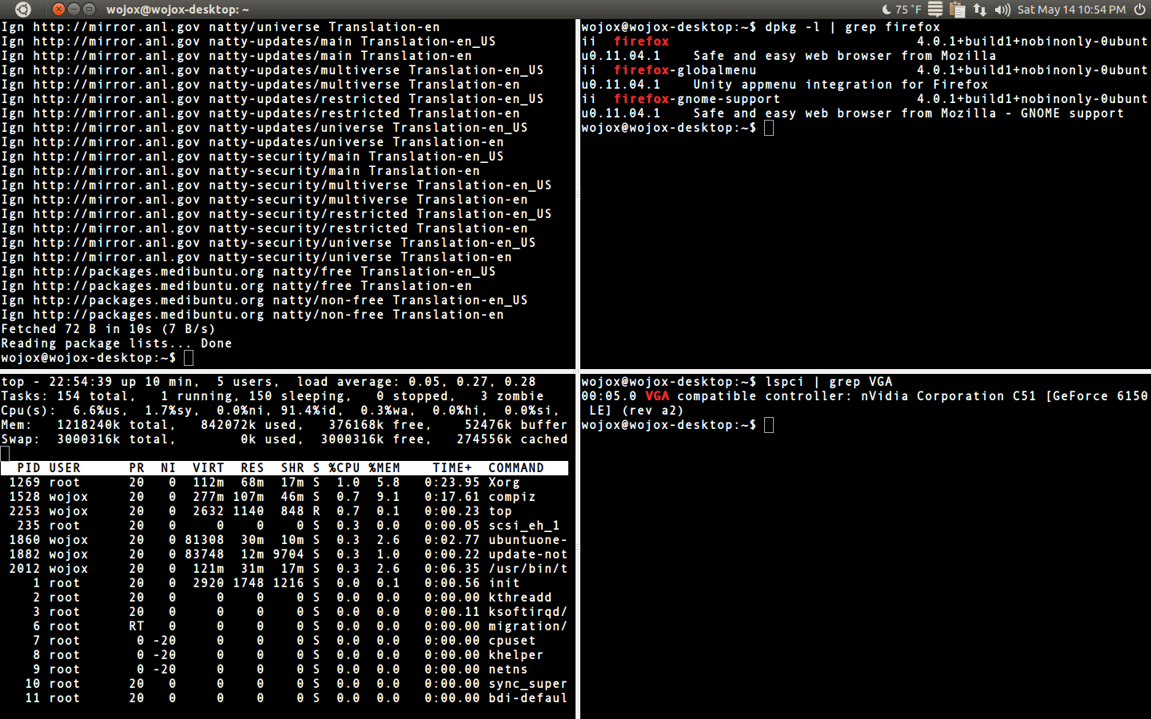
Objective
In order to just get a simple code running in a system they need to go through the process of installing compilers, interpreters, editors.
Converting the complex terminal to a playful and interacting window.

Slide 6
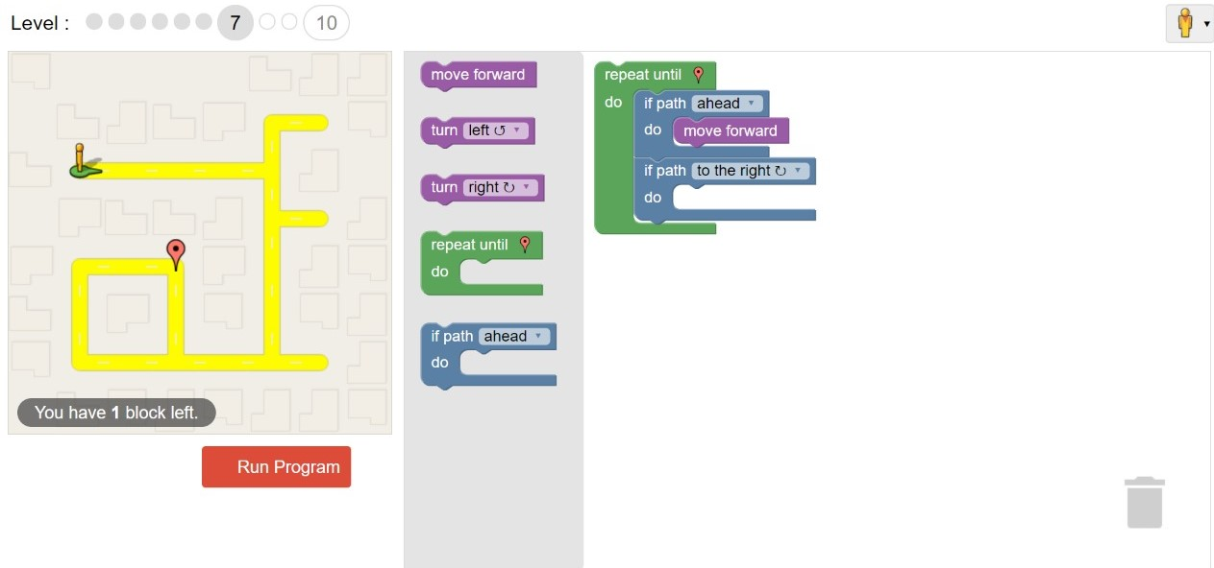
Objective
We are providing a simple and user friendly GUI for coding.
Our aim is to combine fun and learning which could not have been achieved in a way better than games.
By doing so we are reducing the threshold of age to learn coding as well as exploring the talents of children at a much younger age.

Slide 7
Why Coding??
Coding helps in improving creativity.
Coding improves problem solving.
Coding improves persistence [debugging].
It helps in improving communication and collaboration.

Slide 8
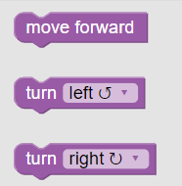
About The Game
The children will be learning to code[ basics of if else and while ] via a maze game. The maze game has certain levels, with every level the child learns a new concept on top of the previous one. The task is to move the man using three basic action functions [predefined], move forward, turn right and turn left and help him reach the destination.

Slide 9
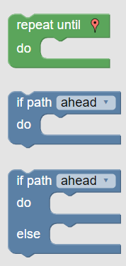
Learning elements
In higher levels[Level 1 – 10] kids will be learning about some complex functions like only-if , if-else and while loop.
Until : similar to the while statement repeats a certain task until the destination is reached
If : condition check and move If its right.
If-else: condition check and do things if its right or not accordingly.

Slide 10
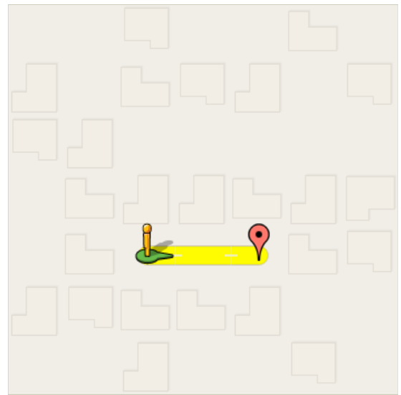
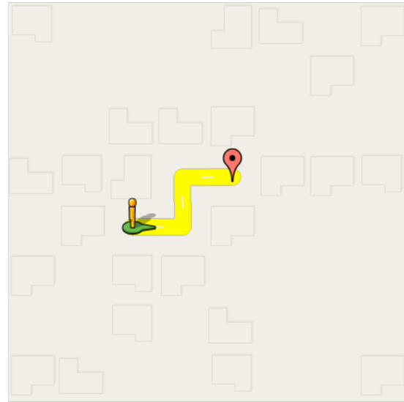
Game Walkthrough
Level 1 : Here we will teach about move forward function
Level 2 : Here we will teach how to use turn left/right and move forward together.

Slide 11
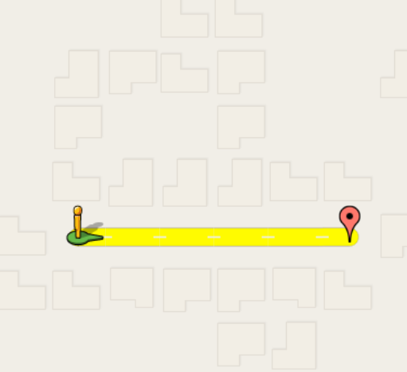
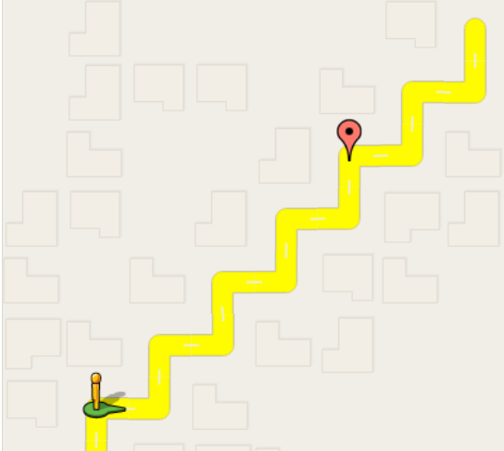
Level 3 : Here we will teach about looping in single statement.
Level 4 : Here we will teach about looping with a combination of forward and left/right.

Slide 12
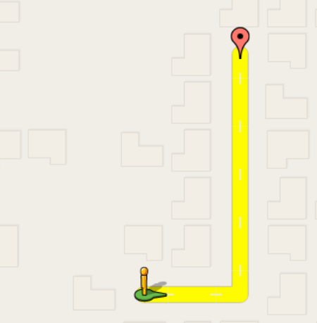
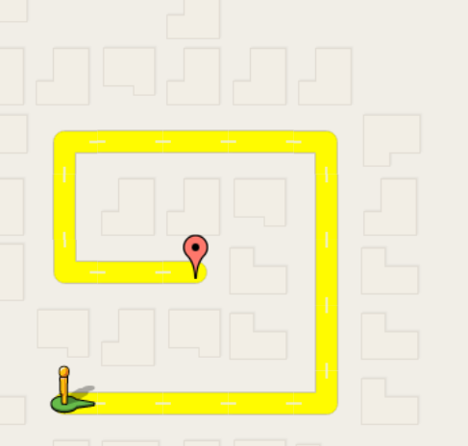
Level 5 : Here we will teach about combination of basic functions with looping in single statement.
Level 6 : Here we will teach about conditional statements with in a loop.

Slide 13
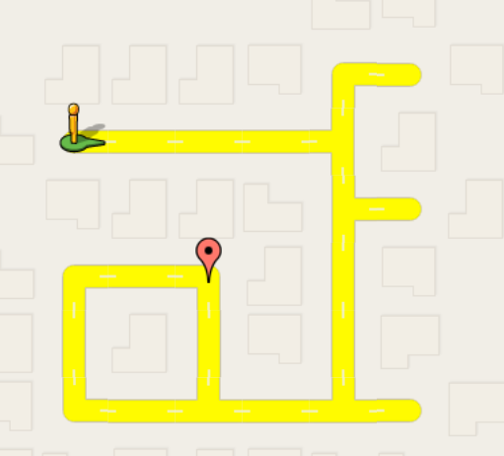
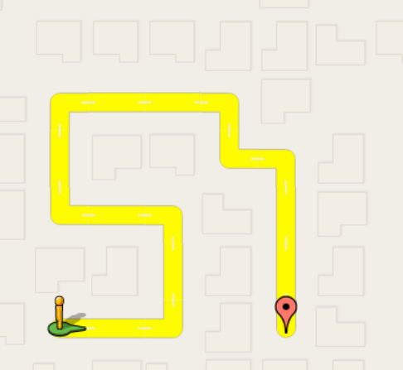
After level 6 kids would have learned basics about every functions .Herby Now onwards We would be increasing the Difficulty of the game by restrict number of statements and require more loops to complete that level
Level 7 :
Level 8 :

Slide 14
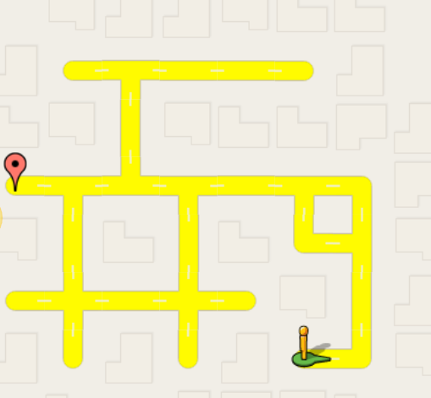
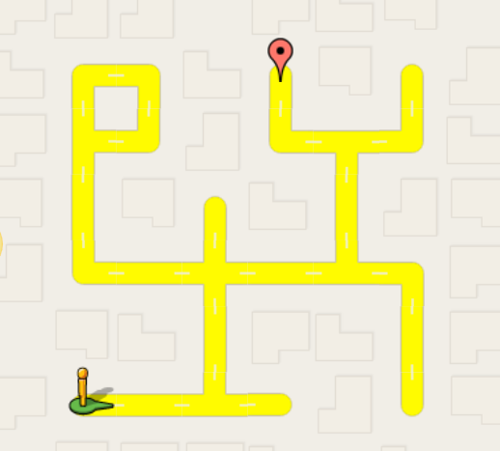
Level 9 :
Level 10 :

Slide 15
Thank You

