Slide 1
Video Swin Transformers
Seminar ADQ 413
Presented By
DON SABU SJC21AD024
Guided By
Ms. RASHMI ANNAMMA GEORGE
Asst. Prof. AD Department
September 27, 2024
Artificial Intelligence and Data Science
01/21

Slide 2
Outline
Introduction
Standard Transformers
Visual Transformers and its Limitations
SWIN Transformers
Architecture of SWIN Transformers
Advantages Over Standard Transformers
Limitations in Temporal Modelling
Video SWIN Transformers
Architecture Overview
Performance and Accuracy Advantages
Conclusion
Artificial Intelligence and Data Science | Seminar ADQ 413
September 27, 2024 | 02/21

Slide 3
Introduction
Evolution from Standard Transformers architecture to Video Swin Transformers.
Transformers are originally designed for natural language processing (NLP) tasks.
To extend the capability of Transformers to adapt to vision, Vision Transformers (ViT) was introduced
To overcome the limitations of ViT such as scalability and efficiency, shifted window based Swin Transformers was introduced.
Video Swin Transformers were developed to address the need to handle videos, extending the Swin architecture to the spatiotemporal domain.
Artificial Intelligence and Data Science | Seminar ADQ 413
September 27, 2024 | 03/21

Slide 4
Standard Transformers [2]
Input Text
Tokenization
Add Positional Embeddings
Encoder
Decoder
Embeddings
Output
Attention
Fig 1. Simple Transformer Architecture
Artificial Intelligence and Data Science | Seminar ADQ 413
September 27, 2024 | 04/21

Slide 5
Vision Transformers [3]
Image
Split into Patches
Patch Flattening and Projection
Encoder
Add Positional Embeddings
Output
Attention
Fig 2. Simple Vision Transformer Architecture
Artificial Intelligence and Data Science | Seminar ADQ 413
September 27, 2024 | 05/21

Slide 6














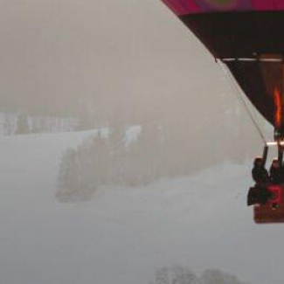
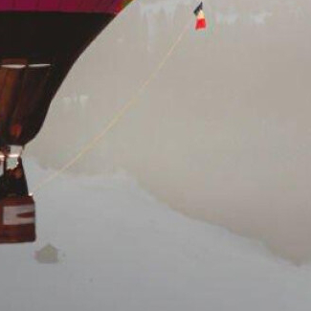
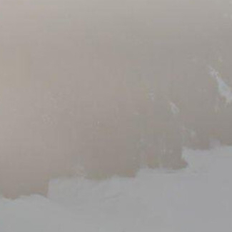
Vision Transformers
Image
Split into Patches
Patch Flattening and Projection
Add Positional Embeddings
Encoder
Attention
1 2 3 4 5 15 16
Transformer
. . . .
Output
Fig 3. Illustration of patches in Vision Transformers
Artificial Intelligence and Data Science | Seminar ADQ 413
September 27, 2024 | 06/21

Slide 7
Limitation of Vision Transformers
High Computational Cost
Fixed Patch Size
Limited Local Context Understanding
Transformer
BALLOON
16x16 Patch
Fig 4. Limitation of Vison Transformers
Artificial Intelligence and Data Science | Seminar ADQ 413
September 27, 2024 | 07/21
1 2 3 4 5 15 16
. . . .

Slide 8

Limitation of Vision Transformers
High Computational Cost
Fixed Patch Size
Limited Local Context Understanding
?
Fig 5. Limitation of Vison Transformers for pixel level identification
HD image (1080p) / 16x16 patches = 4500+ Tokens
Every Pixel as a Token 256x256 image => 65000+ Tokens
Every Pixel as a Token HD image => 2M+ Tokens
Every Pixel as a Token 4K image => 8M+ Tokens
Token Limit of GPT-4
32,768
Artificial Intelligence and Data Science | Seminar ADQ 413
September 27, 2024 | 08/21

Slide 9
Swin Transformers [4]
"Swin" stands for Shifted WINdows.
Shifted Window-based Self-Attention
Hierarchical Feature Representation
Efficient Handling of High-Resolution Images
Uses patches in the same way as ViT.
Starts with smaller patches and merges them in the hidden transformer layers
Artificial Intelligence and Data Science | Seminar ADQ 413
September 27, 2024 | 09/21

Slide 10
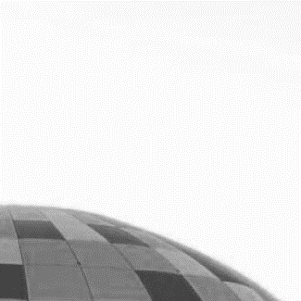
Swin Transformers Architecture
Stage I
Stage II
Stage III
Stage IV
Patch Partition
Linear Embedding
SWIN Transformer Block
Patch Merging
SWIN Transformer Block
Patch Merging
SWIN Transformer Block
Patch Merging
SWIN Transformer Block
H x W x 3
Image
Patch Partition
1 2 3 4 5 15 16
Image
. . . .
4x4 px
Vector Entry for each Patch (c=4)
Fig 6. SWIN Transformer Architecture
4x4x3 = 48
Artificial Intelligence and Data Science | Seminar ADQ 413
September 27, 2024 | 10/21

Slide 11
Swin Transformers Block
1 2 3 4 5 6 7 8 15 16
. . . .
Linear Projection
. . .
Limited Self Attention
Merge Layer
Linear Projection
Fig 7. Working of Swin Transformer Block and shited windows
Artificial Intelligence and Data Science | Seminar ADQ 413
September 27, 2024 | 11/21

Slide 12



Swin Transformers Block
Layer 1
Layer 1+1
A Local Window to Perform Self-Attention
A Patch
Fig 8. An illustration of the shifted window approach
Artificial Intelligence and Data Science | Seminar ADQ 413
September 27, 2024 | 12/21

Slide 13
Advantages of Swin Transformers
Hierarchical Feature Representation
Reduce complexity from n² to m*n
Improved Performance
Better Local and Global Context Modelling
Limitations of Swin Transformers
Lack of Temporal Awareness
No Built-in Mechanism for Sequence Learning
Artificial Intelligence and Data Science | Seminar ADQ 413
September 27, 2024 | 13/21

Slide 14
Video Swin Transformers [1]
Video Swin Transformer is an extension of the Swin Transformer model, designed specifically for handling video data.
It captures spatial and temporal features in videos, making it well-suited for tasks like video classification and action recognition.
Instead of just 2D image patches, Video Swin Transformers operate on 3D patches that include both spatial dimensions (height and width) and the temporal dimension (time).
The shifted window-based self-attention mechanism used in Swin Transformers is extended to 3D, meaning that attention is applied not just within spatial windows but also across adjacent time frames.
Artificial Intelligence and Data Science | Seminar ADQ 413
September 27, 2024 | 14/21

Slide 15
Video Swin Transformers Architecture
Stage I
Stage II
Stage III
Stage IV
Patch Partition
Linear Embedding
SWIN Transformer Block
Patch Merging
SWIN Transformer Block
Patch Merging
SWIN Transformer Block
Patch Merging
SWIN Transformer Block
T x H x W x 3
Video
Modification from Swin Transformers
Fig 9. An illustration of Video Swin Transformer Architecture
Artificial Intelligence and Data Science | Seminar ADQ 413
September 27, 2024 | 15/21

Slide 16

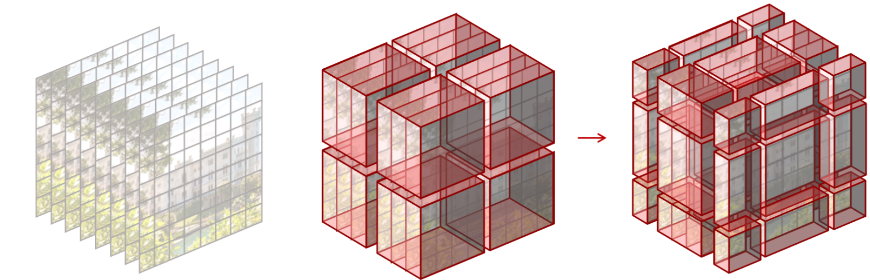
Video Swin Transformers Architecture
Layer 1
2x2x2 = 8
Layer 1+1
3x3x3 = 27
Video Frames as 3D Tokens
3D Local Window to Perform Self-Attention
A Patch
Fig 10. An illustration of 3D shifted window approach
Artificial Intelligence and Data Science | Seminar ADQ 413
September 27, 2024 | 16/21

Slide 17
Advantages of Video Swin Transformers
State-of-the-Art Accuracy on Video Recognition Benchmarks.
Efficient Spatiotemporal Modelling.
Strong Performance in Temporal Modeling
Smaller Model Size and Lower Computational Cost
Improved Local and Global Feature Learning
Artificial Intelligence and Data Science | Seminar ADQ 413
September 27, 2024 | 17/21

Slide 18
Conclusion
Explored the evolution of Transformers from NLP to computer vision.
Introduced Visual Transformers and the need for new approaches.
Swin Transformers are efficient in handling high-resolution images and dense prediction tasks.
Limitations in temporal modelling, leading to the development of Video Swin Transformers.
Video Swin Transformers utilizes 3D shifted window-based attention for spatiotemporal modelling.
It provides a better speed-accuracy trade-off for video tasks.
Artificial Intelligence and Data Science | Seminar ADQ 413
September 27, 2024 | 18/21

Slide 19
References
[1] Ze Liu, Jia Ning, Yue Cao, Yixuan Wei, Zheng Zhang, Stephen Lin, and Han Hu. 2021. Video Swin Transformer. Retrieved from https://arxiv.org/abs/2106.13230
[2] Ashish Vaswani, Noam Shazeer, Niki Parmar, Jakob Uszkoreit, Llion Jones, Aidan N. Gomez, Lukasz Kaiser, and Illia Polosukhin. 2017. Attention Is All You Need. Retrieved from https://arxiv.org/abs/1706.03762
[3] Alexey Dosovitskiy, Lucas Beyer, Alexander Kolesnikov, Dirk Weissenborn, Xiaohua Zhai, Thomas Unterthiner, Mostafa Dehghani, Matthias Minderer, Georg Heigold, Sylvain Gelly, Jakob Uszkoreit, and Neil Houlsby. 2020. An Image is Worth 16x16 Words: Transformers for Image Recognition at Scale. Retrieved from https://arxiv.org/abs/2010.11929
[4] Ze Liu, Yutong Lin, Yue Cao, Han Hu, Yixuan Wei, Zheng Zhang, Stephen Lin, and Baining Guo. 2021. Swin Transformer: Hierarchical Vision Transformer using Shifted Windows. Retrieved from https://arxiv.org/abs/2103.14030
Artificial Intelligence and Data Science | Seminar ADQ 413
September 27, 2024 | 19/21

Slide 20
Questions
Artificial Intelligence and Data Science | Seminar ADQ 413
September 27, 2024 | 20/21

Slide 21
Thank You
Artificial Intelligence and Data Science | Seminar ADQ 413
September 27, 2024 | 21/21

