Slide 1
A four day idea creating exercise. What do you do, like, dislike, what you like that others don’t, what really bugs you, what can’t you live without, and another thing….
Image Sparks
Literacy Routines

Slide 2

Day one - a list. This is your list and no one else’s.
This list we will keep all week. Use a clean BW paper. Name……..Date……..
STEP 1: Think for 30 seconds about 2 things you did yesterday. Write them down.

Slide 3
Step 2
This time think of 2 things that you like that may others do NOT like. Take your 30 seconds and then write them down.

Slide 4
Step 3
This time think of two different conversations you had today. Who were they with and what were they about. Again, you have 30 seconds and write them down.

Slide 5
Step 4
This time you are to think of 2 things that other people do that really bother you - be serious here.

Slide 6
Step 5
This time think of two things you seriously could NOT live without or you would crash out!!
Step 6 - (30 secs) Something U R thinking of right now.

Slide 7
DAY 2
Pick 2 of those 11 things you came up with yesterday. Think of them both for 30 secs.
Yes, again. Write about them for 30 seconds…as many words as you can!!!!

Slide 8
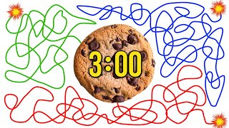
Day 3
Pick one of those 2 things that you wrote about for 30 seconds. Use the one that kept you thinking the most. Now you will free write for 3 minutes. Pretend you are talking to someone about that “thing”. Write that down… for 3 minutes! Don’t worry about spelling or grammar. Don’t worry about sentence structure. Just write your thoughts on the subject.
GO!!

Slide 9

DAY 4
Today you will share what you wrote about for 3 minutes.yesterday. Pick a number between 1 and 3. One will share with TWO. TWO will Share with THREE and THREE will share with ONE! You have 5 minutes to read and write comments. We will come back together for discussion. GO!!

