Slide 1
Say–Mean–Matter
Literacy Routines

Slide 2
Say–Mean–Matter with famous quotations
“Never let the fear of striking out keep you from playing the game.”
Professional baseball player Babe Ruth, who held the homerun record for 34 years
Consider this quote.
We know what Babe Ruth said.
What do his words mean?
Why does this quote matter?

Slide 3
Color-Coded Example
Famous baseball player Babe Ruth states, “Never let the fear of striking out keep you from playing the game.” This quote means that people who aren’t willing to take a risk will never get good at doing something. Knowing this persuades us to not be afraid of failure in our quest to succeed. If everyone tried to avoid failure, there would be no successful people—baseball players or otherwise.
SAY + template to give credit to the source MEAN + template MATTER + template

Slide 4
Famous Quotations for Practice
“None of us is as smart as all of us.”
Ken Blanchard American Author
“Education is the most powerful weapon which you can use to change the world.” Nelson Mandela Activist
“Anyone who stops learning is old, whether at twenty or eighty. Anyone who keeps learning stays young.” Henry Ford Founder of Ford Motor Company
“The important thing is not to stop questioning.” Albert Einstein Physicist

Slide 5
Student Examples
Say-Mean-Matter

Slide 6
SAY What does the text say? Direct quote, paraphrase, or summary | MEAN What does this information mean? Make an inference. Interpret and “read between the lines.” What does the author mean? How can the information be interpreted? What can be inferred? What point is the author making? | MATTER Why does it matter? So what? What are the implications and/or possible outcomes? Why does this information matter? Why is this important or significant? What are the implications or consequences of the information? How does this connect to other ideas?
Here is your quote: Malorie Blackman “Reading is an exercise in empathy; an exercise in walking in someone else’s shoes for a while.”

Slide 7


Here is your quote: Malorie Blackman “Reading is an exercise in empathy; an exercise in walking in someone else’s shoes for a while.” | Write 3 columns and follow along as we look at and analyze her words. | Take 2 minutes to write your response to Literally - then we will discuss Take 2 minutes to write what you think it means - then we will discuss Take 4 minutes to really think about this quote and WHY it is important - to reading, to understanding what you are reading, to the enjoyment of what your are reading.
What is it LITERALLY SAYING: | WHAT DO YOU THINK IT MEANS? | WHY is what she said important in reading?

Slide 8
Now let’s analyze our thoughts.
Turn and Talk - share what you said the quote LITERALLY SAID (30 secs) Did you agree - were your thoughts different? Share with class.
Now Turn & Talk what each thought it meant. (30 sec. )
Did you agree or not. Share with Class
And now - Why does this matter? Turn and Talk - ( 60 secs)
What did each of you think U did you agree with each other? SHARE

Slide 10
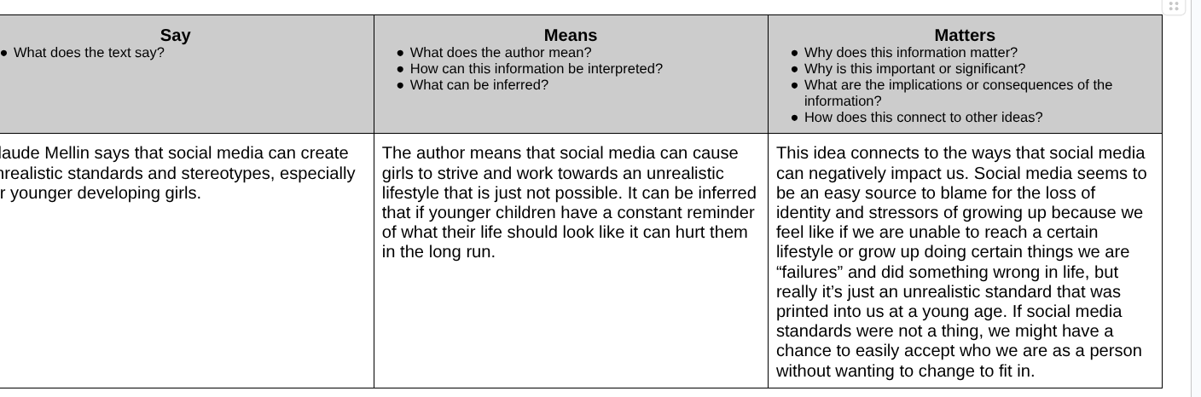
12th grade, self-selected research project

Slide 11
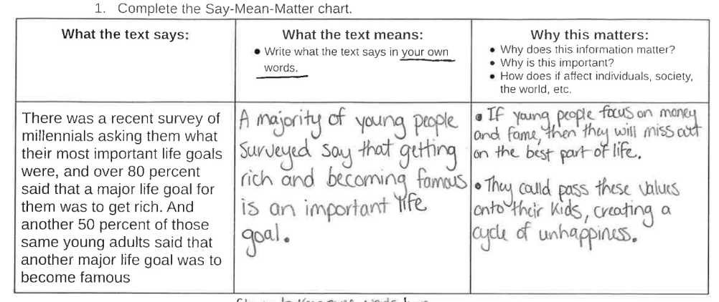
11th grade, teacher-selected quote from an article

Slide 12
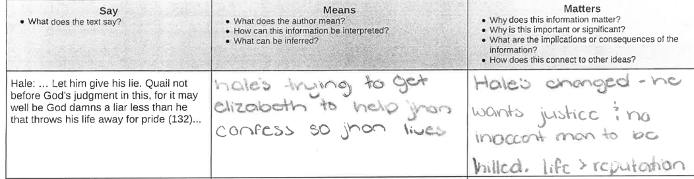
11th grade, response to The Crucible

Slide 13
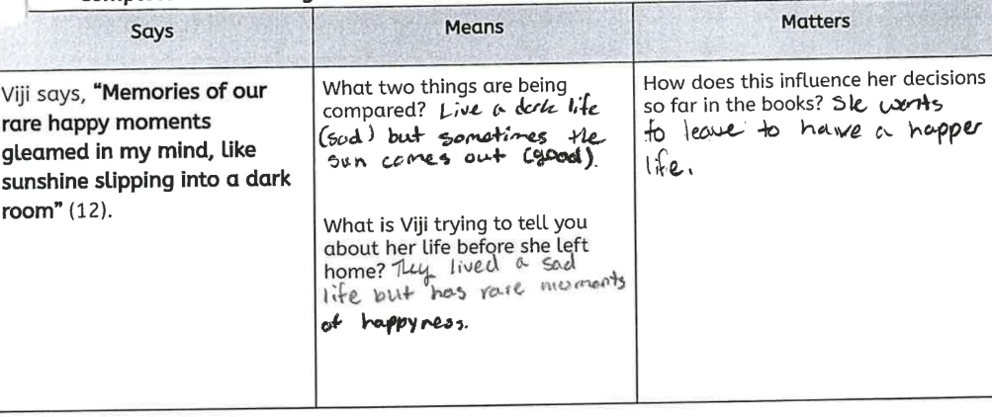
9th grade , reading intervention, with teacher-created prompts for scaffolding

Slide 14
To make a copy of this slideshow,
click here

