Slide 1
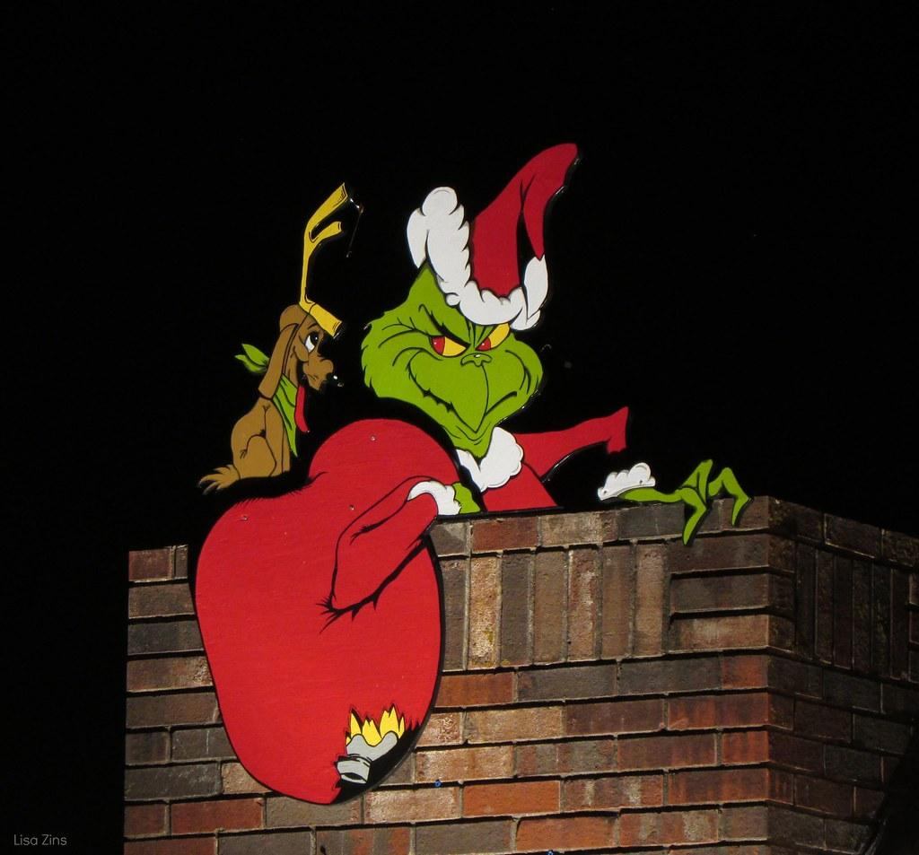
Say-Mean-Matter
How the Grinch Stole Christmas

Slide 2
What is Say-Mean-Matter?
Famous baseball player Babe Ruth states, “Never let the fear of striking out keep you from playing the game.” This quote means that people who aren’t willing to take a risk will never get good at doing something. Knowing this persuades us to not be afraid of failure in our quest to succeed. If everyone tried to avoid failure, there would be no successful people—baseball players or otherwise.
Color-Coded Example:
SAY + template to give credit to the source MEAN + template MATTER + template

Slide 3
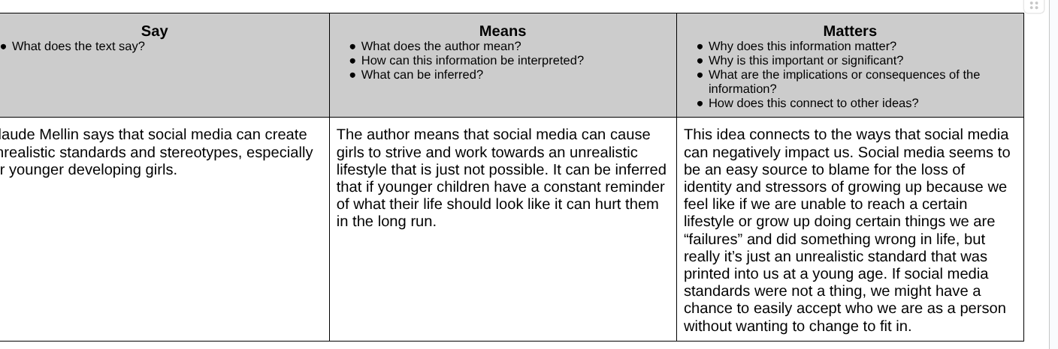
12th grade, self-selected research project

Slide 4
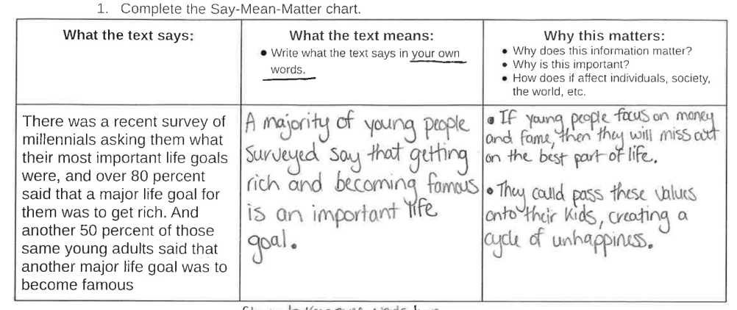
11th grade, teacher-selected quote from an article

Slide 5
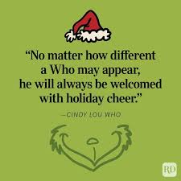
Our Turn!
Say: Cindy Lou Who says “No matter how different a Who may appear, he will always be welcomed with holiday cheer.
Mean: This means that no matter what someone looks like or how different then us they are, they should be treated the same way we want to be treated.
Matter: This matters because people should be treated the same no matter what.

Slide 6

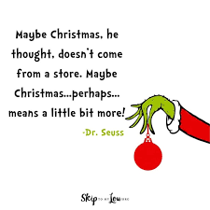
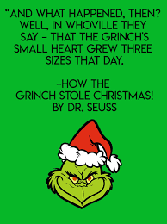
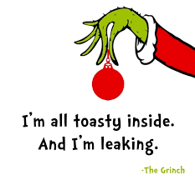
Your Turn! *Pick a quote you like and do your Say-Mean-Matter

