Slide 1

Final Project Presentation
Identifying document topics using the Wikipedia category network
Web Information Retrieval A.A. 2017/2018

Slide 2

The team:
Name: ESA
Members: Luca Carbone
Federico Boarelli
Marco Cuoci
Web Information Retrieval A.A. 2017/2018

Slide 3
The paper:
Name: Identifying document topics using the Wikipedia category network
Goal: Categorize documents from non Wikipedia corpus with the category belonging to the Wikipedia’s articles
Corpora used: entire Wikipedia Corpus (dated 2006, one million articles) and 20 Newsgroups
and RCV1 [10]
Operations implemented: preparation of the Wikipedia corpus following some assumptions (as example, excluding categories with two few (5 <) or to much (> 5000) inside). Confrontation with the other corpora, returning the corresponding Wikipedia’s categories for each document belonging to them.
Web Information Retrieval A.A. 2017/2018

Slide 4
Implementation
Web Information Retrieval A.A. 2017/2018

Slide 5
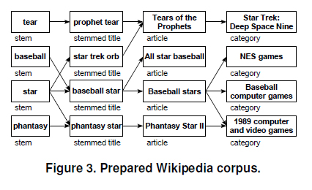


Building the random Wikipedia Corpus
Random Selection Query
with SPARQL
Web Information Retrieval A.A. 2017/2018

Slide 6

20 Newsgroup corpus analysis
While there is a document to analyze:
- Regex, stemming, Vectorization, Tf/idf(category)
Categorization with Wikipedia Corpus
Add computed output to the return result
Then:
Print on file the result
Two experiments over categorization:
Soft categorization
Hard categorization
Web Information Retrieval A.A. 2017/2018

Slide 7
Our experiments:
Idea: replica of the main experiment of the paper using a random subset of the Wikipedia’s Corpus (30k documents, more is too computing expensive) generated using dbpedia. Confrontation with the 20 Newsgroups dataset (around 18k documents)
Goal: we want to demonstrate if the results obtained in the paper with the 20 Newsgroup corpus are still valid with respect the new generated corpus from actual Wikipedia’s one (twelve years newer and ten times bigger).
Relaxing the costraints: Using less articles from Wikipedia we have to relax the costraint over the categories. If we mantain this range, we get just 3166 categories. Removing this limit, we obtain more than 88k categories.
Working strategy: The 20 Newsgroup corpus is exactly the same used in the paper, while we built our Wikipedia corpus following the same steps of the paper. We wil reproduce an equivalent algorithm to the one of the paper to realize the corpora confrontation.
Web Information Retrieval A.A. 2017/2018

Slide 8
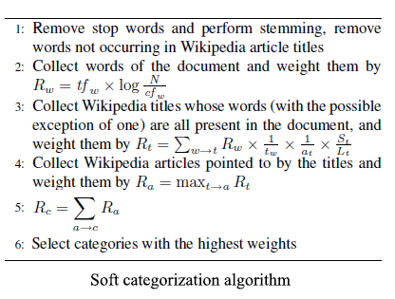
Soft categorization result
No filter on number of articles per category
No optimization of categories weights
The result shows for each document some related categories and some widely diffused categories in the first places.
The result with a random generated Corpus from Wikipedia is reasonably near to result the result obtained with the whole 2006 Wikipedia’s Corpus
Web Information Retrieval A.A. 2017/2018

Slide 9
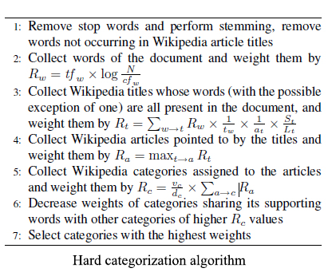
Hard categorization result
Filtering on number of articles per category
Optimization of categories weights
Ambiguity on the Supporting words
The result shows for each document some related categories, reduce the weight of some widely used category but present unrelated categories with good average: this is due to the lack of the whole number of categories contained in the actual Wikipedia corpus (over 10M documents) and to a difficult interpretation over the Supporting word definition
The result with a random generated Corpus from Wikipedia is not reasonably near to result the result obtained with the whole 2006 Wikipedia’s Corpus due to the lack of informations
Web Information Retrieval A.A. 2017/2018

Slide 10
References
- Identifying document topics using the Wikipedia category network by Peter Schonhofen
- Python Library used: scikit-learn, numpy
Web Information Retrieval A.A. 2017/2018

Slide 11
Thank you for your attention!
Web Information Retrieval A.A. 2017/2018

