Slide 1
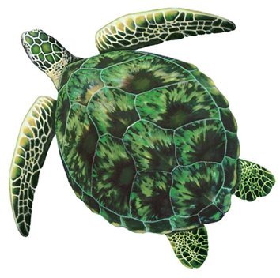
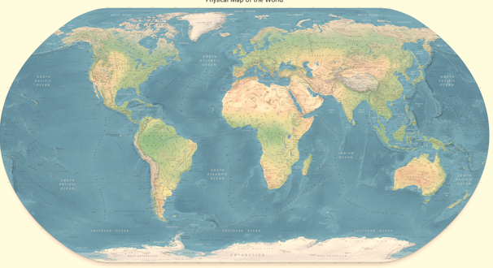
See Turtles
(as in you can see where turtles have traveled)
Select Your Region
(not exact regions, just an example)
Notes:
Not sure about name can think of something better!

Slide 2

Malta Sea Turtles
Select a Topic
Track a turtle/Log in a New Turtle
Current Nesting Sites/New Nesting Site
Injured or Deceased Turtle
Conservation Methods
Graphical Representations of Collected Data
select
select
select
select
select
Back To Select a Region
Notes:
If you were to select Malta for example.

Slide 3
Track a Turtle
Type Units
Record GPS location
Gender if Possible
Age
Tracking Number/Name
See where its Traveled
Type Gender
Type Units
Type Number
select
Back to Select a Topic
Back To Select a Region

Slide 4
Travel
Map showing route or specific regions where tracked
GPS Locations
Distance
Shows Units
Shows Number
Enter New Turtle
Back to Select a Topic
Back To Select a Region

Slide 5
New Sea Turtle
Record GPS location
Gender if Possible
Age
Tracking Number
Species
Type Units
Male / Female
Type Units
Type Number
Type Name
Back to Select a Topic
Back To Select a Region

Slide 6
Malta Sea Turtles
Select a Topic
Track a turtle/Log in a New Turtle
Current Nesting Sites/New Nesting Site
Injured or Deceased Turtle
Conservation Methods
Graphical Representations of Collected Data
select
select
select
select
select
Back To Select a Region

Slide 7
Current Nesting Sites
Number of Sites
Average Nest Temperature
Predicted Genders
Shows Number
Shows Temp
Shows ratio
Create New Site
Click for Individual Nest Information
Back to Select a Topic
Back To Select a Region

Slide 8
Individual Nests
List of Nest Location by GPS Coordinates, Select Nest
1
2
3
35.8978 E, 14.5141 N
36.9373 E, 15.5141 N
34.9976 E, 13.651 N
Back to Select a Topic
Back To Select a Region

Slide 9
35.8978 E, 14.5141 N
Nest Temperature
Expected Genders
Predicted Delivery Date
Date Discovered
Nest Condition
Shows Temp
Shows Gender Number
Shows Date
Shows Date
Provide Description
Create New Site
Back to Select a Topic
Back To Select a Region

Slide 10
Create New Nesting Site
GPS Location
Nest Temperature
Expected Genders
Predicted Delivery Date
Date Discovered
Nest Condition
Type Units
Type Temp
# Male/Females
Type Date
Type Date
Describe
Back to Select a Topic
Back To Select a Region

Slide 11
Malta Sea Turtles
Select a Topic
Track a turtle/Log in a New Turtle
Current Nesting Sites/New Nesting Site
Injured or Deceased Turtle
Conservation Methods
Graphical Representations of Collected Data
select
select
select
select
select
Back To Select a Region

Slide 12
Injured or Deceased Turtles
Number of Injured Turtles This Year
Number of Deceased Turtles This Year
Reasons For Injury or Death
Shows Number
Shows Number
Shows Main Reasons
Click to Report Recent Injury or Death
Back to Select a Topic
Back To Select a Region

Slide 13
Report Injury or Death
Date
Description of Injury
Cause or Suspected Cause
Age
Species
Gender
Tagged or Untagged
Type Date Found
Type Description
Type Cause
Type Number
Type Species
Type Gender
Type Yes/No & #
Back to Select a Topic
Back To Select a Region

Slide 14
Malta Sea Turtles
Select a Topic
Track a turtle/Log in a New Turtle
Current Nesting Sites/New Nesting Site
Injured or Deceased Turtle
Conservation Methods
Graphical Representations of Collected Data
select
select
select
select
select
Back To Select a Region

Slide 15
Conservation Methods
Select a Method for More Information
International Agreements
State and Local Regulations
National Laws
Education
Back to Select a Topic
Back To Select a Region
Notes:
http://www.conserveturtles.org/trackingmap.php?id=22
After you select a method we will have a page description for each

Slide 16
National Laws
Background information
Examples of already implemented laws
How it can help
Information Displayed Here
State and Local Regulations
Information Displayed Here
Education
International Agreements
Information Displayed Here
Back to Select a Topic
Back To Select a Region

Slide 17
International Agreements
Background Information
Examples of already implemented agreements
How it can help
Information Displayed Here
State and Local Regulations
Education
Information Displayed Here
National Laws
Information Displayed Here
Back to Select a Topic
Back To Select a Region

Slide 18
State and Local Agreements
Background information
Examples of already implemented state and local agreements
How it can help
Information Displayed Here
Information Displayed Here
International Agreements
National Laws
Information Displayed Here
Education
Back to Select a Topic
Back To Select a Region

Slide 19
Education
Impacts of Education
Already implemented educational programs
How it can help
Information Displayed Here
Information Displayed Here
Information Displayed Here
Back to Select a Topic
Back To Select a Region

Slide 20
Malta Sea Turtles
Select a Topic
Track a turtle/Log in a New Turtle
Current Nesting Sites/New Nesting Site
Injured or Deceased Turtle
Conservation Methods
Graphical Representations of Collected Data
select
select
select
select
select
Back To Select a Region

Slide 21
Graphical Representation of Data
We will show graphs/charts analyzing turtle data
Deaths/injuries
Male to female ratios
Number of nests and locations
Back to Select a Topic
Back To Select a Region

