Slide 1
Implementing Data Marts in the Work Force
Jeffrey Donahue
CS779

Slide 2
Outline
Describe my company’s systems and current issues
Project Data Mart
Key Business Questions and Schema Design
ETL Process
Results
Customer Data Mart
Schema and ETL
Security Features

Slide 3
My Company And Myself
I work at a small government consulting company focused on transportation
We have about 300 employee, all of which will consumer these Data Marts
We use Cognos as a reporting studio
My main role is to build reports using Cognos, but we have no official Database Administrator, so I take responsibilities for that.

Slide 4

Our Systems
CRM DATABASE
Timesheet DATABASE
Accounting DATABASE
*CSV File access only

Slide 5
Project Data Mart
The current Project Data Mart was built before my time to support a Project Details Report from our Cognos Studio (a 9-tabbed excel file)
This report has gotten laborious to run, taking upwards of 6 minutes
I was assigned to speed up the report.
My goal is to get it to run in under 30 seconds.
I should be able to create a email job that can send out many of this reports as attachments in under 30 minutes.

Slide 6
Key Business Questions
Each tab of the Project Detail report addresses a new key business question
We need to be able to store information about employee hours and costs, expense cost, subcontractor costs, revenue and billing information
The way I handled this was to try to handle each tab as the sole business need and design a schema for that tab, then combine it all together in the most efficient way

Slide 7
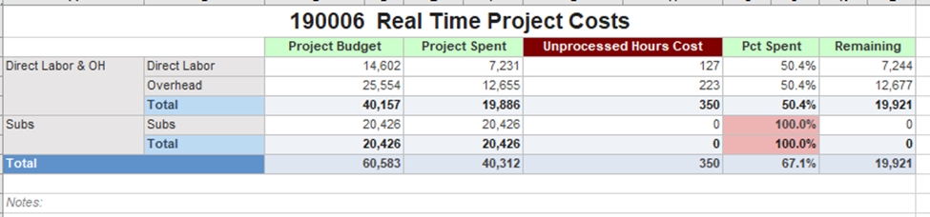
The First Tab: Summary

Slide 8
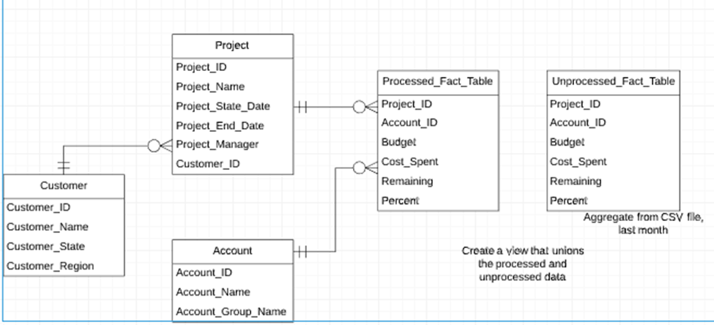

Slide 9
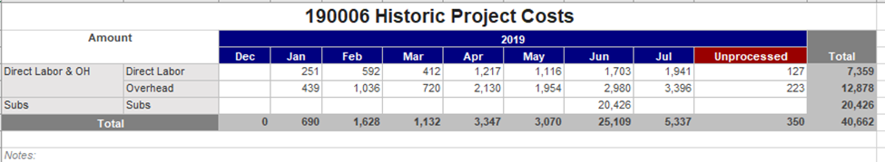
Historic Costs

Slide 10
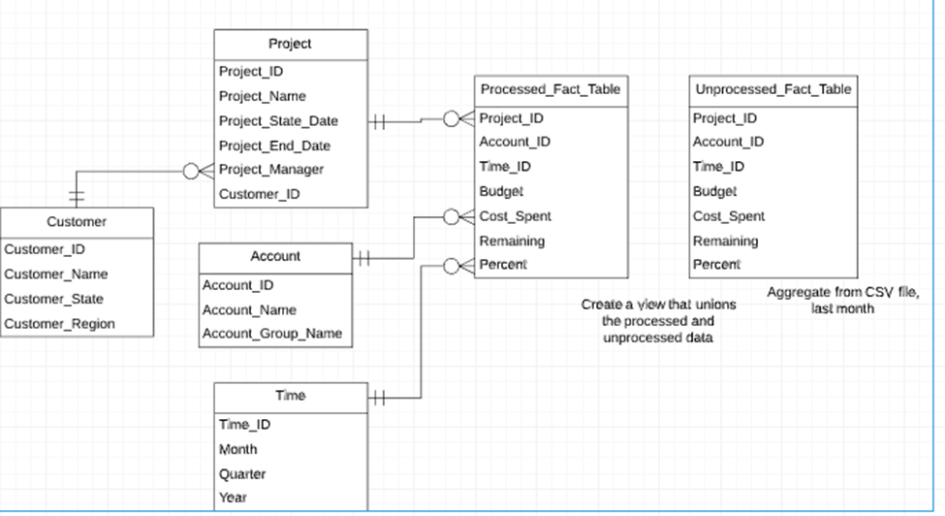

Slide 11
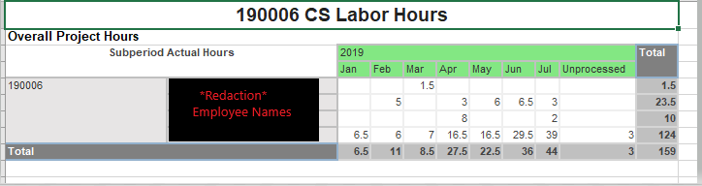
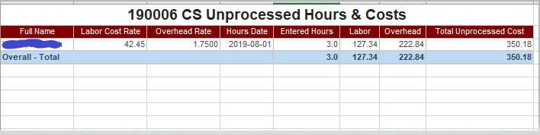
Employee Hours (Tabs 3 and 4)

Slide 12
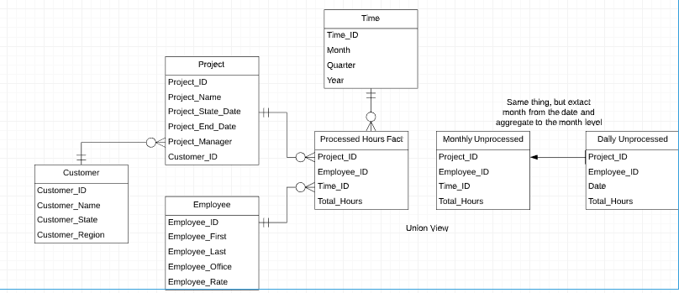

Slide 13
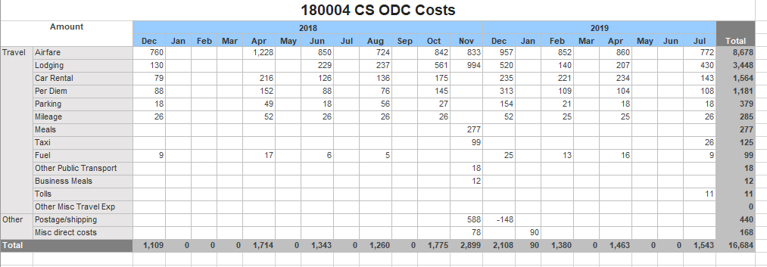
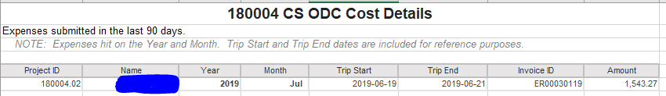
Expenses (Tabs 5 and 6)

Slide 14
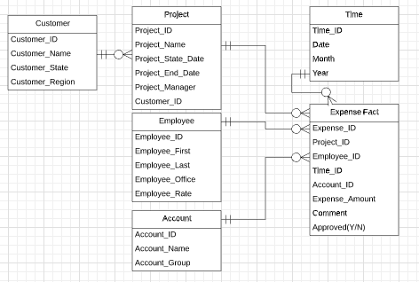

Slide 15
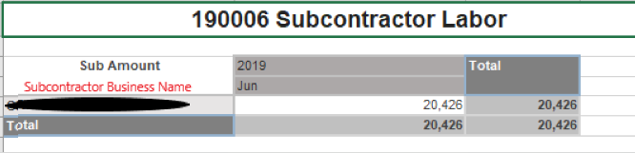
Subcontactors

Slide 16
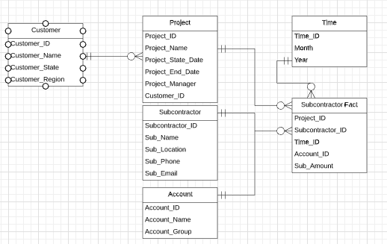

Slide 17
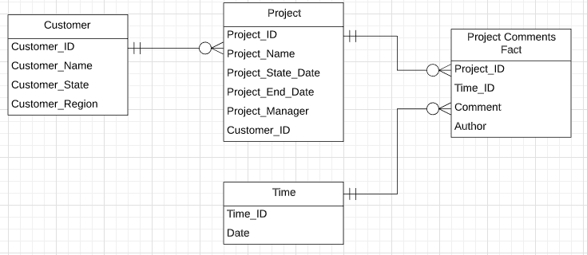
Customer Notes

Slide 18
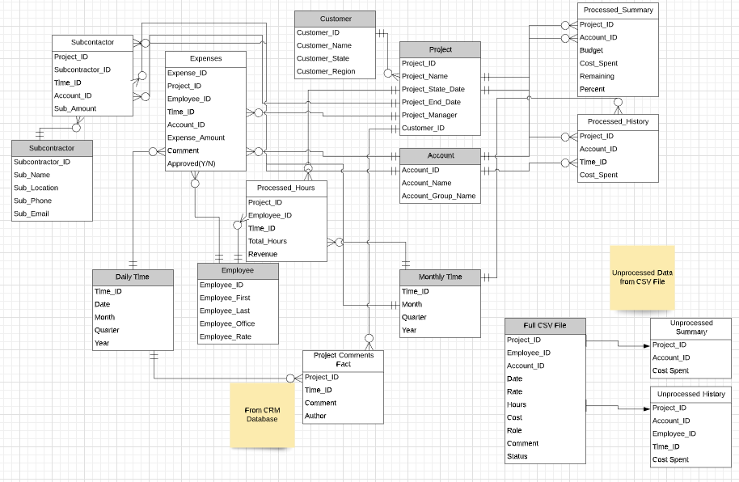
The Entire Schema

Slide 19
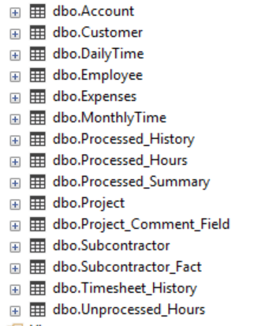
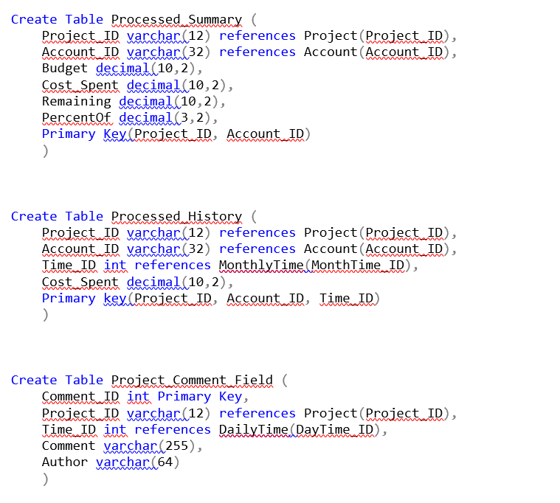
Creating the Tables

Slide 20
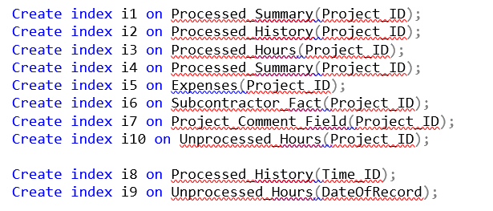
Choosing Indexes
Select common filtered columns on large tables.
Project IDs on all the fact tables
Time_ID on Processed_History
Date of record for timesheet data

Slide 21

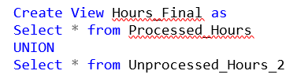
Views
Create Views to prepare the unprocessed timesheet data for union
Create views to union the processed and unprocessed data.

Slide 22

ETL
Extraction Performed by Congos. Will write CSV files to the shared drive.
The CSV files will be in the exact format needed since Cognos can handle this, thus transformation is not needed
Loading the data will be assisted by Visual Studio and the SQL Server Agent

Slide 23
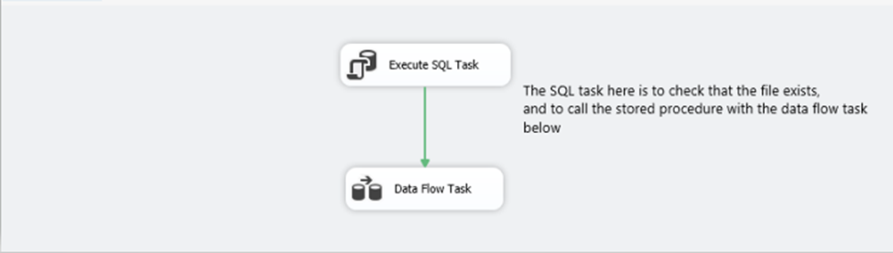
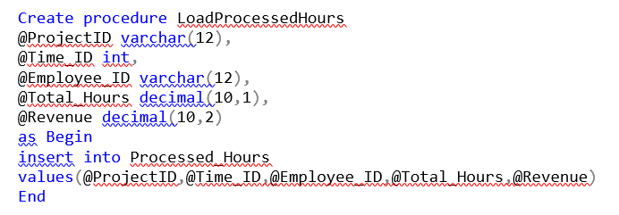
ETL
Cognos Extraction
Visual Studio Job

Slide 24
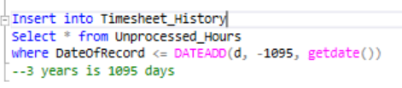
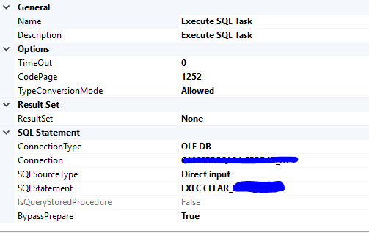
Additional Step for Wipe and Replace of Timesheet
Add Data to History Table
Clear existing table to prepare for new file

Slide 25
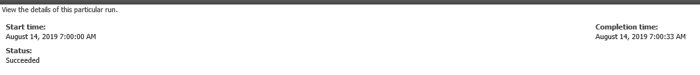
Results
Before:
After:
Went from 6+ minutes to 33 seconds. A 91% reduction of time.

Slide 26
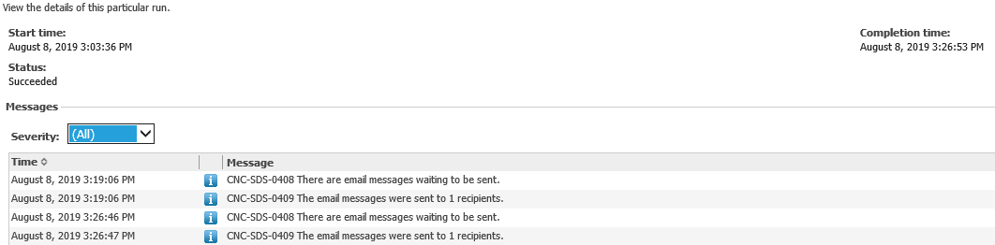
Testing the Email Task
I scheduled 30 projects to run this report and send an email. Prior to this update, I though this task would take 2-3 hours, but with the new Data Mart it only took 23 minutes. Less than a minute per project.

Slide 27
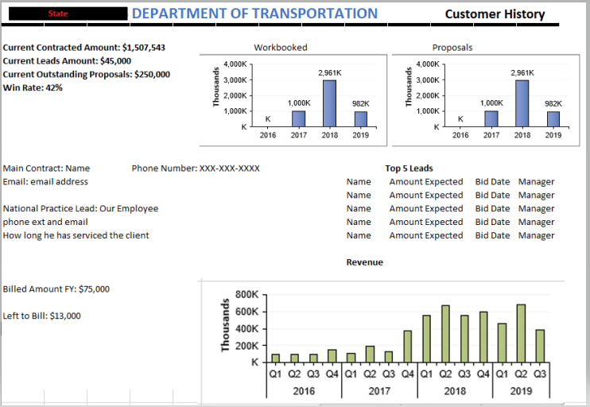
The Customer Data Mart
This data mart is to support a one pager that can be brought to sales meetings. There is no current way to gather this information. Mockup:

Slide 28
Key Business Questions
needs the current contracted, lead, outstanding proposal amounts, as well as the win rate, all on a total aggregated level for the current fiscal year
to show workbooked, proposal and revenue amounts on a yearly basis
Top 5 leads for the client
Dimensions: Customer, Employee and Time
Fact Tables: Summary, Annual, Top 5 Leads

Slide 29

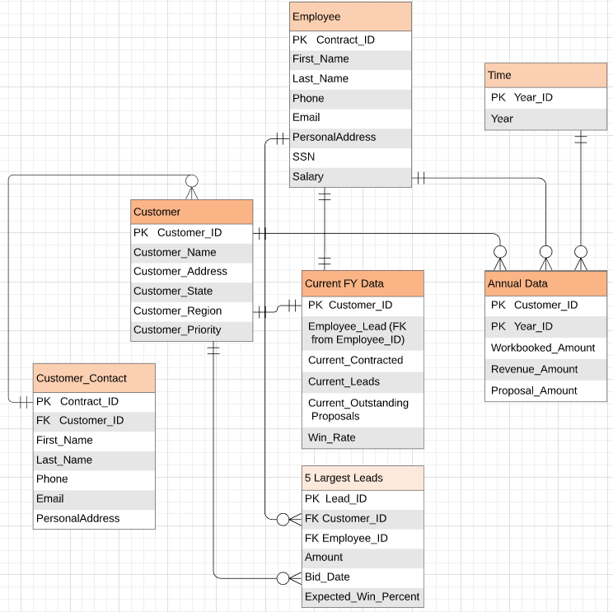
Schema

Slide 30
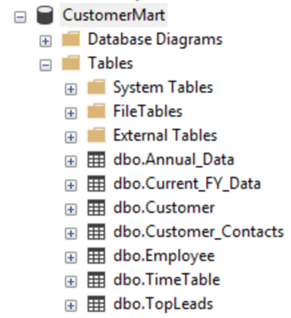
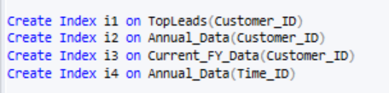
Creating the Tables and ETL

Slide 31
Security Needs
Level 1 security: Semi-Sensitive data. Addresses, phone numbers, emails.
Data Masking
Level 2 security: SSN and salary information
Encryption

Slide 32
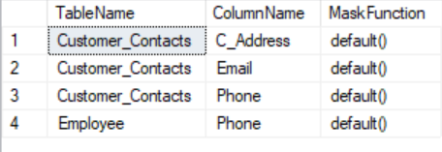
Data Masking
How to mask
What columns I selected to mask
The only accounts who will have access to the above information are admin accounts and users
that I specify.

Slide 33
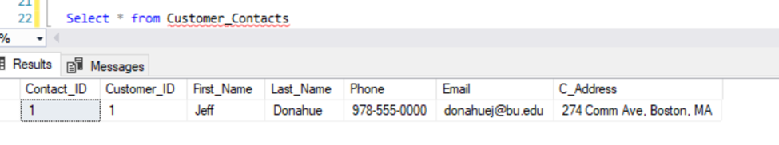
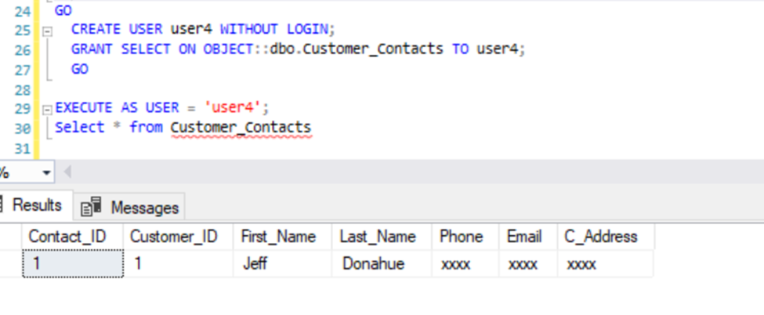
Results
From my admin account:
Created a local user to visualize what other users will see:

Slide 34

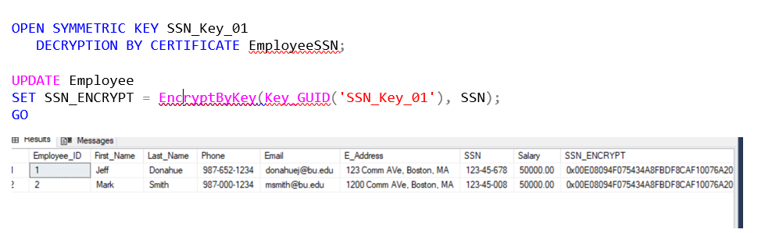
Encryption
I encrypted our employee SSN and salary amount.
First, Created a symmetric key
Opened the key and created a new column to store the encrypted key

Slide 35
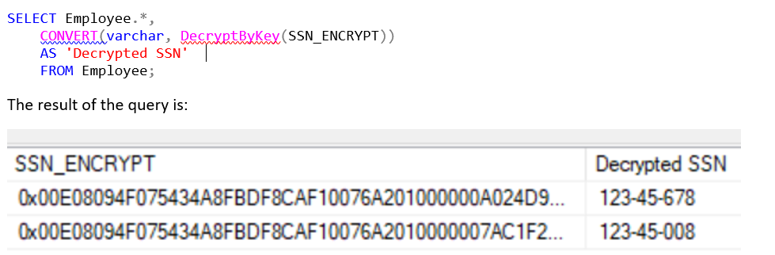
Encryption Results
After the encrypted columns were created, I dropped the plain text columns.
Only way to decrypt the columns is by using the same key

Slide 36
Conclusion
Creating the Project and Customer Data Marts allowed me to explore advanced data warehousing and security techniques
This allowed me to get the conversion started of creating a full encompassing data warehouse at my company
Greatly improved the reporting capabilities

Slide 37
References
(n.d.). Retrieved from https://social.msdn.microsoft.com/Forums/sqlserver/en-US/b88c6ca1-9d24-4af3-9de7-1b06c33d0881/table-level-security?forum=sqlsecurity
Aliceku. (n.d.). Encrypt a Column of Data - SQL Server. Retrieved from https://docs.microsoft.com/en-us/sql/relational-databases/security/encryption/encrypt-a-column-of-data?view=sql-server-2017
CarlRabeler. (n.d.). CREATE COLUMNSTORE INDEX (Transact-SQL) - SQL Server. Retrieved August 10, 2019, from https://docs.microsoft.com/en-us/sql/t-sql/statements/create-columnstore-index-transact-sql?view=sql-server-2017
London training centre. (n.d.). Retrieved August 12, 2019, from https://www.wiseowl.co.uk/blog/s231/schedule_data_import_in_sql_server_pt1.htm
MashaMSFT. (n.d.). Import data from Excel to SQL - SQL Server. Retrieved August 12, 2019, from https://docs.microsoft.com/en-us/sql/relational-databases/import-export/import-data-from-excel-to-sql?view=sql-server-2017
What is columnar database? - Definition from WhatIs.com. (n.d.). Retrieved August 10, 2019, from https://searchdatamanagement.techtarget.com/definition/columnar-database
Sheldon, R. (2017, August 11). Encrypting SQL Server: Dynamic Data Masking. Retrieved from https://www.red-gate.com/simple-talk/sql/sql-development/encrypting-sql-server-dynamic-data-masking/

