Slide 1

Chapter 8
Assumption to date:
predictor has an independent association with the mean of the outcome
The ways in which multiple variables interact with one another to produce conditional outcomes
Notes:
He interchanging interaction and conditioning
The influence of some predictor variables conditional on other predictors

Slide 2

Conditioning means something is dependent on the state of the system
Data are conditional on how they get into our samples
Posterior distributions are conditional on the data
Model-based inference is conditional on the model
”Every inference is conditional on something, whether we notice or not”

Slide 3
Hypothetical Example:
Influence of sugar in coffee depends on stirring
Don’t stir = no influence of sugar
Stir = sweetness effect
So there’s an interaction between sugar and stirring on sweetness….
In other words, sweetness is conditioned on sugar and stirring
Sugar
Coffee Sweetness
Stirred
=
Collider
Notes:
Hypothetical example

Slide 4
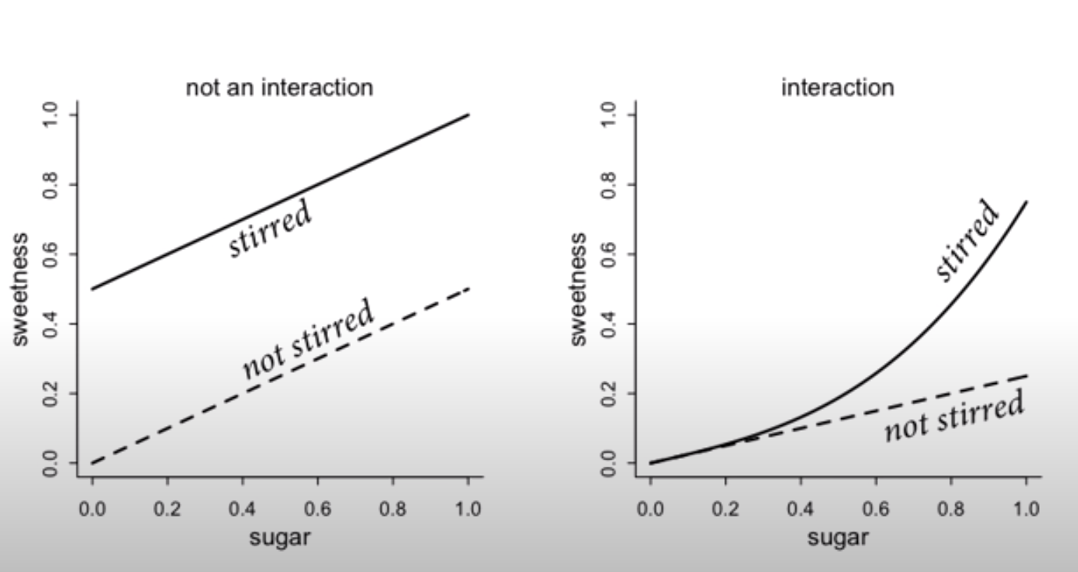
Independently modeled
Modeled as Interaction
Sweetness ~ sugar + stirring
Sweetness ~ sugar ∗ stirring
Sugar
Coffee Sweetness
Stirred

Slide 5
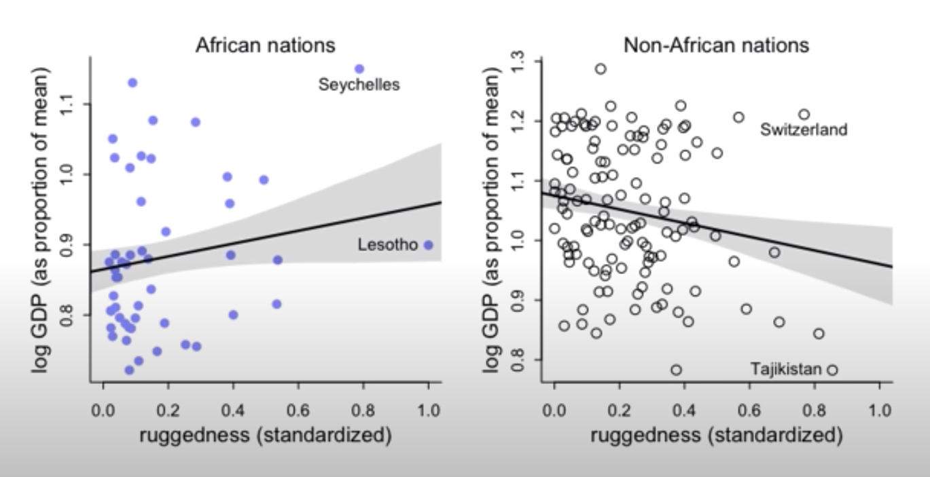
Data Example:
What is the association between economic performance (log GDP) and terrain ruggedness?
GDP ~ ruggedness
Separate linear regression by African vs Non-African nations
Splitting is cheating because have no statistical criterion on which to evaluate the split…
* Want to measure the contrast in slope between African and NonAfrican countries so need to estimate both lines in same
model and this is what interaction effects lets us do….let the model split the data not us….
Notes:
Ruggedness is associated with poorer countries for equates to more challenging transfort of goods so market access is hampered so reduced GDP
But ruggedness is correlated with other geographic features
Splitting is cheating because have no statistical criterion on which to evaluate the split

Slide 6
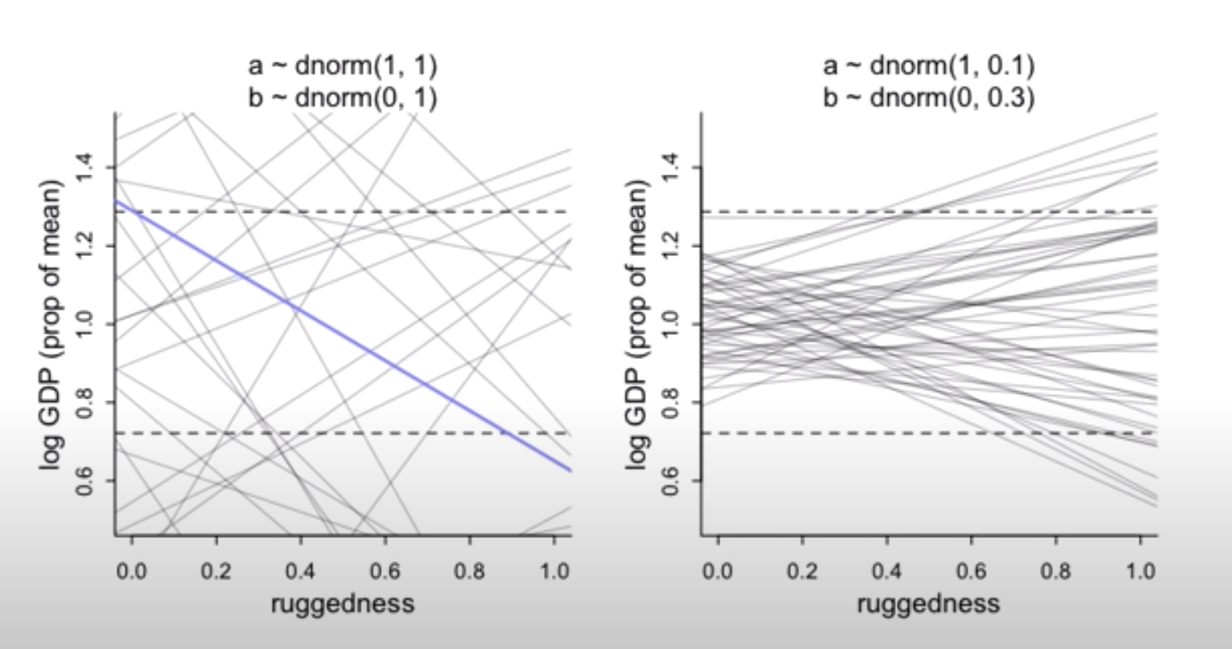
Combined all data….
Fit a single model to all data, ignoring continent to let us think through model structure and priors pre-interaction
Need to constrain priors to the possible outcome space….
GDP ~ ruggedness
Standardize:
Log proportion of mean so 1.0 GDP = average
Ruggedness = scaled 0-1
Log(y_{i}) ~ Normal(𝝻_{i}, 𝞂)
Intercept prior:
centered on one because average GDP
STD guesstimate of 1
𝜶 ~ Normal(1,1)
Ruggedness Slope prior:
centered on 0 to let data tell us whether + or - effect
STD guesstimate of 1
- - - - : Whole World’s GDP
𝜷 ~ Normal(0,1)
Notes:
Ruggedness is divided by the maximum value observed to maintain the meaningfulness of zero ruggedness
Log GDP = proportion of average so 1.5 is 50% more and .5 is half of the average country

Slide 7
Priors need to be tighter to be realistic

Slide 8
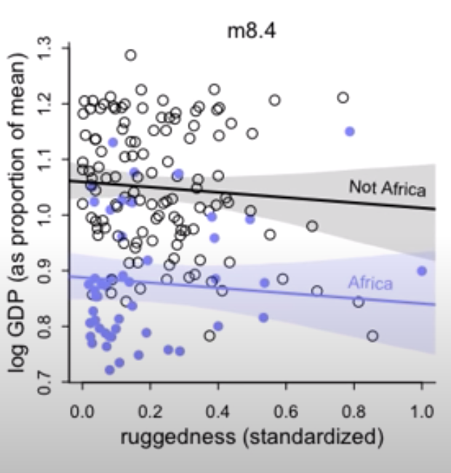
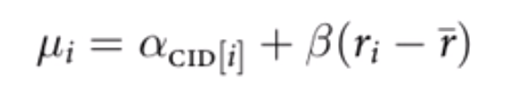
Index variable for continent?
Africa = 1
Other = 2
Can assign the same prior to both continents
This model forces the relationship between terrain ruggedness and continent to be the same
Need to allow effect of ruggedness depend upon continent
Slopes are the same but intercepts are different

Slide 9
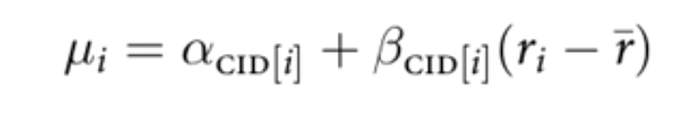
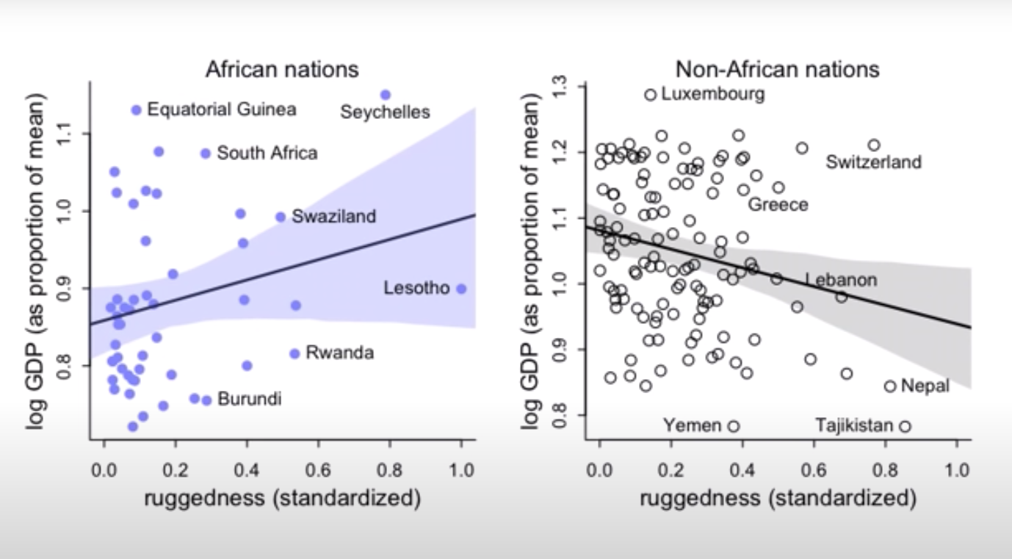
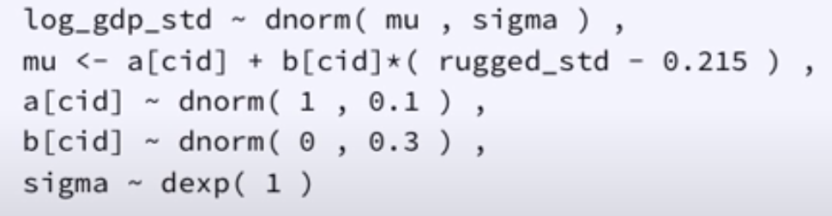
Interaction
By adding index variable to the slope, now have a different slope for every continent
So now, the ruggedness slope is conditional on continent
Notes:
Mean ruggedness = 0.215

Slide 10
Look the same but now have statistical support!
Independent Regressions
Combined Data with Interaction
Notes:
Intercept difference = average GDP is lower in Africa
At mean ruggedness, the average African country has 90% of the average GDP

Slide 11
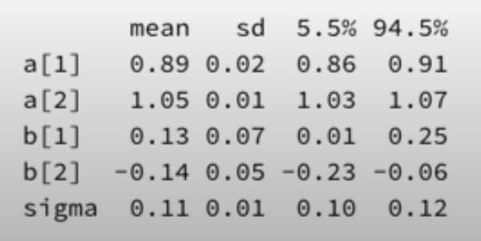
What is the association between economic performance (log GDP) and terrain ruggedness?
1 = Africa 2 = Other
At mean ruggedness, the average African country has 90% of the average GDP
How does GDP change as you move away from avg ruggedness?
Positive for African Countries
Negative for everywhere else
But slope is less certain in Africa most likely because of fewer countries
Notes:
Intercept difference = average GDP is lower in Africa
At mean ruggedness, the average African country has 90% of the average GDP

Slide 12
Take Home:
When you have an interaction, the change in one of the predictors depends on more than one parameter

