Slide 1


E6156 – Mailing Overview
Donald F. Ferguson, dff@cs.columbia.edu
25-Oct-2018
© Donald F. Ferguson, 2018.

Slide 2
Overview
Introduction
  Project discussions; Problem discussion.
  My Elastic Beanstalk configuration.
Overall architecture reminder.
  CloudFront, S3, API Gateway.
  Beanstalk, Lambda, SNS, functions.
Security
  Target architecture.
  Token propagation.
  Run-As Identity.
Simple Notification Service
  Reminder.
  Code/Demo.
Email Verification

Slide 3

http://www.slideshare.net/peacefrg/mailchimp-introduction?from_action=save
Introduction to Mailchimp
Notes:
Shared Knowledge 540.303.2410
Introduction to Mailchimp

Slide 4
What is Mailchimp?
Quote:
  MailChimp helps you design email newsletters, share them on social networks, and track your results. It's like your own personal publishing platform.
What I Say:
  MailChimp is an email sending and marketing platform,
  That has an easy to use web interface,
  AND SPAM Control services help you stay white-listed.

Slide 5
Main Features
Social Network Integration
Templates
A/B Split Testing
Google Analytics
Inbox Inspector
Auto Responders
Groups / Segments
Automated Blast, Drip, and Nurture Campaigns

Slide 6
Potential Uses
Blast Campaign
    Newsletter
    Upcoming specials/sales/events
Drip Campaign
    One email occasionally with a specific purpose
Nurture Campaign
    Develop a relationship or trust with recipients
Education
    How to best use your services
    How to use one of your products
  Squeeze Pages

Slide 7
Overview
Create a template
  These can be re-used, copied, modified later
Create a campaign
  Basically create your message
  Inserted into template
Send or Schedule
  Send immediately
  Schedule a specific time

Slide 8
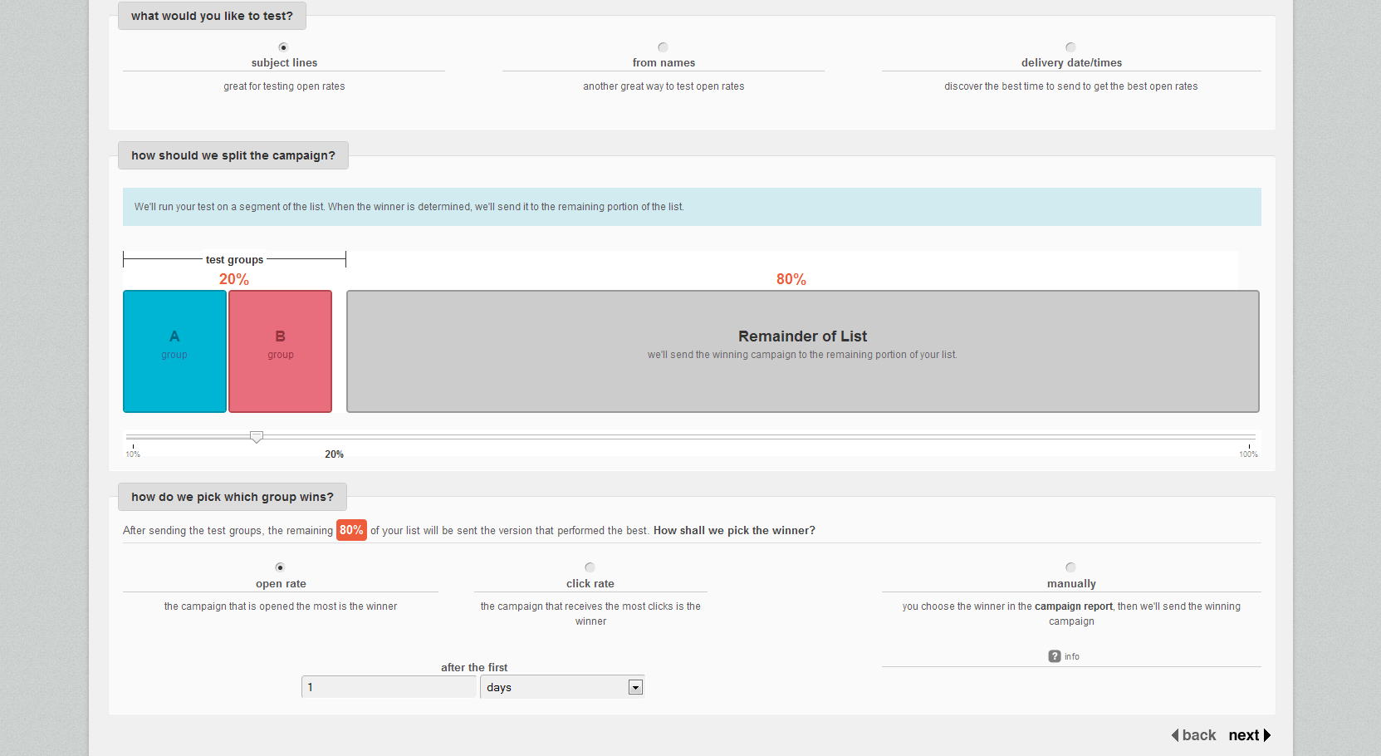
a/b Testing

Slide 9
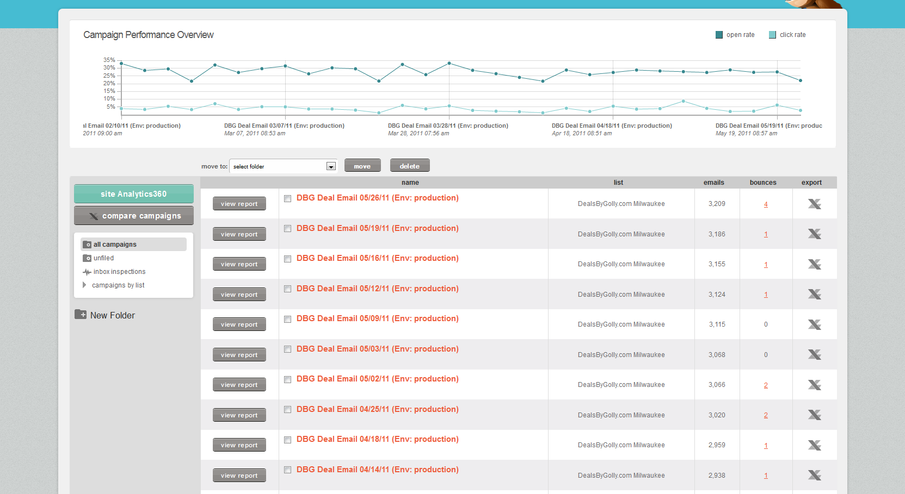
Reports

Slide 10
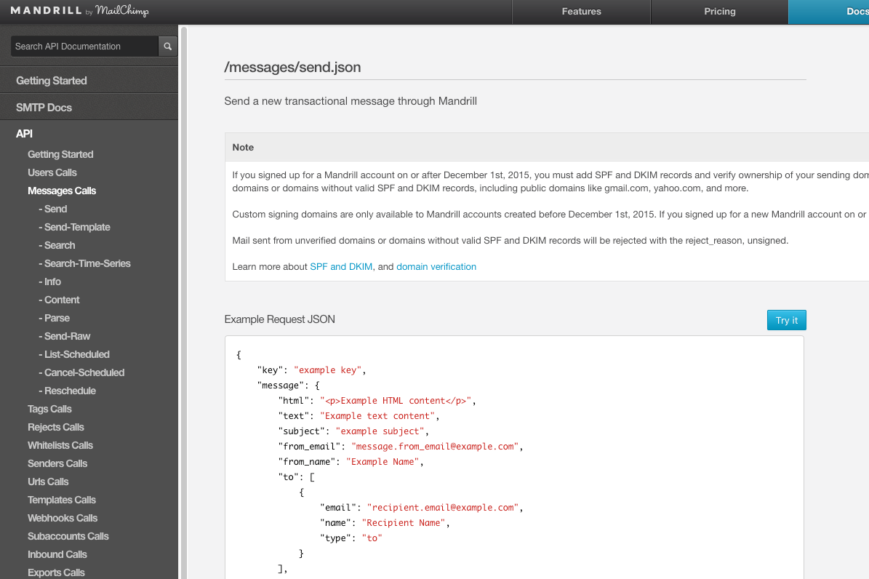
MailChimp/Mandrill API

Slide 11
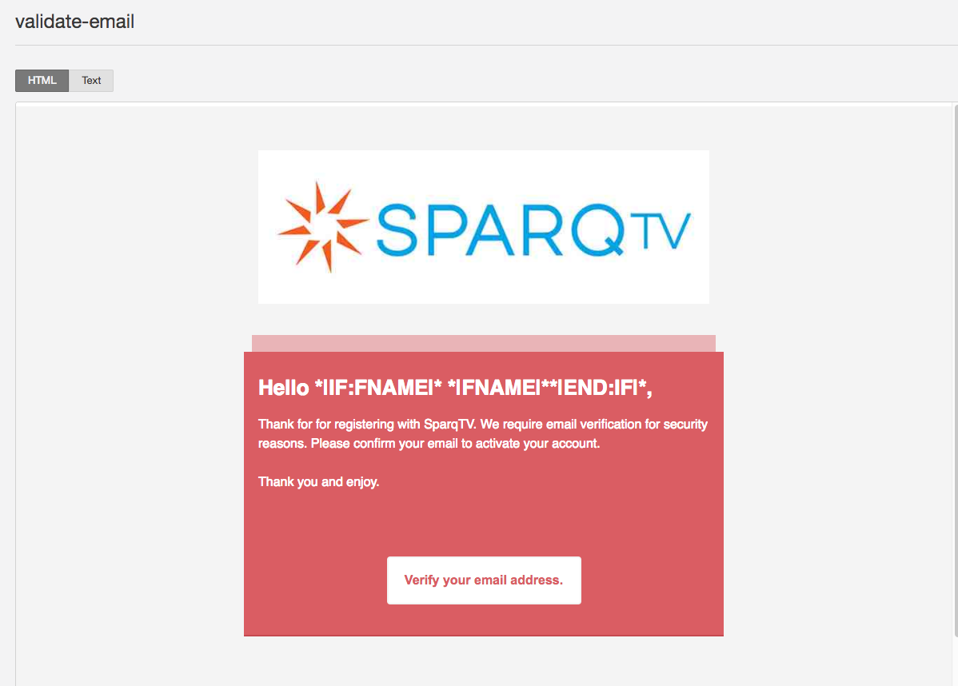
Template and Variables

Slide 12
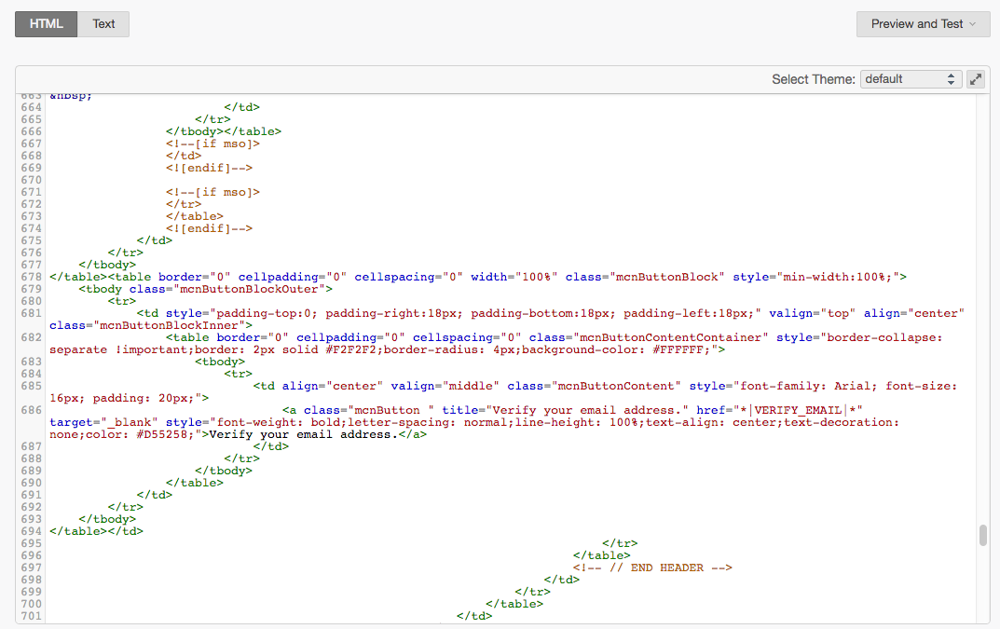
Templates and Variables

Slide 13
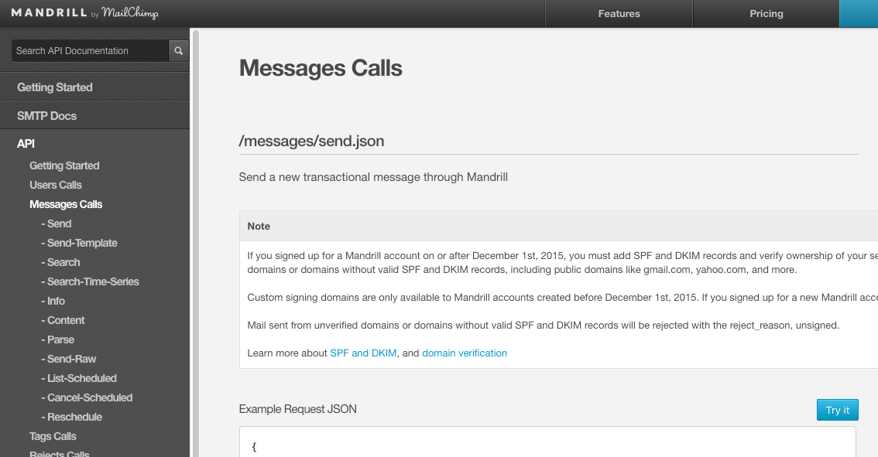
MailChimp/Mandrill Send API

Slide 14
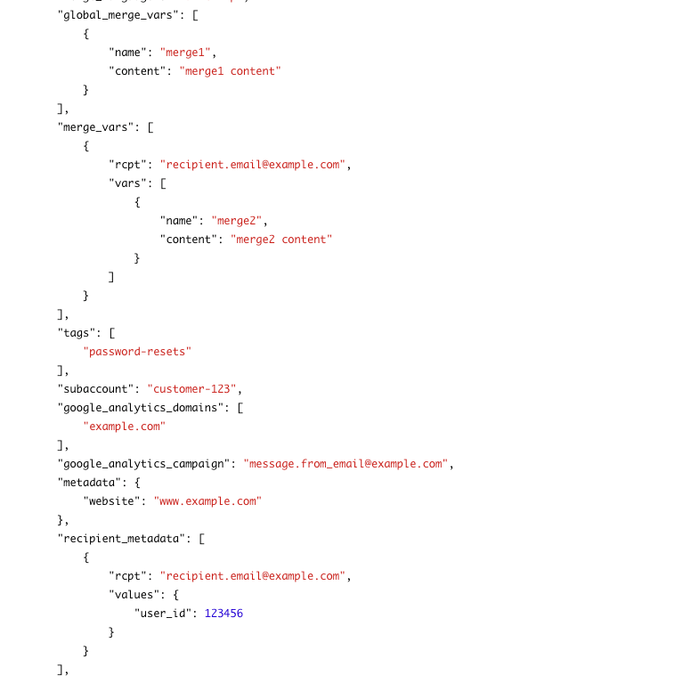
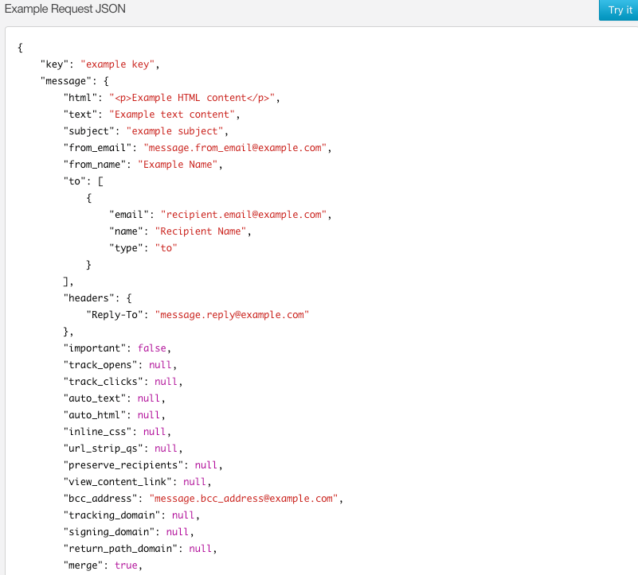
MailChimp/Mandrill Send API

Slide 15
Summary and Implications
as-a-Service (and all) applications
  Interact with users through many channels
    HTTP/browsing
    Email
    SMS/notification
    Chat
    …
  This includes sending messages and triggering application logic on incoming events.
Maintaining all of the necessary servers and software (SMTP, Exchange, …) is burdensome
Even when a company maintains its own infrastructure, it uses cloud services for value added functions. For example for MailChimp
  Templates
  Workflows and merges
  Reporting
  Scheduling
  ...

