Slide 1
W4153 – Cloud Computing Lecture 4: REST (Cont.), Composition, Web Content, DBaaS
© Donald F. Ferguson, 2024

Slide 2
Contents

Slide 3
Contents
Course updates
Next sprint.
Container-as-a-Service (reminder, review)
REST continued
Resources, URLs and parameters.
Querying/filtering, pagination, … …
Linked data
Service composition
Concepts
Orchestration
Choreography

Slide 4
Course Updates

Slide 5
Course Updates
I am finally over Covid and will be more active in engaging again.
We will publish submission instructions for the first team sprint early this weekend. The submission format will be:
A presentation describing what you accomplished.
A document, with links, providing more details on what you accomplished.
We will cover some concepts required for the next sprint in this lecture and the next. You can get started after today.

Slide 6
Next Sprint

Slide 7
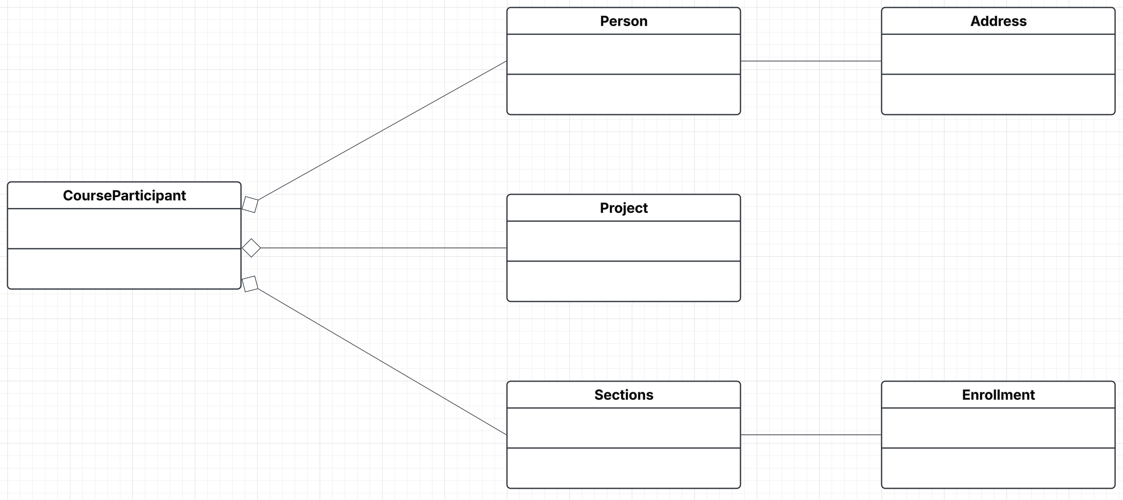
Sprint 2 Initial Resource Model
CourseParticipants “pulls/composes” the basic resources into a composite.
CourseParticipant implements some application logic on the composite, and also delegates onto the more basic microservices.
Exactly what your composite does is up to you and your business problem. You need to demonstrate on synch orchestration and one asynch orchestration.

Slide 8
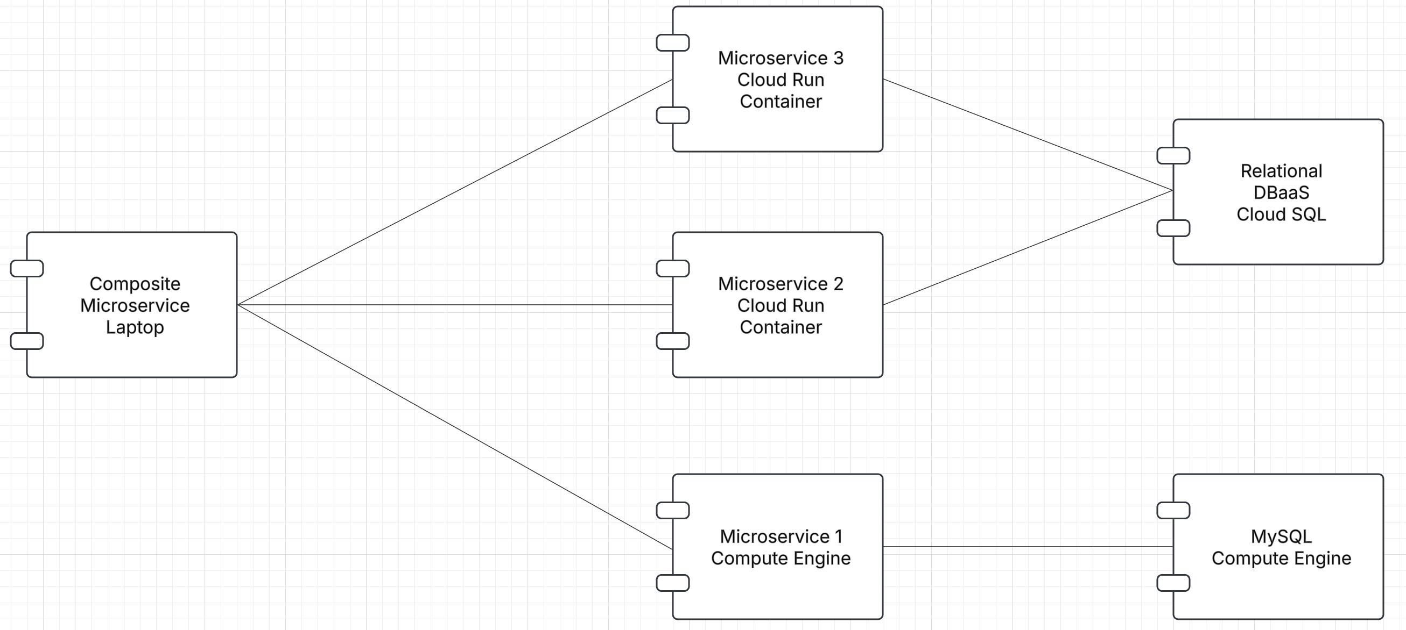
Sprint 2 Topology

Slide 9

CaaS
9 | W4153-24F-L3-Rest(2)-Microservices(2)-CaaS-web_content-DB © Donald F. Ferguson, 2024

Slide 10
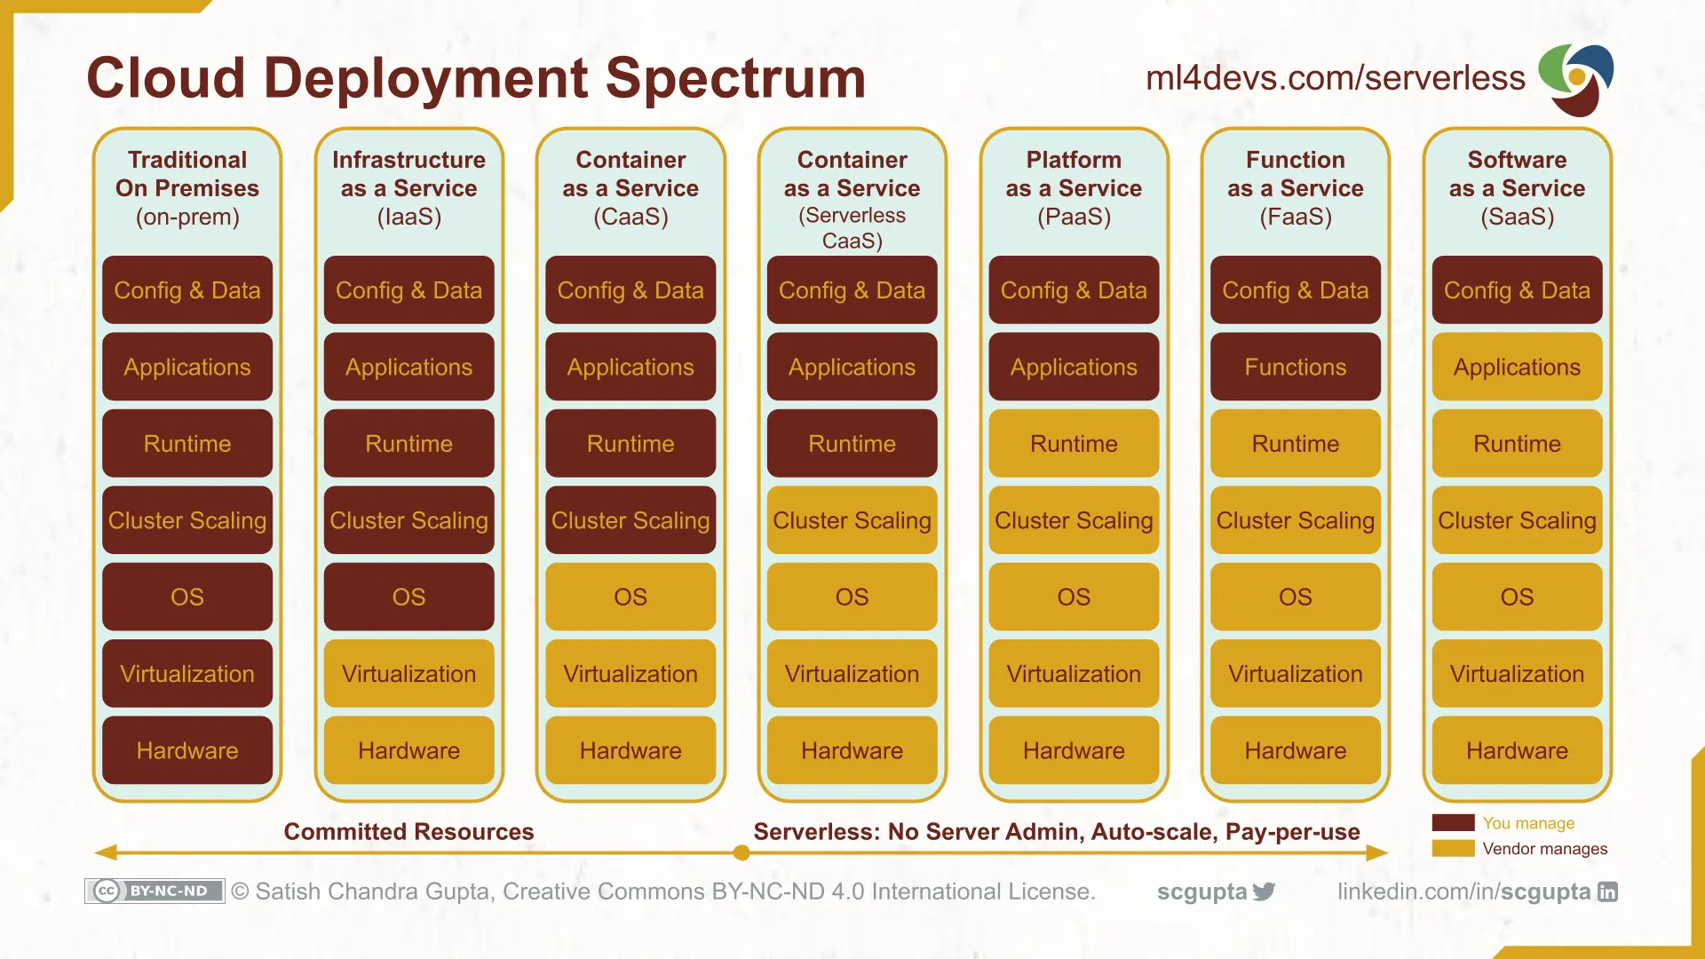
Cloud Layers

Slide 11
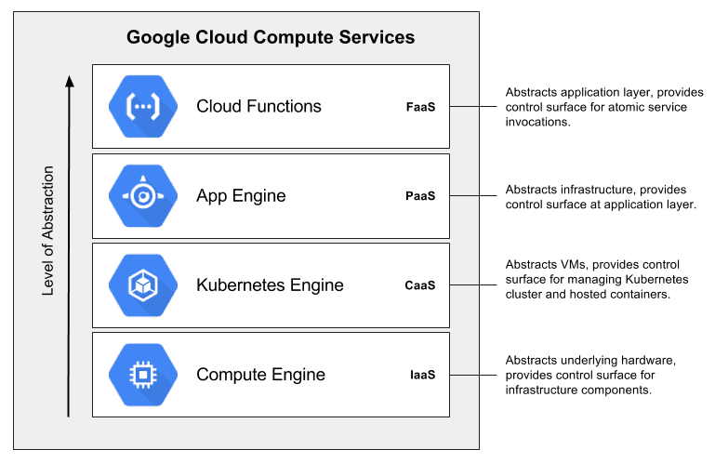
Cloud Layers
To understand the concepts, we will “work our way up the stack.”
This will help us understand the complexity, pros and cons.
This means we start with Google Cloud Platform Compute Engine. – The basic building blocks is a “virtual machine.”

Slide 12
Fundamental, Recurring Problem
I have one big computer and I want to run multiple applications.
This creates several challenges, e.g.
Resource sharing and allocation (CPU, memory, disk, ... ...)
Isolation: Application A should not be able to corrupt/mess with application B’s files, memory, ... ...
Configuration: Applications require libraries, versions of libraries, prerequisites, compiler/interpreter levels, ... ...
Basically, I want a way to someone package or fence all of this. We see some of the issues with Java Classpath, Python environments, ...
There are a few ways to do this:
OS process and paths.
VMs
Containers

Slide 13
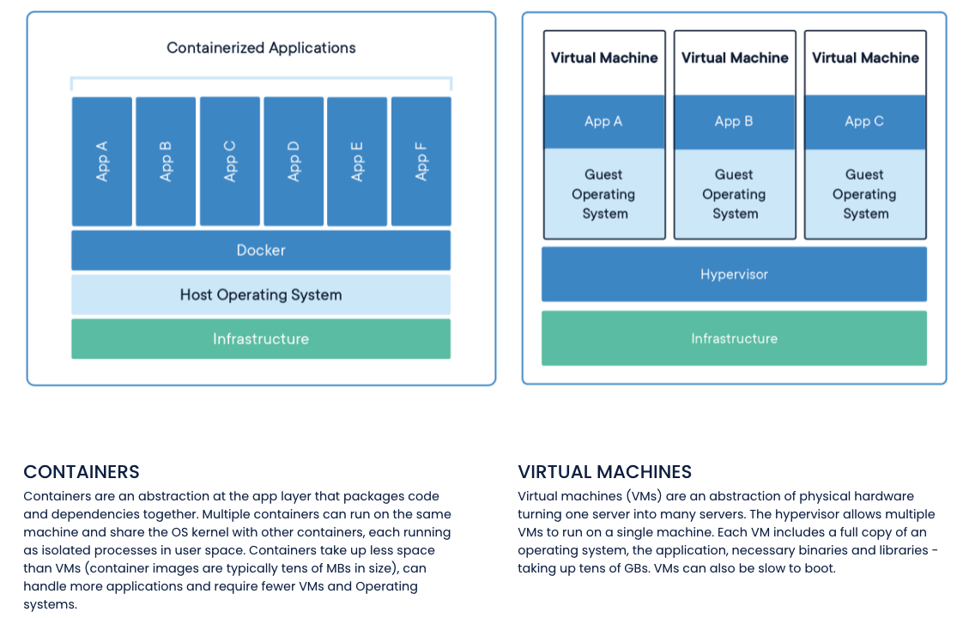
Containers and VMs

Slide 14
Concept (from Wikipedia)
“cgroups (abbreviated from control groups) is a Linux kernel feature that limits, accounts for, and isolates the resource usage (CPU, memory, disk I/O, network, etc.) of a collection of processes.”
“Namespaces are a feature of the Linux kernel that partitions kernel resources such that one set of processes sees one set of resources while another set of processes sees a different set of resources. ... ... those namespaces refer to distinct resources. Resources may exist in multiple spaces. Examples of such resources are process IDs, hostnames, user IDs, file names, and some names associated with network access, ...”

Slide 15
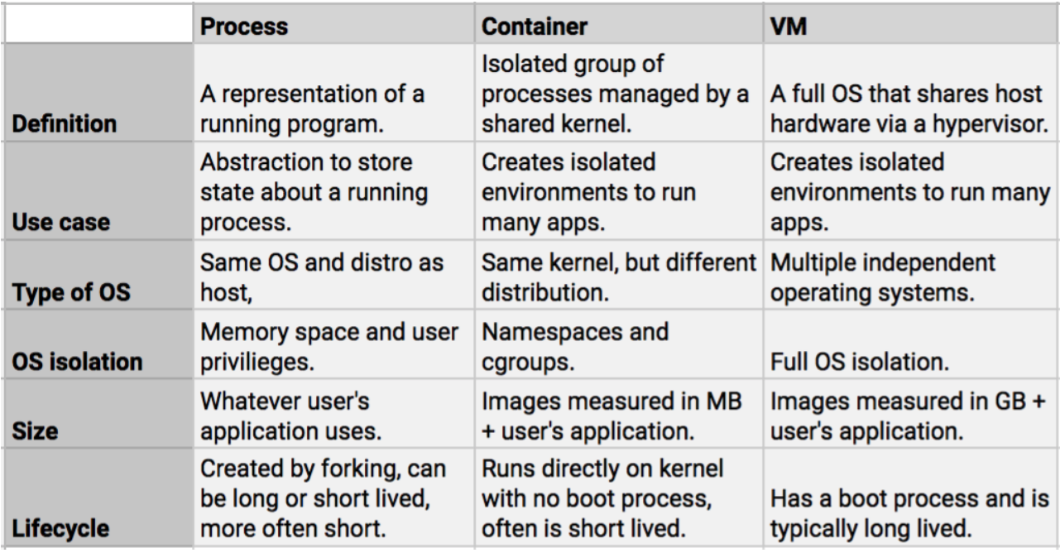
Containers vs VMs

Slide 16
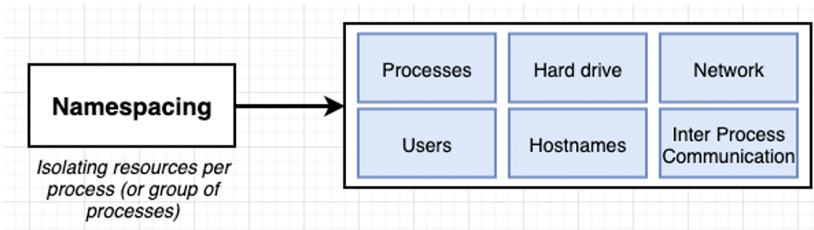
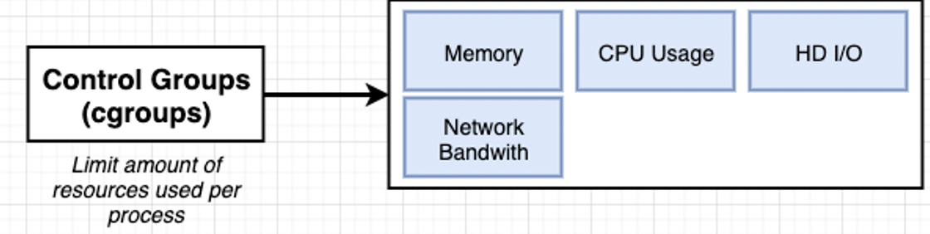
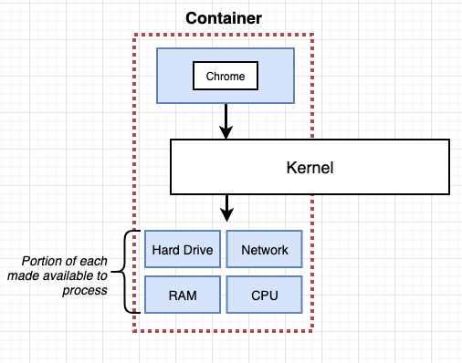
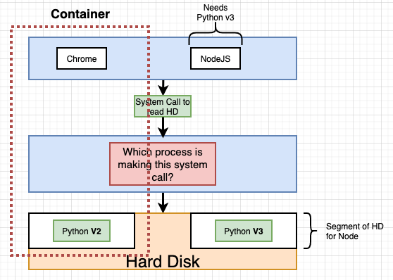
Some Container/Docker Implementation Concepts
Isolates libraries, paths, packages, PIDs, ... ...
Partitions and caps resource consumption.

Slide 17
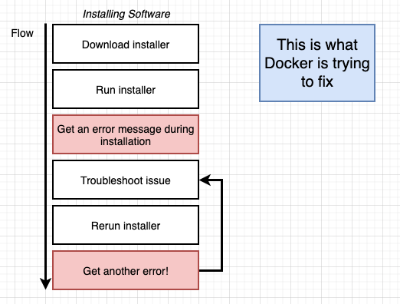
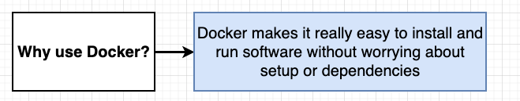
Containers and Some Docker Overview
We are familiar with the problem
We have a system with an OS and installed SW.
We need to install something new, and that requires installing prerequisites, changing versions, etc.
After many tries, we get the application installed only to find out we broke some other application.
Docker and containers allow you to:
Develop an application or SW system.
Package up the entire environment (paths, versions, libs, ...) into an image that works and is self-contained.
Someone installing/starting your application simply gets the image from a repository and starts the image to create a running container.

Slide 18
How to Run Containers on GCP
Cloud Run (serverless): Easiest. Auto-scales to zero, HTTPS by default, request-based billing. Great for web APIs (FastAPI), jobs, and event handlers.
GKE (Google Kubernetes Engine): Full Kubernetes. Best when you need multiple services, custom networking, DaemonSets, stateful workloads, etc.
Compute Engine (VMs + Docker): You manage the VM; simplest if you just want “a box that runs Docker.”
Cloud Functions (2nd gen, container): Event-driven functions packaged as containers.
App Engine Flexible: Runs containers, but most new workloads should prefer Cloud Run or GKE.

Slide 19
REST Continued

Slide 20
REST Continued

Slide 21
REST (https://restfulapi.net/)
What is REST
REST is acronym for REpresentational State Transfer. It is architectural style for distributed hypermedia systems and was first presented by Roy Fielding in 2000 in his famous dissertation.
Like any other architectural style, REST also does have it’s own 6 guiding constraints which must be satisfied if an interface needs to be referred as RESTful. These principles are listed below.
Guiding Principles of REST
Client–server – By separating the user interface concerns from the data storage concerns, we improve the portability of the user interface across multiple platforms and improve scalability by simplifying the server components.
Stateless – Each request from client to server must contain all of the information necessary to understand the request, and cannot take advantage of any stored context on the server. Session state is therefore kept entirely on the client.
Cacheable – Cache constraints require that the data within a response to a request be implicitly or explicitly labeled as cacheable or non-cacheable. If a response is cacheable, then a client cache is given the right to reuse that response data for later, equivalent requests.
Uniform interface – By applying the software engineering principle of generality to the component interface, the overall system architecture is simplified and the visibility of interactions is improved. In order to obtain a uniform interface, multiple architectural constraints are needed to guide the behavior of components. REST is defined by four interface constraints: identification of resources; manipulation of resources through representations; self-descriptive messages; and, hypermedia as the engine of application state.
Layered system – The layered system style allows an architecture to be composed of hierarchical layers by constraining component behavior such that each component cannot “see” beyond the immediate layer with which they are interacting.
Code on demand (optional) – REST allows client functionality to be extended by downloading and executing code in the form of applets or scripts. This simplifies clients by reducing the number of features required to be pre-implemented.

Slide 22
Resource Oriented
There are several good, simple tutorials:
https://www.restapitutorial.com/introduction
https://restfulapi.net/
https://learn.microsoft.com/en-us/azure/architecture/best-practices/api-design
The documentation agrees on a common core, but details and application are subjective.
Identification of resources is URLs:
Resource collections: http://api.contoso.com/api/students
Resource: http://api.contoso.com/api/students/dff9
Links: http://api.contoso.com/api/students/dff9/courses/COMSW4153_002_2024_001/projects
Manipulation of resources through representations: applications, Python/Java objects, relational database rows, air conditioner management APIs, … … are resources.
Self-descriptive message: HTTP verbs, MIME content types, … … For the purposes of your project, your bodies for GET, PUT, POST have: 1) content-type application/json, 2) Use JSON for the body data.
Hypermedia as the engine of application state – HATEOS Just because it sounds so cool and is awesome to day.

Slide 23
URLs and Parameters
Access to a resource is through a URL.
The operations on a collection resource are GET, POST.
GET returns a “list” of resource representations and a links section in the body.
POST take a body containing the new resource data and “inserts” into the collection.
A collection URL is of the form /api/persons.
The operations on an individual resource are GET, PUT and DELETE.
GET returns a body with the resource representation and links section.
PUT takes a body setting the new value for the resource.
DELETE does not take or return a body.
An individual resource URL is of the form /api/persons/dff9, where the primary key is following the collection name.
A method on a resource has the following “parameters.”
Path parameters
Query parameters
Body
Headers

Slide 24
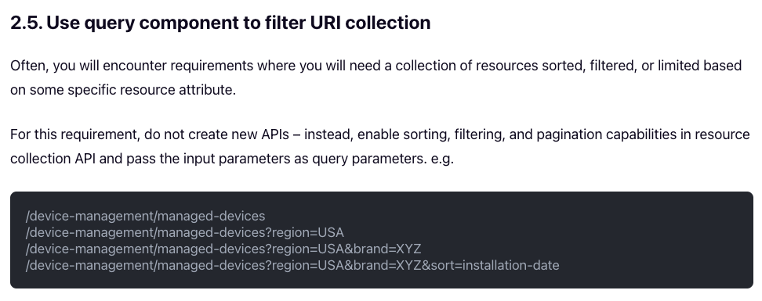
Query Parameters
The basics of query string is very common, e.g. ?region=USA&brand=XYZ
Sort/Order by is not “standard” and APIs pick and document a convention.
Project (choosing a subset of properties) is also not standard. APIs picks and document a convention.

Slide 25
Query and Path Parameters
The concept is simple.
Some resources are containers, which means they have resources ”inside” them. This is analogous to a table in a relational database.
Consider the path /api/persons.
Path parameters: /api/persons/dff9 ➔
GET, PUT and DELETE logically have a where clause WHERE UNI=‘dff9’ if UNI is the primary key.
GET /api/persons/dff9 is logically SELECT * FROM persons WHERE UNI=‘dff9’
/api/persons/ is logically “the table.”
GET /api/persons is logically SELECT * FROM persons
GET /api/persons?last_name=Ferguson&first_name=Donald is conceptually SELECT * FROM persons WHERE last_name=‘Ferguson’ AND first_name=“Donald”
POST is an INSERT INTO persons. The POST “generates” they key and returns the URL to the created resource in a location header.

Slide 26
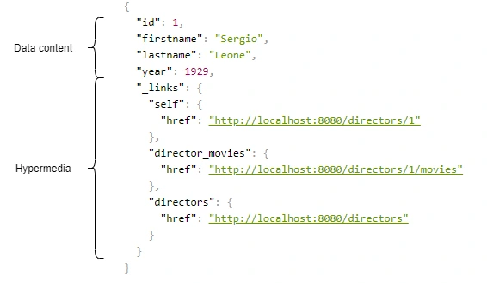
HATEOAS
https://grapeup.com/blog/how-to-build-hypermedia-api-with-spring-hateoas/
HATEOAS (Hypermedia as the Engine of Application State) is a constraint of the REST application architecture. HATEOAS keeps the REST style architecture unique from most other network application architectures.
The term “hypermedia” refers to any content that contains links to other forms of media such as images, movies, and text.
REST architectural style lets us use the hypermedia links in the API response contents. It allows the client to dynamically navigate to the appropriate resources by traversing the hypermedia links.
Navigating hypermedia links is conceptually the same as browsing through web pages by clicking the relevant hyperlinks to achieve a final goal.
In a nutshell:
REST application is basically a graph databases.
And this explains the emergence of GraphQL.
https://restfulapi.net/hateoas/

Slide 27
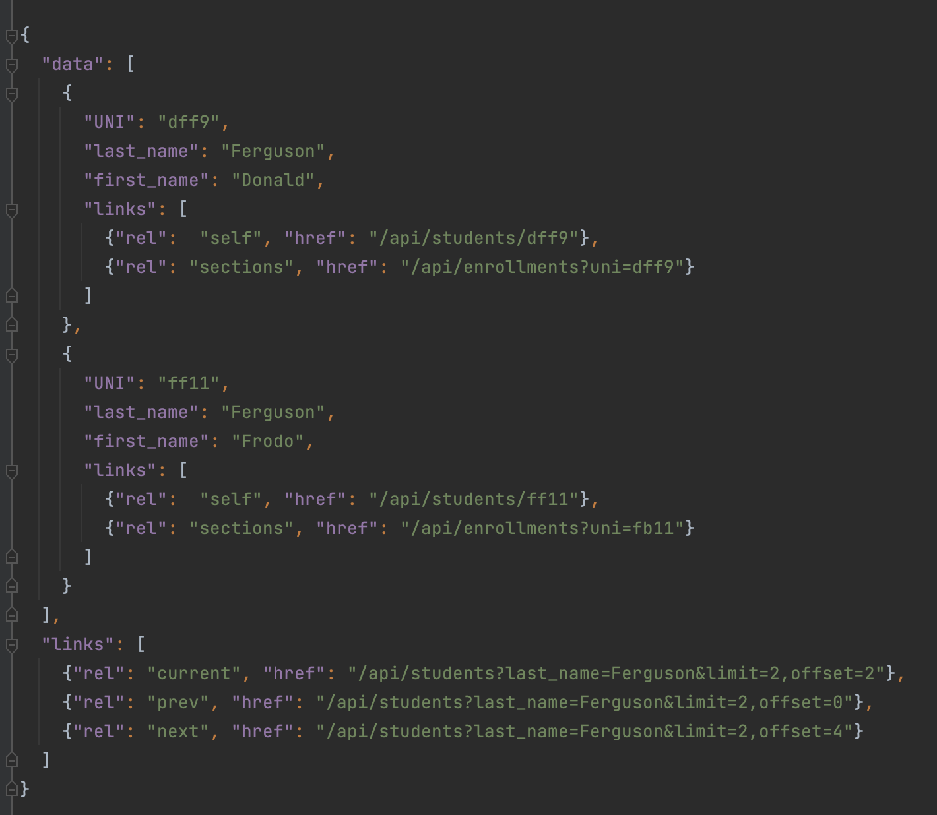
Pagination, Hyper Linked
Bad things may happen when a GET returns a huge result set.
A page is a window on the large result set.
limit is the no. of entries in the result set.
Client may specify a limit.
Server may have a default and/or maximum limit it allows.
There are many design patterns for implementing pagination.
Simplest is mirroring the SQL model:
limit=xxx&offset=yyy
The links section is the response should contain:
prev
next
current
May contain first and last.

Slide 28
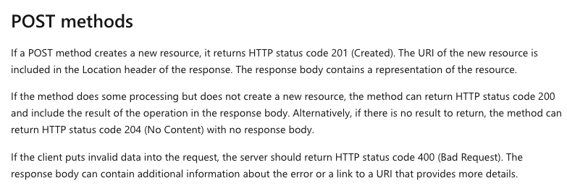
POST -- Creating a Resource
POST sends a body to “create a new resource.”
The identity/URL of the new resource is not always obvious.
POST returns 201 Created with a link header containing the URL to the newly created resource instance.

Slide 29
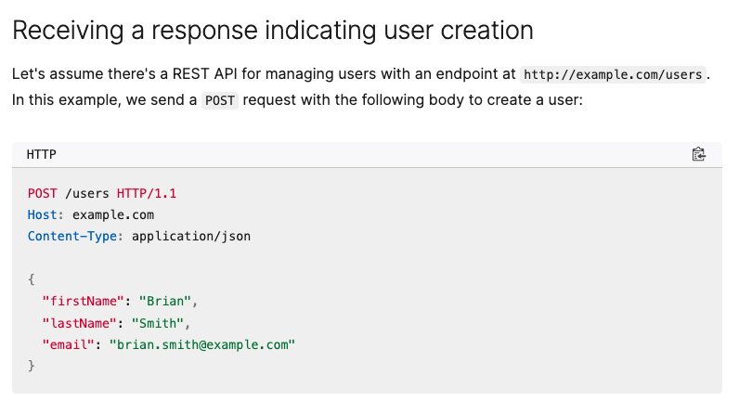
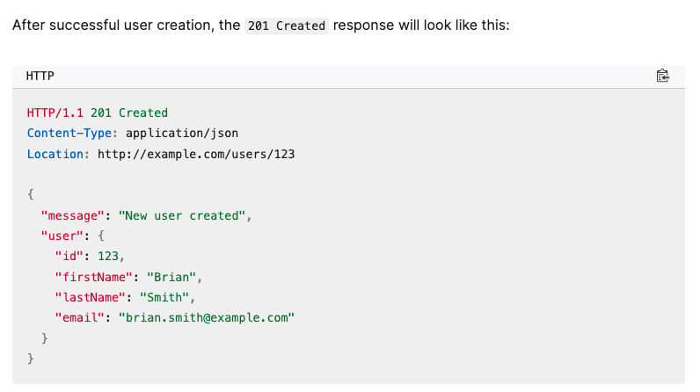
POST

Slide 30
Response
Scroll through HTTP responses and explain ones that the projects should use.
I expect you to return a reasonable set of responses for your methods. You can choose the exact set but be consistent across your resource implementations.
At a minimum, I recommend the following:
200 OK
201 Created
202 Accepted (we will discuss this one in the next lecture)
400 Bad request
401 Unauthorized (next lecture)
403 Forbidden (next lecture)
404 Not found
409 Conflict
418 I’m a teapot
420 Enhance your calm
422 Unprocessable content
501 Not implemented

Slide 31
Composition

Slide 32
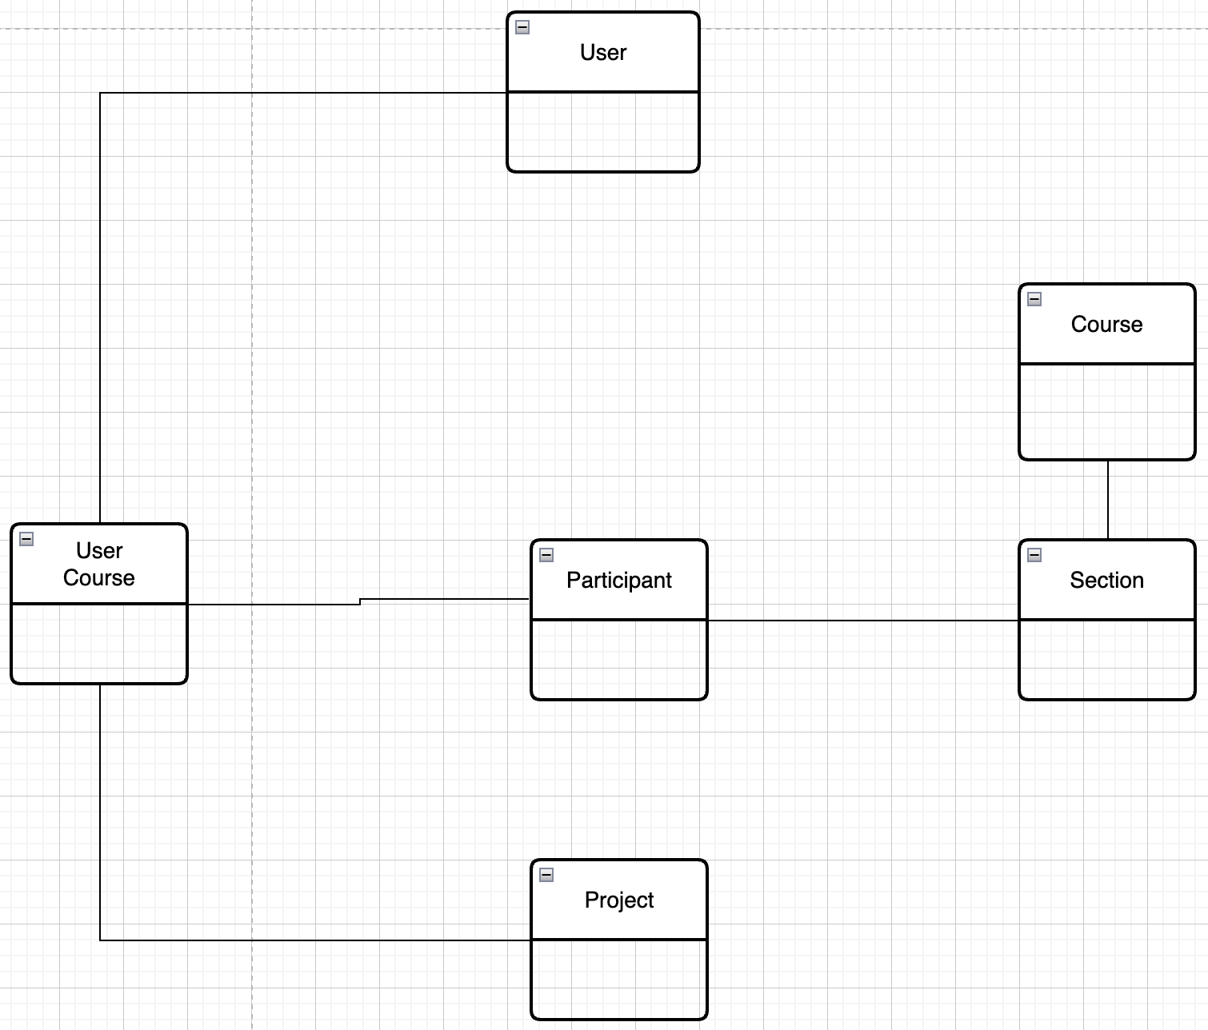
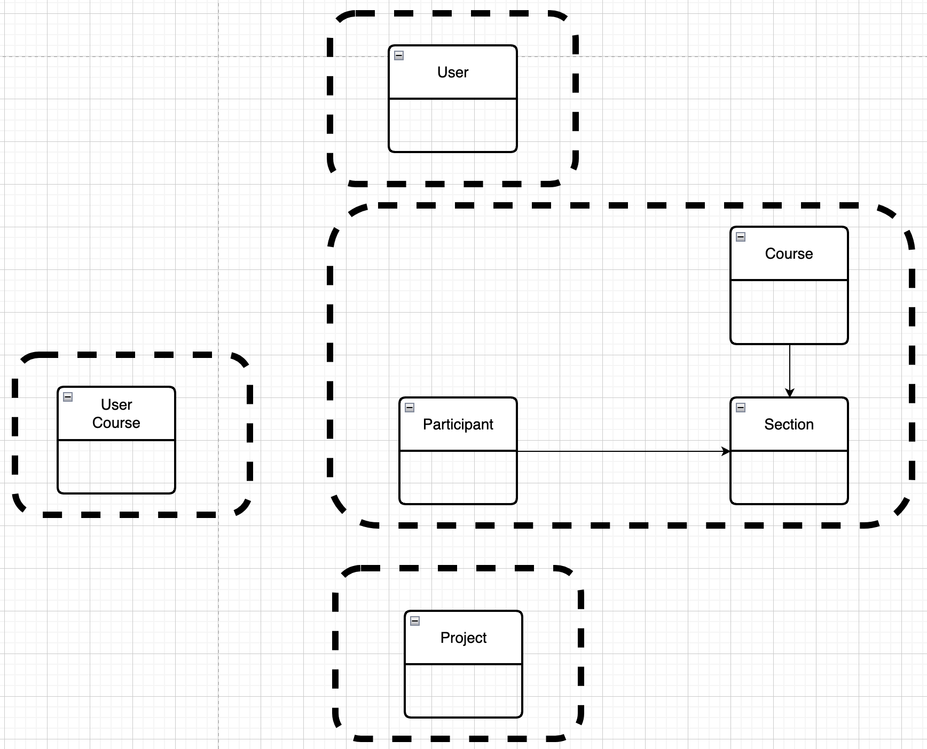
Resource Oriented and Microservices – My Project
Mapped to Microservices
Conceptual Model -- User, Project, Course
This creates some interesting challenges, e.g.
Joins
Foreign Keys
If the cluster of resources might be useful in other solutions → It may be a microservice.

Slide 33
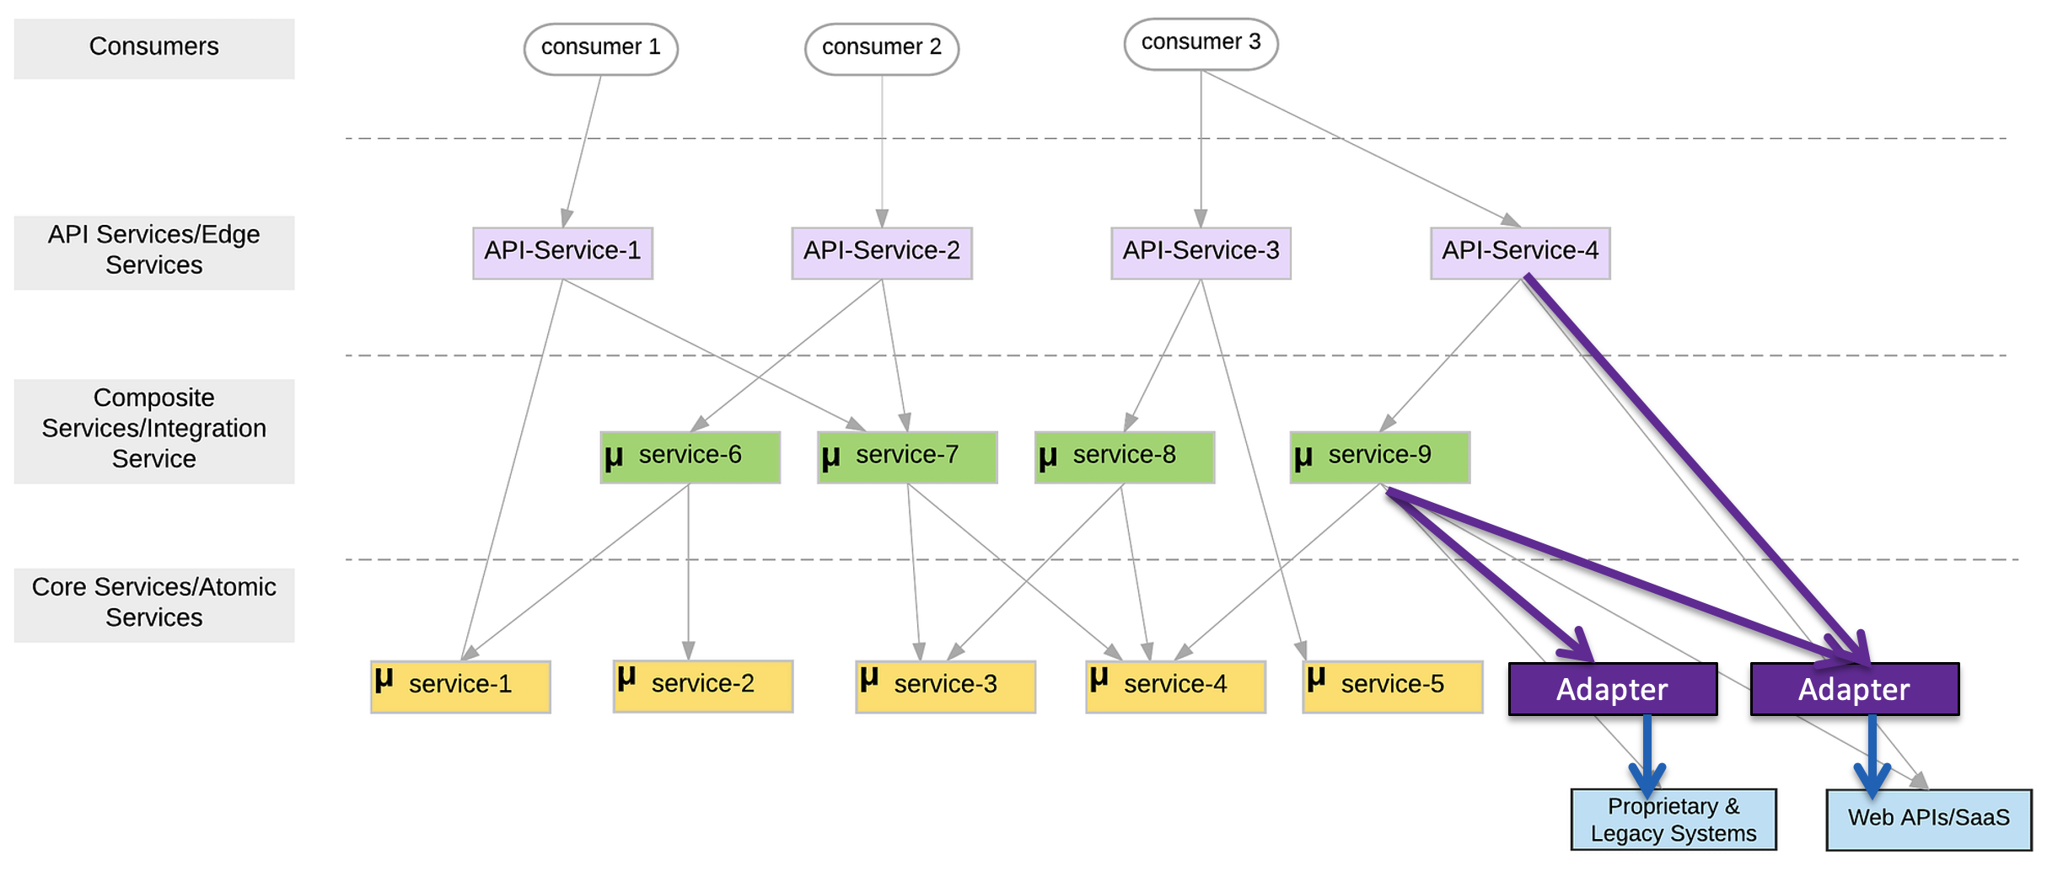
First Group of Microservices
My first sprint with have 5 microservices:
5 core/atomic microservices:
user_info
courseworks_adaptor
course_info
student_coupons
project_teams
1 composite/integration microservice: core_course_management
The composite service:
Implements “consistency” in the data in the core services, e.g. “foreign keys.”
Eliminates the need for complex logic in the UI or client, which would be impacted by changes.
Exposes only information from the basic services that the client requires.
The composite service is conceptually similar to a database view.

Slide 34
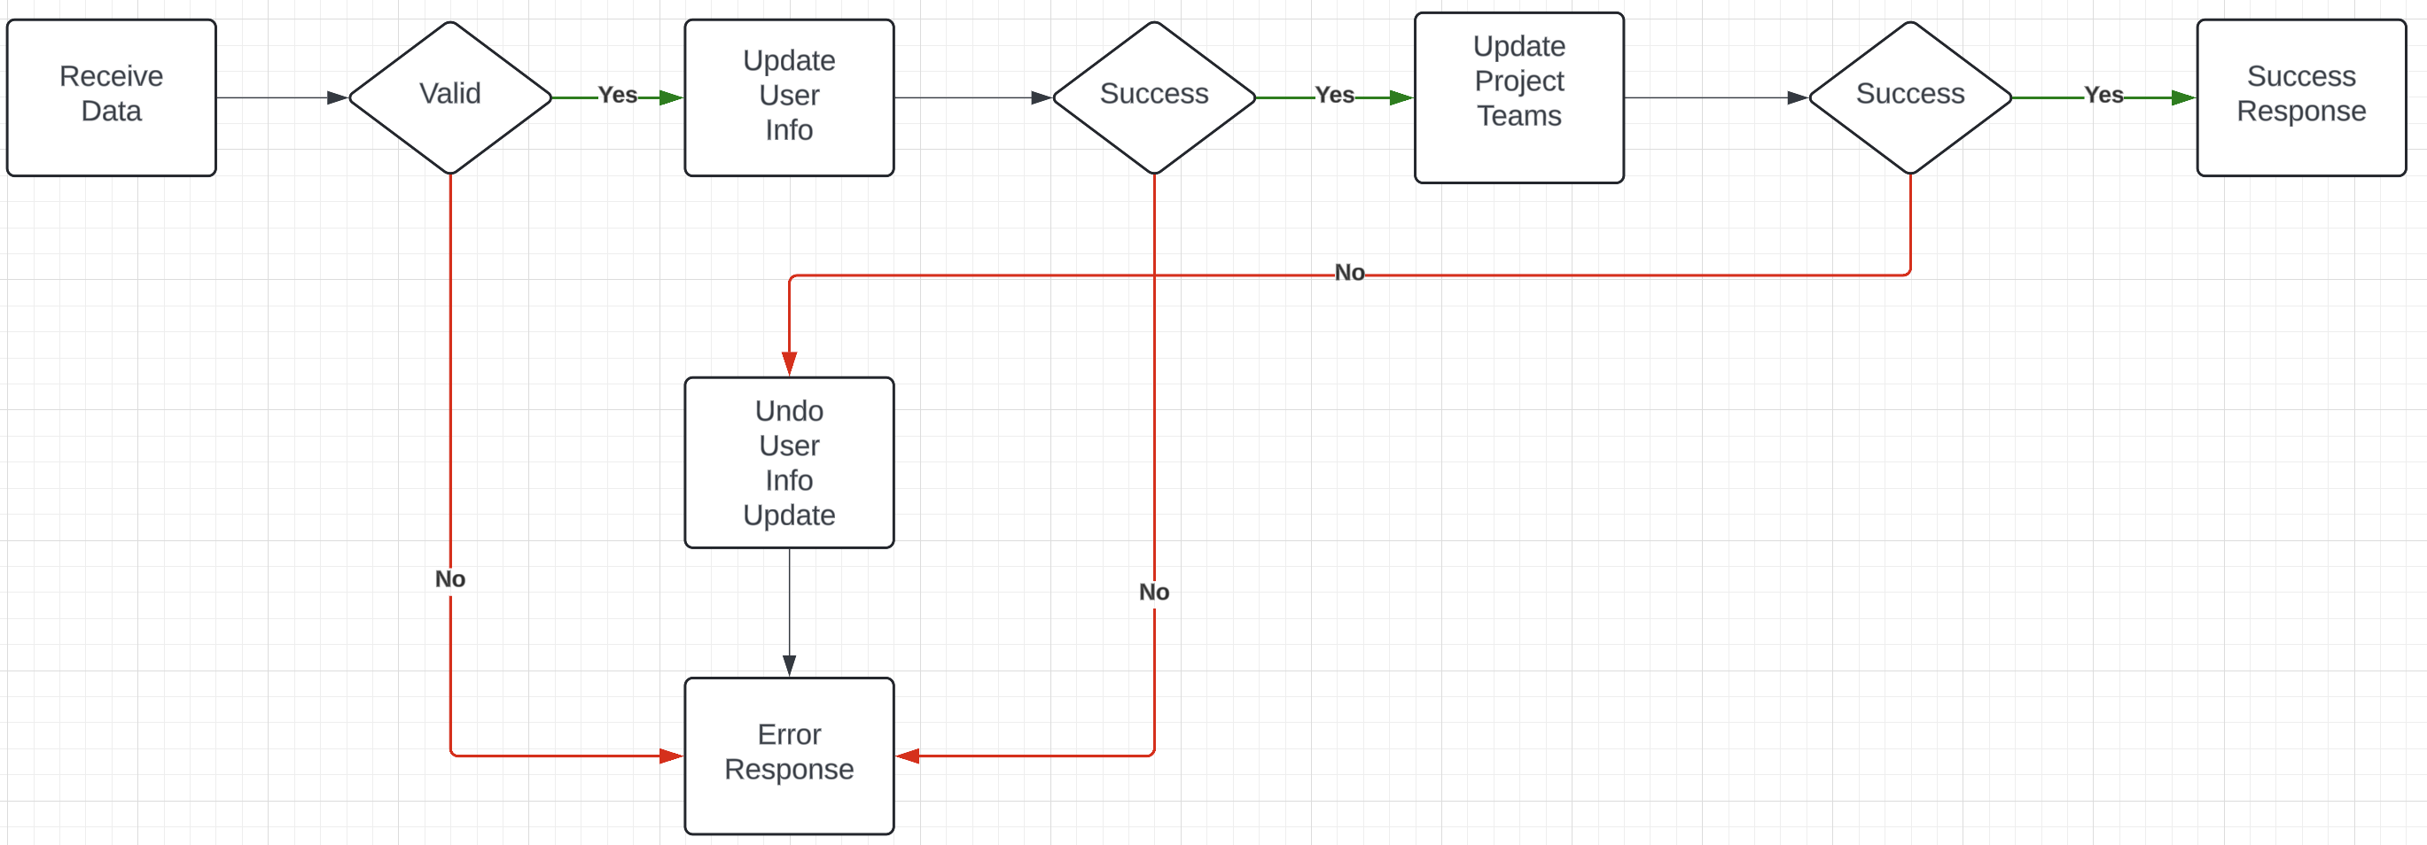
Composite Microservice Logic
The GET on the composite invokes GET on several atomic services. This can occur synchronously or asynchronously in parallel.
PUT, POST and DELETE are more complex. Your logic may have to undo some delegated updates that occur if others fail.
To get started, we will just use simple logic but explore more complex approaches.

Slide 35
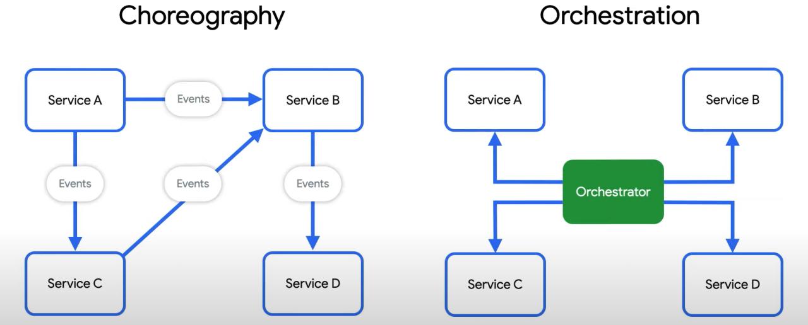
Behavioral Composition
There are two base patterns: choreography and orchestration.
There also several different implementation technologies and choices.
And many related concepts, e.g. Sagas, Event Driven Architectures, Pub/Sub, … …
We will cover and explore incrementally, but for now we will keep it simple and do traditional “if … then …” code.

Slide 36
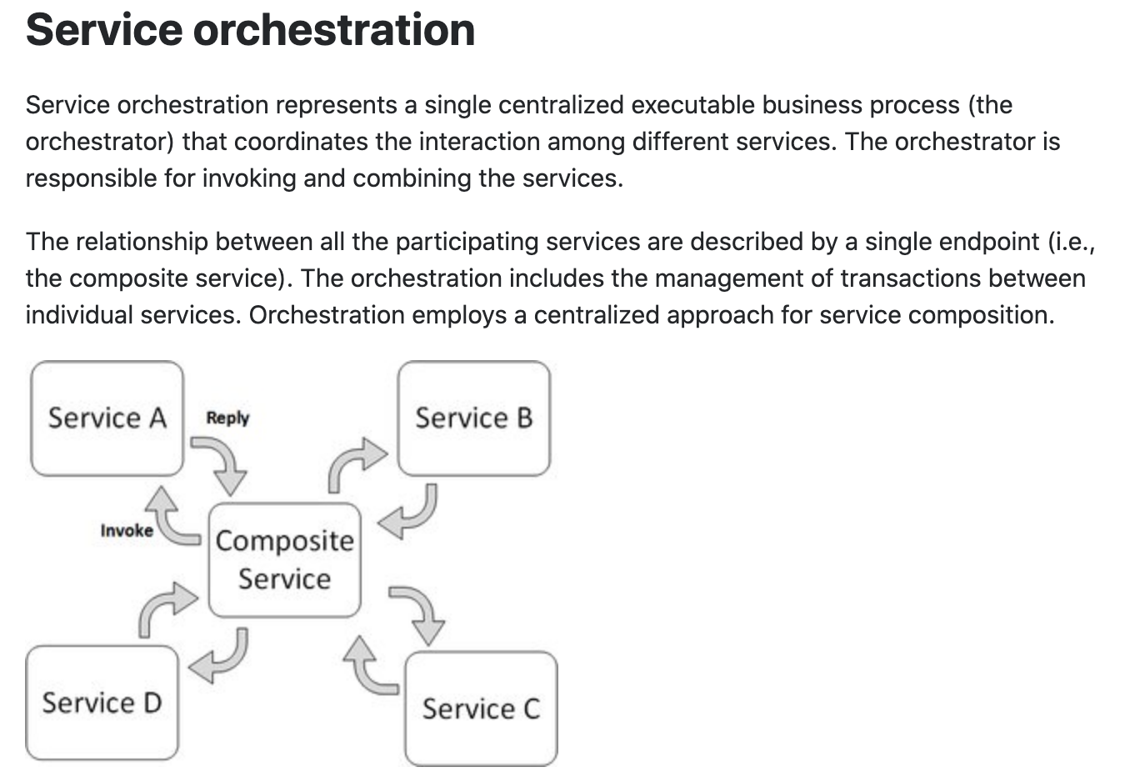
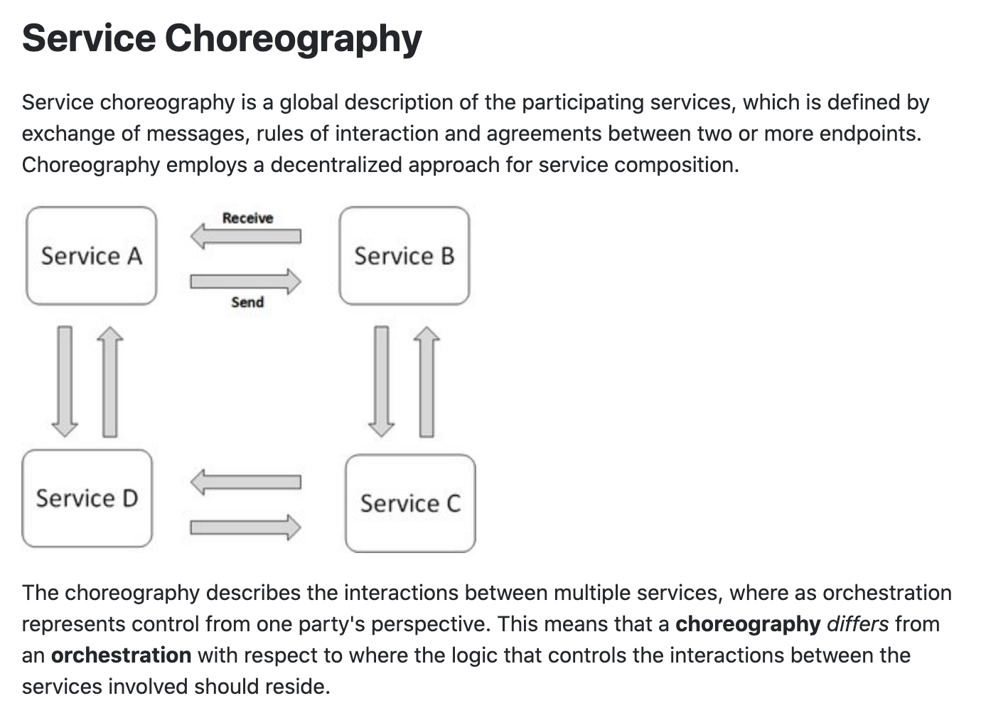
Concepts
These are not formally, rigorously defined terms.

Slide 37
In Code: Composition and Asynchronous Method Invocation
Composite operations can “take a while.”
“Holding open connections and waiting can be bad.”
Consumes resources.
Connections can break.
... ...
There are two options:
Polling
Callbacks
Our next pattern is composition and “polling.” Create a new user requires:
Updating the user database.
Verifying a submitted address.
Creating an account in the catalog service.
Request
202 ACCEPTED Location
GET (Poll)
200

Slide 38
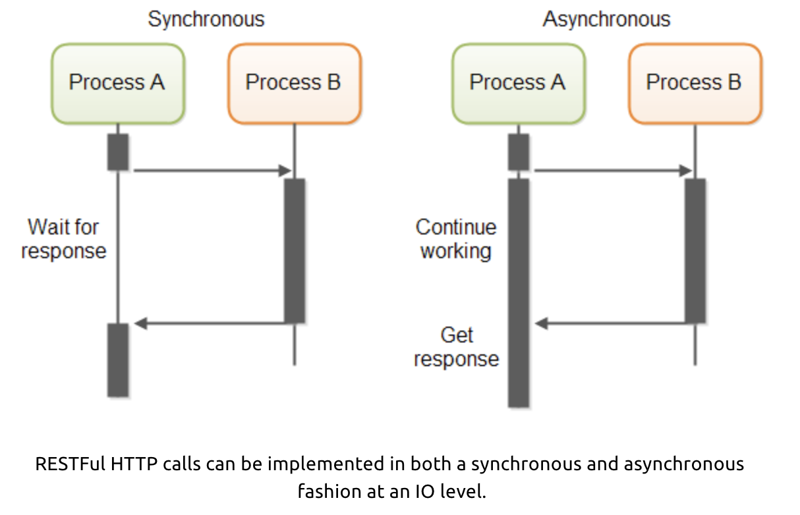
In Code: Service Orchestration/Composition
One call to a composite service
May drive calls to multiple other services.
Which in turn, may drive multiple calls to other services.
Synchronous (Wait) and calling one at a time, in order is
Inefficient
Fragile
... ...
Asynchronous has benefits but can result in complex code.

Slide 39
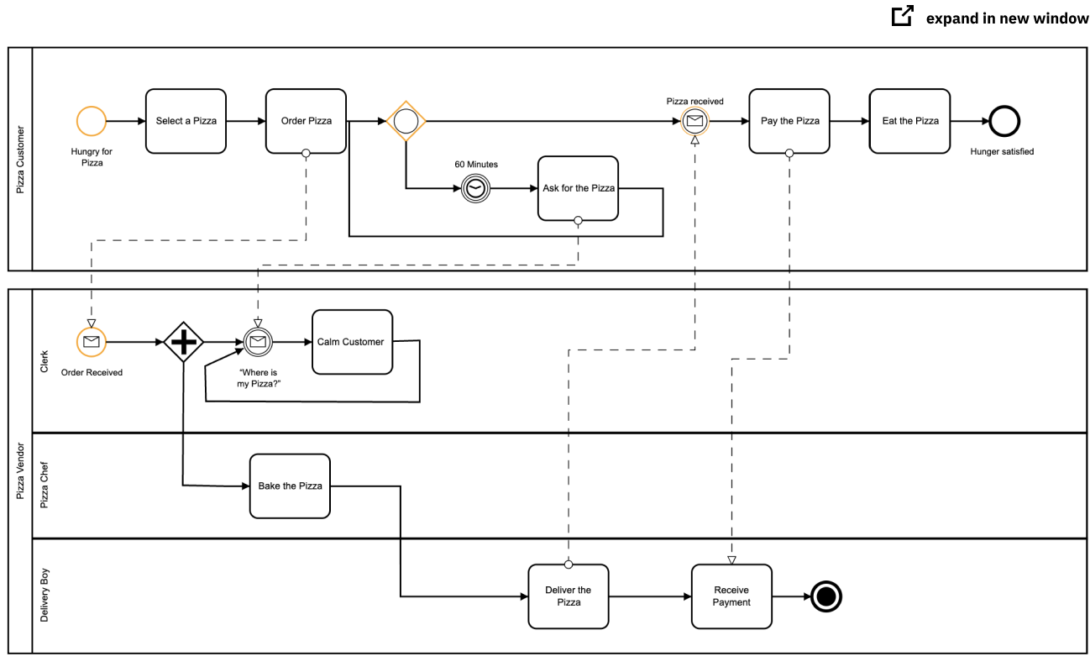
Service Orchestration
Implementing a complex orchestration in code can become complex.
High layer abstractions and tools have emerged, e.g. BPMN.
“Business Process Model and Notation (BPMN) is a graphical representation for specifying business processes in a business process model.”
There are products for defining BPMN processes, generating code, executing, … …, e.g. Camunda: https://camunda.com/bpmn/
There are other languages, tools, execution engines, … …

Slide 40
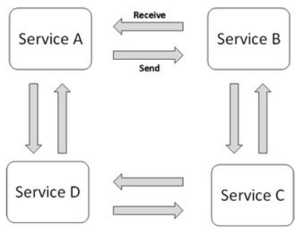
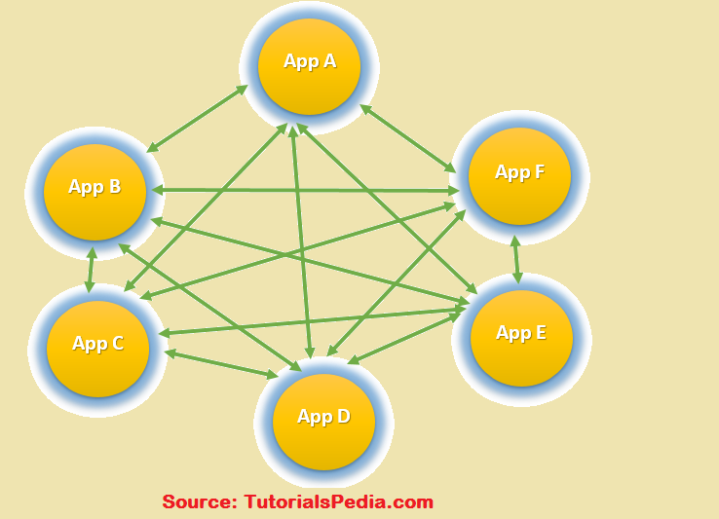
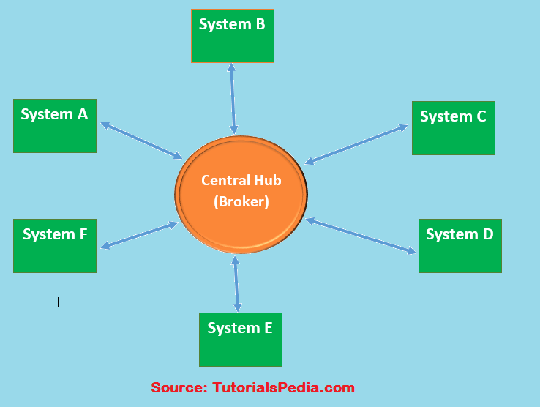
Choreography
We saw the basic diagram, but … this is an anti-pattern and does not scale.
But, how do you write the event driven microservices?
Well, you can just write code … …
Or use a state machines abstraction.

Slide 41
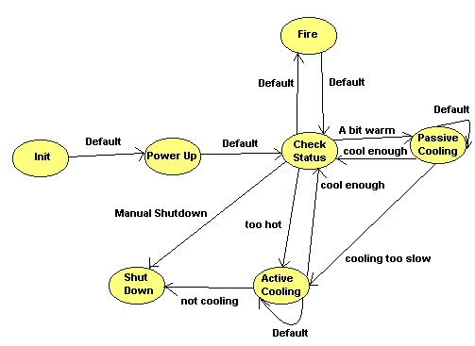
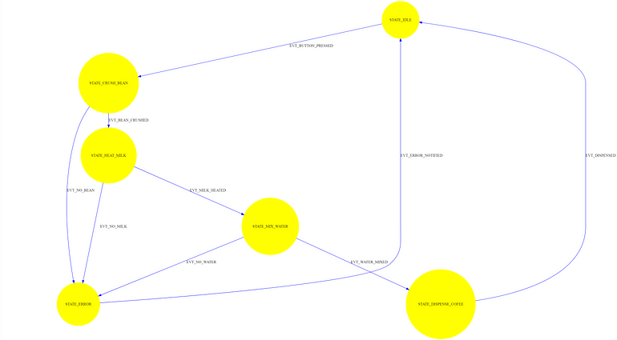
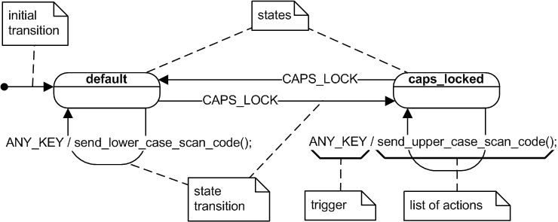
State Machine
A state machine is an abstraction.
There are many models for defining state machines.
There are also development tools, runtimes, … …
We will look at a specific example: AWS Step Functions

Slide 42
Show Code
Show example of calling URL synchronously and asynchronously
/Users/donald.ferguson/Dropbox/000/000-A-2025-Repos/sync_async/async1.py
/Users/donald.ferguson/Dropbox/000/000-A-2025-Repos/sync_async/sync1.py
One of the steps in your next sprint is:
Build a composite microservice that aggregates your basic microservices.
Demonstrating one method on the composite aggregating the base services synchronously.
Demonstrating one method on the composite aggregating the base services asynchronously.
You are probably confused as heck right now.
Think of your initial microservices as base tables.
Think of the composite as a VIEW representing a JOIN of the base tables.
Your composite microservice’s code implements the basic operations, and perhaps some additional logic, in the JOIN to “compose” that basic services.

Slide 43
Web Content (BLOB Storage)

Slide 44
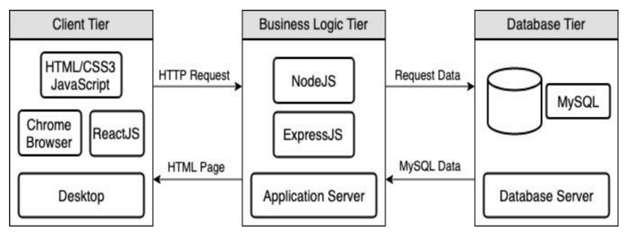
Full Stack Web Application – Reminder
https://levelup.gitconnected.com/a-complete-guide-build-a-scalable-3-tier-architecture-with-mern-stack-es6-ca129d7df805
We have seen how to use Flask (or FastAPI) to implement an endpoint (a set of paths):
Some of the paths can run application logic and return the result data.
Some can return pages that a browser can render. Basically, these paths are returning the “client application” to the browser to execute, and may have API calls in JavaScript/Typescript.
Do not worry about this now.
But, running application logic and simply delivering files are two different “concerns.”
Having one runtime implement both would violate the SOLID principle.
The design points are different: “You can be a floor wax or a mouth wash, but not both.”
So, we need a separate “web server.”

Slide 45
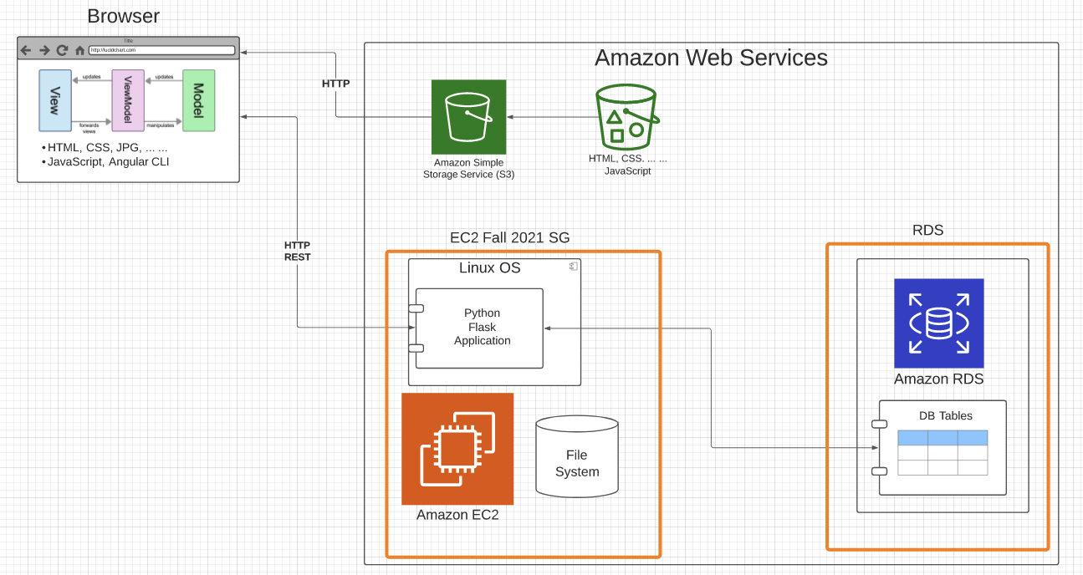

Slide 46
BLOB: Binary Large Object
Definitions:
“A binary large object (BLOB or blob) is a collection of binary data stored as a single entity. Blobs are typically images, audio or other multimedia objects, though sometimes binary executable code is stored as a blob. They can exist as persistent values inside some databases or version control system, or exist at runtime as program variables in some programming languages.” (https://en.wikipedia.org/wiki/Binary_large_object)
“Blob is the data type in MySQL that helps us store the object in the binary format. It is most typically used to store the files, images, etc media files for security reasons or some other purpose in MySQL.” (https://www.educba.com/mysql-blob/)
Intent:
File systems are not good for many application scenarios, which is why database management systems emerged.
Database management systems implement structured (or semi-structured) data, e.g. tables.
Database BLOBs were a way to have some “big things” as table or document properties.

Slide 47
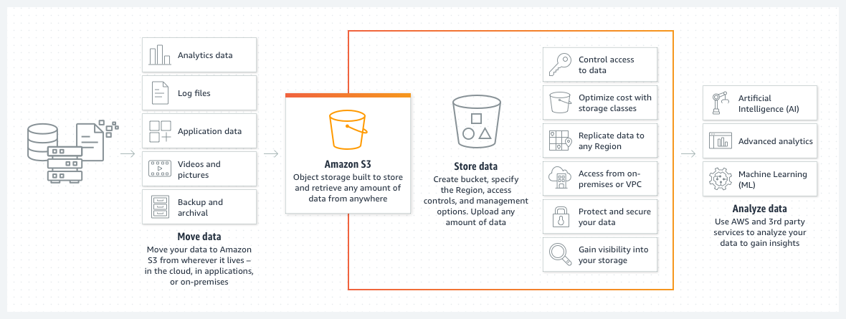
Amazon S3
We used the equivalent capability on Azure for uploading CAD files, storing processed files and results, etc.

Slide 48
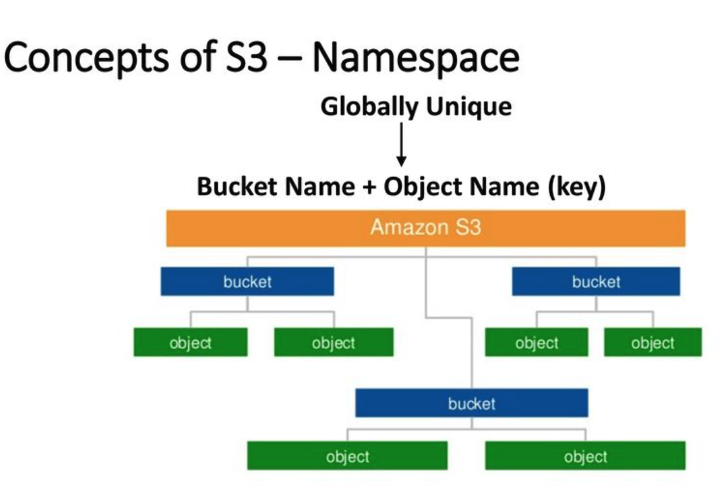
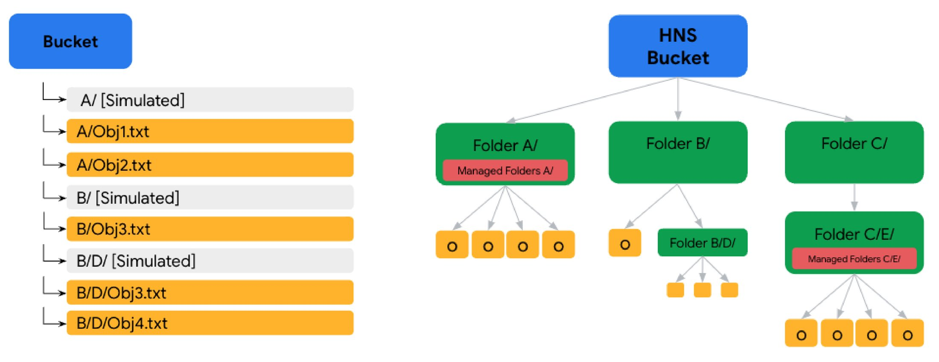
AWS S3
Can support a logical hierarchy with a convention on keys.
x/y
x/z
x/y/z
... ...
Acts kind of file system like, but is really just key strings.
GCP has a very similar model.

Slide 49
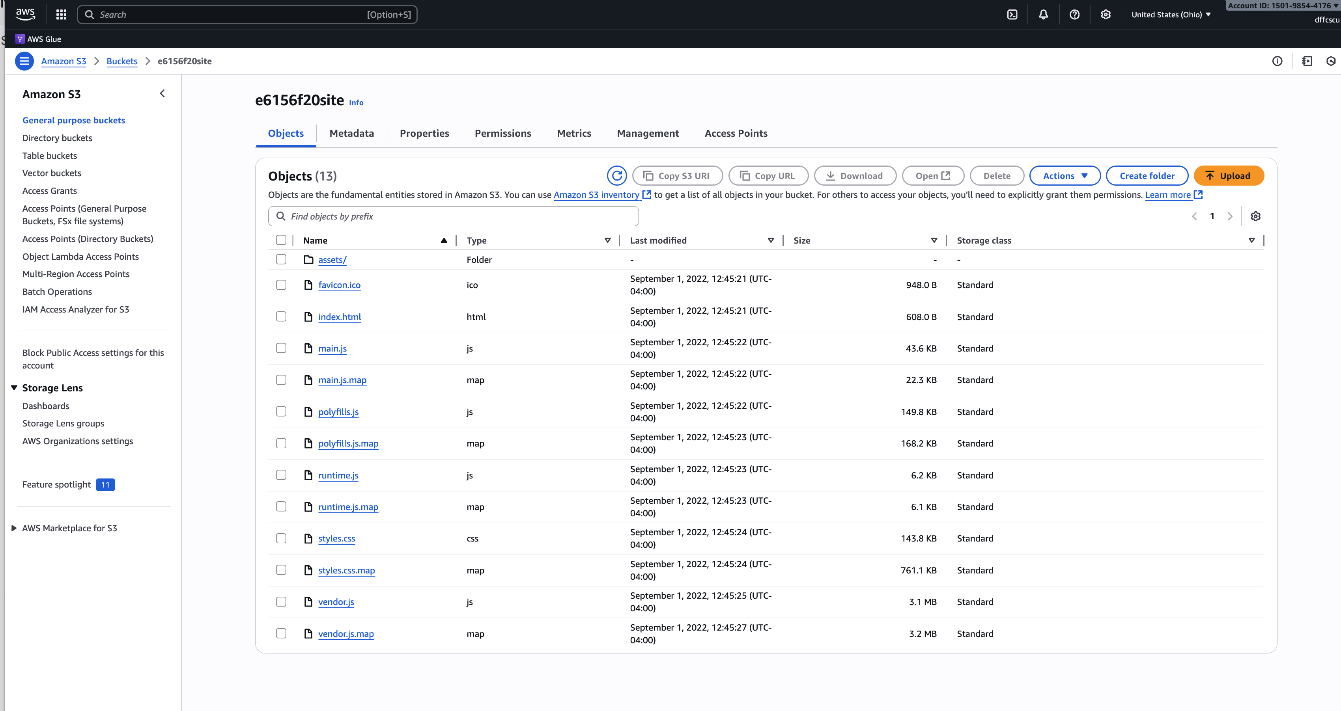
Simple Example
https://e6156f20site.s3.us-east-2.amazonaws.com/index.html
Could be hierarchical.
I need to migrate to GCP.

Slide 50

Static Content
You have several options for hosting your static web content on GCP
Firebase Hosting – Easiest option, HTTPS + CDN, built-in SPA rewrites, great for static SPAs
Cloud Storage + CDN + HTTPS LB – Enterprise-scale, Google-managed SSL, integrates with load balancer infra
Cloud Run + NGINX – Flexible, supports custom rewrites and caching headers, serverless scaling
There are clearly pros and cons to each approach.
For simplicity, I suggest that you use Firebase.
Note:
I followed ChatGPT’s instructions for an hour and nearly had a stroke.
I felt like the Sorcerer’s Apprentice.
I am going to try again over the weekend or switch to Google Cloud Store
Note 2:
I started following the instructions for Google Cloud Storage
I nearly has another stroke.
I will figure this out over the weekend
I finally got it to work but do not know how.
The Global HTTPS Load Balancer and custom domain.

Slide 51
DBaaS

Slide 52
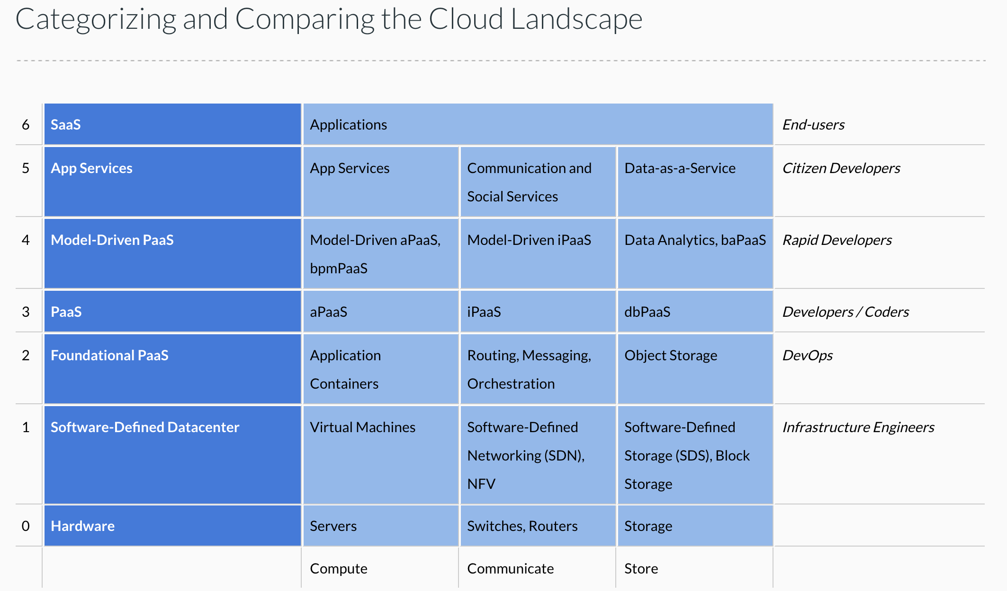
Cloud Concepts – One Perspective
http://www.theenterprisearchitect.eu/blog/2013/10/12/the-cloud-landscape-described-categorized-and-compared/

Slide 53
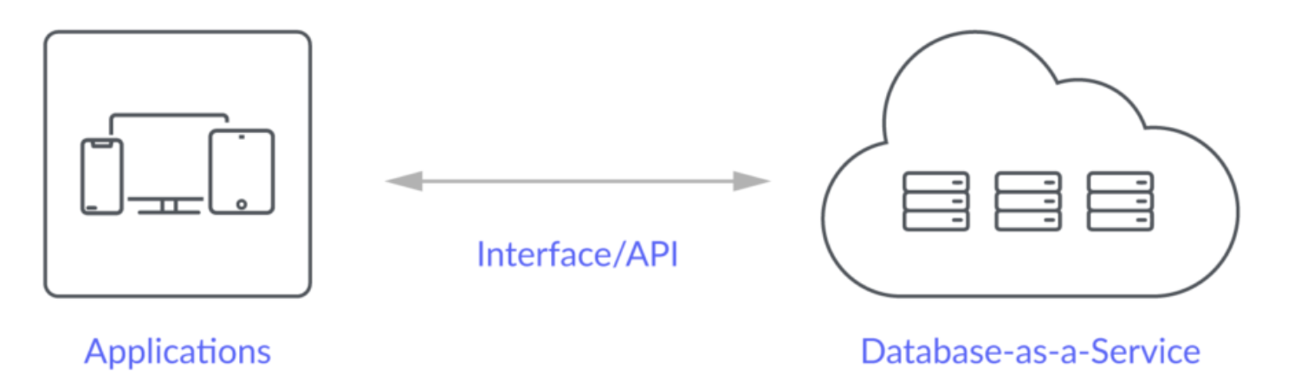
Database-as-a-Service
“A cloud database is a database that typically runs on a cloud computing platform and access to the database is provided as-a-service. There are two common deployment models: users can run databases on the cloud independently, using a virtual machine image, or they can purchase access to a database service, maintained by a cloud database provider. Of the databases available on the cloud, some are SQL-based and some use a NoSQL data model.
Database services take care of scalability and high availability of the database. Database services make the underlying software-stack transparent to the user.” (Wikipedia)
Let’s take a look at 3: Relational Data Service, Dynamo DB, MongoDB (Compass)

Slide 54
12 Factor Applications

Slide 55
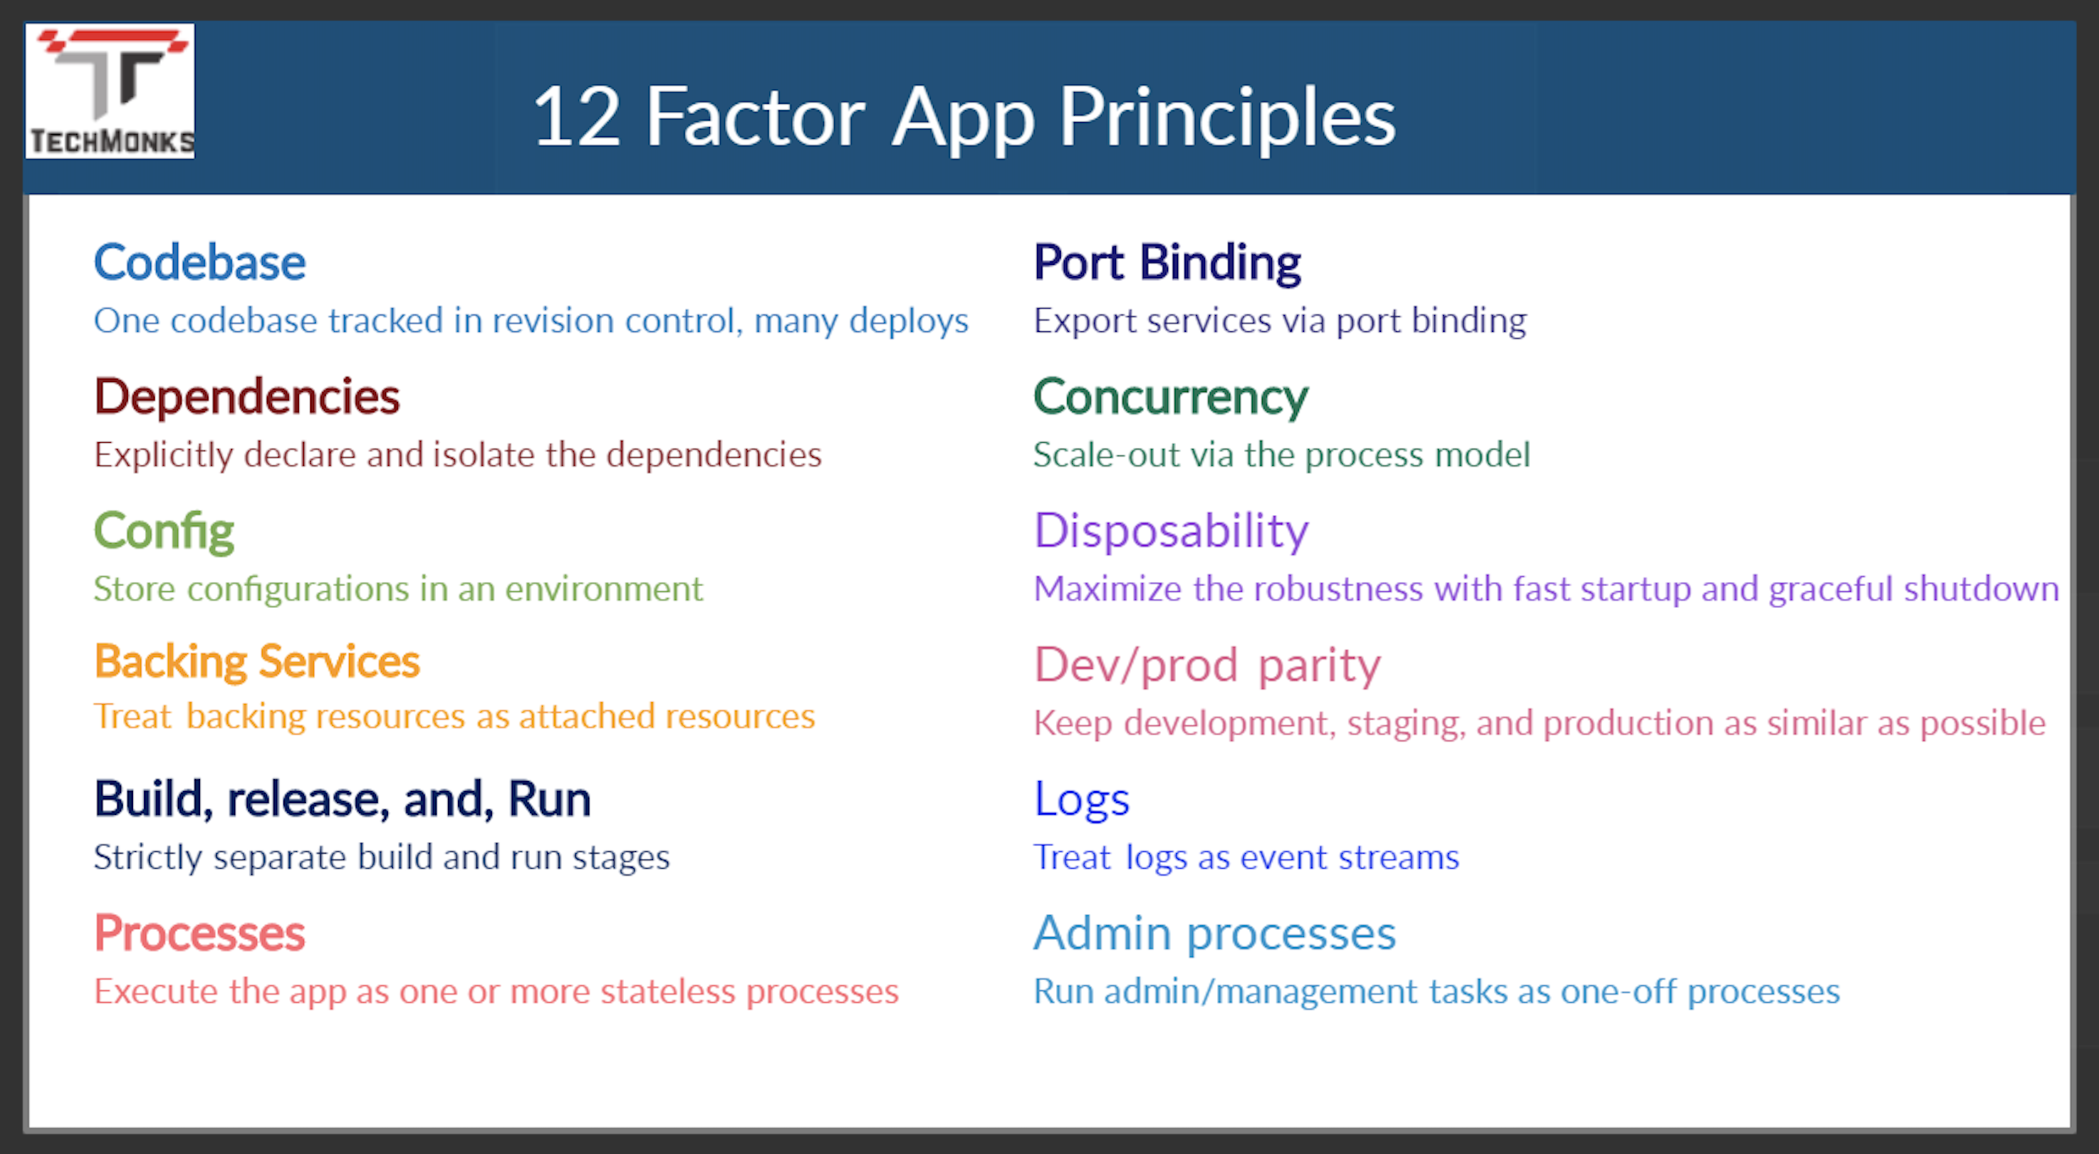
12 Factor Applications
https://dzone.com/articles/12-factor-app-principles-and-cloud-native-microser

Slide 56
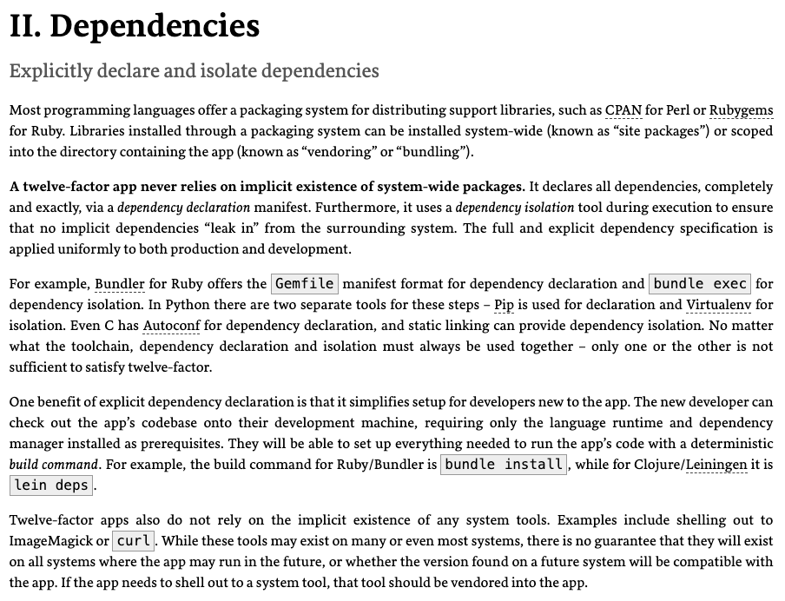
Dependencies
Most application frameworks have a dependency declaration concept.
I have been showing examples with:
Python import
requirements.txt
etc.
My examples also show encapsulating libraries and APIs with Python classes.
II. Dependencies handles “the code,” but we still need to handle the instance. There is a difference between, e.g.
pymysql
A specific connection.

Slide 57
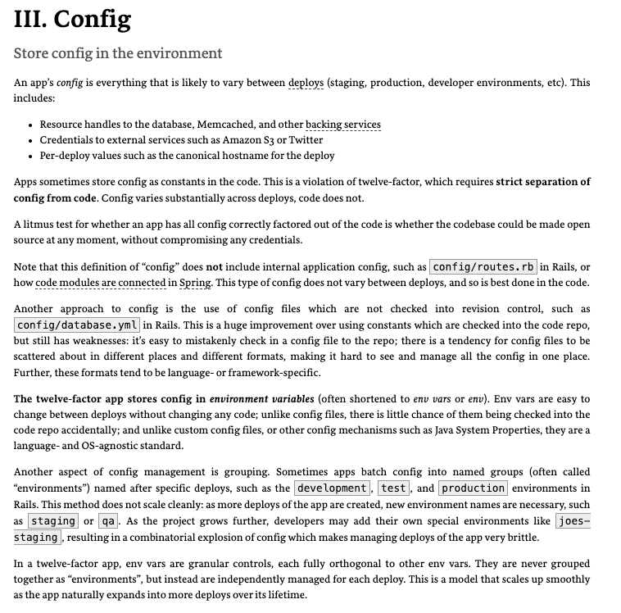
III. Configurations
Each of the deployment environments we will use has a method for configuring environment variables.
CI/CD, GitHub actions, etc. can integrate environment variables with the development process.
Vaults and secrets managers are a better approach for passwords.

Slide 58
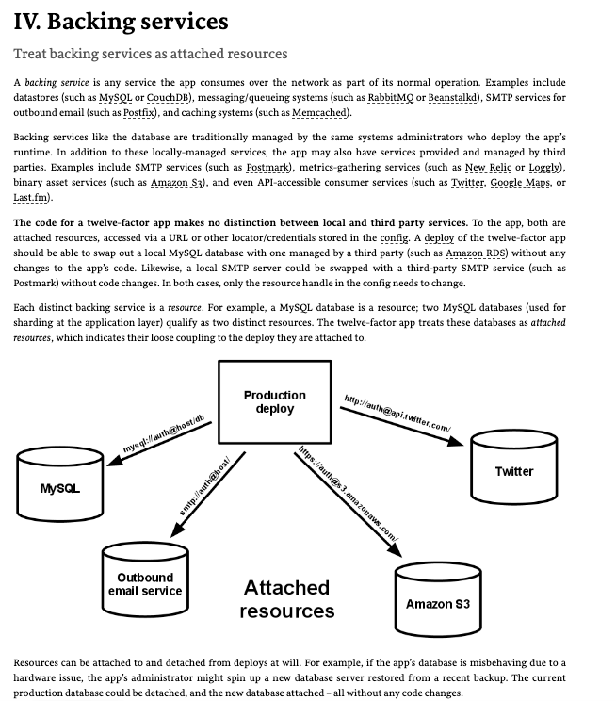
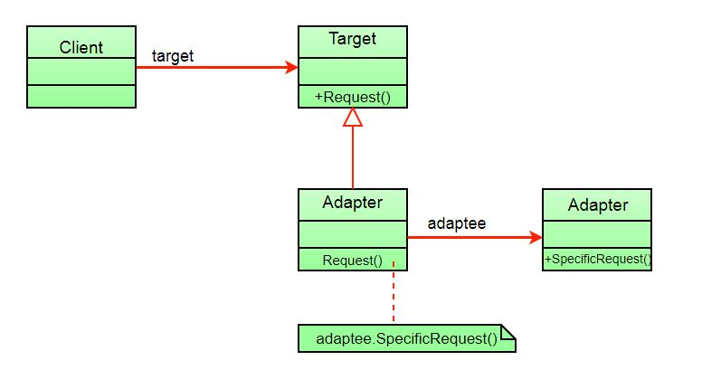
IV. Backing Services
My code has shown encapsulating backing services with a shallow adaptor.
This is an example of the adaptor pattern.
You seen examples of things like AbstractBaseDataService, … …
The approach is also an application of several aspects of SOLID. (https://en.wikipedia.org/wiki/SOLID)

