Slide 1
W4153 – Cloud Computing Lecture 6: REST (4), Composition, OAuth2, Functions
© Donald F. Ferguson, 2024

Slide 2
Contents

Slide 3
Contents
Team presentations
Project status/next sprint
REST continued
Response codes/status codes
201 Created (https://developer.mozilla.org/en-US/docs/Web/HTTP/Reference/Status/201)
202 Accepted -- Asynchronous invocation (https://developer.mozilla.org/en-US/docs/Web/HTTP/Reference/Status/202)
Service composition
Concepts
Orchestration, Choreography
Synchronous, Asynchronous, event driven
Function-as-a-Service
Concepts
My application scenario
Show code and walkthrough
OAuth2
Concepts and scenarios
JWT Tokens
Access token and refresh token; auto-refresh
12 Factor Applications -- Overview
Next sprint

Slide 4
Team Presentations

Slide 5
Team Presentations and Updates
Team: ”Unknown” Focal point: He Qian SHEN

Slide 6
Project Status/Sprints

Slide 7
Project Status and Sprints
But first, my philosophy … …

Slide 8
REST Continued

Slide 9
HTTP Status Codes
There are many, many HTTP response status codes.
I cannot remember most of them.
Also, I almost never see any of them.
But, that is not surprising. Normally the UI or client application handles an error status gracefully and “translates” into an application specific exception or easily understood error page.
There status codes fall into five categories
Informational responses (100 – 199)
Successful responses (200 – 299)
Redirection messages (300 – 399)
Client error responses (400 – 499)
Server error responses (500 – 599)
There are several good sources of information
https://developer.mozilla.org/en-US/docs/Web/HTTP/Reference/Status
https://www.restapitutorial.com/httpstatuscodes
https://www.w3schools.com/tags/ref_httpmessages.asp

Slide 10
Which Ones do I Care about for your Project
Once you have learned how to catch exceptions and return status codes for a few conditions, you understand the pattern for all the conditions.
Many are subject to interpretation. My primary concern is that you
Are consistent over all of your microservices.
You document the status codes in Open API documentation.
The ones I recommend/care about are:
We will cover these today.
200 OK | The request is OK (this is the standard response for successful HTTP requests)
201 Created | The request has been fulfilled, and a new resource is created
202 Accepted | The request has been accepted for processing, but the processing has not been completed

Slide 11
Which Ones do I Care about for your Project
400 Bad Request | The request cannot be fulfilled due to bad syntax
401 Unauthorized | The request was a legal request, but the server is refusing to respond to it. For use when authentication is possible but has failed or not yet been provided
403 Forbidden | The request was a legal request, but the server is refusing to respond to it
404 Not Found | The requested page could not be found but may be available again in the future
405 Method Not Allowed | A request was made of a page using a request method not supported by that page
409 Conflict | The request could not be completed because of a conflict in the request
412 Precondition Failed | The precondition given in the request evaluated to false by the server
418 I am a teapot | Just kidding.
429 Enhance Your Calm | Just kidding
422 Unprocessable Entity | The request was well-formed (i.e., syntactically correct) but could not be processed
428 Precondition Required
500 Internal Sever Error | Error in the server that was not caught and handled properly/gracefully. My go to default.
501 Not Implemented | The server either does not recognize the request method, or it lacks the ability to fulfil the request. Usually this implies future availability (e.g., a new feature of a web-service API).
For eTag processing, which we covered last week.

Slide 12
201 – Created
A POST on a collection /persons is how you create a new resource (person). The URL of the new resource is something lie /persons/dff9.
The client has not way of knowing/being certain what the URL is.
This is probably some type of primary key. There are two types of primary key
Natural key – the key derives from the data.
Surrogate key – the key is an arbitrary, generated value not easily derived from the data.
Even
If the client/user “thinks” that they know the algorithm, they cannot be sure.
Moreover, this is “side information” and the interface is not not HATEOAS/self-describing.
So,
A successful POST returns 201
With a link header containing the URL of the resource.

Slide 13
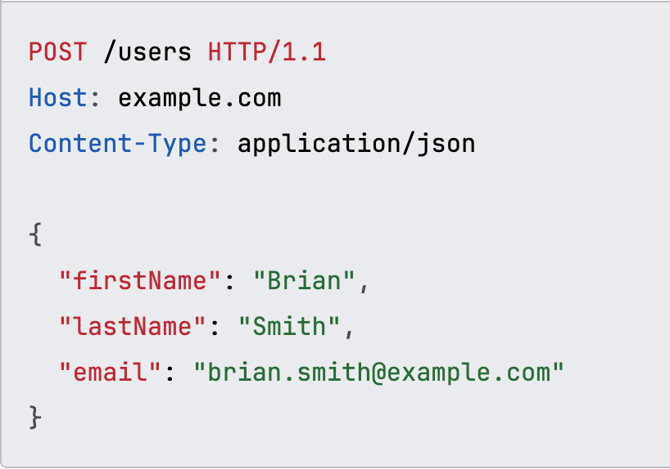
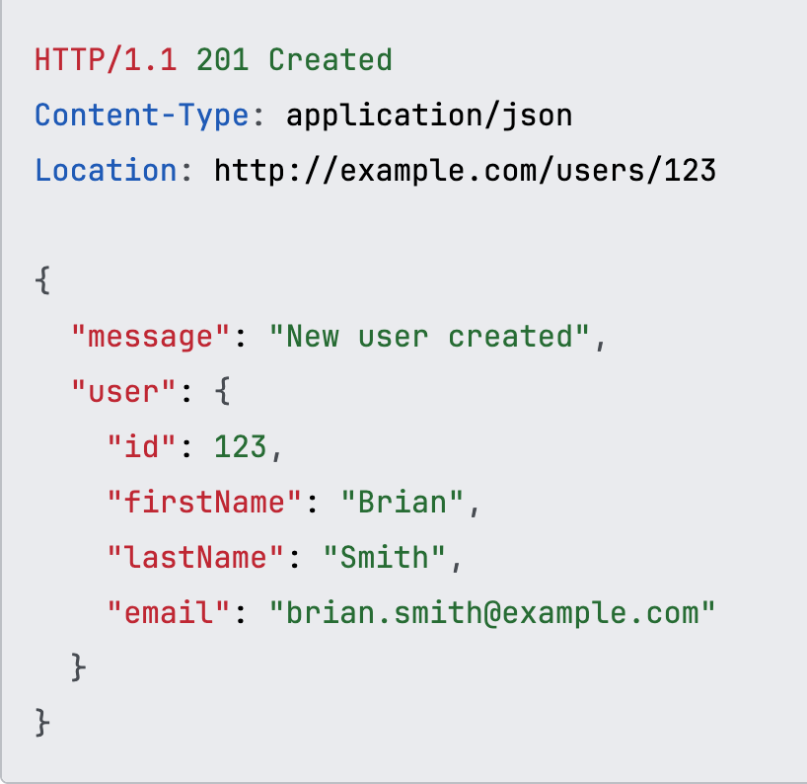
201 – Created
Microservice
Validates the request.
Computes a primary key, perhaps relying on a key created by the data service.
Persists the data.
Returns 201 created with a location header.

Slide 14
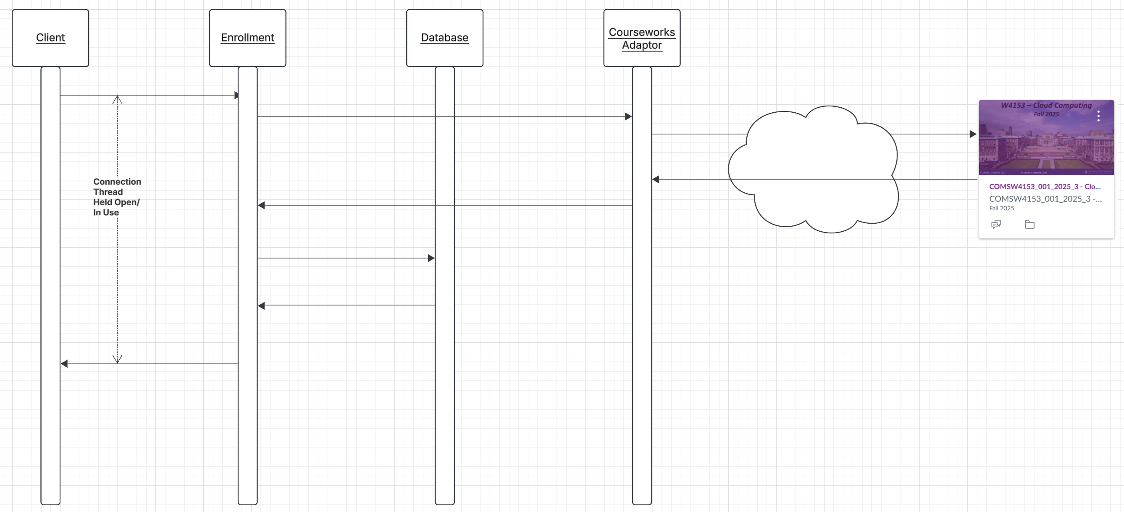
202 – Accepted
Processing a request may “take a lot of time”
Calling other services, which call other services.
Complex computations
Complex queries or accessing multiple databases.
While the operation is in progress, and mostly “waiting.”
Connection are held open/in-use.
Base things happen when connections are held open:
Severs usually have a limit on the number of connections allowed → generates errors.
Connections, even when idle, consume resources
… …
The alternate approach is to respond, “Working on it. Check back later.”

Slide 15
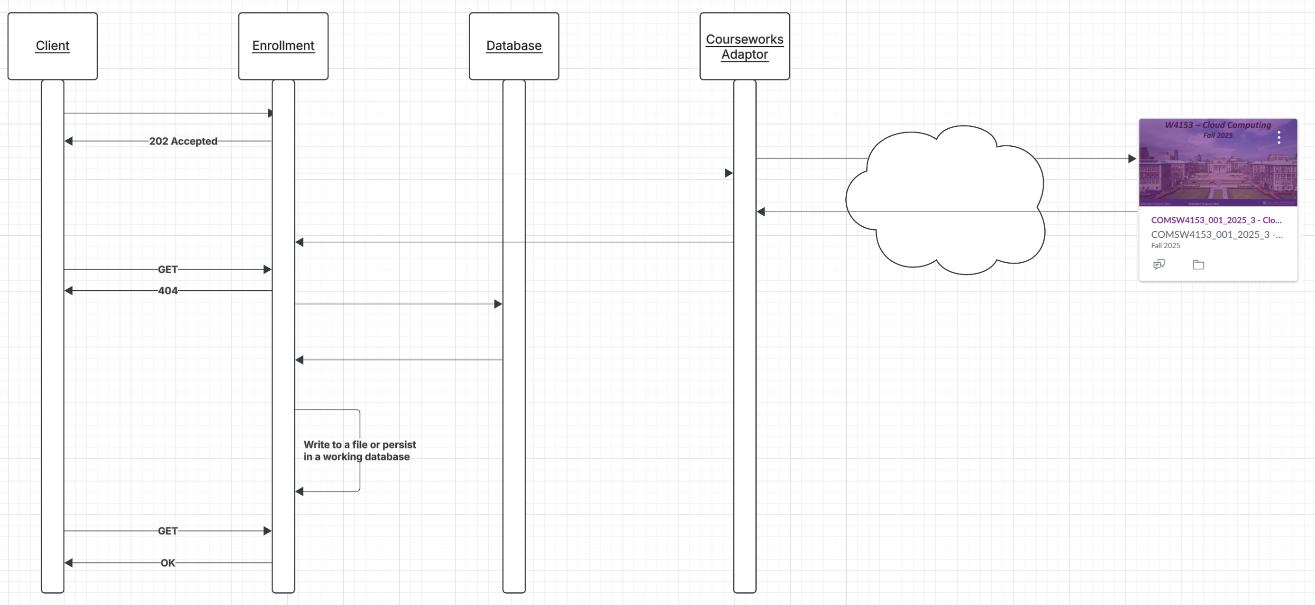
202 – Accepted

Slide 16
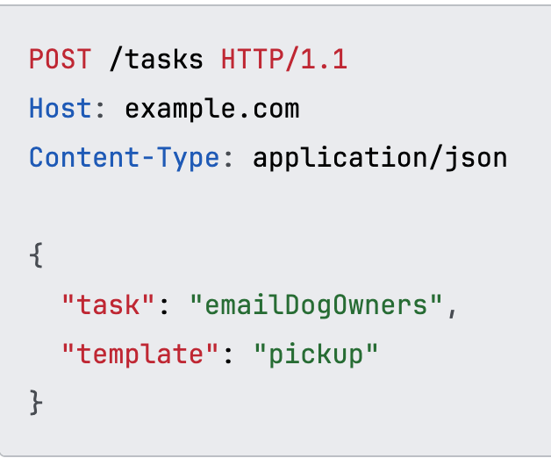
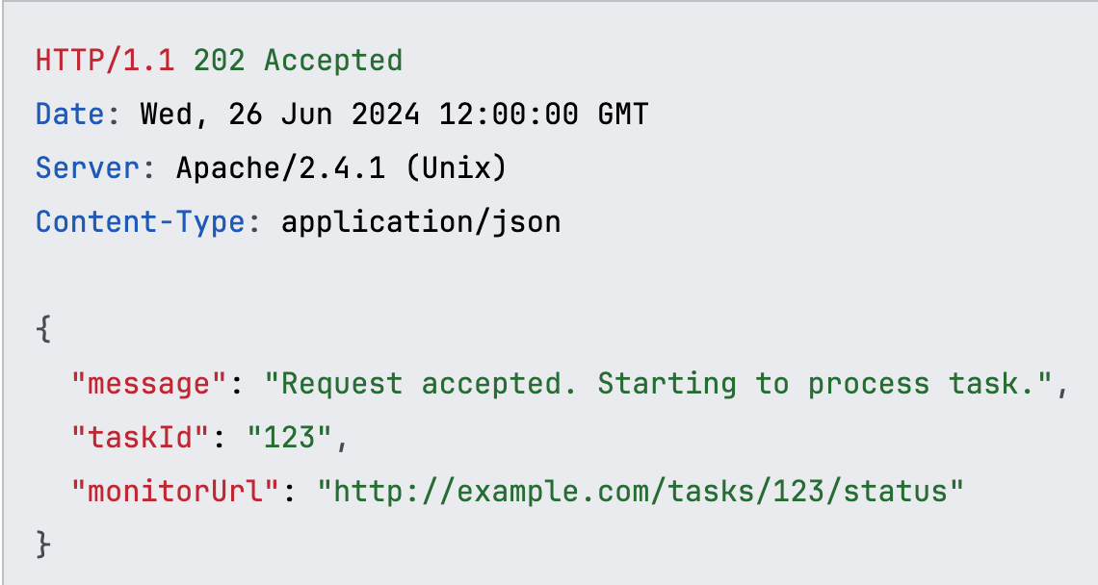
202 – Accepted
This is a “pattern.”
There are several design patterns for the actual message formats.
URL in the response body
Header
… …
You will implement the logic several ways in your code when we implement composition.
My concern from an API/REST perspective is that you choose a reasonable pattern and stick to it.
Service

Slide 17
202 Accepted
Show /Users/donald.ferguson/Dropbox/000/000-A-2025-Repos/sync_async
For now, you can simply replicate the pattern to get started.
For the next sprint, you should implement this pattern for one of your methods on a composite service (see below).

Slide 18
Composition

Slide 19
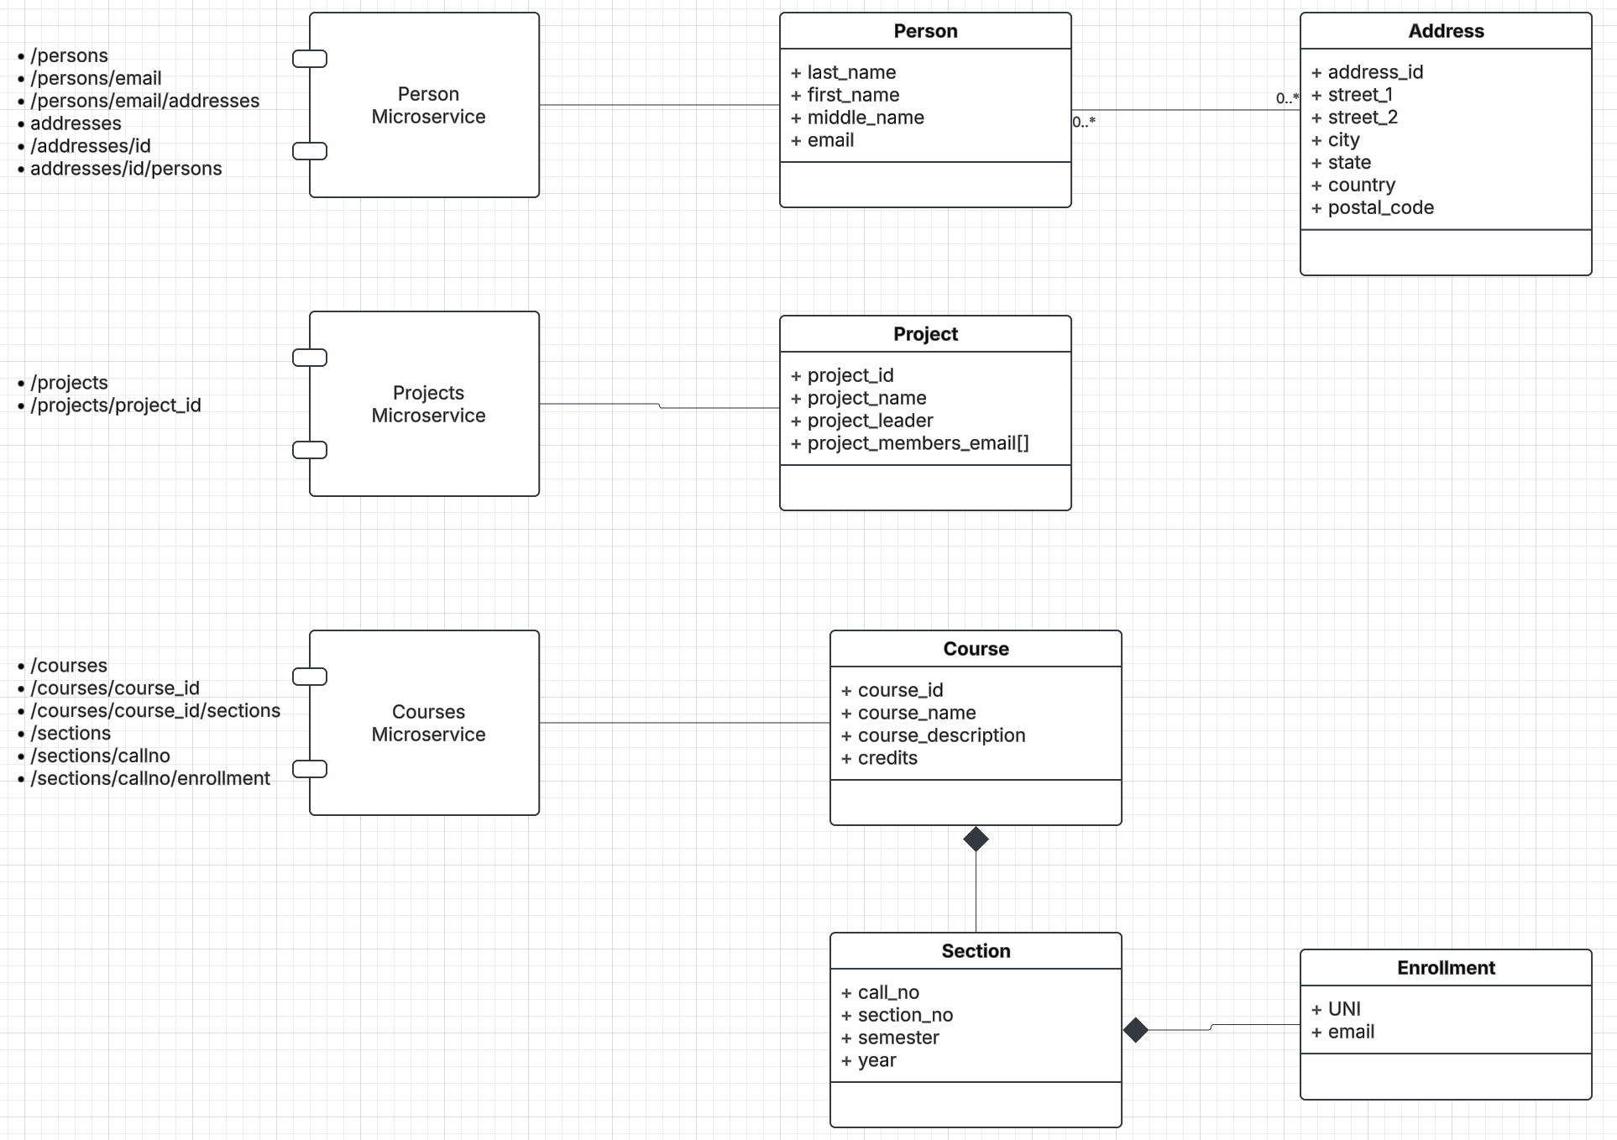
Composition – Somewhat Contrived Exampl
We have 3 independently developed microservices.
Persons
Projects
Courses
Our application scenarios requires composing them into a larger whole with paths for
Person ↔ Project
Course ↔ Project
Person ↔ Section
etc.
And the implied integrity constraints.

Slide 20
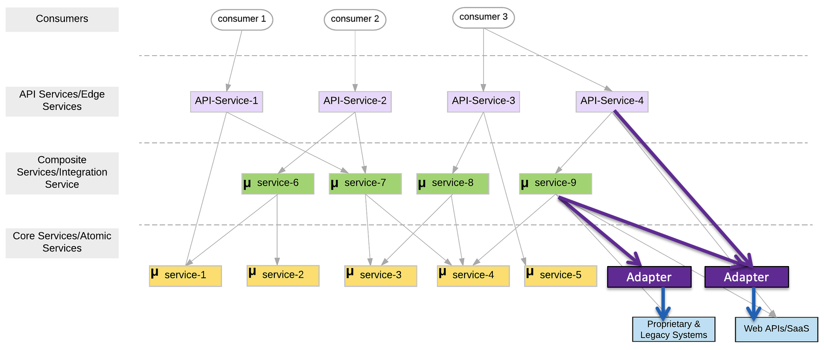
Logical Microservice Layers

Slide 21
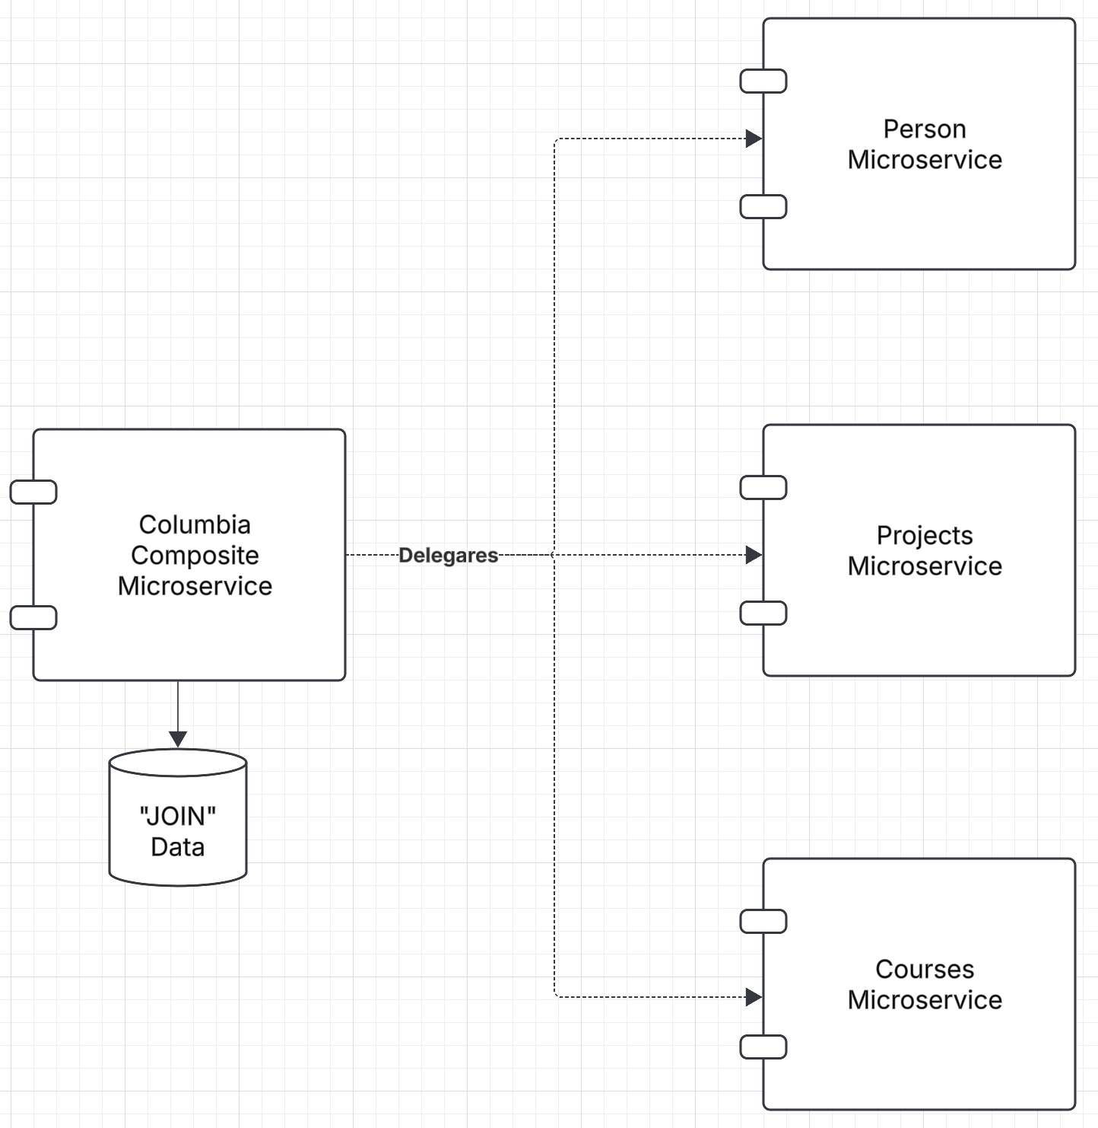
Composite Microservice
Implements implied links and referential integrity between the resources.
Maximally delegates onto basic microservices for the core information/behavior.
Maintains its own database containing
Any additional information, e.g. UNI
“Associative entities” necessary to implements the implied ”foreign keys” and “integrity.”
Implements “logical transactions” via undo when a failure occurs during update of a composite resource.
This is the pattern when the basic microservices are unaware of the other basic services.

Slide 22
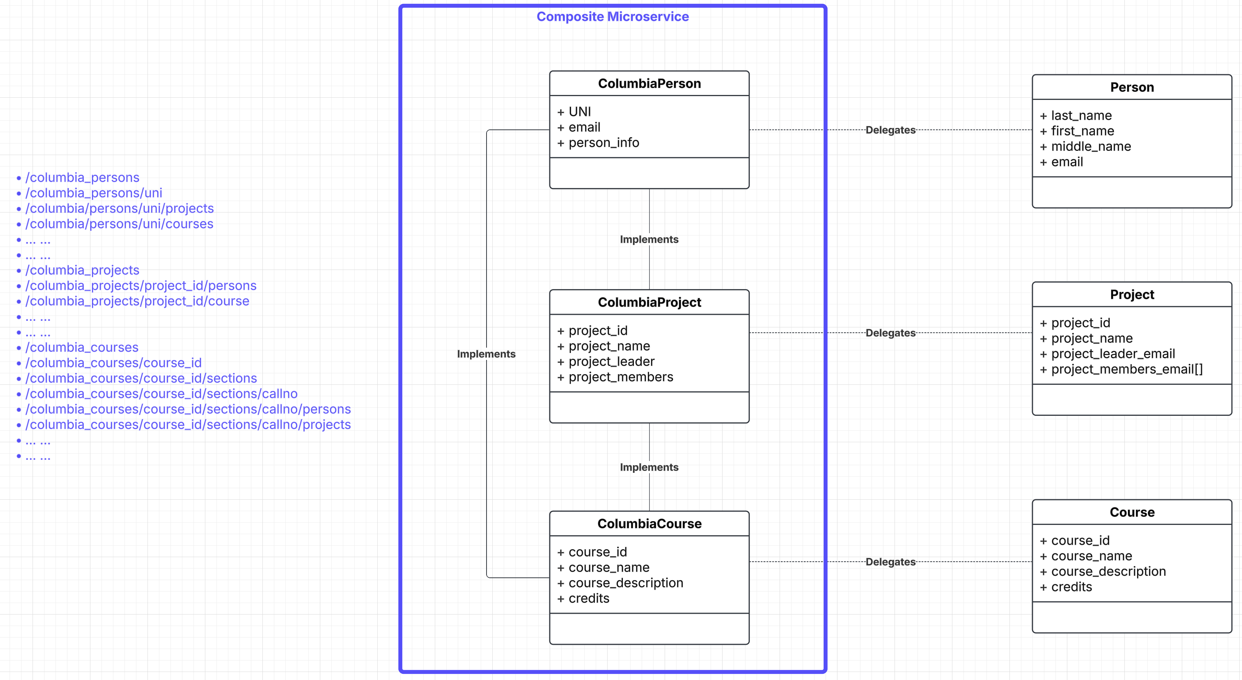
Composite Resources and Microservice

Slide 23
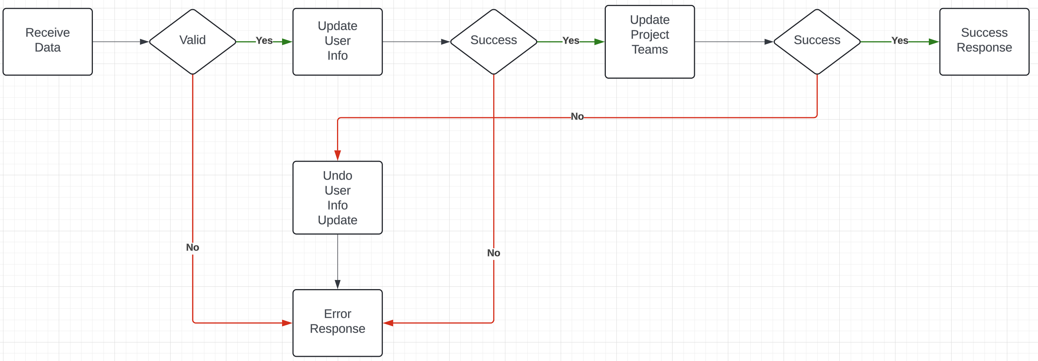
Composite Microservice Logic
The GET on the composite invokes GET on several atomic services. This can occur synchronously or asynchronously in parallel.
PUT, POST and DELETE are more complex. Your logic may have to undo some delegated updates that occur if others fail.
To get started, we will just use simple logic but explore more complex approaches.

Slide 24
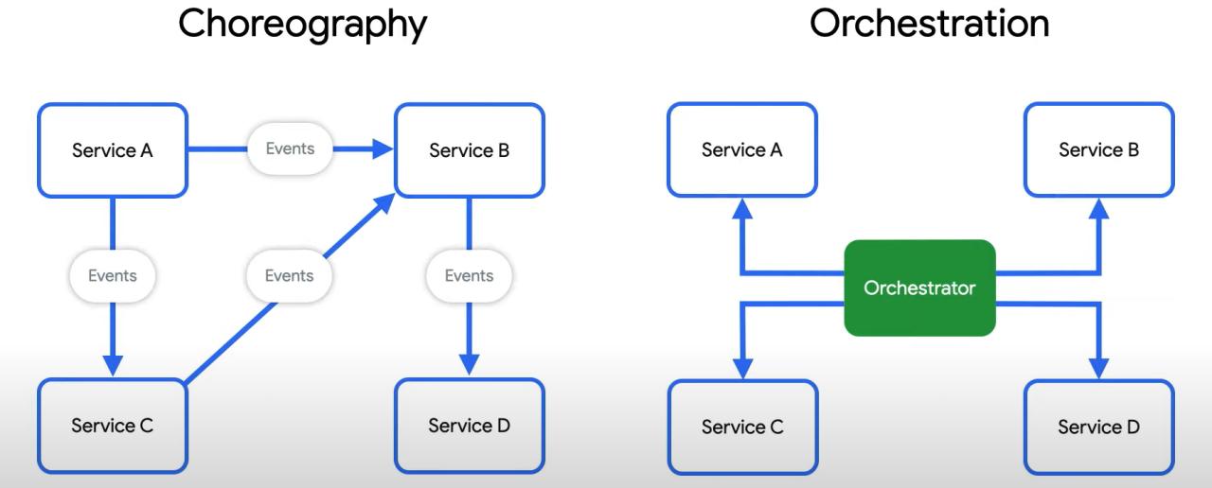
Behavioral Composition
There are two base patterns: choreography and orchestration.
There also several different implementation technologies and choices.
And many related concepts, e.g. Sagas, Event Driven Architectures, Pub/Sub, … …
We will cover and explore incrementally, but for now we will keep it simple and do traditional “if … then …” code.

Slide 25
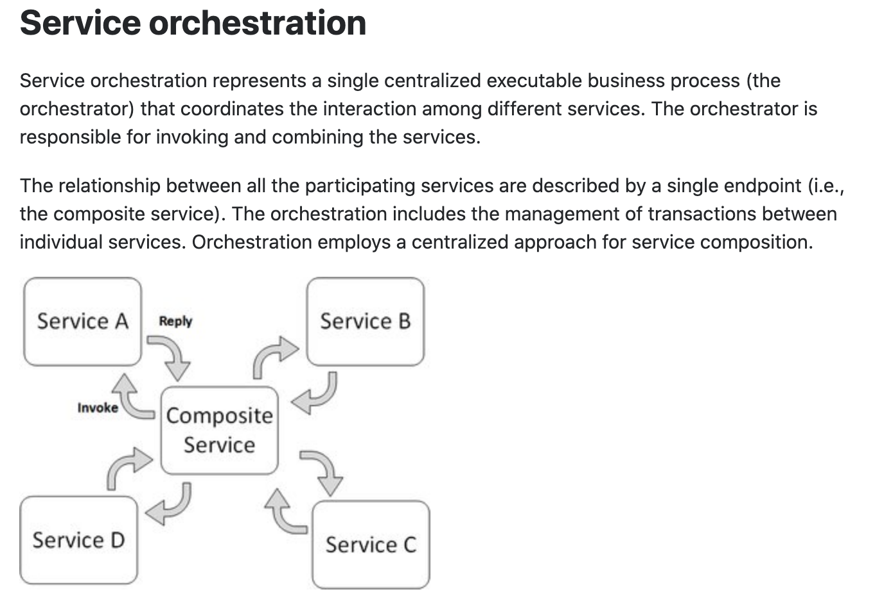
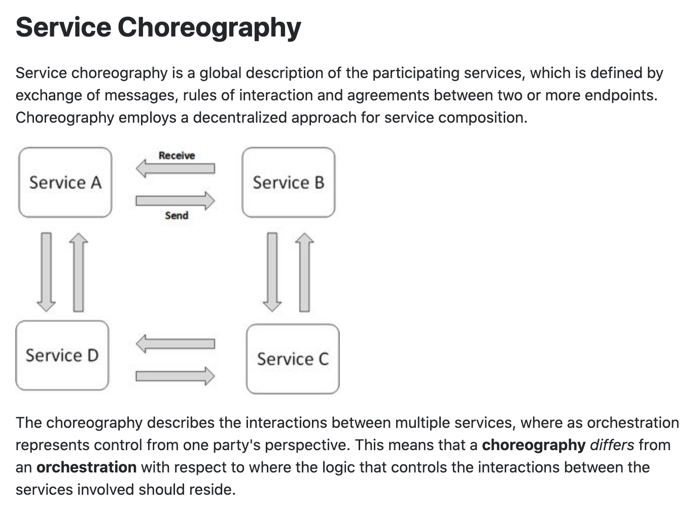
Concepts
These are not formally, rigorously defined terms.

Slide 26
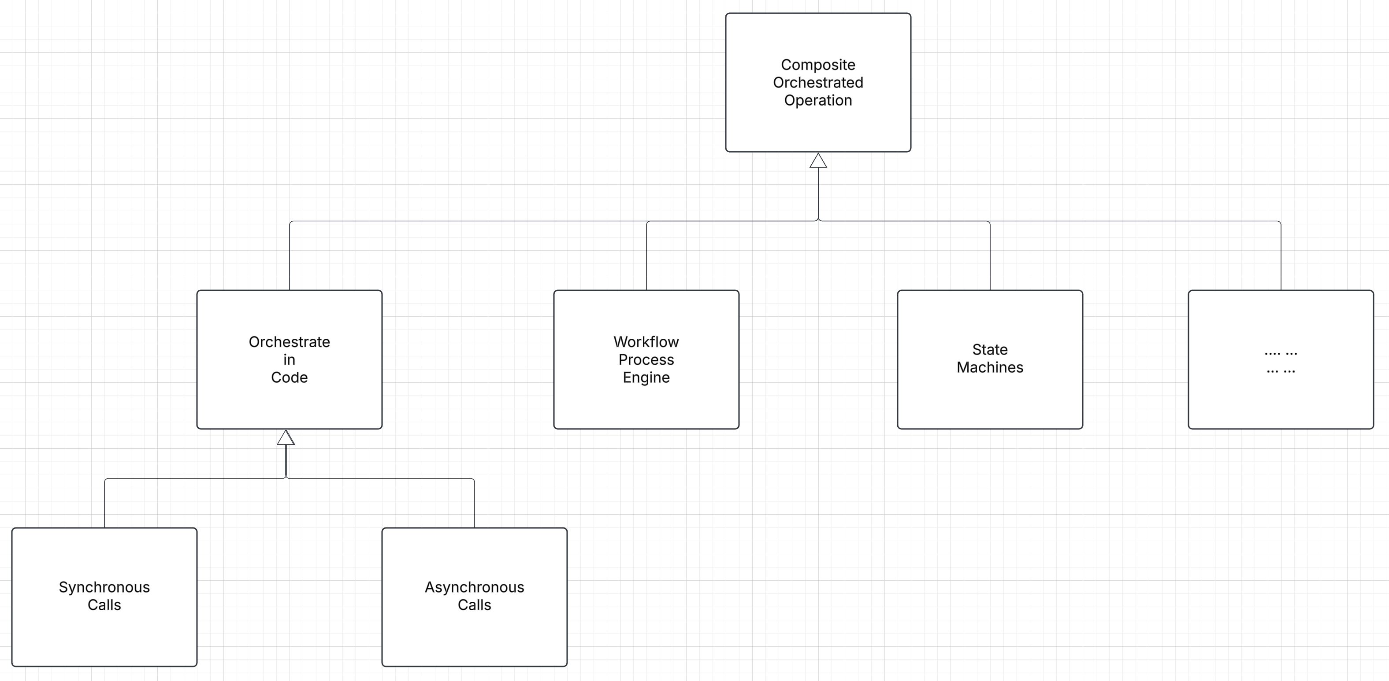
Implementing Composite Operations
There are several approaches to implementing the orchestrating composite operations.
The simplest is in code.
Process/workflow engines.
State machines.
… …

Slide 27
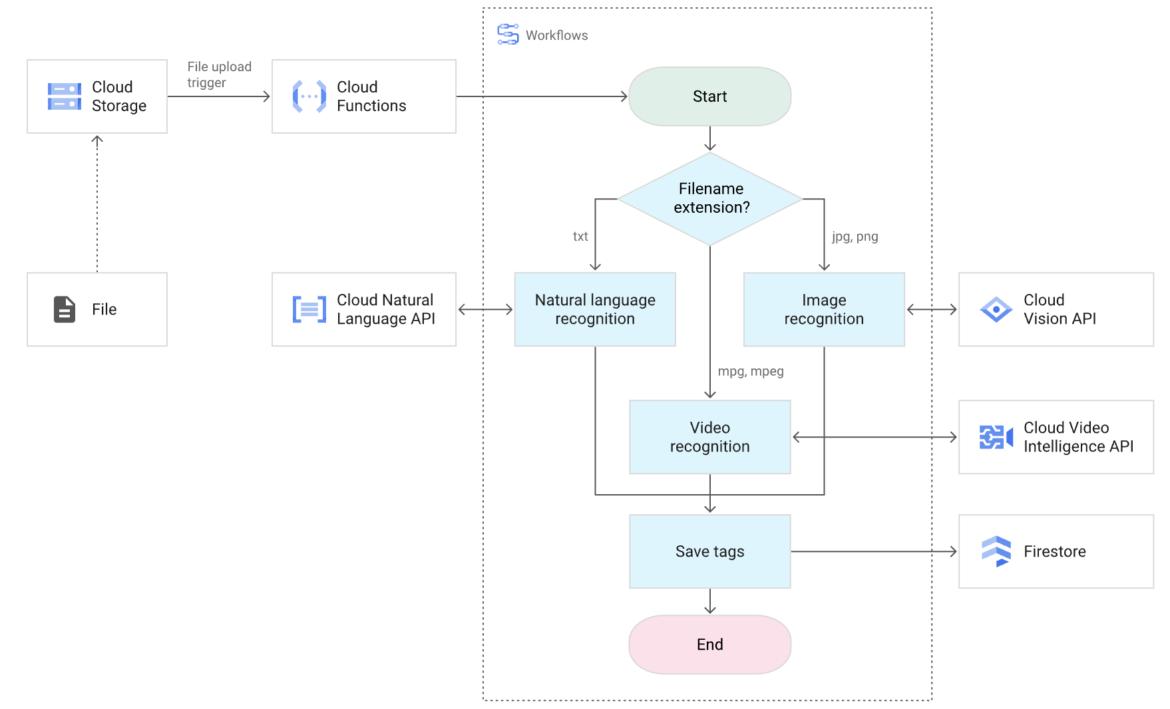
Google Cloud Workflow

Slide 28
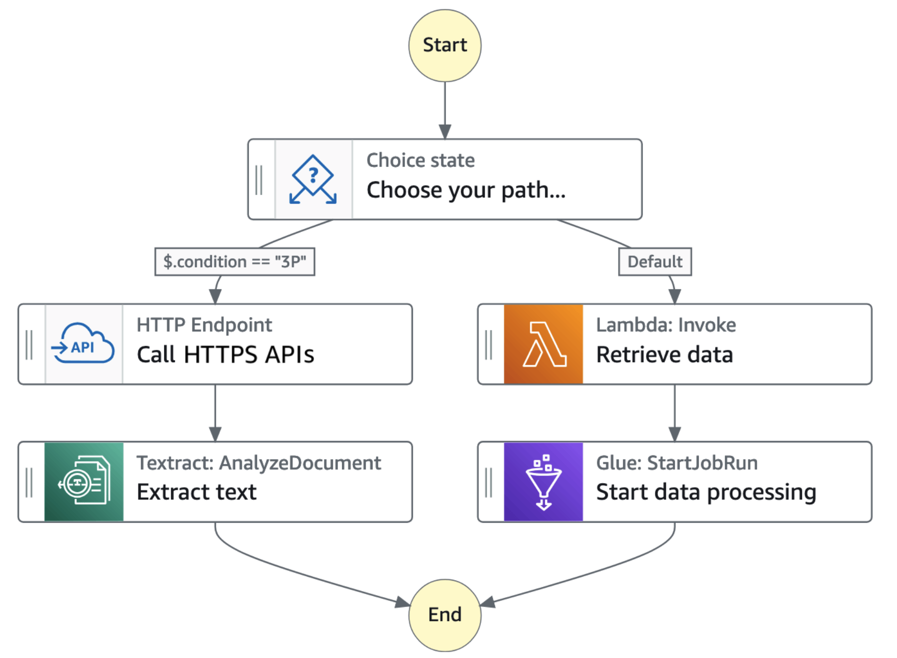
AWS Step Functions

Slide 29
In Code: Composition and Asynchronous Method Invocation
Composite operations can “take a while.”
“Holding open connections and waiting can be bad.”
Consumes resources.
Connections can break.
... ...
There are several options:
Polling
Callbacks
Asynchronous calls
Events
… …
Our next pattern is composition and “polling.” Create a new user requires:
Updating the user database.
Verifying a submitted address.
Creating an account in the catalog service.
Request
202 ACCEPTED Location
GET (Poll)
200

Slide 30
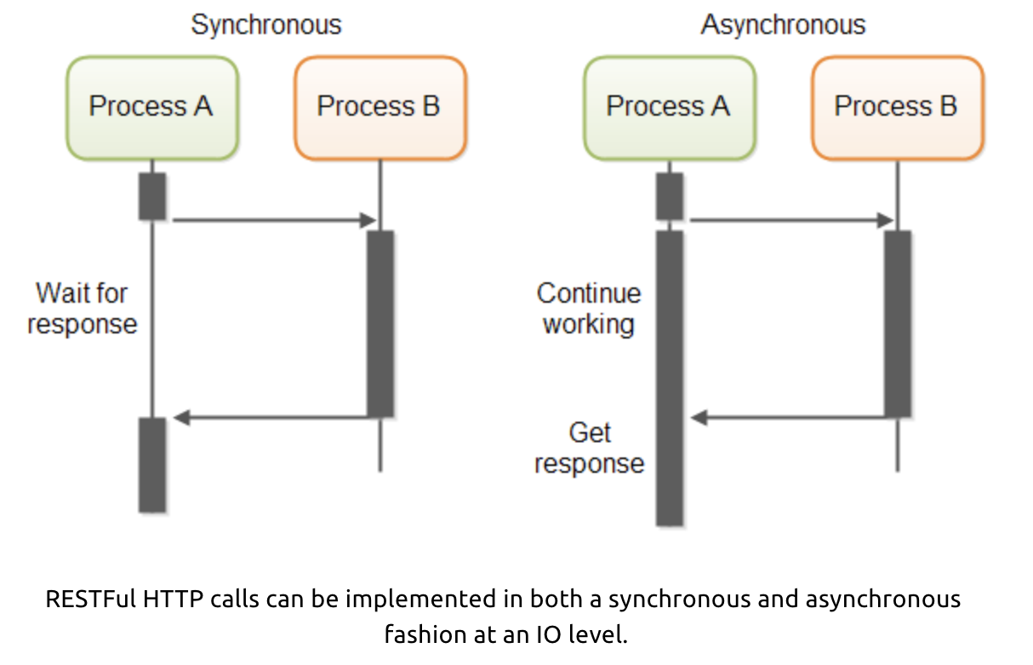
In Code: Service Orchestration/Composition
One call to a composite service
May drive calls to multiple other services.
Which in turn, may drive multiple calls to other services.
Synchronous (Wait) and calling one at a time, in order is
Inefficient
Fragile
... ...
Asynchronous has benefits but can result in complex code.

Slide 31
Synchronous/Asynchronous Show Code
Show example of calling URL synchronously and asynchronously
/Users/donald.ferguson/Dropbox/000/000-A-2025-Repos/sync_async/async1.py
/Users/donald.ferguson/Dropbox/000/000-A-2025-Repos/sync_async/sync1.py
One of the steps in your next sprint is:
Build a composite microservice that aggregates your basic microservices.
Demonstrating one method on the composite aggregating the base services synchronously.
Demonstrating one method on the composite aggregating the base services asynchronously.
Demonstrate one method using a thread and synchronous calls, implementing 202 accepted
You are probably confused as heck right now.
Think of your initial microservices as base tables.
Think of the composite as a VIEW representing a JOIN of the base tables.
Your composite microservice’s code implements the basic operations, and perhaps some additional logic, in the JOIN to “compose” that basic services.

Slide 32
Threads and Coroutines
Threads
Definition: A thread is an operating system (OS)-level execution unit. Multiple threads can run truly in parallel on multiple CPU cores (if the Global Interpreter Lock, GIL, isn’t a limiting factor).
Preemptive Scheduling: The OS decides when to pause one thread and switch to another. This can happen at any point in the code.
Context Switching: Switching between threads requires saving and restoring OS-level state, which is relatively expensive.
Use Case: Good for I/O-bound tasks (like downloading files, reading/writing to databases, waiting on network responses). For CPU-bound tasks in CPython, the GIL prevents true parallelism—so multiple threads don’t improve raw compute speed.
Coroutines
Definition: A coroutine is a special Python function declared with async def. It represents a cooperative unit of execution managed by an event loop (usually asyncio).
Cooperative Scheduling: Coroutines yield control voluntarily (using await) so other coroutines can run. Unlike threads, they don’t get interrupted at arbitrary points.
Context Switching: Switching between coroutines is very cheap—just a function call in the interpreter, no OS involvement.
Use Case: Excellent for handling massive numbers of I/O-bound tasks (e.g., serving thousands of HTTP requests). Not good for CPU-heavy tasks unless you explicitly run them in threads or processes.

Slide 33
For Now, … …
I am trying to get you familiar with basics of asynchronous programming.
There are much “cleaner” but potentially more complex ways to handle asynchronous and long running operations.
We will see several examples:
Functions
Pub/Sub
Message Queues
Workflow
But for now, just play with coroutines and threads.

Slide 34
OAuth2 Open ID Connect

Slide 35
Function-as-a-Service

Slide 36
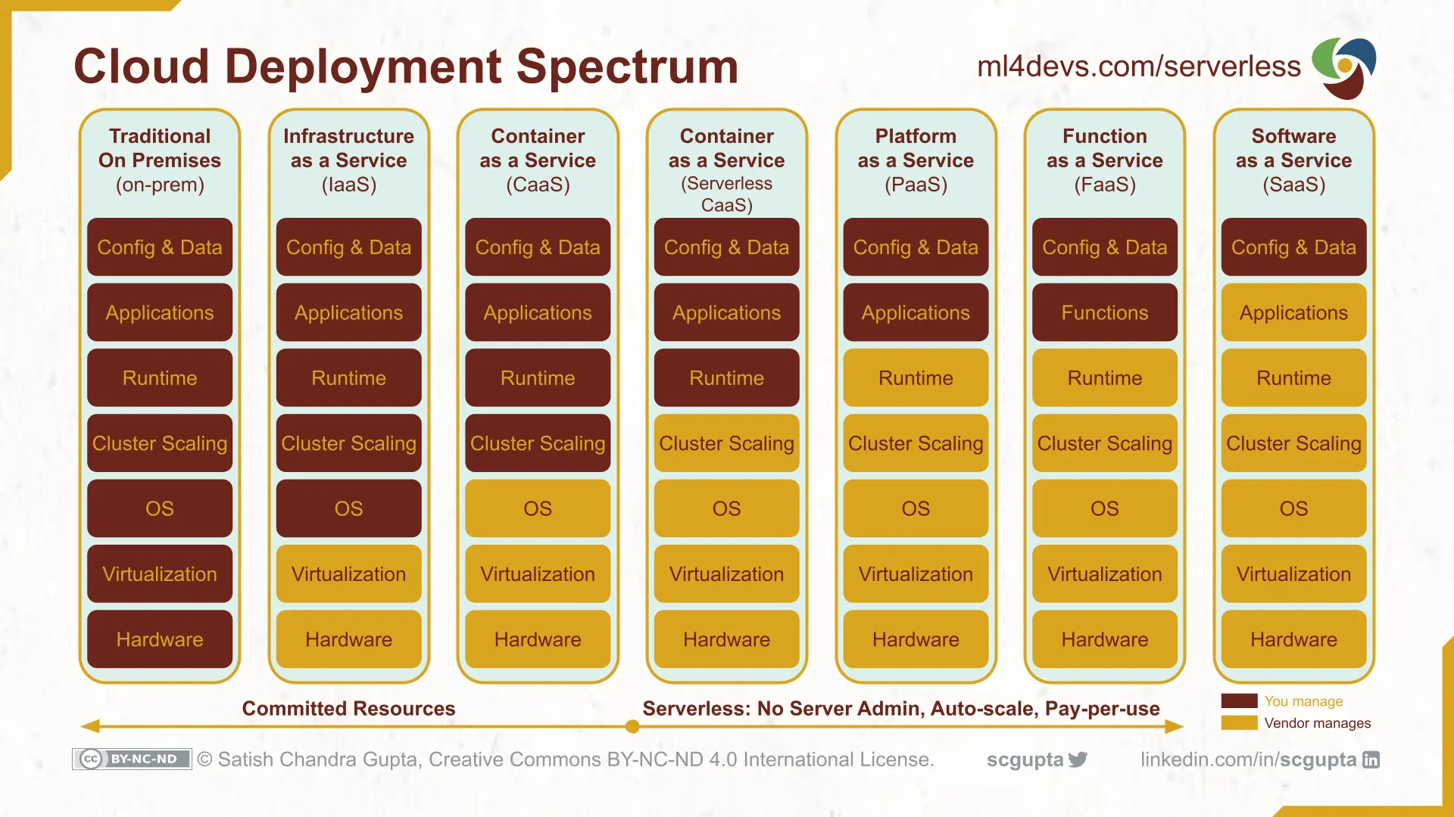
Cloud Layers

Slide 37
Function-as-a-Service Principles
Event-Driven Execution:
Specific events trigger FaaS functions. These events can be an HTTP request, a message in a queue, database update, scheduled task, … …
The corresponding function executes when an event occurs.
Think of this being like the generalization of a database trigger.
Stateless Functions: Each function is self-contained. It maintains no state between invocations, enabling easy scaling and parallel execution.
Short-Lived Execution: Functions run for a short duration, typically seconds to minutes. The system creates them when needed and removes them once their task is complete, optimizing resource use.
Managed Infrastructure: The cloud provider handles the underlying infrastructure, including servers, scaling, and security. It abstracts the functional complexities away from the developers.

Slide 38
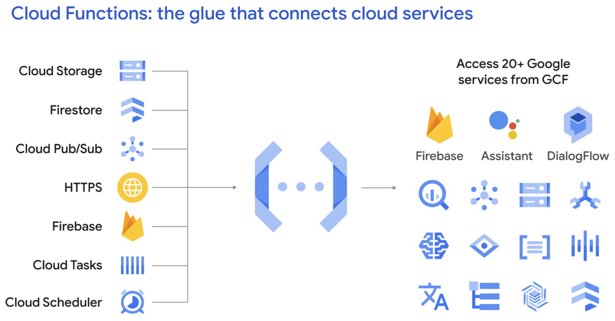
Google Cloud Functions

Slide 39
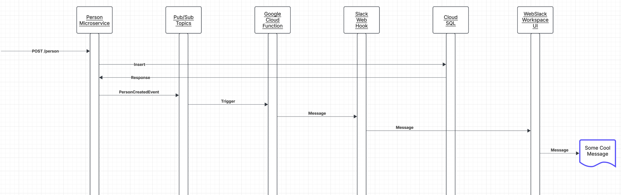
Scenario
For now, just focus on plumbing everything together.
You do not need to connect the microservice. You can just trigger with gcloud CLI.
Collaboration/Social Media space:
I will use either Slack or Discord. You can choose whatever you want.
For now, you can just write to the Google log to check and demonstrate that your function ran.

Slide 40
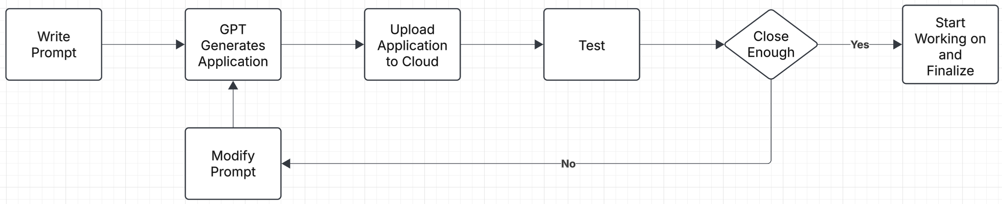
Project Walkthrough
/Users/donald.ferguson/Dropbox/000/000-A-2025-Repos/simple_html
Not tested on GCP yet. Will do this weekend, but … …
This is a simple ChatGPT generated template/starter project.
The new style of programming is … …
You can/should do the same.

Slide 41
Show Code
/Users/donald.ferguson/Dropbox/000/000-A-2025-Repos/slack-pubsub-notify
/Users/donald.ferguson/Dropbox/000/000-A-2025-Repos/pubsub-hello 2
Where are we going with this … …
We are going to learn about pub/sub an events.
We will expand our composition example to use pub/sub and functions.
We will also include some form of “user notification” in our project using functions and pub/sub
And seeing the complexity, we will look at workflow and state machines

Slide 42
12 Factor Applications

Slide 43
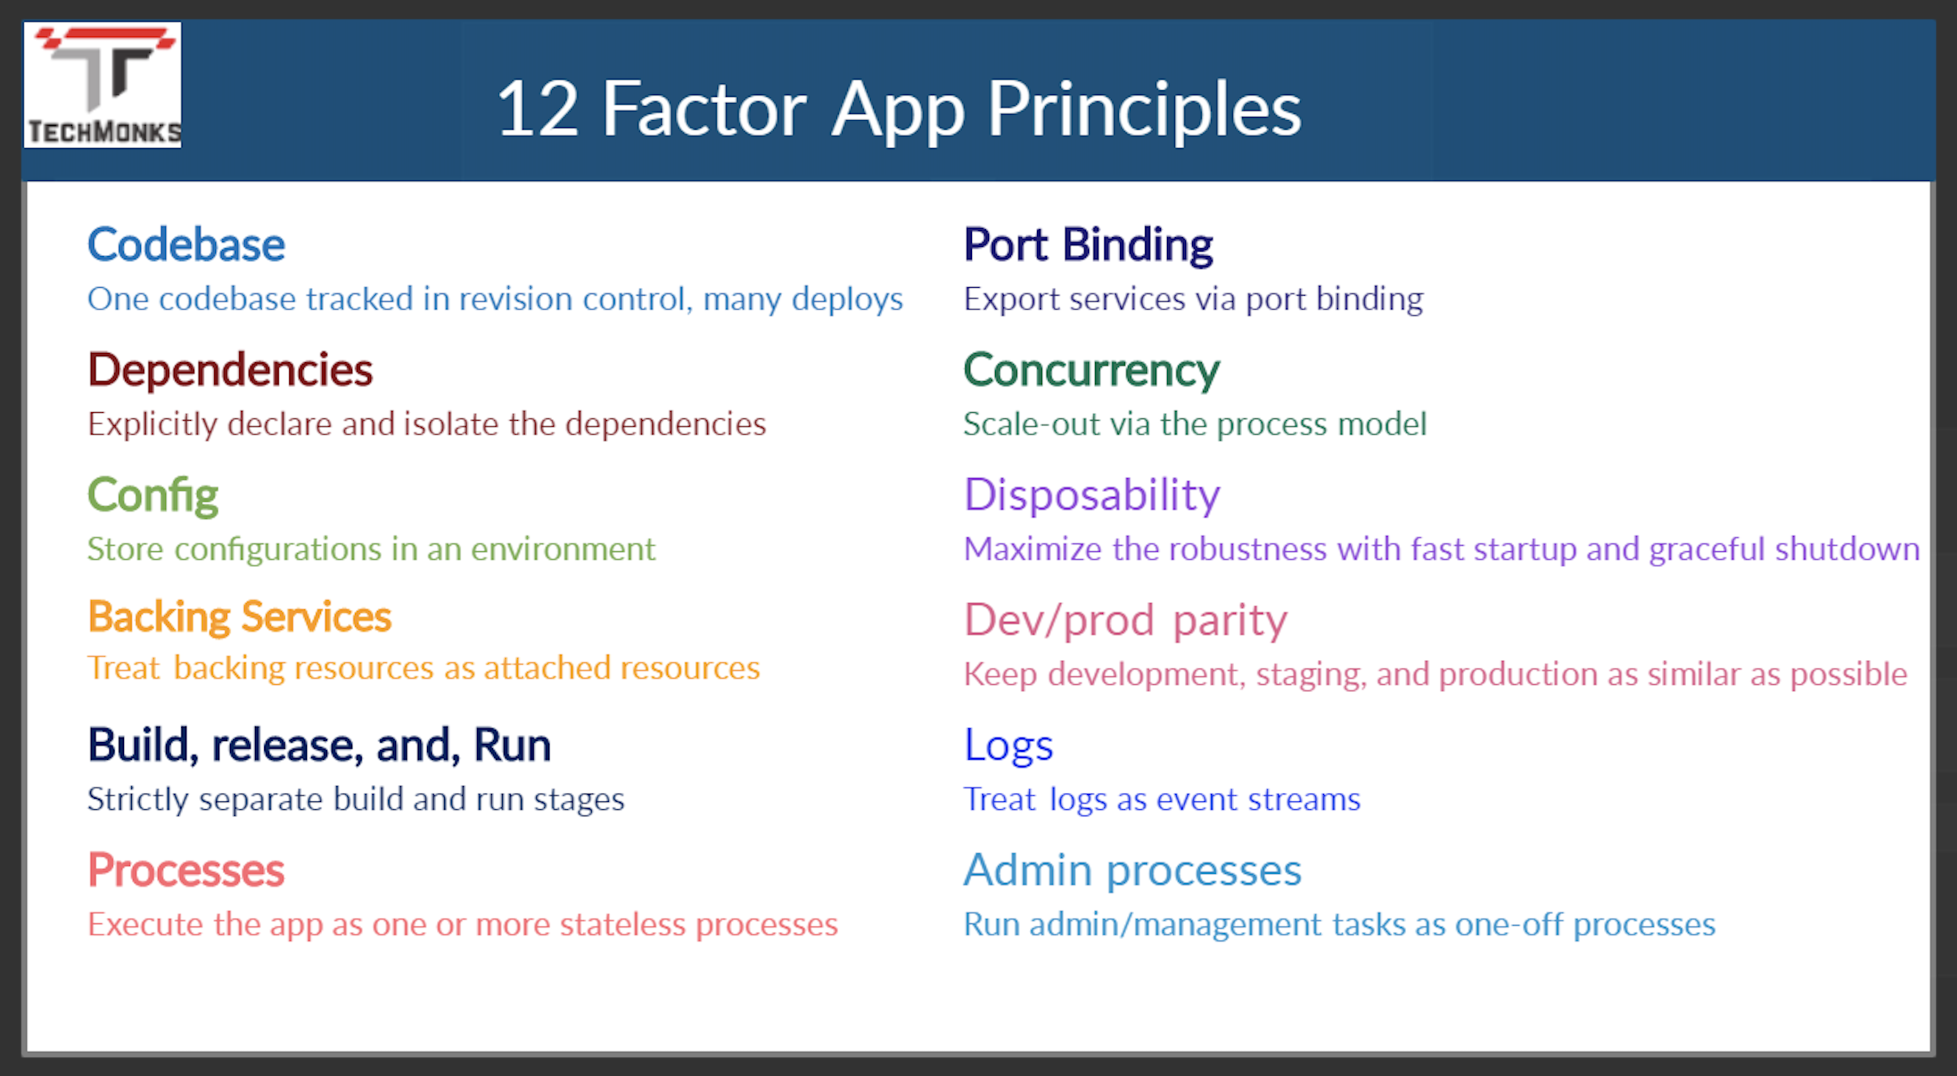
12 Factor Applications
https://dzone.com/articles/12-factor-app-principles-and-cloud-native-microser

Slide 44
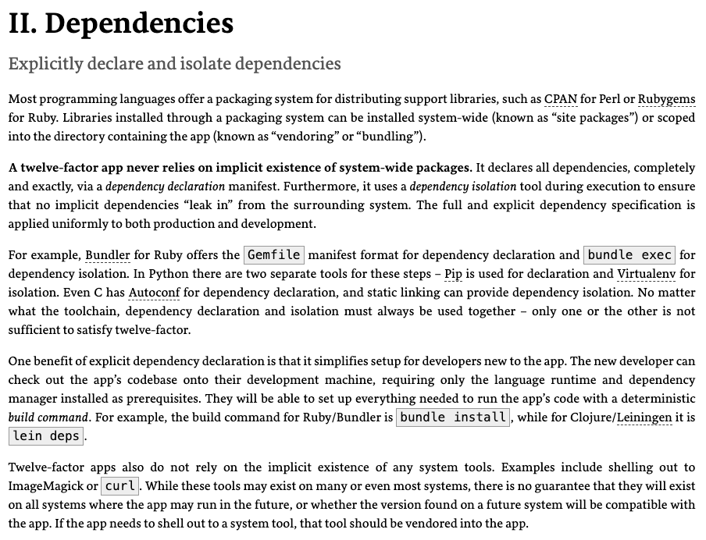
Dependencies
Most application frameworks have a dependency declaration concept.
I have been showing examples with:
Python import
requirements.txt
etc.
My examples also show encapsulating libraries and APIs with Python classes.
II. Dependencies handles “the code,” but we still need to handle the instance. There is a difference between, e.g.
pymysql
A specific connection.

Slide 45
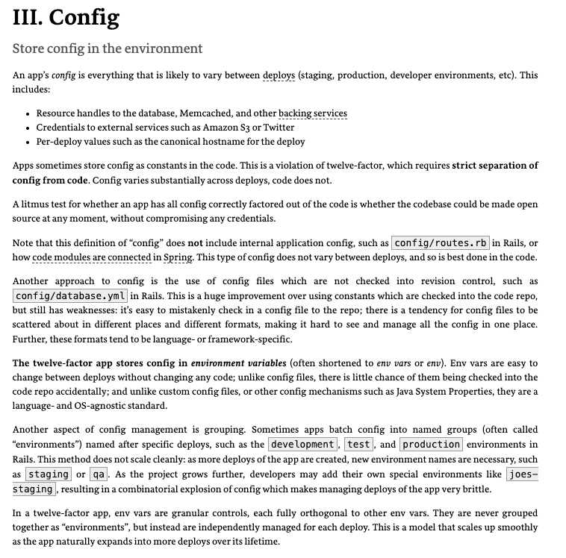
III. Configurations
Each of the deployment environments we will use has a method for configuring environment variables.
CI/CD, GitHub actions, etc. can integrate environment variables with the development process.
Vaults and secrets managers are a better approach for passwords.

Slide 46
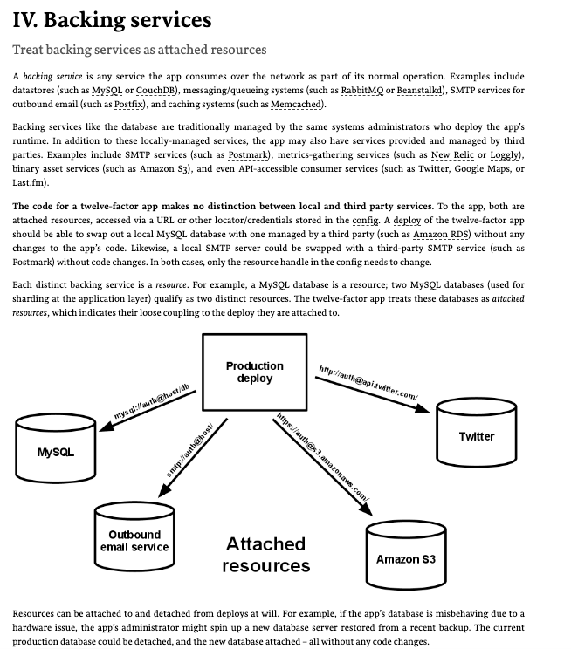
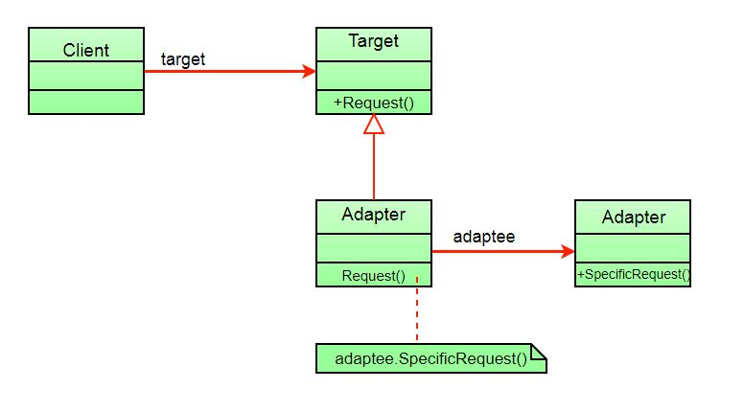
IV. Backing Services
My code has shown encapsulating backing services with a shallow adaptor.
This is an example of the adaptor pattern.
You seen examples of things like AbstractBaseDataService, … …
The approach is also an application of several aspects of SOLID. (https://en.wikipedia.org/wiki/SOLID)

Slide 47
Next Sprint

Slide 48
Next Sprint
Well-design REST applications for basic and composite microservices, e.g.
eTag
Query parameters
Linked data and relative paths
201 Created for POST
One deployed on Cloud Compute and one deployed using CaaS on Cloud Run
Composite microservices
Well-defined API
One operation implement synchronously and one operation asynchronously
DBaaS and one microservice/database pattern
1 SQL VM/Cloud Compute MySQL instance
1 or two Cloud SQL instances
Simple Cloud Storage based web UI accessing composite, and other microservices
Template/scaffolded Google Cloud Function triggered by pub/sub
Updated GitHub projects and Trello for sprints
Will document.
You can accomplish in stages.

