Slide 1
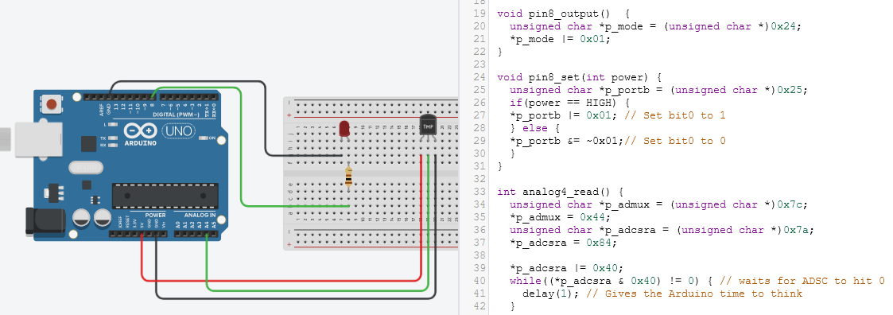
Computer Systems and Programming (CS367)
Bits, Bytes, and Booleans
CS 110 (Bases) and CS 262 (Bitwise Operations)
Prof. Kevin Andrea

Slide 2
Reading Ahead of this Lecture
This Lecture covers Chapter 2.1 (Bits and Integers) and CS 222/CS262
Reading Homework ahead of next Lecture:
Read through Chapter 2.2-2.3 (Integer Representations)
Continue to Review C
  This semester, you’ll be doing the following operations in Assembly Language
  If you know these well in C, it will be a lot easier over the next two months.
  Passing by Reference and working with Pointers in functions.
  Dereferencing Values *ptr = 42;
  Pointer Arithmetic with Arrays *(ary + 3) = 42;
  Working with Structs and Dynamic Memory
  Working with Singly Linked Lists using Dynamically Allocated Structs

Slide 3
Bits and Bytes (Chapter 2.1)
Learning Objective | Task | Description of Task
Describe the Four Key Boolean Algebra Operations | Describe and Draw a Truth Table for Boolean AND | Understand Bitwise AND when Applied to Data
 | Describe and Draw a Truth Table for Boolean OR | Understand Bitwise OR when Applied to Data
 | Describe and Draw a Truth Table for Boolean XOR | Understand Bitwise Exclusive-OR when Applied to Data
 | Describe and Draw a Truth Table for Boolean Negation | Understand Bitwise Negation when Applied to Data
Perform Bitwise and Logical Operations in C | Perform a Bitwise AND on two Integers | Understand Bitwise AND in C (&)
 | Perform a Bitwise OR on two Integers | Understand Bitwise OR in C (|)
 | Perform a Bitwise XOR on two Integers | Understand Bitwise Exclusive-OR in C (^)
 | Perform a Bitwise Negation on two Integers | Understand Bitwise Negation in C (~)
 | Apply a Bit-Mask on to an Integer | Understand using Bitwise AND/OR as Appropriate to Apply a Mask
 | Use a Bit-Mask to Extract Data from an Integer | Understand using Bitwise AND/OR as Appropriate to Apply a Mask
 | Perform a Logical AND on two Statements | Understand using Logical AND (&&) as a Boolean Expression
 | Perform a Logical OR on two Statements | Understand using Logical OR (||) as a Boolean Expression
 | Perform a Logical NOT on two Statements | Understand using Logical NOT (!) as a Boolean Expression
 | Normalize an Integer using Logical NOT | Understand using two Logical NOT (!!) to Normalize to 0/1
Perform Arithmetic Operations on Integers by Constants | Perform Left and Right Shifts on an Integer | Understand using << and >> Operators
 | Multiply an Integer by Shifts and Arithmetic | Understand how to Multiple by an Arbitrary Amount using << , +, and -
 | Divide an Integer Properly using Shifts and Arithmetic | Understand how >> performs Floor Integer Division
 | Describe the Dangers of Right Shifting in C | Understand that Right Shifts (>>) on Signed Integers is Undefined

Slide 4
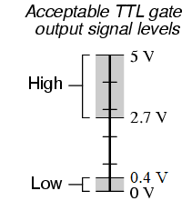
Everything in a System is just Bits
Each bit is a 0 or a 1
By encoding / interpreting sets of bits in various ways:
Computers determine what to do (operations/instructions)
Computers represent and manipulate numbers/sets/strings/etc (data)
Why bits?
Easy to store with bistable elements (electronics)
0
1
0
5.0V
2.7V
0.4V
0.0V
Image: https://learn.sparkfun.com/tutorials/logic-levels/all

Slide 5
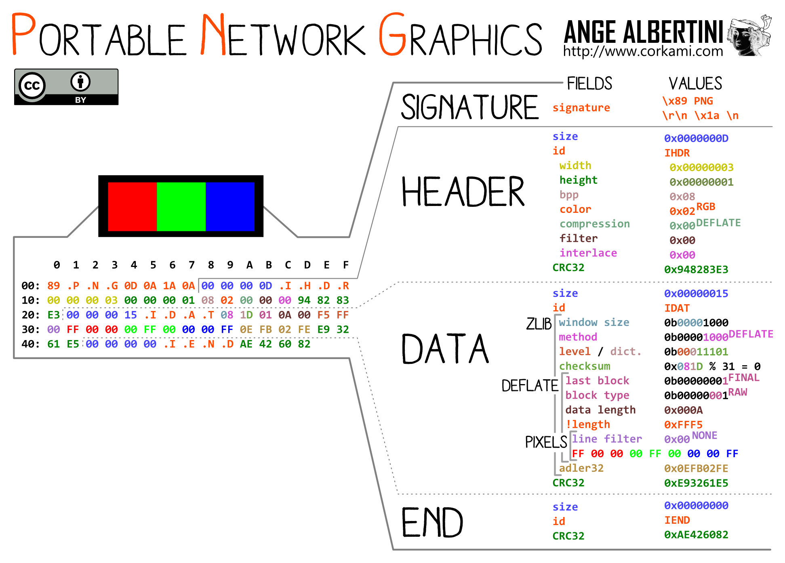
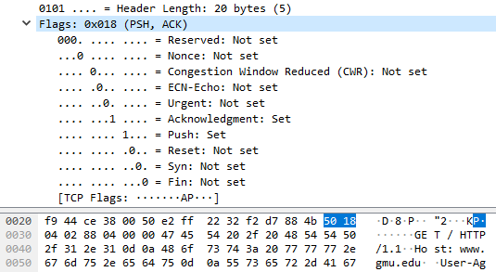
Main Points
(2.1.6)
It’s all about Bits and Bytes (Examples Shown Below)
Text (ASCII/UTF-8 and Binary Files)
Images and Media Files
Network Traffic and Headers
Image: https://github.com/corkami/pics/blob/master/binary/PNG.png

Slide 6
Boolean Algebra
(2.1.6)
Mathematical Branch of Algebra where Expressions result in True or False
All Values of Variables and Expressions are only True or False
In Computer Systems, these are denoted as:
  True: Non-Zero Value
  False: Zero Value
There are two Types of Boolean Operations in C: Logical and Bitwise
Logical Operations only result in True or False
Bitwise Operations perform Boolean operations on each pair of bits.
  The final result will be a string of bits, each of which is the result of the Boolean operation on a pair of corresponding bits.

Slide 7
Boolean Algebra (Logical Operations)
(2.1.8)
Logical Operations only result in True (non-zero) or False
These are performed on two variables in C
The output will be either 0 (for False) or 1 (for True)
AND
OR
NEGATE
A | B | A&&B
0 | 0 | 0
0 | X | 0
X | 0 | 0
X | X | 1
A | B | A||B
0 | 0 | 0
0 | X | 1
X | 0 | 1
X | X | 1
A | !A
0 | 1
X | 0
Where x is a non-zero value

Slide 8
Boolean Algebra (Logical Operations)
logic.c
(2.1.6)
Logical Operations perform Boolean operations on each Value.
Example Operation (Logical AND) on two Byte Values as a Whole
0x3C && 0x95 // && is Logical AND in C
0 | 0 | 1 | 1 | 1 | 1 | 0 | 0 | 0x3C
&& |  |  |  |  |  |  |  | (True)
1 | 0 | 0 | 1 | 0 | 1 | 0 | 1 | 0x95
== |  |  |  |  |  |  |  | (True)
0x01 |  |  |  |  |  |  |  | 0x01
 |  |  |  |  |  |  |  | (True)
According to Boolean Algebra, True AND True results with True

Slide 9
Boolean Algebra (Bitwise Operations)
(2.1.6)
Bitwise Operations perform Boolean operations on each pair of bits.
These operations are performed on each pair of corresponding bits.
The Result may be any legal value for the type (not just 0 or 1).
This looks at individual bits within a value, not the value as a whole.
AND
OR
XOR
Complement
A | B | A&B
0 | 0 | 0
0 | 1 | 0
1 | 0 | 0
1 | 1 | 1
A | B | A|B
0 | 0 | 0
0 | 1 | 1
1 | 0 | 1
1 | 1 | 1
A | B | A^B
0 | 0 | 0
0 | 1 | 1
1 | 0 | 1
1 | 1 | 0
A | ~A
0 | 1
1 | 0

Slide 10
Boolean Algebra (Bitwise Operations)
bitwise.c
(2.1.8)
Bitwise Operations perform Boolean operations on each pair of bits.
These operations are performed on each pair of corresponding bits.
0x3C & 0x95 // & is Bitwise AND in C
0 | 0 | 1 | 1 | 1 | 1 | 0 | 0 | 0x3C
& | & | & | & | & | & | & | &
1 | 0 | 0 | 1 | 0 | 1 | 0 | 1 | 0x95
↓ | ↓ | ↓ | ↓ | ↓ | ↓ | ↓ | ↓
0 | 0 | 0 | 1 | 0 | 1 | 0 | 0 | 0x14

Slide 11
General Boolean Expressions
(2.1.6)
What are the results of the following expressions as an 8-bit Hex value?
A&B
A = 0x49
A|B
B = 0x55
A^B
~B

Slide 12
General Boolean Expressions
(2.1.6)
What are the results of the following expressions as an 8-bit Hex value?
A&B
0x41
A = 0x49
A|B
0x5D
0 | 1 | 0 | 0 | 1 | 0 | 0 | 1
A^B
0x1C
B = 0x55
~B
0xAA
0 | 1 | 0 | 1 | 0 | 1 | 0 | 1

Slide 13
Bitwise Expressions in C
question2.c
(2.1.7)
Let’s look at this in C code just for fun.
A&B
0x41
unsigned char A = 0x49;
unsigned char B = 0x55;
printf("0x%.2x\n", A&B);
printf("0x%.2x\n", A|B);
printf("0x%.2x\n", A^B);
printf("0x%.2x\n", (unsigned char)~B);
A|B
0x5D
A^B
0x1C
~B
0xAA
printf("0x%.2x\n", ~B);
0xffffffaa
printf("0x%.2x\n", ~B & 0xFF);
0xaa

Slide 14
Bitwise Expressions in C
question2.c
(2.1.7)
Let’s take a look under the hood... a little. (Don’t worry, this won’t be on a test)
unsigned char A = 0x49;
unsigned char B = 0x55;
printf(" A is %d Bytes\n", sizeof(A));
printf(" B is %d Bytes\n", sizeof(B));
printf(" A&B is %d Bytes\n", sizeof(A&B));
printf(" A|B is %d Bytes\n", sizeof(A|B));
printf(" A^B is %d Bytes\n", sizeof(A^B));
printf(" ~B is %d Bytes\n", sizeof(~B)); printf("A&&B is %d Bytes\n", sizeof(A&&B));
printf("A||B is %d Bytes\n", sizeof(A||B));printf(" !B is %d Bytes\n", sizeof(!B));
This integer promotion applies to all Arithmetic Operations on chars and shorts!
A is 1 Bytes
B is 1 Bytes
A&B is 4 Bytes
A|B is 4 Bytes
A^B is 4 Bytes
~B is 4 Bytes
A&&B is 4 Bytes
A||B is 4 Bytes
!B is 4 Bytes

Slide 15
Example: Representing Sets
Bitwise Operations can be used to Represent Sets
 | 7 | 6 | 5 | 4 | 3 | 2 | 1 | 0 | Members
A | 0 | 1 | 1 | 0 | 1 | 0 | 0 | 1 | A = {0,3,5,6}
B | 0 | 1 | 0 | 1 | 0 | 1 | 0 | 1 | B = {0,2,4,6}
Operations on the above Bits (representing Set Operations)
  & Intersection (A&B) 01000001 { 0, 6 }
  | Union (A|B) 01111101 { 0, 2, 3, 4, 5, 6 }
  ^ Symmetric diff. (A^B) 00111100 { 2, 3, 4, 5 }
  ~ Complement (~B) 10101010 { 1, 3, 5, 7 }

Slide 16
Bitwise Masking
mask.c
MSB |  |  |  |  |  |  | LSB
0 | 0 | 1 | 0 | 1 | 0 | 1 | 0
Bit 7 |  |  | ... | Bit 3 | Bit 2 | Bit 1 | Bit 0
Common Techniques
Setting certain bits to a 1:
Example: You have a char and want to set bits 1 and 2. (LSB is Bit 0)
Mask: Use a mask with a value with the 1 bits you want to set.
00000110 = 0x6
OR: Apply the mask with the bitwise OR operator to set those bits.
mask = 0x6;
value |= mask;
1) Set bits 1 and 2 to a 1.
value: 0x2a (00101010)
With mask: 0x2e (00101110)

Slide 17
Bitwise Masking
mask.c
MSB |  |  |  |  |  |  | LSB
0 | 0 | 1 | 0 | 1 | 0 | 1 | 0
Bit 7 |  |  | ... | Bit 3 | Bit 2 | Bit 1 | Bit 0
Common Techniques
Setting certain bits to a 0 (clearing bits):
Example: You have a char and want to clear bits 1 and 2. (LSB is Bit 0)
Mask: Use a mask with a value with the 0 bits you want to clear.
11111001 = 0xF9 // ~00000110
AND: Apply the mask with the bitwise AND operator to clear the bits.
mask = 0xF9;
value &= mask;
2) Clear bits 1 and 2 (set to a 0).
value: 0x2a (00101010)
With mask: 0x28 (00101000)

Slide 18
Bitwise Masking
mask.c
MSB |  |  |  |  |  |  | LSB
0 | 0 | 1 | 0 | 1 | 0 | 1 | 0
Bit 7 |  |  | ... | Bit 3 | Bit 2 | Bit 1 | Bit 0
Common Techniques
Flipping certain bits:
Example: You have a char and want to flip bits 1 and 2.
Mask: Use a mask with a value with the 1 bits you want to flip.
00000110 = 0x6
XOR: Apply the mask with the bitwise XOR operator to flip those bits.
mask = 0x6;
value ^= mask;
3) Flip bits 1 and 2.
value: 0x2a (00101010)
With mask: 0x2c (00101100)

Slide 19
Bitwise Reading
MSB |  |  |  |  |  |  | LSB
0 | 0 | 1 | 0 | 1 | 0 | 1 | 1
Bit 7 |  |  | ... | Bit 3 | Bit 2 | Bit 1 | Bit 0
Reading certain bits:
Example: You have a char and want to read bit 1.
Mask: Use a mask with a value with the 1 bits you want to read.
00000010 = 0x2
AND: Apply the mask with bitwise AND operator to KEEP those bits.
mask = 0x2;
value &= mask;
Now, your chat has only two values possible: 0 or non-zero.
You can use other techniques to turn that value into a 0 or 1.

Slide 20
Bitwise Reading
MSB |  |  |  |  |  |  | LSB
0 | 0 | 1 | 0 | 1 | 0 | 1 | 1
Bit 7 |  |  | ... | Bit 3 | Bit 2 | Bit 1 | Bit 0
Alternate Version for
Reading certain bits:
Example: You have a char and want to read bit 1.
1) Shift the value to put the bit of interest on the right.
value // 00101011
value // 00010101 <- After >> 1
2) Apply a mask with bitwise AND operator to KEEP the LSB only.
mask = 0x1; // 00000001
value &= mask;
value // 00000001 <- After AND mask
Now, your chat has only two values possible: 0 or 1

Slide 21
Bitwise Combining
Example: You have have a value that only uses the lower 2-bits and want to put it inside the middle 2-bits of result.
result // 01000100
value // 11010010 <- Other bits garbage
1) Use a mask to set all other bits of value to 0 to clean it up.
result // 01000100
value // 00000010 <- Last 2 bits clean now
2) Now, shift value to put those two bits in the middle.
value // 00010000 <- 2 bits in right place!
3) Now, OR the result with value
result // 01010100

Slide 22
Shift Operations (Left Shift)
(2.1.9)
C also lets you shift bits in a value to the left or to the right.
Left Shift
Shifts the bits in a value x to the left by k bits.
  The first k bits shifted off the left are discarded.
Fills the new k bits on the right with 0s.
x << k
char x = 0x5B;
x <<= 3;
Before | 0 | 1 | 0 | 1 | 1 | 0 | 1 | 1 | 0x5B
Shift: | x << 3
After | 1 | 1 | 0 | 1 | 1 | 0 | 0 | 0 | 0xD8

Slide 23
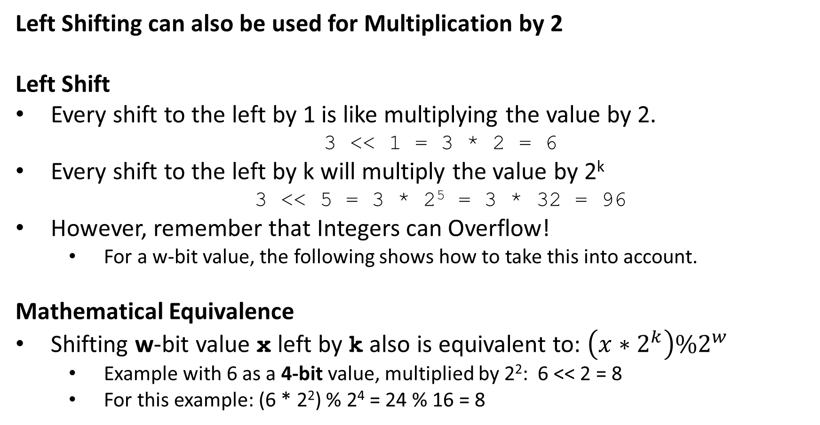
Using Left Shift to Multiply
(2.1.9)
Left Shifting can also be used for Multiplication by 2
Left Shift
Every shift to the left by 1 is like multiplying the value by 2.
  3 << 1 = 3 * 2 = 6
Every shift to the left by k will multiply the value by 2^{k}
  3 << 5 = 3 * 2⁵ = 3 * 32 = 96
However, remember that Integers can Overflow!
  For a w-bit value, the following shows how to take this into account.
Mathematical Equivalence
Shifting w-bit value x left by k also is equivalent to: $\left(x∗2^{k}\right)\%2^{w}$
  Example with 6 as a 4-bit value, multiplied by 2²: 6 << 2 = 8
  For this example: (6 * 2²) % 2⁴ = 24 % 16 = 8
x << k

Slide 24
Shift Operations (Right Shift)
(2.1.9)
C also lets you shift bits in a value to the left or to the right.
Right Shift
Shifts the bits in a value x to the right by k bits.
Fills in with 0s or 1s on the right. It depends on the Type
Types of Right Shifts
Logical Right Shift: Shift in 0s from the left.
Arithmetic Right Shift: Shift in the MSB from the left.
(Most Significant Bit)
Undefined Behavior if k < 0 or if k >= Word Size
x >> k

Slide 25
Shift Operations (Unsigned Right Shift)
(2.1.9)
C Compilers Generally Use (assume these for Zeus):
Logical Right Shift: Unsigned Integer Types
Shifts the bits in a value x to the right by k bits.
  Those last k bits shifted off the right side are discarded.
Fills the new k bits on the left with 0s.
  Only if this was an UNSIGNED int.
unsigned char x = 0x92;
x >>= 3;
Before | 1 | 0 | 0 | 1 | 0 | 0 | 1 | 0 | 0x92
Shift | x >>= 3
After | 0 | 0 | 0 | 1 | 0 | 0 | 1 | 0 | 0x12

Slide 26
Shift Operations (Signed Right Shift)
(2.1.9)
C Compilers Generally Use (assume these for Zeus):
Arithmetic Right Shift: Signed Integer Types
Shifts the bits in a value x to the right by k bits.
  Those last k bits shifted off the right side are discarded.
Fills the new k bits on the left with MSB
  Copy the MSB and use that Value.
char x = 0x92;
x >>= 3;
MSB
Before | 1 | 0 | 0 | 1 | 0 | 0 | 1 | 0 | 0x92
Shift | x >>= 3
After | 1 | 1 | 1 | 1 | 0 | 0 | 1 | 0 | 0xF2
Copies of the MSB (1) Value

Slide 27
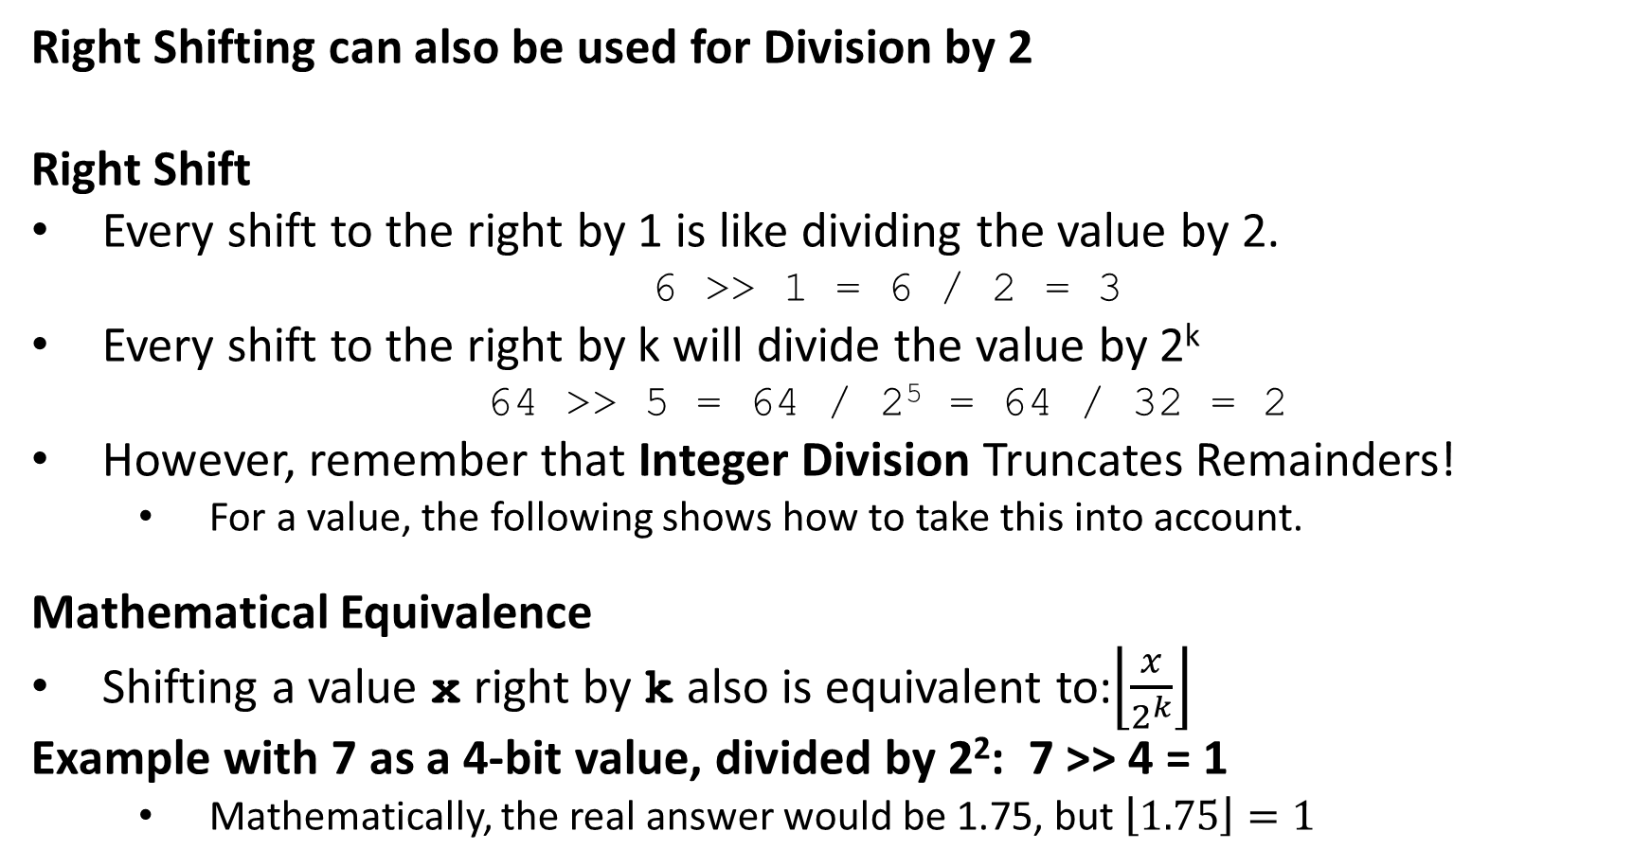
Using Right Shift to Divide
(2.1.9)
Right Shifting can also be used for Division by 2
Right Shift
Every shift to the right by 1 is like dividing the value by 2.
  6 >> 1 = 6 / 2 = 3
Every shift to the right by k will divide the value by 2^{k}
  64 >> 5 = 64 / 2⁵ = 64 / 32 = 2
However, remember that Integer Division Truncates Remainders!
  For a value, the following shows how to take this into account.
Mathematical Equivalence
Shifting a value x right by k also is equivalent to:$\left\lfloor \frac{x}{2^{k}}\right\rfloor$
Example with 7 as a 4-bit value, divided by 2²: 7 >> 4 = 1
  Mathematically, the real answer would be 1.75, but $\left\lfloor 1.75\right\rfloor =1$
x >> k

