Slide 1
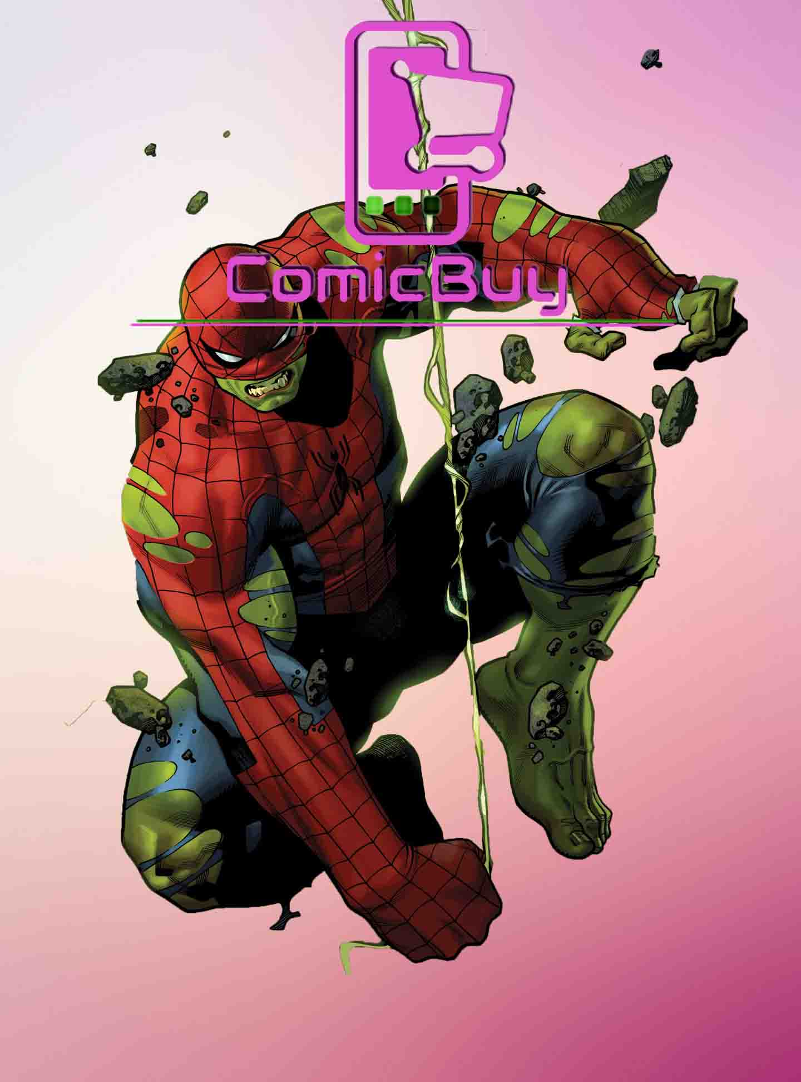
Project Zero Website
By Donald Lopez

Slide 2
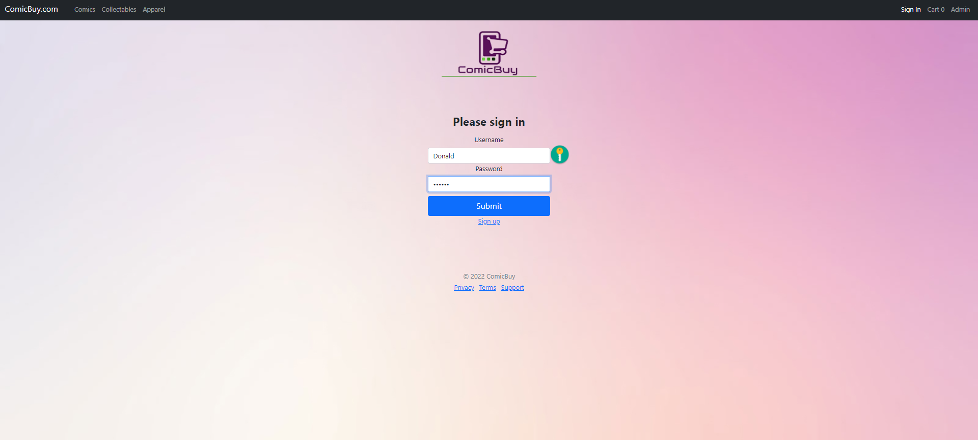
Welcome to my ComicBuy Website
This my login page kept it simple.

Slide 3
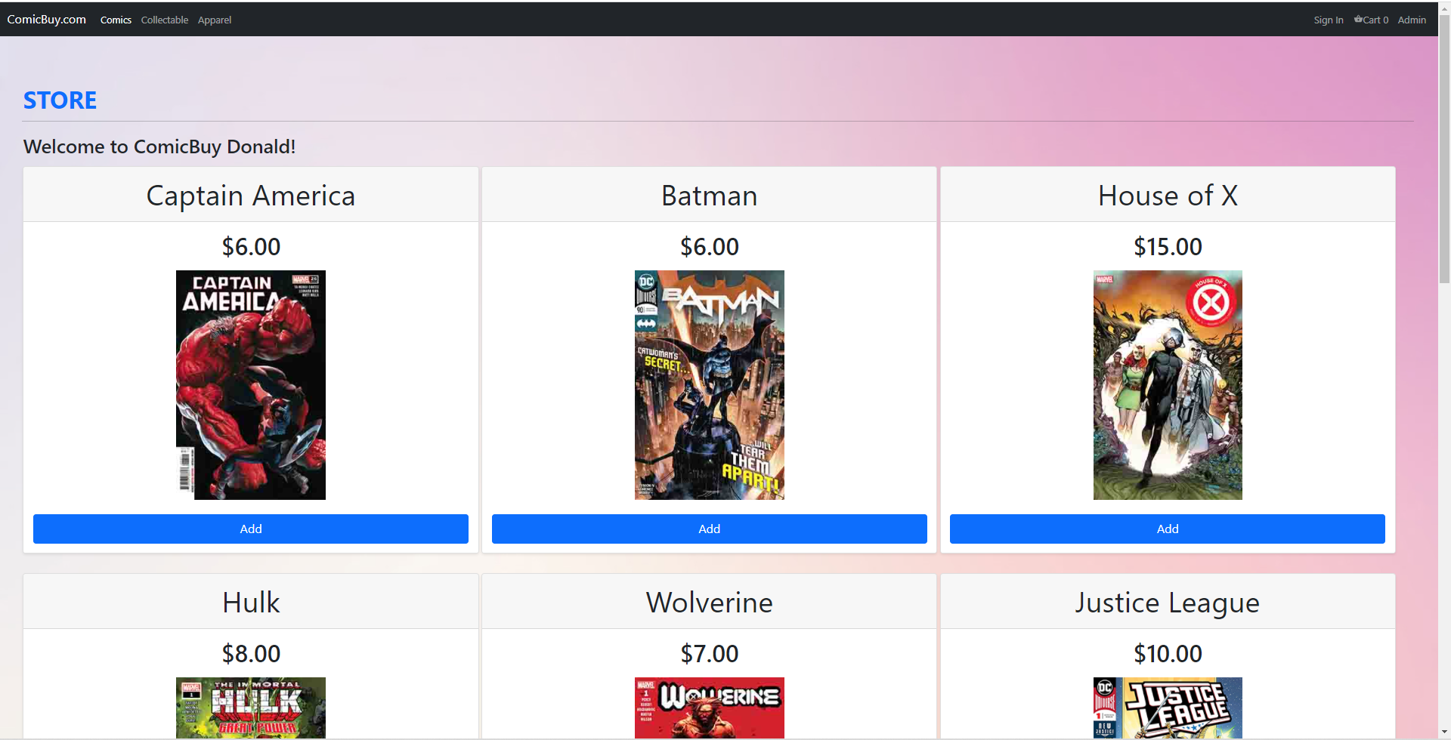
This is my Store at ComicBuy

Slide 4
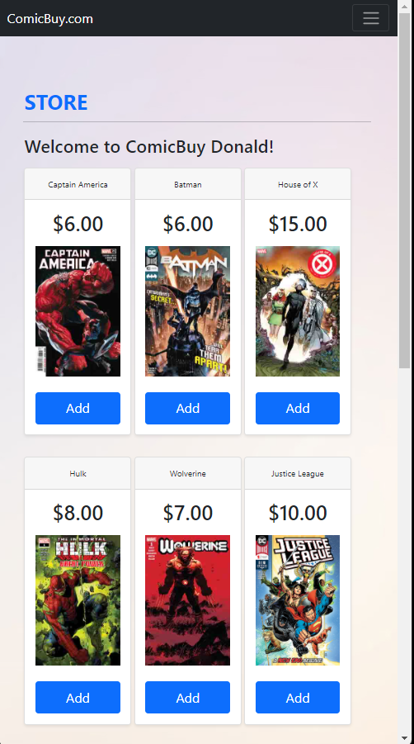
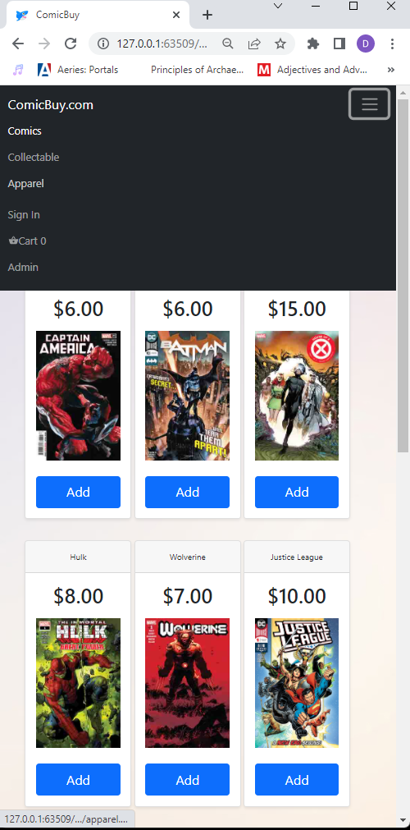
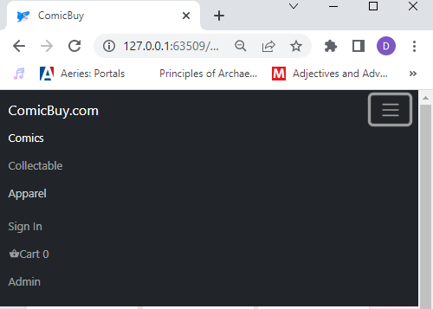

I made my Website Responsive
with a Dropdown Navbar
added a Favicon in my browser tab

Slide 5
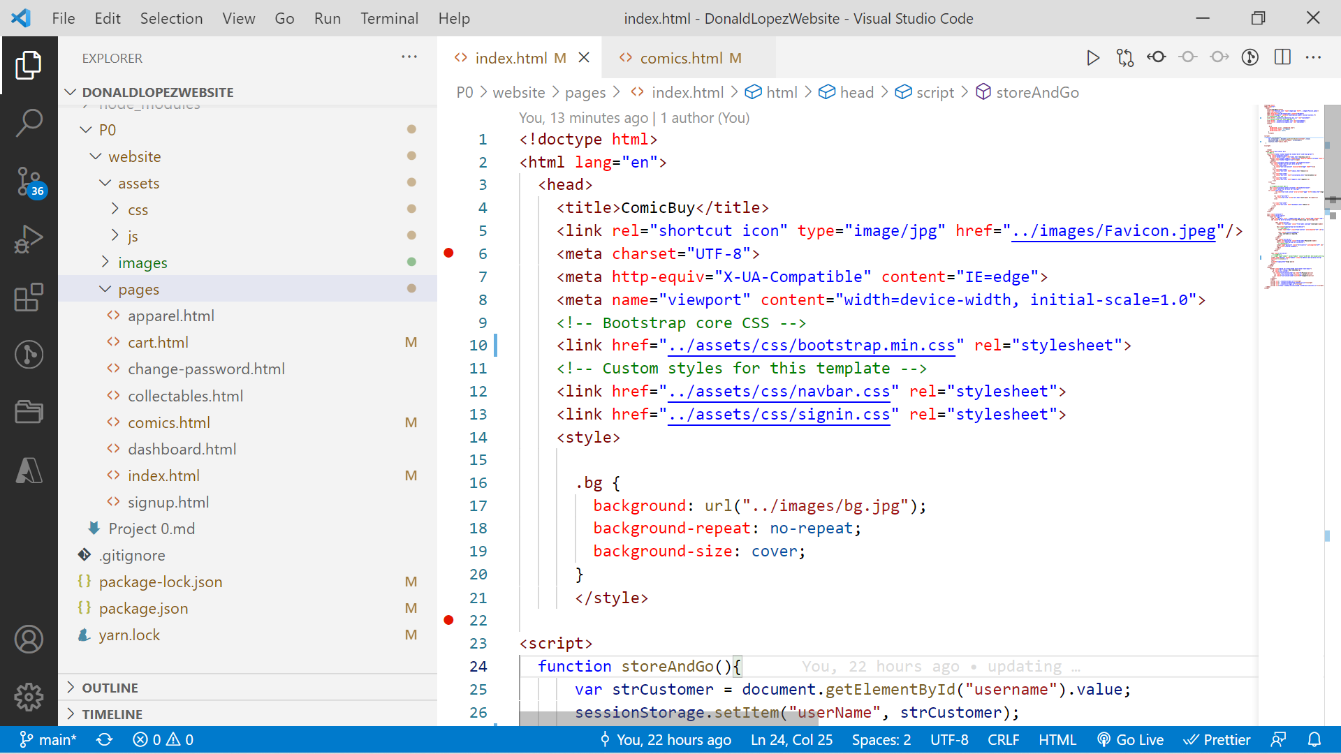







How I Organized my Files
Code Preview

Slide 6
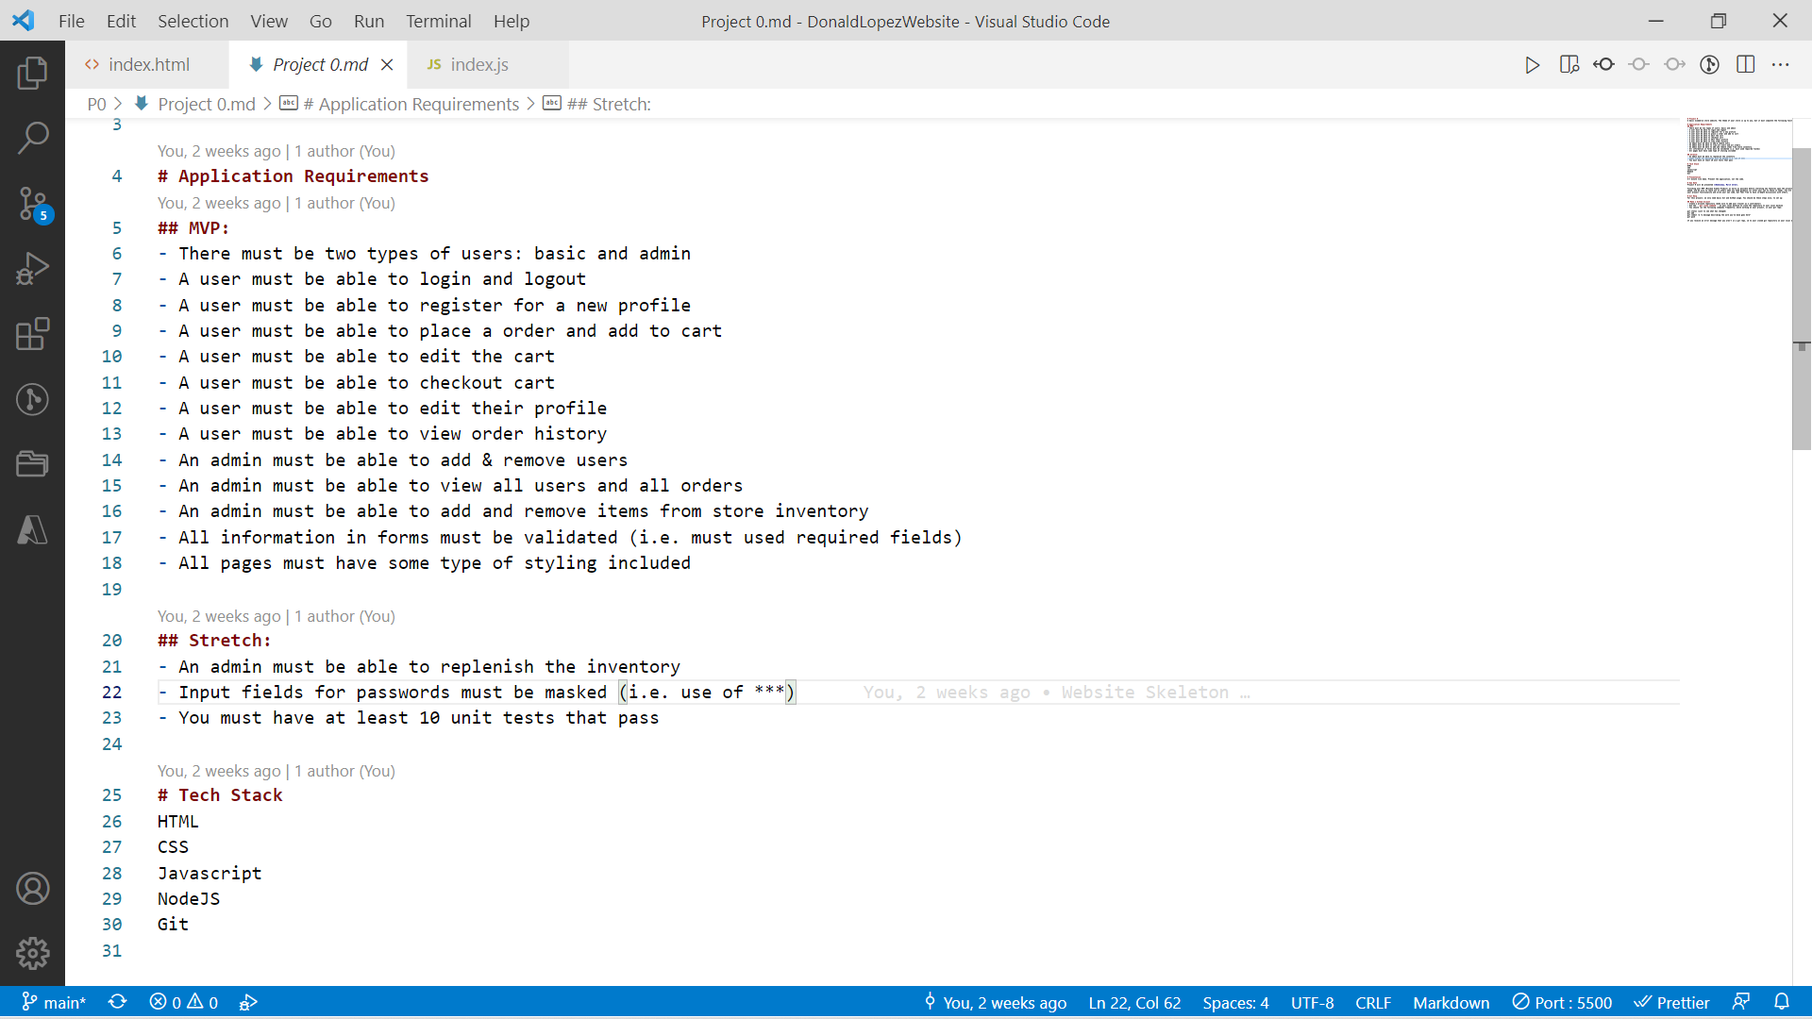





P0 CHECKLIST What I learned? My Web design is stronger than my Web development.
How I feel after P0?
Can I try again?

