Slide 1
Coded Unit Testing with RUnit
And A Little on [S]OLID & TDD
Donald Sawyer (Donald.Sawyer@gmail.com)
Presentation & Source Code on GitHub:
https://github.com/donaldsawyer/Demos/tree/master/tcrug/unit_testing

Slide 2
What is Unit Testing?
Types of testing
Unit
Integration
System
Unit Testing
Testing of an individual code module, function, or “unit”
Done by a developer before deployment
Verifies input/output of a “unit”
Why?
Verify the individual components perform as expected
Gain confidence that “done” code is still working as the program changes

Slide 3
An Introduction to SOLID
SOLID Principles of Object-Oriented Design
S – Single Responsibility
O – Open/Closed Principle
L – Liskov Substitution
I – Interface Segregation
D – Dependency Inversion
Single Responsibility
A module should have a single responsibility and that responsibility should be entirely encapsulated in the module
A module should have one, and only one, reason to change
THIS is what we’ll unit test tonight

Slide 4
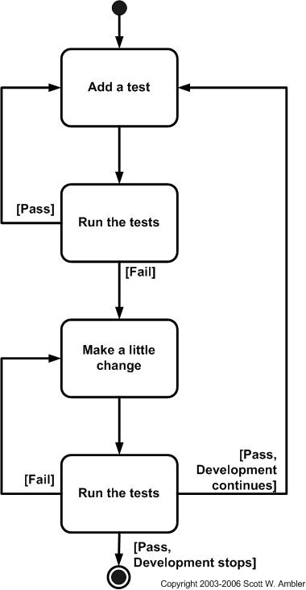
An Introduction to TDD

Slide 5
Coded Unit Testing with RUnit
Why?
Every time you change your code, you want to re-test it, ENTIRELY
Without coded testing, we skip testing pieces we’ve already tested
Gain confidence in testing changes to large data sets
What if we broke something we previously built?
We won’t know until a defect is reported
Integrate testing within the deployment process
Package: Runit
Allows automated verification of code units
Allows a test suites to be defined and tested together
Allows for test results to be reported
Steps
Create a test driver
Create test scripts
Add test scripts to test suites in driver
Run test driver
View results

Slide 6
A Doorbuster Metric Program
Requirements
Shall read two product csv files
Doorbuster1.csv
Doorbuster2.csv
Shall add two metrics to the product data
Products that are doorbusters but have no price assigned
Products that are doorbusters and online, but are out of stock
Shall write out a csv with the following:
Product id
No price metric
Online but out of stock metric

Slide 7
The R Example
0_monolith.R
A typical R Script
Contains a lot of code that all runs in sequence
What the script does
Reads 2 data sets from csv (doorbuster data)
Doorbuster1.csv & doorbuster2.csv
Combines the datasets
Adds metrics for
Doorbuster items missing a price
Doorbuster items that are online, but out of stock
Writes metric data to csv called doorbuster_metrics.csv

Slide 8
Refactor: Extract Method
Purpose
Take a chunk of code and create a method/function so it can be tested.
Make a small function to follow the Single Responsibility principle
In 0_monolith.R
Create a method for reading a single doorbuster csv file
Create a method that reads both doorbuster csv files
Create a method that adds metric for doorbusters with no price
Create a method that adds metric for doorbusters that are online but out of stock

Slide 9
To Refactor (the TDD Way)
Stub out a function for the code being refactored
Write the appropriate unit tests
RUN the tests → They BETTER fail!
Fill the code into the method
RUN the tests & fix function until the tests pass
Move on
Every change to the program you make, RUN ALL THE TESTS
Every defect that gets reported → CREATE NEW TESTS

Slide 10
Helpful Resources
TDD
https://en.wikipedia.org/wiki/Test-driven_development
http://www.agiledata.org/essays/tdd.html
Refactoring
http://refactoring.com/
Code Smells: https://en.wikipedia.org/wiki/Code_smell

