Slide 1
Become a Software Engineer (not a programmer)
Donald Sawyer
November 19, 2015
Presentation & Code on GitHub:
https://github.com/donaldsawyer/Demos/tree/master/ARCC/2015_11_19_EngineeringPrinciples

Slide 2



About Me
B.S. Computer Science
Focus: Artificial Intelligence
President, ACM
M.S. Software Engineering
Class of 2016
Ashly: Wife
Carly: 2.3 years
Kendra: 5.5 months
Notes:
School: SCSU, UMN
Family: Ashly, Carly, Kendra
Career: Minco, Guidant, Target, Aon, Target

Slide 3
Software Engineering vs. Programming
Study and application of engineering to the design, development, and maintenance of software.
Let’s say you were asked to engineer an airplane…
System View:
Would you just manufacture the parts and throw them together?
Principles:
Would you make the parts any way you felt like that day? Would you look at best practices?
Organization/modularity:
Would you make every component out of a single piece of material?
Separation of Concerns:
Would the altimeter also be the throttle?
Notes:
Engineering: The creative application of scientific principles to design or develop structures, machines, apparatus, or manufacturing processes, or works utilizing them singly or in combination; or to construct or operate the same with full cognizance of their design; or to forecast their behavior under specific operating conditions; all as respects an intended function, economics of operation or safety to life and property.

Slide 4
What is a Good Engineer?
Cares about quality over [everything]
Cares about doing right for the customer
Tests everywhere
Creative
Assertive
Accountable
Team player, not toxin
Technically savvy and resilient
Notes:
Quality: Defects? Customer happy? Quality Attributes?

Slide 5
S.O.L.I.D. Principles of OOD
Single Responsibility
Open/Closed Principle
Liskov Substitution
Interface Segregation
Dependency Inversion

Slide 6
Design Patterns
Strategy
Template Method
Façade
Adapter
Many Others

Slide 7
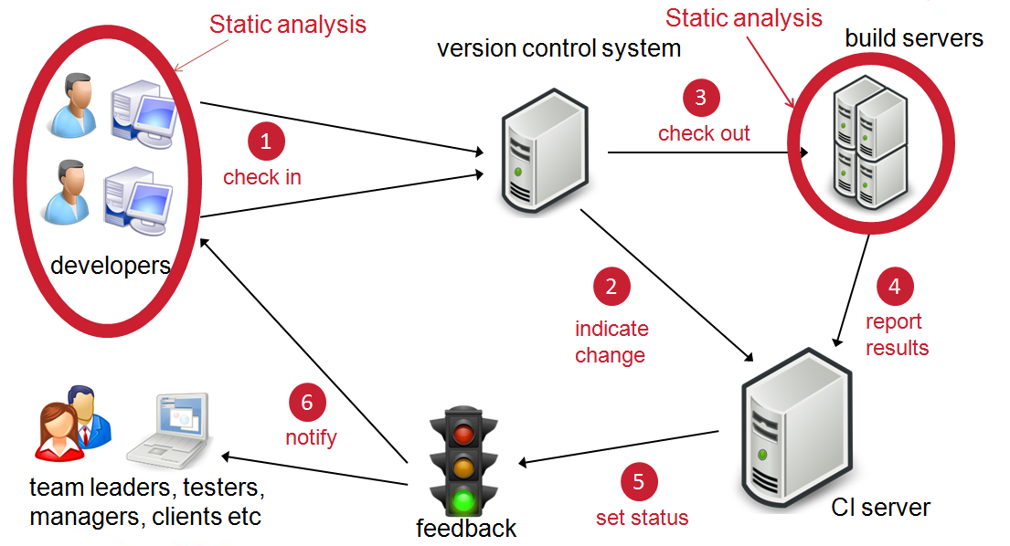
Continuous Integration

Slide 8
Testing
Static Testing
Design Reviews
Code Reviews
Static Analysis
Dynamic Testing
Unit
Integration
System

Slide 9
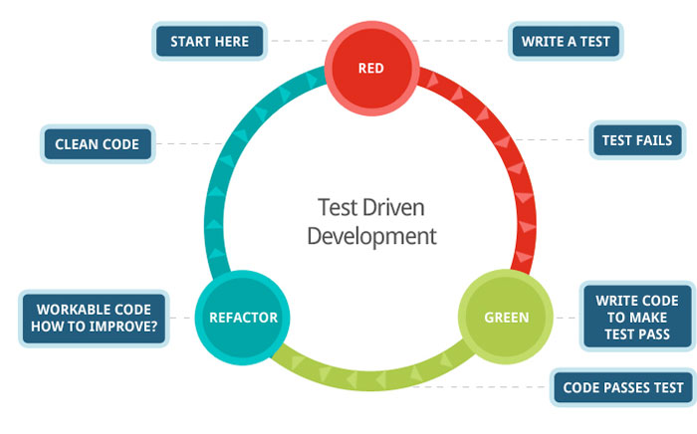
Test-Driven Development (TDD)

Slide 10
Refactoring
Code “smells”
Refactoring Catalog
Tools
Resharper Plugin (.Net)
IntelliJ (Java)
Check your IDE features
Clean Code
Notes:
PRACTICE. A LOT!!!

Slide 11
Keys to Your Success
Focus on quality
Embrace quality attributes
Testability
Maintainability
Extensibility
Many more
Learn Continuously
Coursera
MOOC
Codeschool
Pluralsight
Lynda
DataCamp
Notes:
If you don’t think you can do a quality job in the constraints, speak up. Quality means more than coding. Analysis, design, code, test, deliver.

