Slide 1
TDD for Hive ETL
(and a little testing 101)
Donald Sawyer
dsawyer@phdata.io
@phdatainc
phdata.io

Slide 2
Resources for Presentation
Presentation Location:
https://docs.google.com/presentation/d/1n2lYxI-kAl1tdJCRTGfvUhPGptR2YBwZOSDB5uMdwwU
Donald’s GitHub Repo:
https://github.com/donaldsawyer/hive-unit-testing
Javadocs for Code:
https://donaldsawyer.github.io/hive-unit-testing/

Slide 3
#1 Reason I Test
trust
noun
A firm belief in the reliability, truth, ability, or strength of someone or something. “relations have to be built on trust” synonyms: confidence, belief, faith, certainty, assurance, conviction, credence; reliance antonyms: distrust, mistrust, doubt

Slide 4
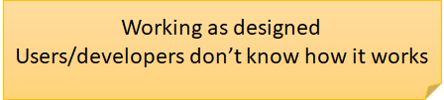
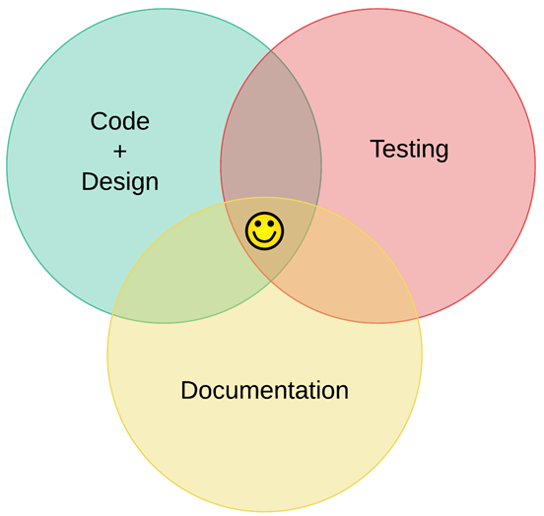
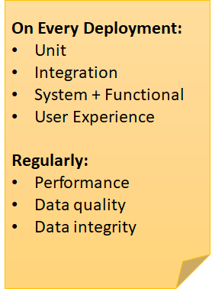

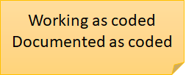
Cost of Engineering
Majority of Devs Here

Slide 5
What is Needed for Automated Testing?
Ability to execute your code & tests [in an isolated environment]
Unit/Integration -- Ability to isolate modules/methods
Define/generate inputs
Define/generate expected output
Format of a Single Test
given
when
then
Setup Test State
Execute Module Being Tested (System Under Test)
Verify Results
Set up the state as expected prior to the module running, for the given test case.
With state setup, execute the module, method, or code that is being tested for this scenario.
Verify the results and as many side effects of the module execution. Verify as much as possible to ensure the module operated as expected.

Slide 6
Designing Your Inputs: Equivalence Classes
Mathematical Definition
The sets in a partition of the domain (input or output)
Motivation
Gain a sense of complete testing without redundancy
Create Equivalence Classes
Determine the boundaries
Determine the equivalencies
If a set of values all cause the program to behave in exactly the same way, then that might be a candidate for an Input Equivalence Class.

Slide 7
Hive ETL Example: Materialized View of Large Sales
Goal: Create a table called “large_sales” that ingests from sales table,
Any sales that are > 100
Convert chan_c from character to text (S ➔ Store, O ➔ Online)
Need transaction id, channel, total
Column | Type | Description
tran_id | INT | The sale’s transaction id.
chan_c | STRING | A single character code that represents the selling channel. Possible values (S, O)
subtotal | DOUBLE | The subtotal of all items before taxes and discounts are applied.
total | DOUBLE | The total purchase, after taxes and discounts are applied.

Slide 8
What are the Input Partitions?
DROP TABLE IF EXISTS large_sales; CREATE TABLE large_sales (
tran_id INT, sell_chan STRING, total DOUBLE) COMMENT 'Contains only large online transactions over $100 total.' AS SELECT tran_id, CASE chan_c WHEN "S" THEN "Store" WHEN "O" THEN "Online" END sell_chan, total FROM sales WHERE total >= 100;

Slide 9
What are the Input Partitions? (Part 1)
DROP TABLE IF EXISTS large_sales; CREATE TABLE large_sales (
tran_id INT, sell_chan STRING, total DOUBLE) COMMENT 'Contains only large online transactions over $100 total.' AS SELECT tran_id, CASE chan_c WHEN "S" THEN "Store" WHEN "O" THEN "Online" END sell_chan, total FROM sales WHERE total >= 100;

Slide 10
What are the Input Partitions? (Part 2)
DROP TABLE IF EXISTS large_sales; CREATE TABLE large_sales (
tran_id INT, sell_chan STRING, total DOUBLE) COMMENT 'Contains only large online transactions over $100 total.' AS SELECT tran_id, CASE chan_c WHEN "S" THEN "Store" WHEN "O" THEN "Online" END sell_chan, total FROM sales WHERE total >= 100;

Slide 11
What are the Input Partitions? (Part 3)
DROP TABLE IF EXISTS large_sales; CREATE TABLE large_sales (
tran_id INT, sell_chan STRING, total DOUBLE) COMMENT 'Contains only large online transactions over $100 total.' AS SELECT tran_id, CASE chan_c WHEN "S" THEN "Store" WHEN "O" THEN "Online" END sell_chan, total FROM sales WHERE total >= 100;

Slide 12
What are the Input Partitions? (Part 4)
DROP TABLE IF EXISTS large_sales; CREATE TABLE large_sales (
tran_id INT, sell_chan STRING, total DOUBLE) COMMENT 'Contains only large online transactions over $100 total.' AS SELECT tran_id, CASE chan_c WHEN "S" THEN "Store" WHEN "O" THEN "Online" END sell_chan, total FROM sales WHERE total >= 100;

Slide 13
DEMO w/ HiveRunner!

