Slide 1
Become a Software Engineer (not a programmer)
Donald Sawyer
November 19, 2015
Presentation & Code on GitHub:
https://github.com/donaldsawyer/Demos/tree/master/ARCC/2015_11_19_EngineeringPrinciples

Slide 2



About Me
B.S. Computer Science
Focus: Artificial Intelligence
President, ACM
M.S. Software Engineering
Class of 2016
Ashly: Wife
Carly: 2.3 years
Kendra: 5.5 months
Notes:
School: SCSU, UMN
Family: Ashly, Carly, Kendra
Career: Minco, Guidant, Target, Aon, Target

Slide 3
Software Engineering vs. Programming
Study and application of engineering to the design, development, and maintenance of software.
Let’s say you were asked to engineer an airplane…
System View:
Would you just manufacture the parts and throw them together?
Principles:
Would you make the parts any way you felt like that day? Would you look at best practices?
Organization/modularity:
Would you make every component out of a single piece of material?
Separation of Concerns:
Would the altimeter also be the throttle?
Notes:
Engineering: The creative application of scientific principles to design or develop structures, machines, apparatus, or manufacturing processes, or works utilizing them singly or in combination; or to construct or operate the same with full cognizance of their design; or to forecast their behavior under specific operating conditions; all as respects an intended function, economics of operation or safety to life and property.

Slide 4
What is a Good Engineer?
Cares about quality over [everything]
Cares about doing right for the customer
Tests everywhere
Creative
Assertive
Accountable
Team player, not toxin
Technically savvy and resilient
Notes:
Quality: Defects? Customer happy? Quality Attributes?

Slide 5
S.O.L.I.D. Principles of OOD
Single Responsibility
Open/Closed Principle
Liskov Substitution
Interface Segregation
Dependency Inversion

Slide 6
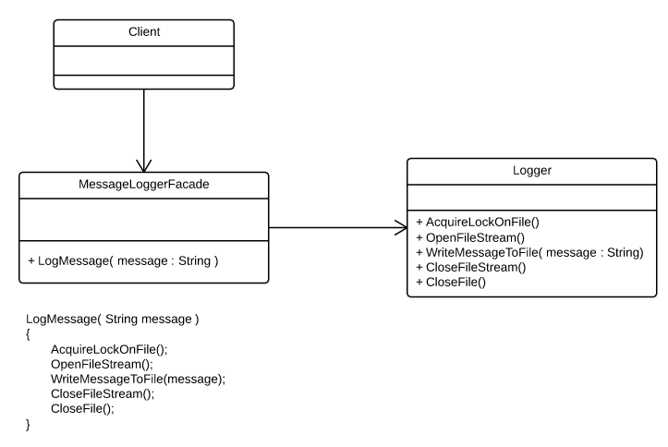
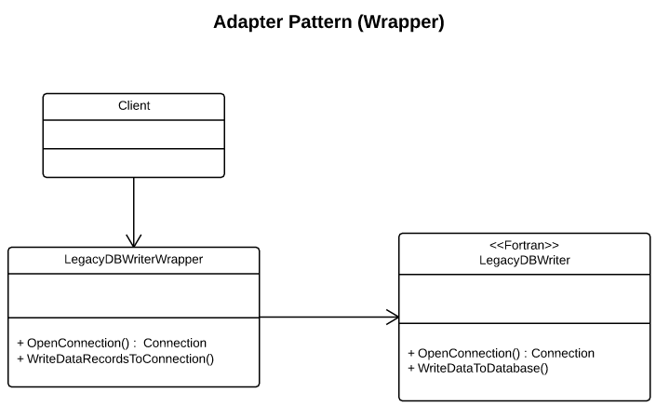
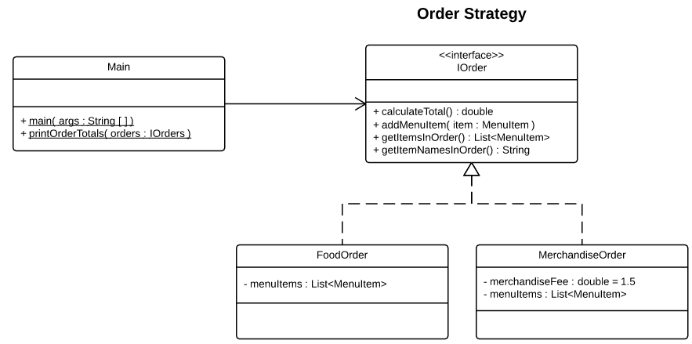
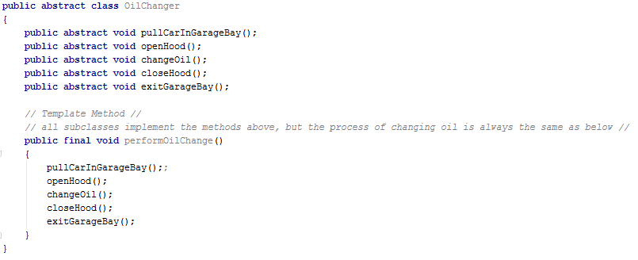
Design Patterns
Strategy
Template Method
Façade
Adapter
Many Others

Slide 7
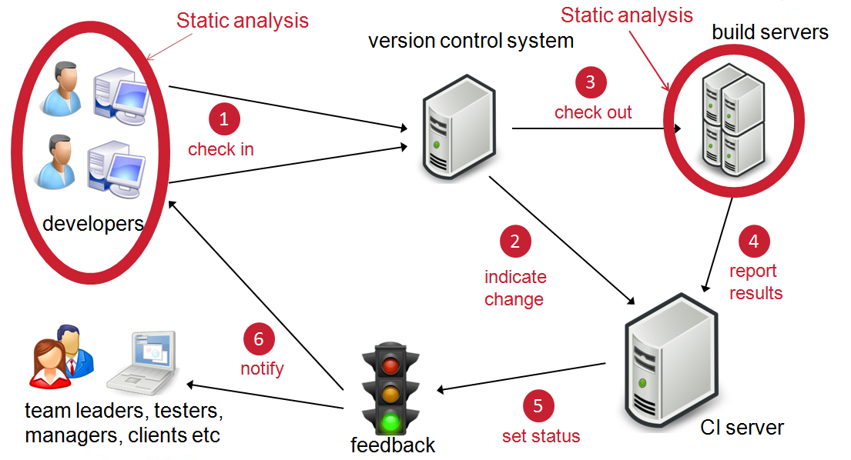
Continuous Integration

Slide 8
Testing
Static Testing
Design Reviews
Code Reviews
Static Analysis
Dynamic Testing
Unit
Integration
System

Slide 9
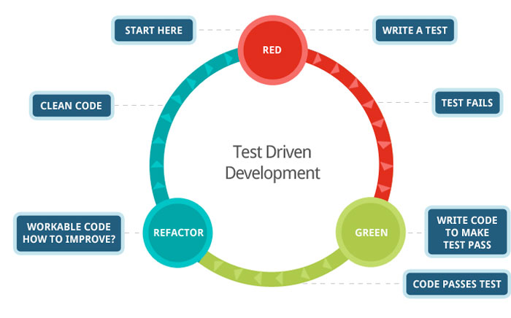
Test-Driven Development (TDD)

Slide 10
Refactoring
Code “smells”
Refactoring Catalog
Tools
Resharper Plugin (.Net)
IntelliJ (Java)
Check your IDE features
Clean Code
Notes:
PRACTICE. A LOT!!!

Slide 11
Keys to Your Success
Focus on quality in EVERYTHING (not just code)
Embrace quality attributes
Testability
Maintainability
Extensibility
Many more
Learn Continuously
Coursera
MOOC
Codeschool
Pluralsight
Lynda
DataCamp
Notes:
If you don’t think you can do a quality job in the constraints, speak up. Quality means more than coding. Analysis, design, code, test, deliver.

