Slide 1
Identifying a DDOS Attack in Realtime
A non-scaled solution using Kafka and Java
https://github.com/donaldsawyer/ddos-checker

Slide 2
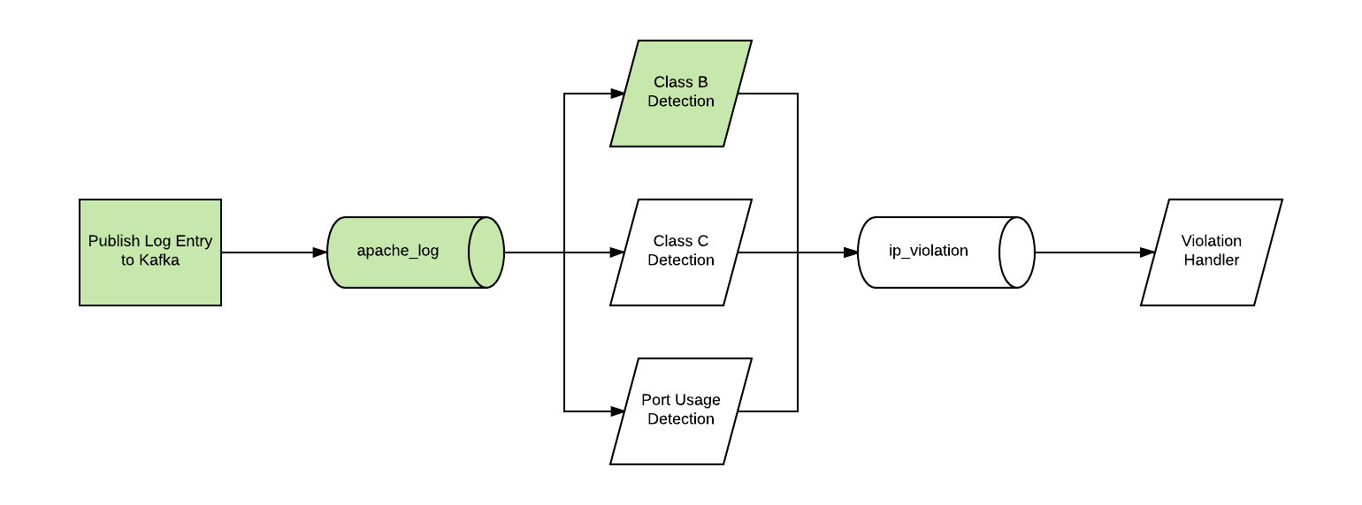
Ideal DDOS Detection Stream
GREEN: Items I’ve simulated in this project. Java application used to simulate streams.

Slide 3
High-Level Solution
Assumption:
The attack is perpetrated by spoofing Class B ip addresses.
High-Level Detection:
DDOS attack is identified IPs from same host (xxx.yyy)
Count hits in a given time window to check if threshold exceeded
Sliding windows are simulated using Java Map where key is the start window, and value is a list of hosts (xxx.yyy)

Slide 4
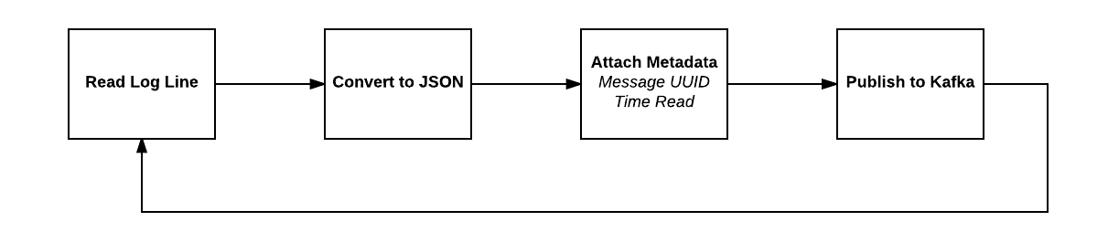
Generating Data Flow

Slide 5
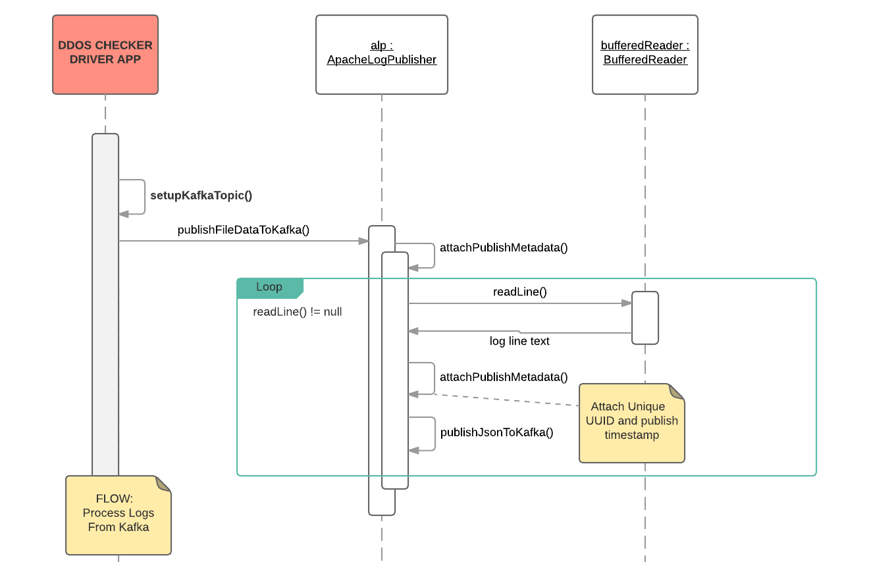
Log Publish Sequence

Slide 6
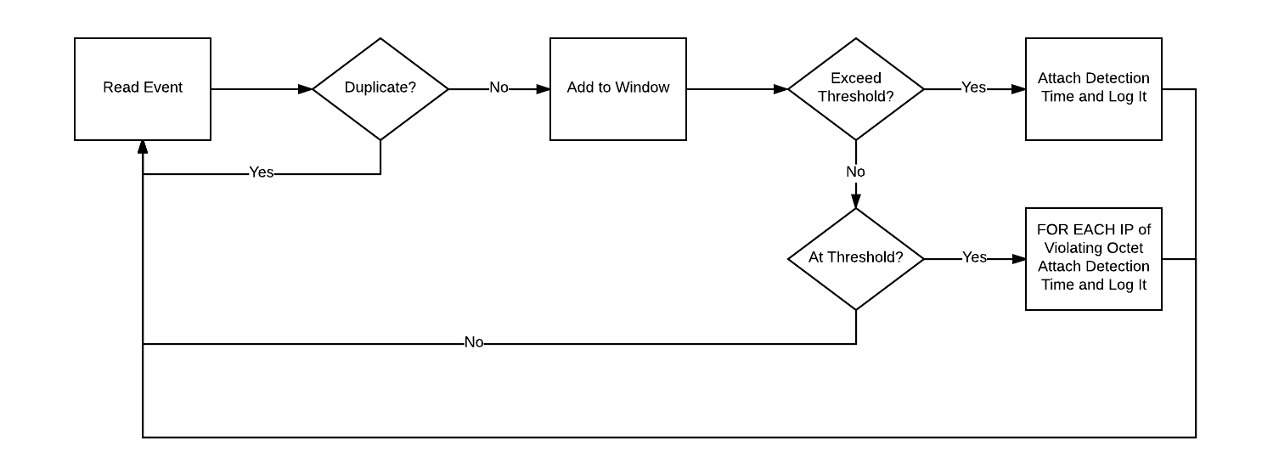
Processing Logs High-Level Flow

Slide 7
Process Log Pseudocode
If Message Not Duplicate
If window for current message exists
Add IP Info to Window
Get Count of IPs for ClassB Host
If IP Count > Threshold
Attach metadata (detection time)
Publish raw json
Else if IP Count == Threshold
// need to publish all IPs for Octet/Window as violations
For Each IP in Window/ClassB IP Collection
Attach metadata (detection time)
Publish raw json
Else // IP, window pair not found
Create new window and add IP Info

