Slide 1
Testing, TDD, and R
And A Little on [S]OLID
Donald Sawyer (dsawyer@phdata.io)
Presentation & Source Code on GitHub:
https://github.com/donaldsawyer/phdata-tdd-r

Slide 2
Essentials of Software Testing
Quality of process determines success of test effort
Use techniques to test early in lifecycle
Use tools
Somebody MUST take responsibility for improving testing
Testing requires trained, skilled people
Embrace a creative destruction culture

Slide 3
Principles of Testing
Shows presence of bugs, never their absence
Hard to know when to stop
Impossible to test your own program
Where there’s smoke, there’s fire
Creative and intellectually challenging
Notes:
Even if you find the last bug, you’ll never know it.
Exhaustive testing is impossible
You’ll run out of time before you run out of cases
Determine a confidence of when “testing is complete.”

Slide 4
What is Unit Testing?
Types of testing
Unit
Integration
System
Data Quality, Functional, Acceptance, UX, and many more…
Unit Testing
Testing of an individual code module, function, or “unit”
Done by a developer before deployment
Verifies input/output of a “unit”
Why?
Verify the individual components perform as expected
Gain confidence that “done” code is still working as the program changes

Slide 5
Concepts of Automated Testing
Coded tests
Your tests are code
They need code review too
SOLID is the key
They should be run by your CI tools (Jenkins)
Try to achieve high coverage
You’ll use a framework
Mocking is often required (more in detailed slides)

Slide 6
Quick Tips

Slide 7
1 Test > No Tests. Always.

Slide 8
Coder: I’ve only got legacy code and it’s really hard to start integrating automated unit tests.
Me: So? Be creative. Refactor.
Notes:
Me: So? Be creative.

Slide 9
Coder: There’s no framework for the language I’m using.
Me: You’re a developer, build what you need.
Notes:
Me: You’re a developer, build what you need.

Slide 10
You’ll need to learn a lot of new things.

Slide 11
If you can “find time” to support defects and product issues, you can make time to start testing.

Slide 12
Let’s Get Started!

Slide 13
An Introduction to SOLID
SOLID Principles of Object-Oriented Design
S – Single Responsibility
O – Open/Closed Principle
L – Liskov Substitution
I – Interface Segregation
D – Dependency Inversion
Single Responsibility
A module should have a single responsibility and that responsibility should be entirely encapsulated in the module
A module should have one, and only one, reason to change
THIS is what we’ll unit test in this talk
Notes:
Single Responsibility
A “class” should have responsibility over a single part of the functionality in software AND entirely encapsulated within
A class should have one, and only one, reason to change
Classes with many responsibilities are tightly coupled
Making one change shouldn’t break 10 other functions
https://drive.google.com/file/d/0ByOwmqah_nuGNHEtcU5OekdDMkk/view
Example from Martin: Rectangle that renders and computes area
Open/Closed Principle
Open for extension, closed for modification
Ideologically hard, in my experience
Idea: Design Patterns like the strategy pattern
Example:
https://drive.google.com/file/d/0BwhCYaYDn8EgN2M5MTkwM2EtNWFkZC00ZTI3LWFjZTUtNTFhZGZiYmUzODc1/view
Liskov Substitution
You should be able to substitute a subclass for a superclass without adverse change in behavior
Derived types should be suitable for their parent types
A subtype should never strengthen the preconditions/contract of a supertype
A subtype should never weaken the postconditions of a supertype
http://www.ckode.dk/programming/solid-principles-part-3-liskovs-substitution-principle/#postconditions
https://drive.google.com/file/d/0BwhCYaYDn8EgNzAzZjA5ZmItNjU3NS00MzQ5LTkwYjMtMDJhNDU5ZTM0MTlh/view
Interface Segregation
Classes should not be forced to depend on interfaces that they do not use
Think of utility classes and interfaces
Cohesion
Make fine-grained interfaces that are client specific (role interfaces)
Heavily violated
Some studies of design patterns might help with this
https://drive.google.com/file/d/0BwhCYaYDn8EgOTViYjJhYzMtMzYxMC00MzFjLWJjMzYtOGJiMDc5N2JkYmJi/view
Dependency Inversion
Principles:
High level modules should not depend on low-level modules, rather abstractions for both
Abstractions should not depend on details, detals should depend on abstractions
Reduce the coupling between classes
Depend on abstractions, not on concretions
This might be tougher in BI
Where have you seen this one?
https://drive.google.com/file/d/0BwhCYaYDn8EgMjdlMWIzNGUtZTQ0NC00ZjQ5LTkwYzQtZjRhMDRlNTQ3ZGMz/view

Slide 14
Test-Driven Development (TDD)
Helps you understand your requirements
Forces you to test (YAY!)
If your test doesn’t fail first, it’s a bad test
Avoid false positives
Ensure better tests
When you have tests, you can CONFIDENTLY change your code in the future
Incorporate SOLID to make it easier
It takes practice!
Notes:
TDD Isn’t easy to start, you have to practice.

Slide 15
Whole Lotta Definitions
You first need to know what testing is.

Slide 16
Statement Coverage
Every statement executed once
Snippet →
Only one test needed to get 100% statement coverage are_both_positive(1, 1)
def are_both_positive(x, y): rval = false if x > 0 and y > 0: rval = true return rval

Slide 17
Multiple Condition Coverage
All possible Boolean expression outcomes are tested (all combinations)
Snippet →
If x is positive, the 2nd condition is never tested
Need 4 cases
(-1, -1)
(-1, 1)
(1, -1)
(1, 1)
def are_any_positive(x, y): rval = False if x > 0 or y > 0: rval = True return rval

Slide 18
Boundary Value Analysis

Slide 19
Boundary Testing
Test values near design limits
Value limits
First/last rows in a table or data frame
Null, empty, single-character strings
Errors tend to occur near extremes
Robustness: reaction when boundaries are exceeded

Slide 20
Boundary Testing (cont’d)
Single Fault Assumption (SFA):
Assume that a failure is NOT the result of 2+ simultaneous faults.
SFA Boundary Value Testing
Stay within the design limits
SFA Robustness Boundary Value Testing
Exceed the limits, if possible
Worst-case Boundary Value Testing
Two or more variables
Discard SFA
Stay within limits
Worst-case Robustness Boundary Value Testing
Two or more variables
Discard SFA
Exceed the limits

Slide 21
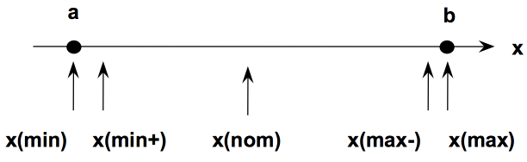
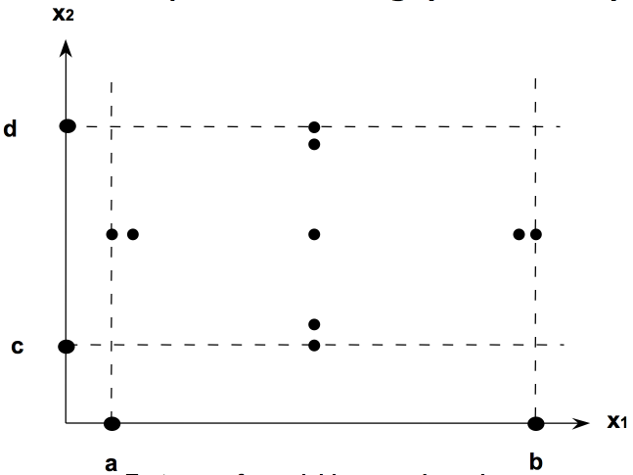
Boundary Values
Single Input Variable
Two Input Variables
Best Practice:
Use input variables at and just above minimum, and at and just below maximum.

Slide 22
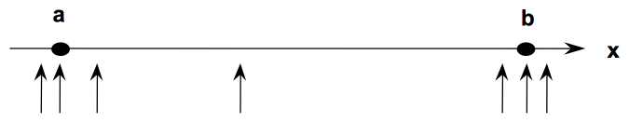
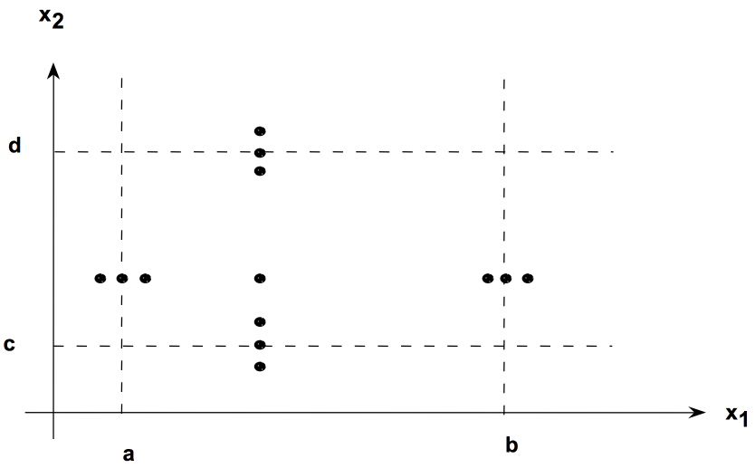
Robustness Boundary Value Testing
Include values below the minimum and above the maximum.
Single Input Variable
Two Input Variables
Notes:
Verify acceptable responses for invalid inputs.

Slide 23
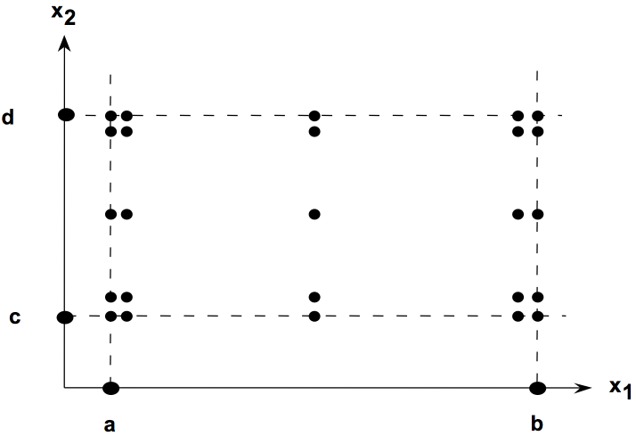
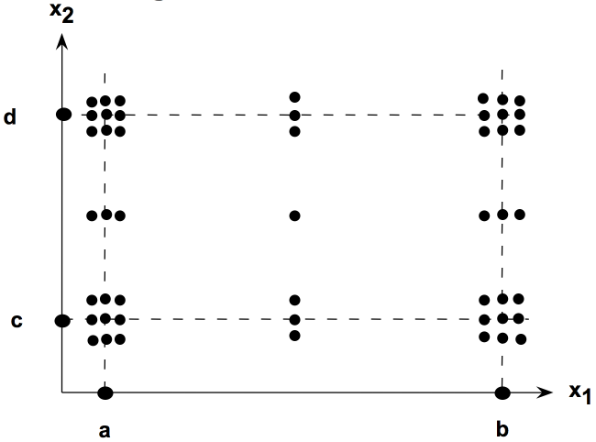
Worst-Case BV Testing
Allow both variables to approach (and maybe exceed) boundaries.
Worst-Case Boundary Value
Worst-Case Robustness BV (paranoid)

Slide 24
Choosing Your Inputs
Using equivalence classes to choose inputs

Slide 25
Equivalence Classes
Mathematical Definition
The sets in a partition of the domain (input or output)
Motivation
Gain a sense of complete testing without redundancy
Create Equivalence Classes
Determine the boundaries → Determine the equivalencies
If a set of values all cause the program to behave in exactly the same way, then that might be a candidate for an Input Equivalence Class.

Slide 26
Demo App in R

Slide 27
Coded Unit Testing with RUnit
Why?
Every time you change your code, you want to re-test it, ENTIRELY
Without coded testing, we skip testing pieces we’ve already tested
Gain confidence in testing changes to large data sets
What if we broke something we previously built?
We won’t know until a defect is reported
Integrate testing within the deployment process
Package: Runit
Allows automated verification of code units
Allows a test suites to be defined and tested together
Allows for test results to be reported
Steps
Create a test driver
Create test scripts
Add test scripts to test suites in driver
Run test driver
View results

Slide 28
A Doorbuster Metric Program
Requirements
Shall read two product csv files
Doorbuster1.csv
Doorbuster2.csv
Shall add two metrics to the product data
Products that are doorbusters but have no price assigned
Products that are doorbusters and online, but are out of stock
Shall write out a csv with the following:
Product id
No price metric
Online but out of stock metric

Slide 29
The R Example
0_monolith.R
A typical R Script
Contains a lot of code that all runs in sequence
What the script does
Reads 2 data sets from csv (doorbuster data)
doorbuster1.csv & doorbuster2.csv
Combines the datasets
Adds metrics for
Doorbuster items missing a price
Doorbuster items that are online, but out of stock
Writes metric data to csv called doorbuster_metrics.csv

Slide 30
Refactor: Extract Method
Purpose
Take a chunk of code and create a method/function so it can be tested.
Make a small function to follow the Single Responsibility principle
In 0_monolith.R
Create a method for reading a single doorbuster csv file
Create a method that reads both doorbuster csv files
Create a method that adds metric for doorbusters with no price
Create a method that adds metric for doorbusters that are online but out of stock

Slide 31
To Refactor (the TDD Way)
Stub out a function for the code being refactored
Write the appropriate unit tests
RUN the tests → They BETTER fail!
Fill the code into the method
RUN the tests & fix function until the tests pass
Move on
Every change to the program you make, RUN ALL THE TESTS
Every defect that gets reported → CREATE NEW TESTS

Slide 32
Helpful Resources
TDD
https://en.wikipedia.org/wiki/Test-driven_development
http://www.agiledata.org/essays/tdd.html
Refactoring
http://refactoring.com/
Code Smells: https://en.wikipedia.org/wiki/Code_smell

Slide 33
Detailed Slides
Slides that were removed from the main presentation.

Slide 34
Verification or Validation?
Verification
Validation
Check a program against a “design” or specification.
Check a system against an expectation/requirement.
Evaluate artifacts to ensure their correctness.
Focus on product –related activities by executing something!
Did you build the THING RIGHT?
Did you build the RIGHT THING?
Notes:
Verification
Evaluating the products of a development phase
How do you verify your programs? (PR)
Validation
requires DOMAIN KNOWLEDGE.
Evaluate software to ensure it meets expectations
https://www.youtube.com/watch?v=v9FKB5nqsDI
http://www.softwaretestinghelp.com/difference-between-verification-vs-validation/

Slide 35
Error, Fault, and Failure
Error
A mistake made in coding
Ex: use wrong database name
Fault
Representation of the error
Ex: Data written to wrong database
Failure
User-visible manifestation of the failure
Ex: User doesn't see new data
The tester is tasked with writing cases to cause failures!
Notes:
Tester task
Find failures with as few test cases as possible.
Don’t have many cases cause the same failure

Slide 36
Example: Error vs. Fault vs. Failure
def count_postive_transactions(transList):
positive_tran_count = 0 for t in transList: if t.saleAmount >= 0: positive_tran_count += 1 return positive_tran_count
What is the error made?
What is the fault?
Give a test case that will cause a failure.
Give a test case that will not cause a failure (fault still there).
If saleAmount is 0, it’s not a positive transaction. The logical operator is wrong.
Fault: sales transactions are counted incorrectly if their saleAmount is 0.
Failed Test Case: call function with at least one transaction where saleAmount = 0.
This is how most people test, at BEST… and why our [automated] tests stink.
No Failure Case: call function where all transactions have saleAmount greater than 0.
Happy Path

Slide 37
Black vs. White Box Testing
Black Box Testing
White Box Testing
No knowledge of internal structure/design
Based on functional spec
AKA Functional Testing
Examine internal design of program
Requires knowledge of program structure
AKA Structural Testing
Notes:
Goals of White Box Testing:
Coverage metrics and requirements testing

Slide 38
Static vs. Dynamic Testing
Static Testing
Dynamic Testing
Test w/o executing software
Structural testing
Walkthroughs, reviews, compiling
Test by executing software
Structural & functional testing

Slide 39
Main Types of Testing
Testing Type | Typically by Who? | White/Black | Automate?
Unit | Programmer | White | YES
Integration | Programmer | Mostly white | Desired
Functional/System | Debatable, historically not the programmer | Mostly black | Desired
Acceptance | Customer/Product Owner | Black | Not likely, but doable
Regression | It depends | All | Good automation of unit, integration, and system testing can cover this.
Design Verification | Team | White | No. Verifying design artifacts.
Notes:
Unit
Done by developer
Attempt to execute all code in a “unit”
See TDD & SOLID
Verify no surprises
Verify functionality
Measure unit test coverage
Integration
Integration between 2 or more software components (API, GUI, DB, Hardware)
Often by programmer or automated system
White box because you need to know expected input output after two components communicate
Must assume that components work correctly
System
Used to be done by QA
Preferred not by programmer
Execute system based on input/output
Black box
Validation of customer requirements, quality, satisfaction
Regression
Retest
Partial
Full

Slide 40
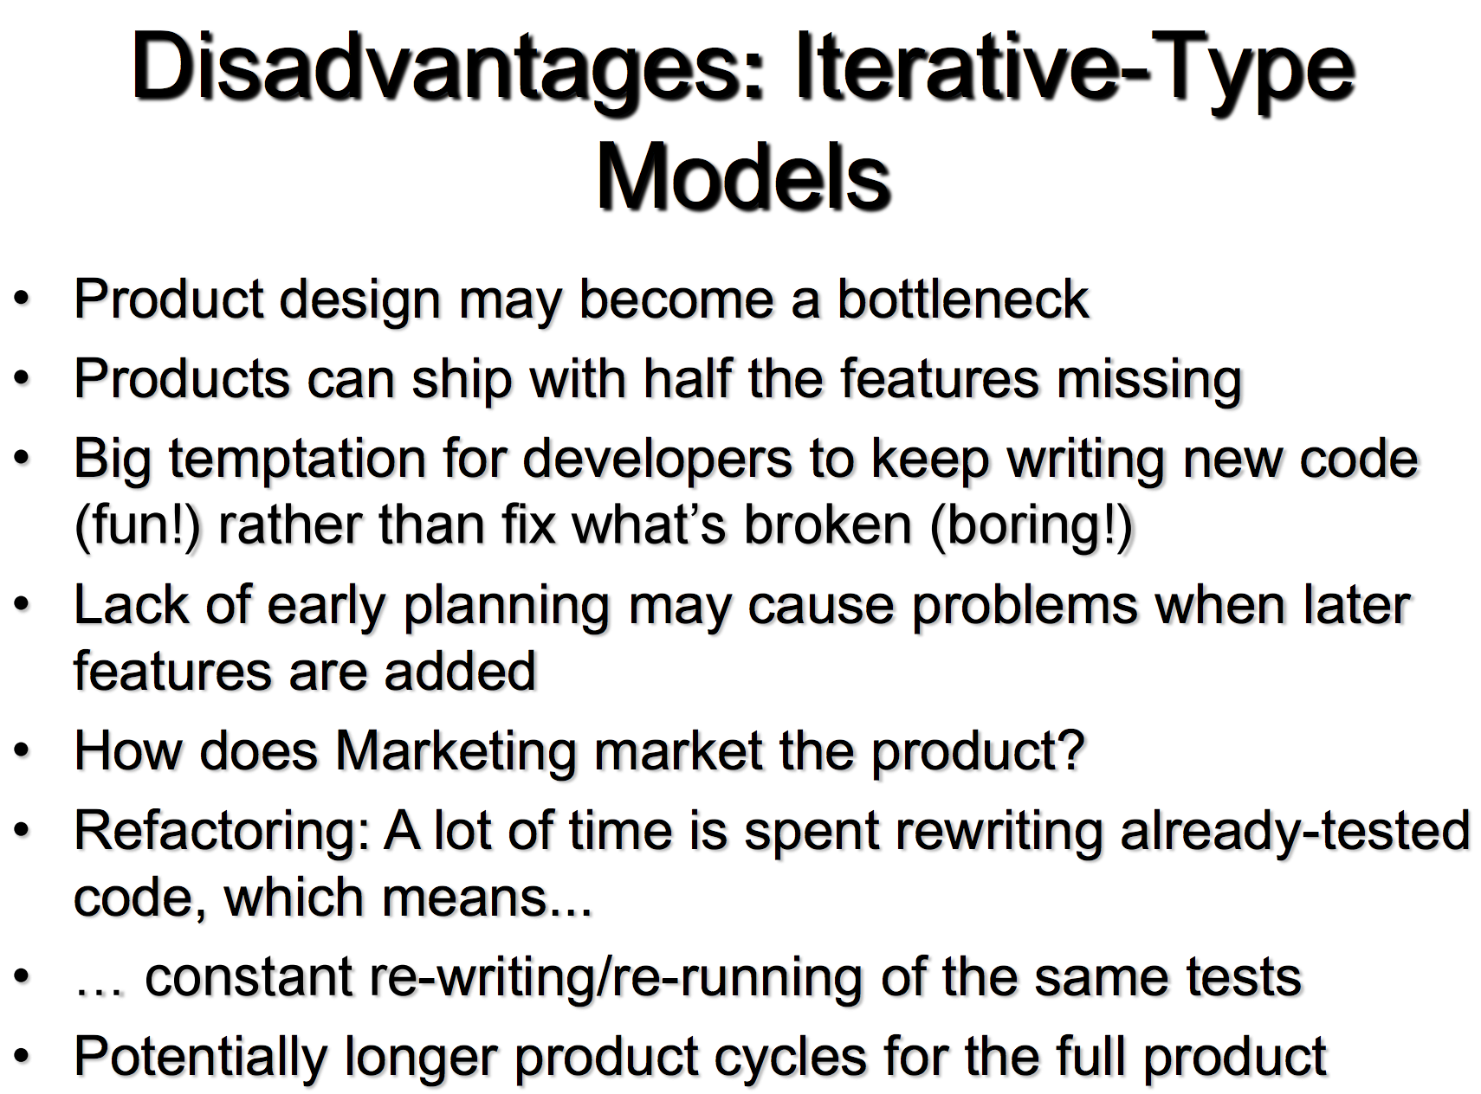
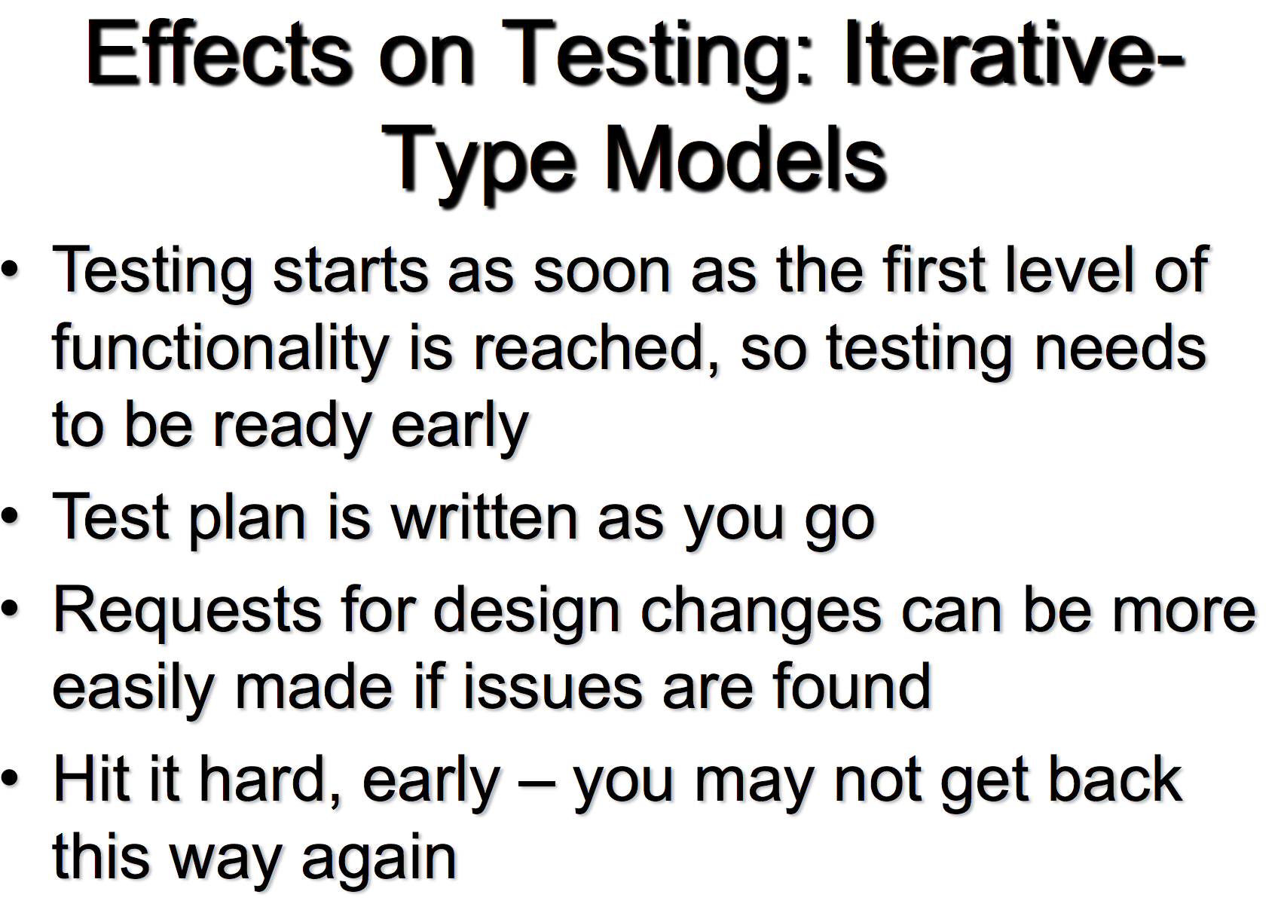
Testing in an Agile Model

Slide 41
Code Coverage
Statement
Branch/Decision
Condition
Multiple Condition
Modified Condition/Decision Coverage (MCDC)
Path

Slide 42
Statement Coverage
Every statement executed once
Snippet →
Only one test needed to get 100% statement coverage are_both_positive(1, 1)
def are_both_positive(x, y): rval = false if x > 0 and y > 0: rval = true return rval

Slide 43
Branch/Decision Coverage
Every decision branch gets executed at least once
Program Snippet/Path →
Two tests needed
1A-2C-4E-5G-7
1B-3D-4F-6H-7
Could different test paths be used?
def get_max(x, y, z): max = x if x > y else y max = z if z > max else max return max

Slide 44
Condition Coverage
Every Boolean sub-expression has been evaluated to both True and False at least once.
Program Snippet/Path →
Two tests needed
1A-2C-4E-5G-7
1B-3D-4F-6H-7
Could different test paths be used?
def get_max(x, y, z): max = x if x > y else y max = z if z > max else max return max

Slide 45
Multiple Condition Coverage
All possible Boolean expression outcomes are tested (all combinations)
Snippet →
If x is positive, the 2nd condition is never tested
Need 4 cases
(-1, -1)
(-1, 1)
(1, -1)
(1, 1)
def are_any_positive(x, y): rval = False if x > 0 or y > 0: rval = True return rval

Slide 46
Boundary Value Analysis

Slide 47
Boundary Testing
Test values near design limits
Value limits
First/last rows in a table or data frame
Null, empty, single-character strings
Errors tend to occur near extremes
Robustness: reaction when boundaries are exceeded

Slide 48
Boundary Testing (cont’d)
Single Fault Assumption (SFA):
Assume that a failure is NOT the result of 2+ simultaneous faults.
SFA Boundary Value Testing
Stay within the design limits
SFA Robustness Boundary Value Testing
Exceed the limits, if possible
Worst-case Boundary Value Testing
Two or more variables
Discard SFA
Stay within limits
Worst-case Robustness Boundary Value Testing
Two or more variables
Discard SFA
Exceed the limits

Slide 49
Boundary Values
Single Input Variable
Two Input Variables
Best Practice:
Use input variables at and just above minimum, and at and just below maximum.

Slide 50
Robustness Boundary Value Testing
Include values below the minimum and above the maximum.
Single Input Variable
Two Input Variables
Notes:
Verify acceptable responses for invalid inputs.

Slide 51
Worst-Case BV Testing
Allow both variables to approach (and maybe exceed) boundaries.
Worst-Case Boundary Value
Worst-Case Robustness BV (paranoid)

Slide 52
Boundary Testing: How Many Tests?
SFA BV: 4n + 1
SFA Robust BV: 6n +1
Worst-Case BV: 5^{n}
Paranoid: 7^{n}

Slide 53
Testing Automation

Slide 54
A Few Notes on Automation
It’s hard
You’ll hit roadblocks
You MUST be creative
Apply all the test theory to develop good tests
It is VERY expensive up front
The quality is absolutely worth the investment
Work toward eliminating the need for formal regression testing

Slide 55
Concepts of Automated Testing
Coded tests
Your tests are code
They need code review too
SOLID is the key
They should be run by your CI tools (Jenkins)
Try to achieve high coverage
You’ll use a framework
Mocking is often required (more in two slides)

Slide 56
Automation Tools & Resources (Some)
Unit Testing Frameworks
Static Code Analysis
Javascript tools
GUI Testing Tools
Apache Pig
Big Data
In EDABI (BI-System-Automation)

Slide 57
Concept: Mocking
Sometimes your program calls other classes, methods, or external modules.
Mocking simulates these complex integrations.
You can mock exceptions being thrown.
Examples:
Calling legacy libraries
Calling other classes
API Calls
DB Calls

