Slide 1
Test-Driven Data Engineering
Using VS Code, Docker, python, PySpark, and AWS Glue
Presented May 24, 2022 at Open Source North

Slide 2
Which of you can describe the quality of your data pipelines using the results of an automated testing process?

Slide 3
Today’s Problem Statement
Specific examples to demonstrate multiple TDDE concepts.
Data Engineers need the ability to automate unit testing for data engineering pipelines so that test-driven methodologies can be used.
Issues this specific demo addresses:
Local development requiring multiple frameworks (python, PySpark, Glue)
Leveraging Docker for testing & development for automation
Using a free tool (VS Code) instead of paid (PyCharm)
Designing code to enable unit testing, reducing integration tests
Notes:
Read problem statement.
(CLICK)
I wanted to demonstrate some of these concepts with a demo that addressed
Developing pipelines locally with common tech that require distributed frameworks
Use docker for as much of the development as possible because it makes CI/CD easier
Use an IDE other than PyCharm
Show how to design code to separate integration from unit tests
NOTE: these are common situations that come up, even if your stack is not the same as this exact stack. You have to challenge yourself to find novel solutions to your development needs.

Slide 4
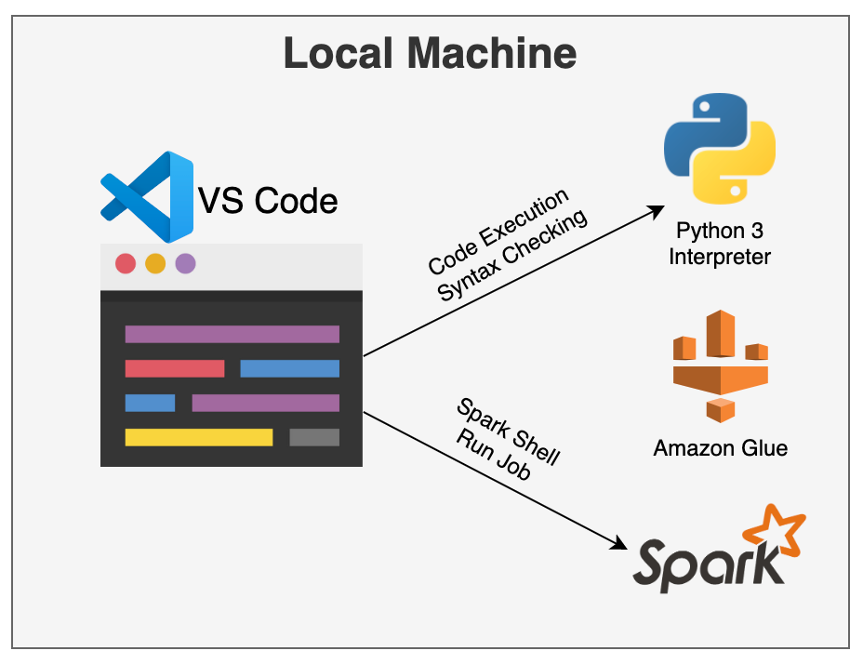
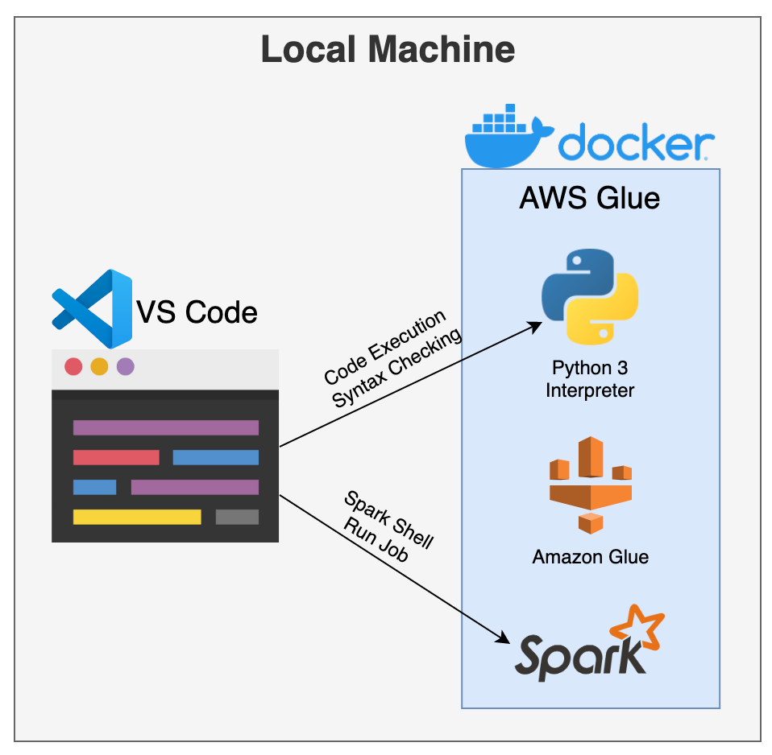
Develop Local
Pytest is used as the python testing framework for this demo.
MUST Be Installed
Local Installations
Dockerized Tooling
Notes:
The holy grail of testing – isolating it.
Local means you will be able to do it on a build server. How to get to a local development environment?
(CLICK)
Option 1: requires build server to be “built”.
(CLICK)
You have to install the tools and “set up” the machine.
(CLICK)
Option 2: allows build to be repeatable, isolated, and portable.

Slide 5
Today’s Test Automation Journey
Context
TDD + python
TDDE + PySpark
TDDE + AWS Glue
Background info and overview of the demo
Using VS Code + Docker for python TDD
Test-Driven Spark UDF and DataFrame ops
Automated testing with AWS Glue
01
02
03
04

Slide 6
Overview and Context

Slide 7
Background Information
Test-Driven Data Engineering
A test-first approach to building data pipelines that sometimes breaks the rules of TDD because sometimes integration tests must be used instead of unit test.
Docker
Docker provides the ability to package and run an application in a loosely isolated environment called a container.
VS Code
Visual Studio Code is a lightweight but powerful source code editor which runs on your desktop and is available for Windows, macOS and Linux.
Apache Spark
Apache Spark™ is a multi-language engine for executing data engineering, data science, and machine learning on single-node machines or clusters.
Amazon Glue
AWS Glue is a fully managed ETL (extract, transform, and load) service that makes it simple and cost-effective to categorize your data, clean it, enrich it, and move it reliably between various data stores and data streams.

Slide 8
Demos Used in this Presentation
Integrate VS Code and Docker to use the container as the execution environment.
TDD of a transformation function implemented in python.
TDDE of function and DynamicFrame manipulation with Amazon Glue (using the python function).
TDDE of Spark UDF and DataFrame manipulation with PySpark (using the python function).

Slide 9
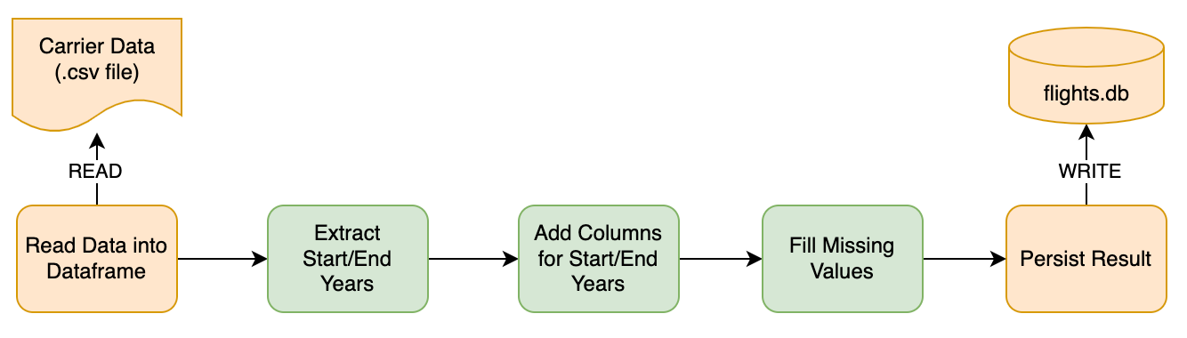
Use Case for this Presentation
Focus on the unit testable code.
Given a csv file of carrier information:
Read the carriers and parse the start/end effective years
Add start/end years as new columns
Replace null start years with the value 1900
Replace null end years with the value 9999
Invalid ranges should use [-1, -1] for [start, end]
Sample Carrier String Values:
Trans-American Airlines( - 2010)
American Airlines Intl (2011 - 2016)
American Airlines (2016 - )
Sun Country ( - )
Notes:
This demo will center around airline carrier data that has two columns: carrier code and a description string.
(CLICK)
Here are some example values. We want to parse the start/end years as part of the pipeline.
(CLICK)
So, the process is to
Read the carrier csv data and parse the start/end years (CLICK)
Add the start/end years as new columns ((CLICK)
Replace empty start and end years with 1900 and 9999, respectively (CLICK)
Any invalid data should get a -1 for the start and end years
AT THE END, we’ll have a dataframe with two new columns, which can be persisted.
(CLICK)

Slide 10
Use Case for this Presentation
Focus on the unit testable code.
Given a csv file of carrier information:
Read the carriers and parse the start/end effective years
Add start/end years as new columns
Replace null start years with the value 1900
Replace null end years with the value 9999
Invalid ranges should use [-1, -1] for [start, end]
Sample Carrier String Values:
Trans-American Airlines( - 2010)
American Airlines Intl (2011 - 2016)
American Airlines (2016 - )
Sun Country ( - )
Integration Test
Integration Test
Unit Test
Notes:
In order to perform local/unit testing, you’ll need to design your pipeline to separate out the transformation logic from the other integrations, like system I/O.
The I/O is considered integration testing
(CLICK)
The transformations are considered unit tests, so isolate the transformation logic by designing the middle portion to start with a dataframe or other data structure, and end with a similar data structure.

Slide 11
Test Cases
Test planning requires creation of test scenarios and expected output given an input value (input comes from a column)
Id | Test Case | Sample | Validity | Start | End
1 | Two years | Carrier (2016 - 2020) | Valid | 2016 | 2020
2 | Missing end year | Carrier (2016 - ) | Valid | 2016 | 9999
3 | Missing start year | Carrier ( - 2016) | Valid | 1900 | 2016
4 | Two years, extra parenthesis | Carrier (carrier) (2010 - 2016) | Valid | 2010 | 2016
5 | Missing both years, but valid string | Carrier ( - ) | Valid | 1900 | 9999
6 | Missing parenthesis | Carrier | Invalid | -1 | -1
7 | Missing right parenthesis | Carrier (2016 – 2022 | Invalid | -1 | -1
8 | Missing left parenthesis | Carrier 2016 - 2022) | Invalid | -1 | -1

Slide 12
TDD Methodology
PASS (bad test)
FAIL
[Re]Write 1+ test(s)
Check Test
Write Minimum Code
Run All Tests
Clean or Refactor Code
FAIL
PASS
Run All Tests
FAIL
PASS: GO TO NEXT FEATURE
Notes:
Go over how on TDD I won’t cover the why’s of the TDD methodology, but this is my preferred method of development and learning new languages.

Slide 13
Test-Driven Development with python
Isolate python-only logic into python functions

Slide 14
Demos Used in this Presentation
Integrate VS Code and Docker to use the container as the execution environment.
Notes:
BEFORE showing the testing demos, I want to show you how to connect VS Code to the Docker image.

Slide 15



Implement the Python Logic
Test Code File: tests/test_flight_utilities.py Code file: flight_utilities.py
Notes:
Isolate the scalar business logic from the transformation path. This can follow the traditional TDD path because no other frameworks are needed.

Slide 16
TDD: Write the Tests
Code stubs are required so the test can run dummy code.
PASS (bad test)
FAIL
[Re]Write 1+ test(s)
Check Test
Write Minimum Code
Run All Tests
Clean or Refactor Code
FAIL
PASS
Run All Tests
FAIL
PASS: GO TO NEXT FEATURE

Slide 17
Write the Stub(s) and Test(s)
Test Methodology: One coded test per test case. Tests Code File: test_flight_utilities.py, Code File: flight_utilities.py
Function Stub
Sample Test Function
def get_year_range(desc_str: object):
return None
def test_get_year_range_2016_2020():
# given
sut_input = 'Carrier (2016 - 2020)'
expected = [2016, 2020]
# when
actual = sut.get_year_range(sut_input)
# then
assert expected == actual

Slide 18
TDD: Write the Implementation Code
Demo: Implement the function code and re-run the tests.
PASS (bad test)
FAIL
[Re]Write 1+ test(s)
Check Test
Write Minimum Code
Run All Tests
Clean or Refactor Code
FAIL
PASS
Run All Tests
FAIL
PASS: GO TO NEXT FEATURE

Slide 19
Test-Driven Data Engineering with PySpark
Implement the DataFrame manipulations with PySpark

Slide 20
Implement the PySpark Transformations (UDF)
Tests Code File: tests/test_get_effective_year_udfs.py, Code file: carrier_transforms.py
Notes:
Next screen shows the methodology.

Slide 21
UDF Test: Test Cases with Similar Output
Group the valid and invalid test cases together.
What is a UDF?
User-Defined Functions (UDFs) are user-programmable routines that act on one row.
Input DataFrame
Output DataFrame
expected | input_str
2016 | Carrier (2016 - 2020)
2016 | Carrier (2016 - )
1900 | Carrier ( - 2016)
2010 | Carrier (carrier) (2010 - 2016)
1900 | Carrier ( - )
expected | input_str | actual
2016 | Carrier (2016 - 2020) | ???
2016 | Carrier (2016 - ) | ???
1900 | Carrier ( - 2016) | ???
2010 | Carrier (carrier) (2010 - 2016) | ???
1900 | Carrier ( - ) | ???
UDF
get_start_year()
Notes:
A UDF is a function that allows for operation on a row in a dataframe – in this case, takes a column and computes another.
(click)
Create a DataFrame that has the “input value” and the expected output.
(click)
Execute the UDF, which will use the previously tested python function.
(click)
Validate the new column (actual) is equal to “expected”
NOTE: When testing a UDF, you don’t need to use the exact shape of the dataframe that you expect in prod because you’re just testing the function operation.
PERFORM DEMO
* Show the test case functions (show data, execution, assertion)
* Show the fixtures
* Show the UDF
* execute UDF

Slide 22
UDF Test: All Test Cases at Once
Group all test cases together.
Input DataFrame
Output DataFrame
expected | Sample
2016 | Carrier (2016 - 2020)
2016 | Carrier (2016 - )
1900 | Carrier ( - 2016)
2010 | Carrier (carrier) (2010 - 2016)
1900 | Carrier ( - )
-1 | Carrier
-1 | Carrier (2016 – 2022
-1 | Carrier 2016 - 2022)
expected | Sample | actual
2020 | Carrier (2016 - 2020) | ???
9999 | Carrier (2016 - ) | ???
2016 | Carrier ( - 2016) | ???
2016 | Carrier (carrier) (2010 - 2016) | ???
9999 | Carrier ( - ) | ???
-1 | Carrier | ???
-1 | Carrier (2016 – 2022 | ???
-1 | Carrier 2016 - 2022) | ???
UDF
get_end_year()
Notes:
Show that all test cases can be included in the same dataframe, but this makes debugging much more challenging.
PERFORM DEMO
* Show the test case functions (show data, execution, assertion)
* Show the UDF
* execute UDF

Slide 23
Two Sample Test Methods
By Similarity of Output Result
All Results at Once
def test_get_start_year_valid_ranges(spark_session):
# given
sut_df: DataFrame = spark_session.createDataFrame(
[
(2016, 'Carrier (2016 - 2020)’),
(2016,'Carrier (2016 - )’),
(None, 'Carrier ( - 2016)’),
(2010, 'Carrier (carrier) (2010 - 2016)’),
(None, 'Carrier ( - )’)
],
["expected", "input_str"])
# when
result_df = sut_df.\
withColumn("actual", ct.get_start_year(col("input_str"))).\
select('expected', 'actual’)
# then
failure_df = result_df.where(col("actual") != col("expected"))
failure_df.show()
assert(failure_df.rdd.isEmpty())
def test_get_end_year_all_formats(spark_session):
# given
sut_df: DataFrame = spark_session.createDataFrame(
[
(2020, 'Carrier (2016 - 2020)’),
(None,'Carrier (2016 - )’),
(2016, 'Carrier ( - 2016)’),
(2016, 'Carrier (carrier) (2010 - 2016)’),
(None, 'Carrier ( - )’),
(-1, 'Carrier’),
(-1, 'Carrier (2016 - 2022’),
(-1, 'Carrier 2016 - 2022)’)
],
["expected", "input_str"])
# when
result_df = sut_df.\
withColumn("actual", ct.get_end_year(col("input_str"))).\
select('expected', 'actual’)
# then
failure_df = result_df.where(col("actual") != col("expected"))
failure_df.show()
assert(failure_df.rdd.isEmpty())

Slide 24
Implement the Spark DataFrame Transformations
Tests Code File: tests/test_carrier_transforms_spark, Code file: carrier_transforms.py
Notes:
Now we have a functional parser function, functional UDF transformation function, now let’s use them to compute the new dataframe.
Notice that all the functionality before this is tested, so dataframe manipulations can reuse the functionality with high confidence.
I’ll go through the process visually before showing the code.
(CLICK)

Slide 25
DataFrame Test: Test Cases with Similar Input
Group the test cases by inputs that have similar attributes.
Input DataFrame
code | description
C01 | Carrier (2016 - 2020)
C04 | Carrier (carrier) (2010 - 2016)
processYearRange()
Actual Output DataFrame
Expected Output DataFrame
code | description | effective_ start_ year | effective_ end_ year
C01 | Carrier (2016 - 2020) | ??? | ???
C04 | Carrier (carrier) (2010 - 2016) | ??? | ???
code | description | effective_ start_ year | effective_ end_ year
C01 | Carrier (2016 - 2020) | 2016 | 2020
C04 | Carrier (carrier) (2010 - 2016) | 2010 | 2016
Compare for Equality
Notes:
Start with an input dataframe
(click)
Define the expected output as a dataframe
(click)
Run the transformation function
(click)
Compare the actual vs. expected
PERFORM DEMO
* Show the test case functions (show data, execution, assertion)
* Show the fixtures
* Show the dataframe comparison

Slide 26
Reusable Test Resources: Pytest Fixtures
Reusable resources available for tests -- https://docs.pytest.org/en/6.2.x/fixture.html
Session Fixture – for all tests
Used for resources that need to be used across all tests in a test run. e.g. Spark Session
Module Fixture – for a specific test module
Used for functions and resources that can be reused within a module. e.g. schema definitions
@pytest.fixture(scope="session")
def spark_session(request) -> SparkSession:
"""Fixture for creating a spark context."""
spark = (SparkSession
.builder
.master('local[*]’)
.appName("pytest spark_session")
.enableHiveSupport()
.getOrCreate())
request.addfinalizer(lambda: spark.stop())
quiet_py4j()
return spark
@pytest.fixture(scope="module")
def carrier_input_schema() -> StructType:
return StructType([
StructField("code", StringType(), False),
StructField("description", StringType(), False)
])
@pytest.fixture(scope="module")
def carrier_output_schema() -> StructType:
return StructType([
StructField("code", StringType(), False),
StructField("description", StringType(), False),
StructField("effective_start_year", IntegerType(), True),
StructField("effective_end_year", IntegerType(), True)
])

Slide 27
Test-Driven Data Engineering with AWS Glue
Implement the DynamicFrame manipulations with AWS Glue

Slide 28
Implement the Spark DataFrame Transformations
Tests Code File: tests/test_carrier_transforms_spark, Code file: carrier_transforms.py

Slide 29
AWS Glue Differences
Spark UDF
Python Function
DataFrame
DynamicFrame
Spark Libs
Glue Libs

Slide 30
AWS Glue Test
Sample Test (using DataFrame & Glue)
A Few Notes
def test_processYearRange_valid_twoYears(
spark_session, glue_context, carrier_input_schema,
carrier_output_schema):
# given
input_data = [
('C01', 'Carrier (2016 - 2020)’),
('C04', 'Carrier (carrier) (2010 - 2016)’)]
input_df = spark_session.createDataFrame(
data=input_data, schema=carrier_input_schema)
expected_df = spark_session.createDataFrame(
data=[
('C01', 'Carrier (2016 - 2020)', 2016, 2020),
('C04 ', 'Carrier (carrier) (2010 - 2016)', 2010, 2016)
],
schema=carrier_output_schema)
# when
actual_df = processYearRange(input_df, glue_context)
# then
assert_dataframes_equal(expected_df, actual_df)
This test starts with a DataFrame and not a DynamicFrame to show the similarity in test writing.
Normally DynamicFrames would be used exclusively.
Notice that the change is that processYearRange() takes in glue_context
GlueContext will be used in the Docker container to leverage AWS Glue
Notes:
Create a DataFrame that has the “input value” and the expected output
(click)
Execute the UDF
(click)
Validate the new column (actual) is equal to “expected”
NOTE: When testing a UDF, you don’t need to use the exact shape of the dataframe that you expect in prod because you’re just testing the function operation.
PERFORM DEMO
* Show the test case functions (show data, execution, assertion)
* Show the fixtures
*

Slide 31
Review
Docker is a great way to isolate development environments
Dev IDEs can use the Docker containers as the python interpreter
Design your pipelines by isolating transformations from integrations (I/O)
Create testable scalar functions for business logic
For Spark/Glue, define test data as input DataFrames/DynamicFrames
Use fixtures for reusable resources like the SparkSession or GlueContext
Notes:
You now have an initial look into setting up and leveraging a local development environment for python, pyspark, and glue development.

Slide 32
Next Steps & Challenges
The Docker setup was not as easy as hoped (see Readme.md)
Use more efficient code organization for tests (no copy/paste)
Explore other Glue APIs
Implement tests using S3 and other integrations
Configure the IDE to be able to debug tests
As ELT/ETL gets more complex, the test automation gets more difficult
Testing is a very complex skill that requires practice
Notes:
You now have an initial look into setting up and leveraging a local development environment for python, pyspark, and glue development.

Slide 33
Parting Words for Action

Slide 34
1 Test > No Tests.
Always.

Slide 35
Be quantifiably and visibly trustworthy.

Slide 36
If you can “find time” to support defects and production issues, you can plan time to start testing.

Slide 37
Thank You!
Github → https://github.com/donaldsawyer/tdde-py-pyspark
LinkedIn → https://www.linkedin.com/my/donaldsawyer

