Slide 1
Test-Driven Data Wrangling in R
And A Little on [S]OLID
Donald Sawyer
(https://www.linkedin.com/in/donaldsawyer)
Presentation & Source Code on GitHub:
https://github.com/donaldsawyer/test-driven-data-wrangling-r

Slide 2
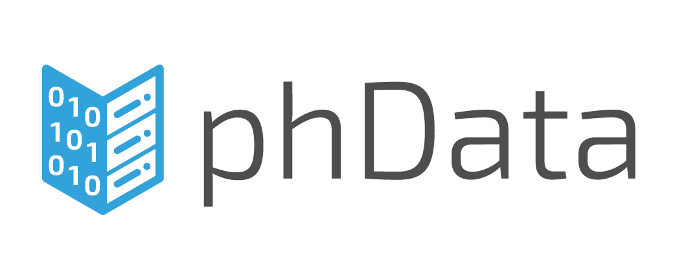

About Me
Sr. Solution Architect
We’re Hiring!
Adjunct
Designed & Teach Big Data Engineering & Analytics

Slide 3
What is Unit Testing?
Types of testing
Unit
Integration
System
Data Quality, Functional, Acceptance, UX, and many more…
Unit Testing
Testing of an individual code module, function, or “unit”
Done by a developer before deployment
Verifies input/output of a “unit”
Why?
Verify the individual components perform as expected
Gain confidence that “done” code is still working as the program changes

Slide 4
Concepts of Automated Testing
Coded tests
Your tests are code
They need code review too
SOLID is the key
They should be run by your CI tools (Jenkins, Drone, etc.)
Try to achieve high [statement, branch] coverage
You’ll use a framework

Slide 5
Let’s Get Started!

Slide 6
An Introduction to SOLID
SOLID Principles of Object-Oriented Design
S – Single Responsibility
O – Open/Closed Principle
L – Liskov Substitution
I – Interface Segregation
D – Dependency Inversion
Single Responsibility
A module should have a single responsibility and that responsibility should be entirely encapsulated in the module
A module should have one, and only one, reason to change
THIS is what we’ll unit test in this talk
Notes:
Single Responsibility
A “class” should have responsibility over a single part of the functionality in software AND entirely encapsulated within
A class should have one, and only one, reason to change
Classes with many responsibilities are tightly coupled
Making one change shouldn’t break 10 other functions
https://drive.google.com/file/d/0ByOwmqah_nuGNHEtcU5OekdDMkk/view
Example from Martin: Rectangle that renders and computes area
Open/Closed Principle
Open for extension, closed for modification
Ideologically hard, in my experience
Idea: Design Patterns like the strategy pattern
Example:
https://drive.google.com/file/d/0BwhCYaYDn8EgN2M5MTkwM2EtNWFkZC00ZTI3LWFjZTUtNTFhZGZiYmUzODc1/view
Liskov Substitution
You should be able to substitute a subclass for a superclass without adverse change in behavior
Derived types should be suitable for their parent types
A subtype should never strengthen the preconditions/contract of a supertype
A subtype should never weaken the postconditions of a supertype
http://www.ckode.dk/programming/solid-principles-part-3-liskovs-substitution-principle/#postconditions
https://drive.google.com/file/d/0BwhCYaYDn8EgNzAzZjA5ZmItNjU3NS00MzQ5LTkwYjMtMDJhNDU5ZTM0MTlh/view
Interface Segregation
Classes should not be forced to depend on interfaces that they do not use
Think of utility classes and interfaces
Cohesion
Make fine-grained interfaces that are client specific (role interfaces)
Heavily violated
Some studies of design patterns might help with this
https://drive.google.com/file/d/0BwhCYaYDn8EgOTViYjJhYzMtMzYxMC00MzFjLWJjMzYtOGJiMDc5N2JkYmJi/view
Dependency Inversion
Principles:
High level modules should not depend on low-level modules, rather abstractions for both
Abstractions should not depend on details, detals should depend on abstractions
Reduce the coupling between classes
Depend on abstractions, not on concretions
This might be tougher in BI
Where have you seen this one?
https://drive.google.com/file/d/0BwhCYaYDn8EgMjdlMWIzNGUtZTQ0NC00ZjQ5LTkwYzQtZjRhMDRlNTQ3ZGMz/view

Slide 7
Test-Driven Development (TDD)
Helps you understand your requirements
Forces you to test (YAY!)
If your test doesn’t fail first, it’s a bad test
Avoid false positives
Ensure better tests
When you have tests, you can CONFIDENTLY change your code in the future
Incorporate SOLID to make it easier
It takes practice!
Notes:
TDD Isn’t easy to start, you have to practice.

Slide 8
Demo App in R

Slide 9
Coded Unit Testing with RUnit
Why?
Every time you change your code, you want to re-test it, ENTIRELY
Without coded testing, we skip testing pieces we’ve already tested
Gain confidence in testing changes to large data sets
What if we broke something we previously built?
We won’t know until a defect is reported
Integrate testing within the deployment process
Package: Runit
Allows automated verification of code units
Allows a test suites to be defined and tested together
Allows for test results to be reported
Also: testthat

Slide 10
A Doorbuster Metric Program
Requirements
Shall read two product csv files
Doorbuster1.csv
Doorbuster2.csv
Shall add two metrics to the product data
Products that are doorbusters but have no price assigned
Products that are doorbusters and online, but are out of stock
Shall write out a csv with the following:
Product id
No price metric
Online but out of stock metric

Slide 11
The R Example
0_monolith.R
A typical R Script
Contains a lot of code that all runs in sequence
What the script does
Reads 2 data sets from csv (doorbuster data)
doorbuster1.csv & doorbuster2.csv
Combines the datasets
Adds metrics for
Doorbuster items missing a price
Doorbuster items that are online, but out of stock
Writes metric data to csv called doorbuster_metrics.csv

Slide 12
To Refactor (the TDD Way)
Stub out a function for the code being refactored
Write the appropriate unit tests
RUN the tests → They BETTER fail!
Fill the code into the method
RUN the tests & fix function until the tests pass
Move on
Every change to the program you make, RUN ALL THE TESTS
Every defect that gets reported → CREATE NEW TESTS

Slide 13
Refactor: Extract Method
Purpose
Take a chunk of code and create a method/function so it can be tested.
Make a small function to follow the Single Responsibility principle
In 0_monolith.R
Create a method for reading a single doorbuster csv file
Create a method that reads both doorbuster csv files
Create a method that adds metric for doorbusters with no price
Create a method that adds metric for doorbusters that are online but out of stock

Slide 14
Refactor 1: Reading Files
Create a function that reads a csv file
read.doorbuster.csv()
Create a function that reads the specific files and combines them
read.all.doorbuster.files()
Why two functions?
Replace data acquisition functionality in monolith

Slide 15
Refactor 2: Adding Metrics
Create two new functions for the metrics required
add.column.db.noprice
add.column.db.online.outofstock
Replace manipulations in monolith

Slide 16
Feature Add: Snake Case Columns
Convert columns from column.name format to column_name format
Functions
Convert a string to snake case
Convert array of strings to snake case
Add to monolith

Slide 17
Quick Tips

Slide 18
1 Test > No Tests. Always.

Slide 19
Where there’s smoke, there’s fire.

Slide 20
You’ll need to learn a lot of new things.

Slide 21
If you can “find time” to support defects and product issues, you can make time to start testing.

Slide 22
Helpful Resources
TDD
https://en.wikipedia.org/wiki/Test-driven_development
http://www.agiledata.org/essays/tdd.html
Refactoring
http://refactoring.com/
Code Smells: https://en.wikipedia.org/wiki/Code_smell

