Slide 1
Asthma Severity
Kadie Iverson & Matthew Donaldson
3/21/2022

Slide 2
Executive Summary
Analytic Objective(s): To predict the severity of an asthma attack
Decisions to be impacted:
Business Value: Improve severity of asthma attacks by determining the most significant predictors and suggesting to make a change
Data Assets: 10 features

Slide 3
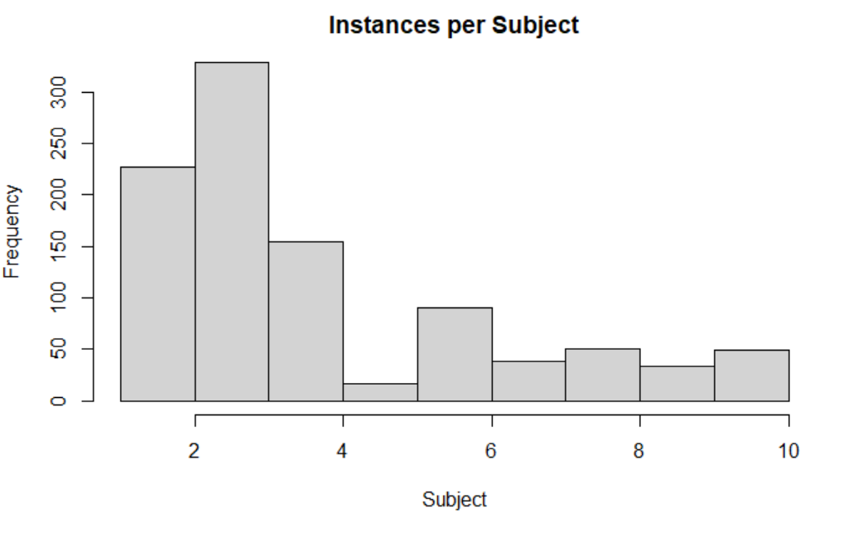
Data Asset Description
[Summarize using graphs, summary statistics the data set.

Slide 4
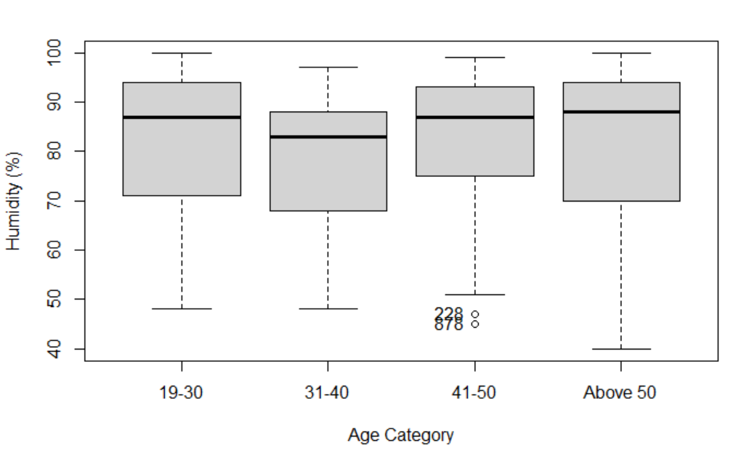
Preprocessing – Outlier detection
[please elaborate on any observation that were consider outliers. Please describe method used to arrive to that conclusion]

Slide 5
Model Update
[please update on what models the team is using or planning to use to support the decision. Make sure to be ready to articulate on the reasoning behind your choice]

Slide 6
Next steps
Determine best linear mixed-effects model to predict asthma attacks
Based on R² and Akaike Information Criterion (AIC)
Build Rshiny feature
Research previous studies done using weather features

