Slide 1
Asthma Severity
Kadie Iverson & Matthew Donaldson
3/21/2022

Slide 2
Executive Summary
Analytic Objective(s): To predict the severity of an asthma attack
Decisions Impacted: Help people with asthma become more aware of having an asthma attack and if it could be severe
Business Value: Could change the way inhalers (app) are manufactured by accounting for the most significant predictors and suggesting to make a change
Data Assets: 11 features, and a grouping variable(subjects)
Data is from a study for predicting asthma attacks

Slide 3
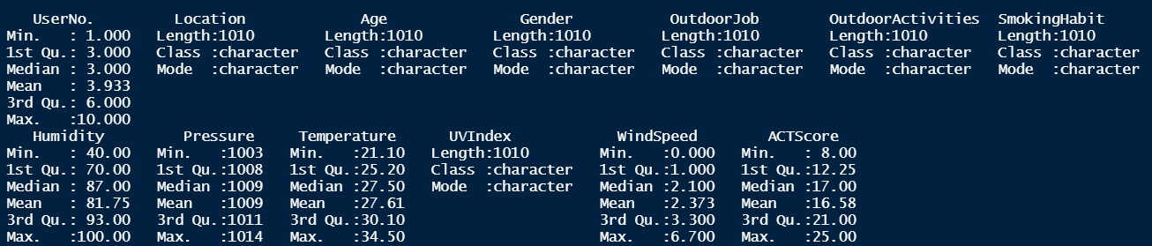
Data Asset Description
Dimension: 1010 by 13

Slide 4
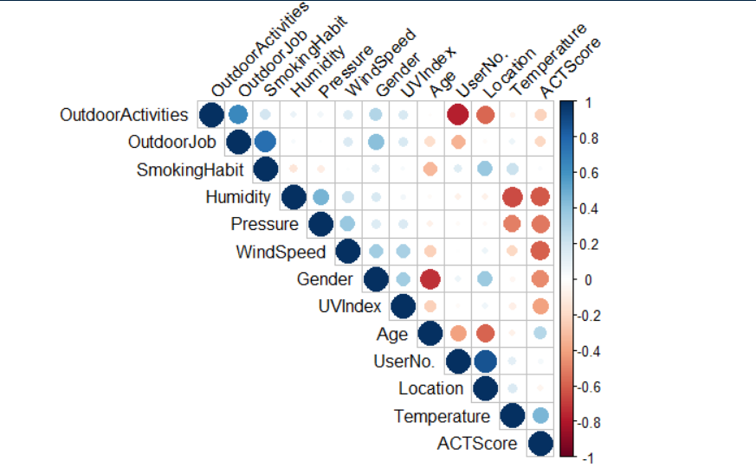
Data Asset Description

Slide 5
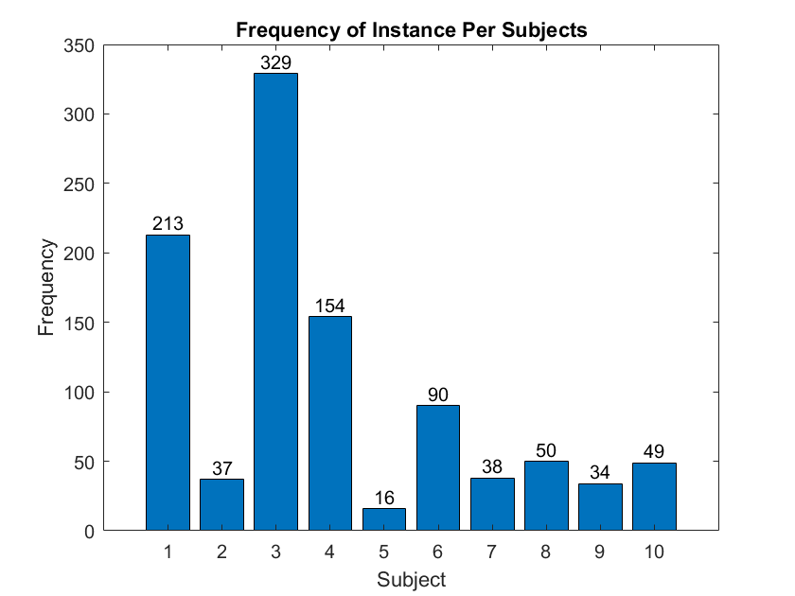
Data Asset Description

Slide 6
Data Preprocessing - Factoring
Handling categorical data: lapply() function
Converts the categories into numbers
First category is considered 0 and each group afterward is a binary number
Important for interpreting the intercept of the regression model
Example: Outdoor Job
Category | Frequently | Occasionally | Rarely
Frequently | 0 | 0 | 0
Occasionally | 0 | 1 | 0
Rarely | 0 | 0 | 1

Slide 7
Preprocessing – Outlier detection
All categorical variables box plotted against continuous variables
Any value outside of 1.5*IQR
Values that showed up more than once deemed an outlier
23 observations deemed as outliers

Slide 8
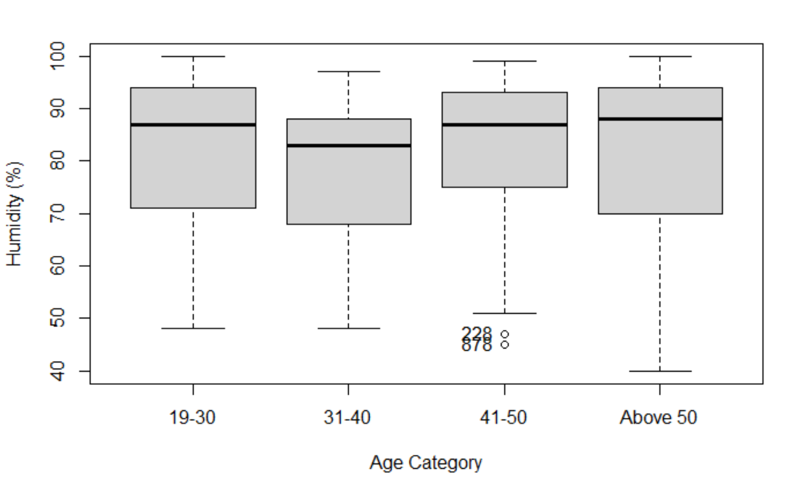

Slide 9
Preprocessing – Normalizing the data
Standard Normal ~N(0,1)
Only for continuous variables
Needed in order to be in form that is interpretable for a linear regression model

Slide 10
Model Update – Splitting the Data
Kept 3 subjects out
Less chance of bias when evaluating performance of test set
Captures ruggedness
More confidence that the model can accurately predict the severity of an attack for individuals that were not monitored for this study

Slide 11

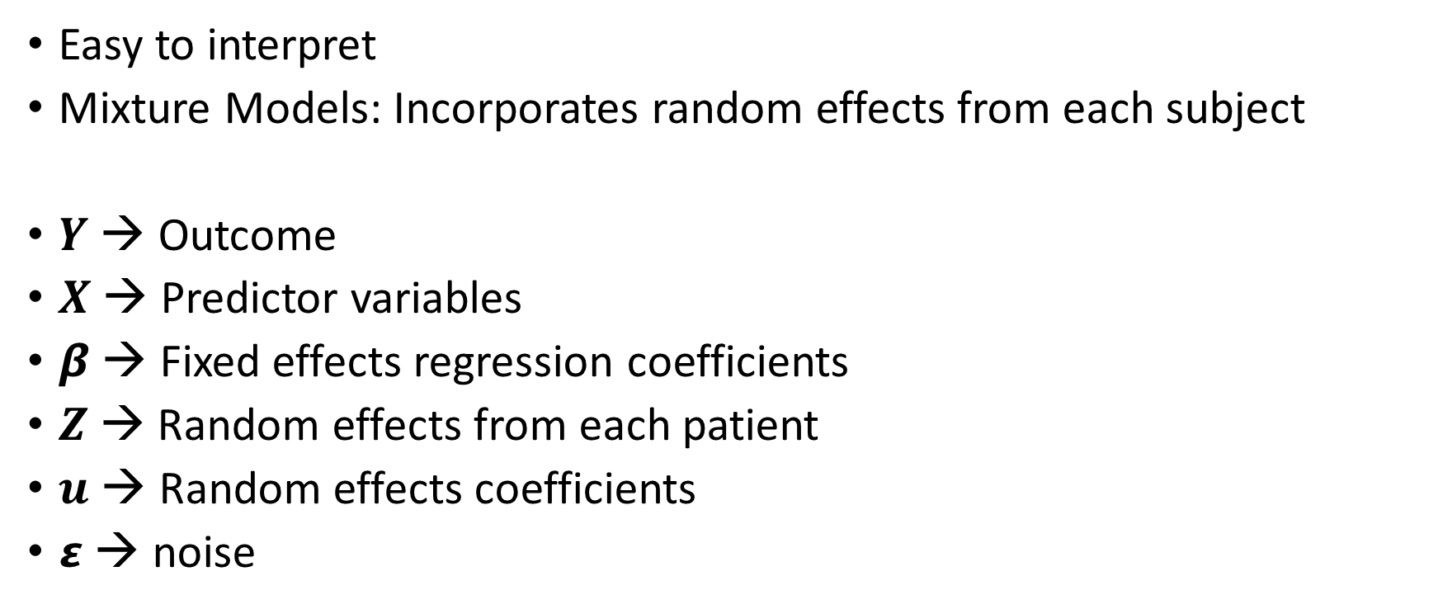
Model Update – Mixed Effects Model
Model: $Y=Xβ+Zu+ ε$
Easy to interpret
Mixture Models: Incorporates random effects from each subject
$Y$ → Outcome
$X$ → Predictor variables
$β$ → Fixed effects regression coefficients
$Z$→ Random effects from each patient
$u$ → Random effects coefficients
$ε$ → noise

Slide 12
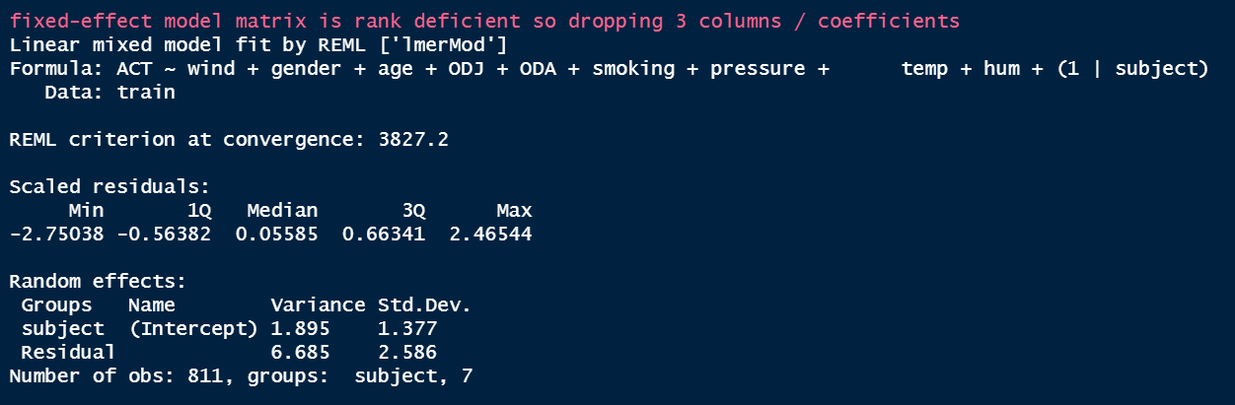
Model Update

Slide 13
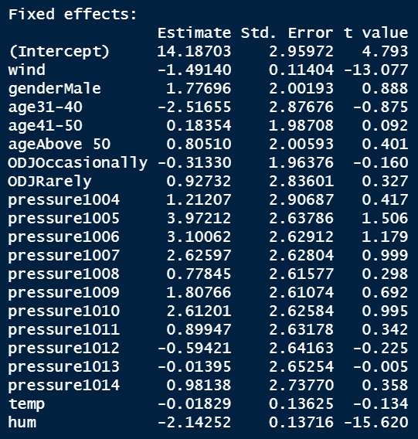

Slide 14
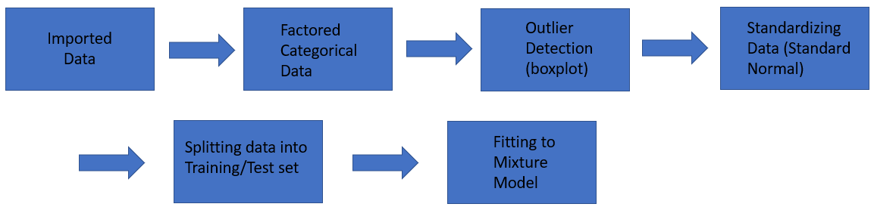
Model Update – MLM

Slide 15
Next steps
Determine best linear mixed-effects model through exhaustive search to predict asthma attacks
Based on R² and Akaike Information Criterion (AIC)
Compare best linear mixed-effects model to a model that uses lasso regression with the linear mixed model
Look into K-fold cross validation
Build Rshiny feature
Research previous studies done using weather features

