Slide 1
Asthma Severity
Kadie Iverson & Matthew Donaldson
3/21/2022

Slide 2
Executive Summary
Analytic Objective(s): To predict the severity of an asthma attack
Decisions Impacted: - Help people with asthma become more aware of having an asthma attack and if it could be severe
- Could change the way inhalers are manufactured
Business Value: Improve severity of asthma attacks by determining the most significant predictors and suggesting to make a change
Data Assets: 10 features (I think it might actually be 11 if we include location)

Slide 3
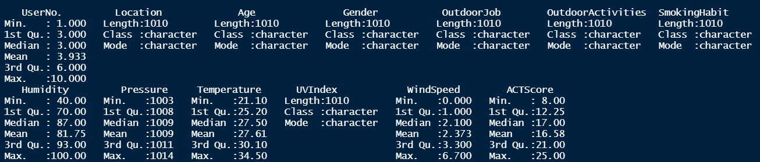
Data Asset Description
Dimension: 1010 by 13

Slide 4
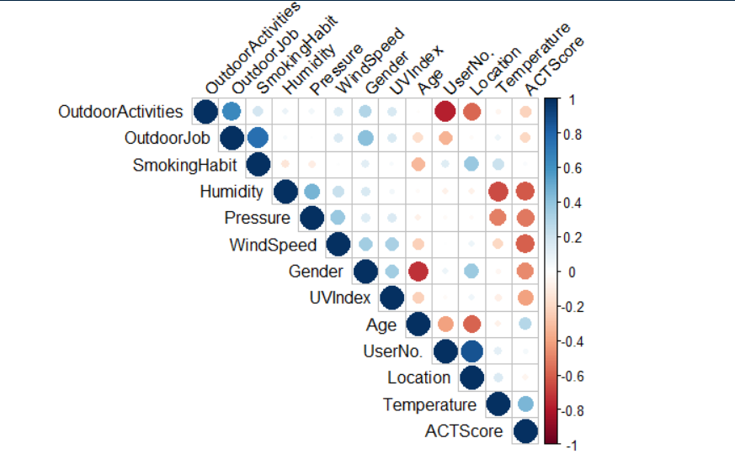
Data Asset Description

Slide 5
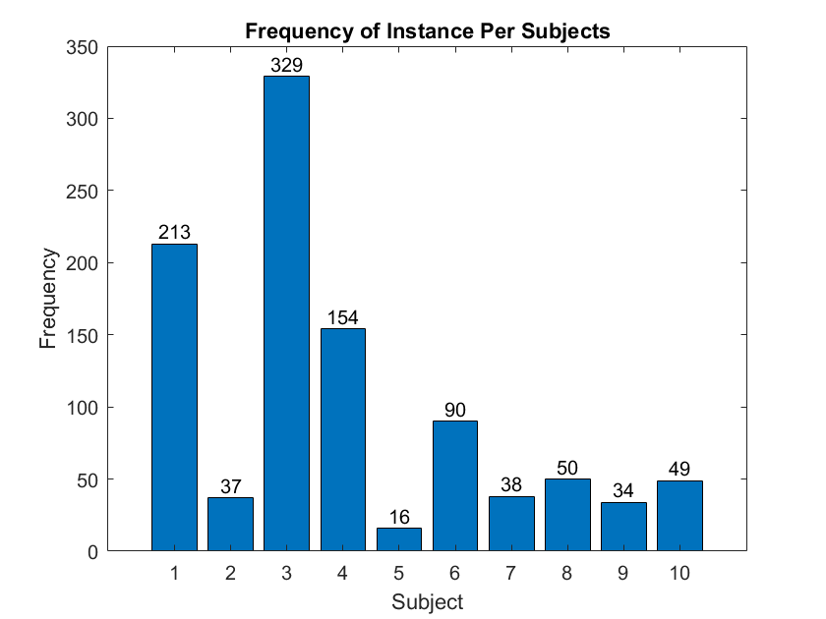
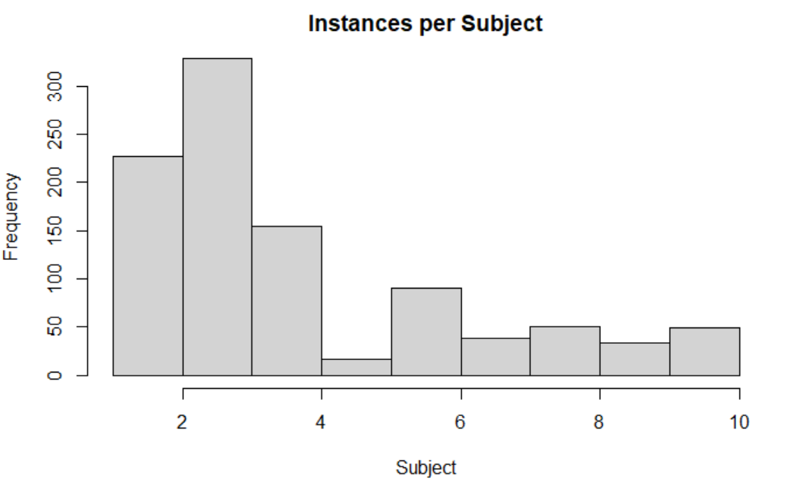
Data Asset Description
[Summarize using graphs, summary statistics the data set.

Slide 6
Data Preprocessing - Factoring
Handling categorical data: lapply() function
Converts the categories into numbers
First category is considered 0 and each group afterward is a binary number
Example: Outdoor Job
Category | Frequently | Occasionally | Rarely
Frequently | 0 | 0 | 0
Occasionally | 0 | 1 | 0
Rarely | 0 | 0 | 1

Slide 7
Preprocessing – Outlier detection
[please elaborate on any observation that were consider outliers. Please describe method used to arrive to that conclusion]
All categorical variables box plotted against continuous variables
Any value outside of 1.5*IQR
Values that showed up more than once deemed an outlier

Slide 8
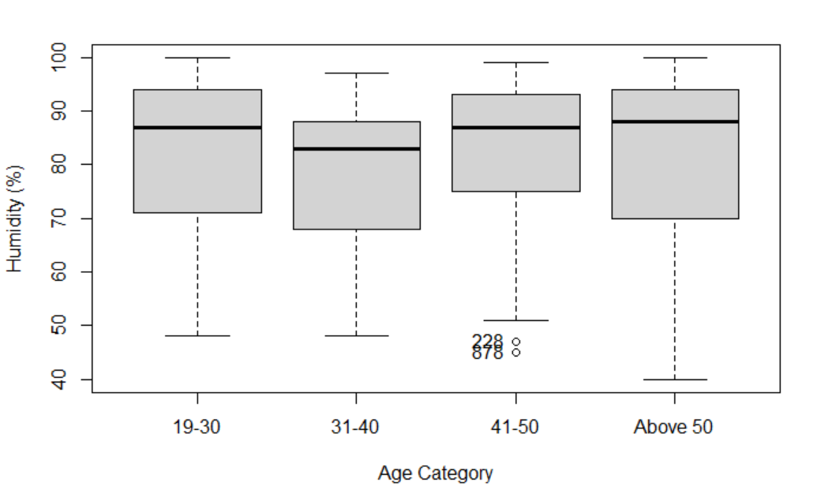

Slide 9
Preprocessing – Normalizing the data
Standard Normal ~N(0,1)
Only for continuous variables

Slide 10
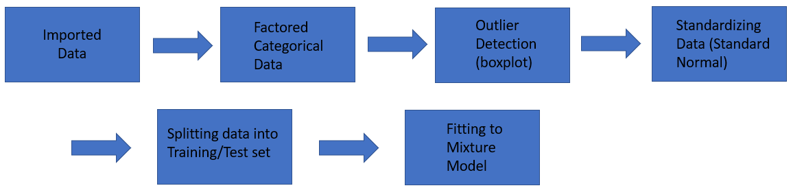
Model Update – MLM

Slide 11
Model Update – Splitting the Data
Kept 3 subjects out
K-fold cross validation
…………….

Slide 12
Model Update
[please update on what models the team is using or planning to use to support the decision. Make sure to be ready to articulate on the reasoning behind your choice]
Easy to interpret
Incorporates random effects from each subject
Model: y = beta*X + b*x + epsilon → need to write this as equation
Discuss beta and b and epsilon and give mean and variance for the normal distribution.

Slide 13
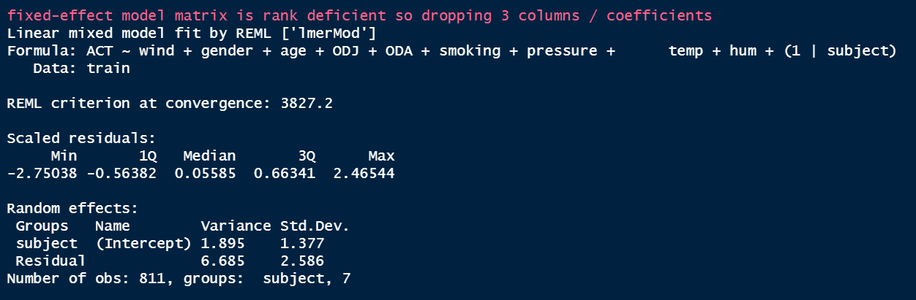
Model Update
[please update on what models the team is using or planning to use to support the decision. Make sure to be ready to articulate on the reasoning behind your choice]

Slide 14
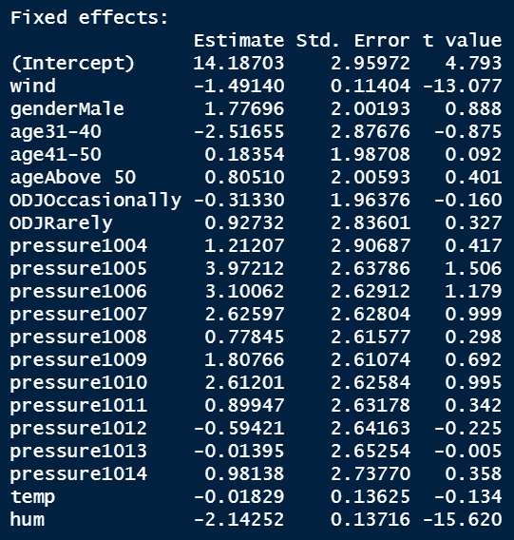

Slide 15
Next steps
Determine best linear mixed-effects model to predict asthma attacks
Based on R² and Akaike Information Criterion (AIC)
Compare best linear mixed-effects model to a model with l1norm in it (NEED TO REWRITE)
Build Rshiny feature
Research previous studies done using weather features

