Slide 1
Asthma Severity
Kadie Iverson & Matthew Donaldson
3/21/2022

Slide 2
Executive Summary
Analytic Objective(s): To predict the severity of an asthma attack
Decisions Impacted: Help people with asthma become more aware of having an asthma attack and if it could be severe
Business Value: Could change the way inhalers (app) are manufactured by accounting for the most significant predictors and suggesting to make a change
Data Assets: 11 features, complete data set is from

Slide 3
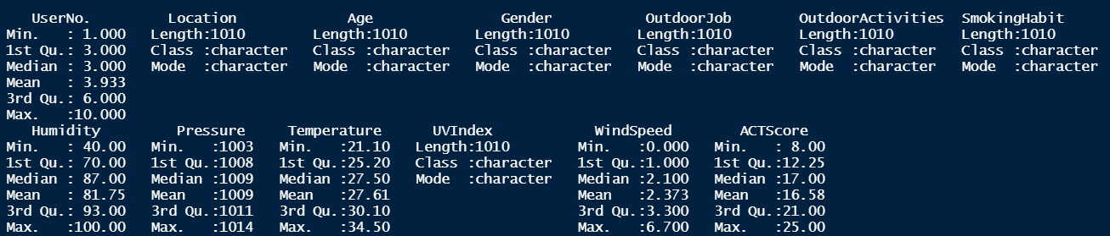
Data Asset Description
Dimension: 1010 by 13

Slide 4
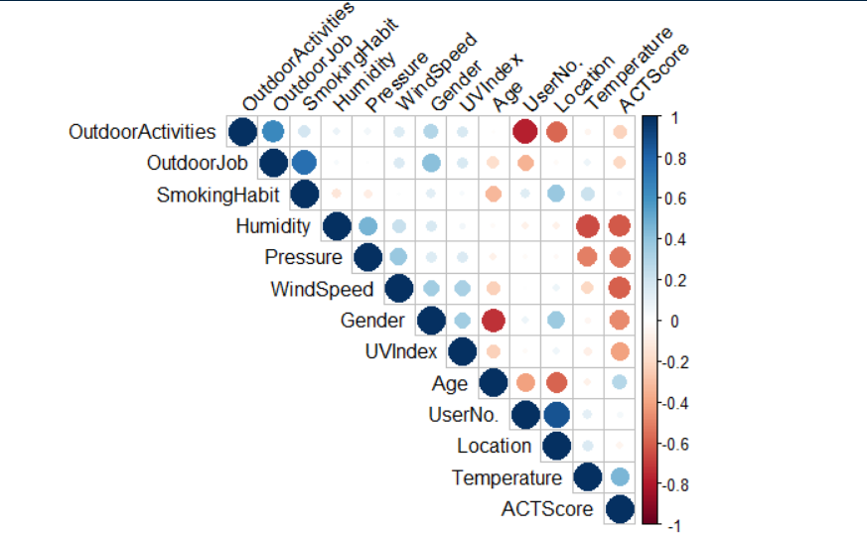
Data Asset Description

Slide 5
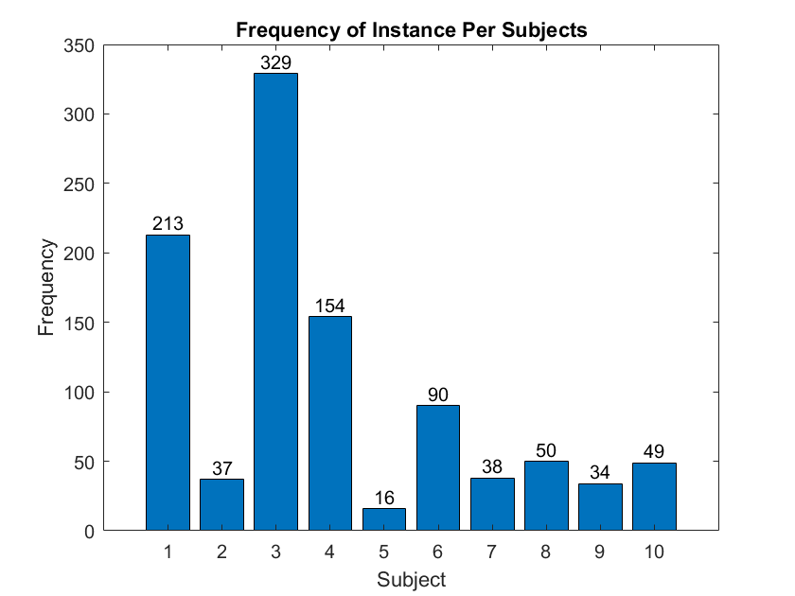
Data Asset Description

Slide 6
Data Preprocessing - Factoring
Handling categorical data: lapply() function
Converts the categories into numbers
First category is considered 0 and each group afterward is a binary number
Important for interpreting the intercept of the regression model
Example: Outdoor Job
Category | Frequently | Occasionally | Rarely
Frequently | 0 | 0 | 0
Occasionally | 0 | 1 | 0
Rarely | 0 | 0 | 1

Slide 7
Preprocessing – Outlier detection
All categorical variables box plotted against continuous variables
Any value outside of 1.5*IQR
Values that showed up more than once deemed an outlier
23 observations deemed as outliers

Slide 8
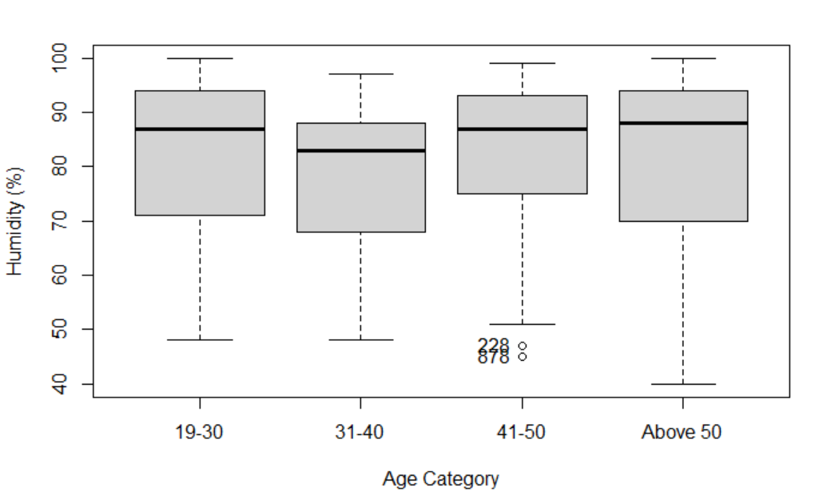

Slide 9
Preprocessing – Normalizing the data
Standard Normal ~N(0,1)
Only for continuous variables
Needed in order to be in form that is interpable for a linear regression model

Slide 10
Model Update – Splitting the Data
Kept 3 subjects out
For use outside of the study, more confidence that the model can accurately predict the severity of an attack for individuals that were not monitored for this study
K-fold cross validation LOOK MORE INTO

Slide 11
Model Update – Mixed Effects Model
Easy to interpret
Mixture Models: Incorporates random effects from each subject
Model: y = beta*X + b*x + epsilon → need to write this as equation
Discuss beta and b and epsilon and give mean and variance for the normal distribution.

Slide 12
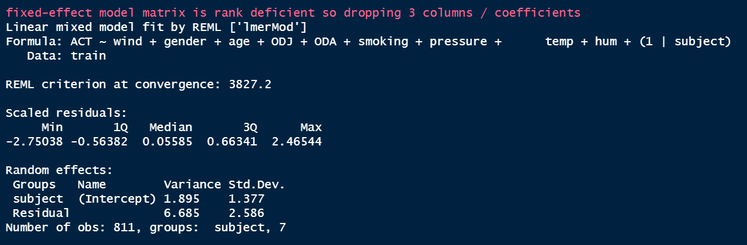
Model Update

Slide 13
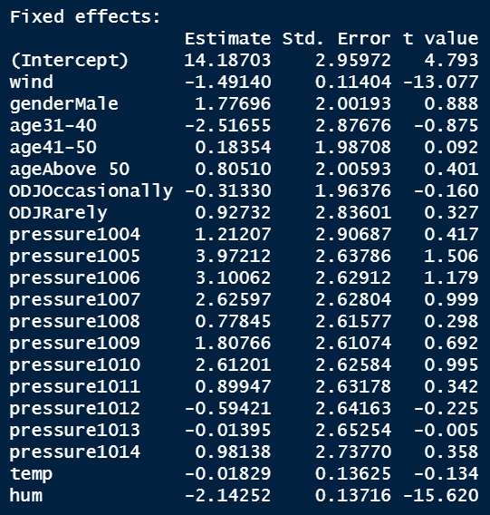

Slide 14
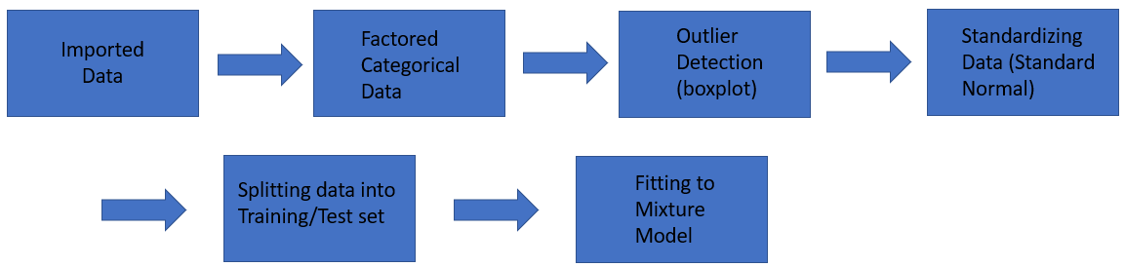
Model Update – MLM

Slide 15
Next steps
Determine best linear mixed-effects model through exhaustive search to predict asthma attacks
Based on R² and Akaike Information Criterion (AIC)
Compare best linear mixed-effects model to a model with l1norm in it (NEED TO REWRITE)
Build Rshiny feature
Research previous studies done using weather features

