Slide 1
Carster
Cars For Days
Buy/ Trade/ Sell Cars

Slide 2
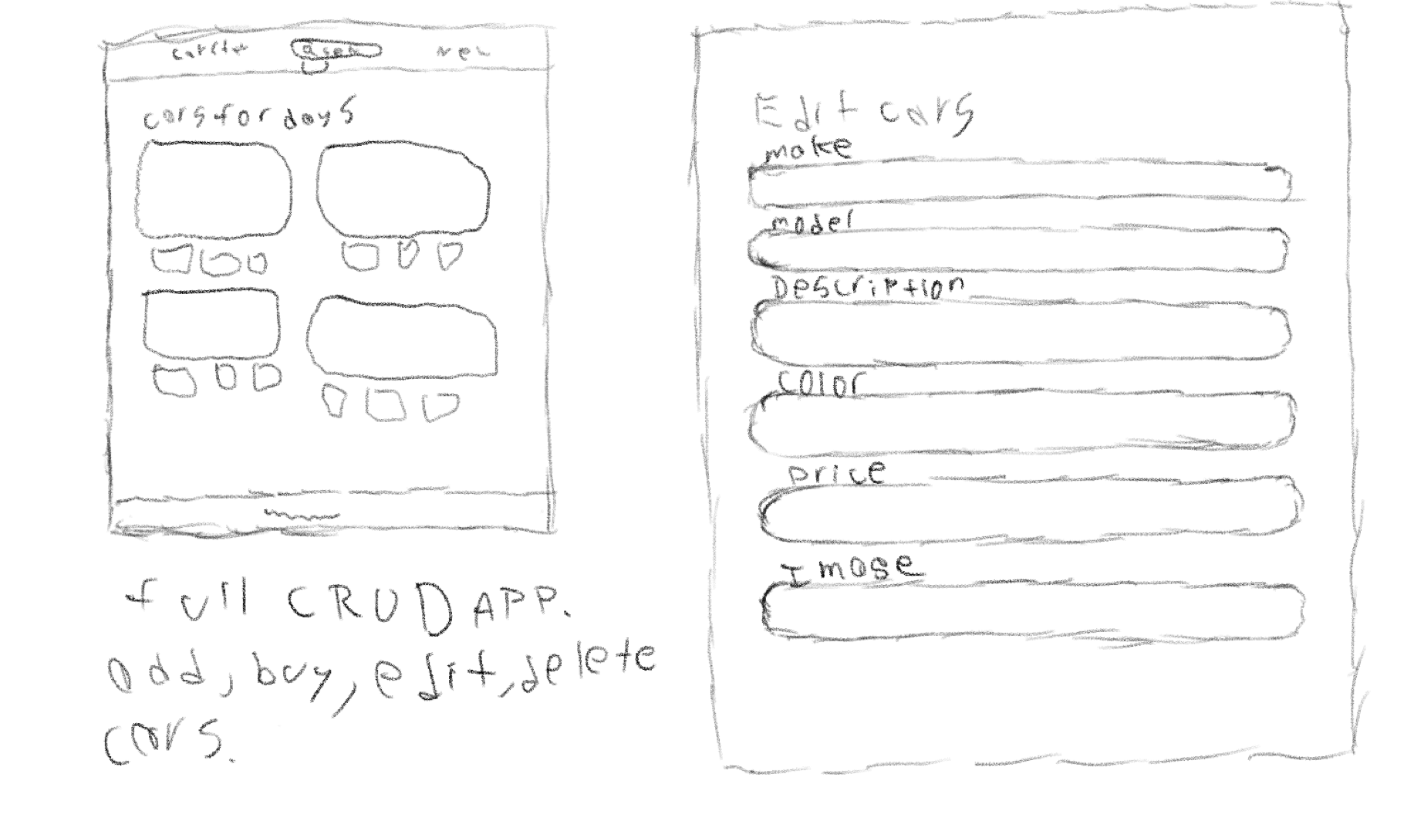
Wire Frame

Slide 3
Favorite Features
Dynamic search bar provides easy searching
Allowing users to post comments

Slide 4
Remaining Challenges
Shopping cart
Confirmation Page
User Authentication

