Slide 1
Cars For Days
Buy/ Trade/ Sell Cars

Slide 2
Our Mission
To get everyone a car
And have tons of cars available for days

Slide 3
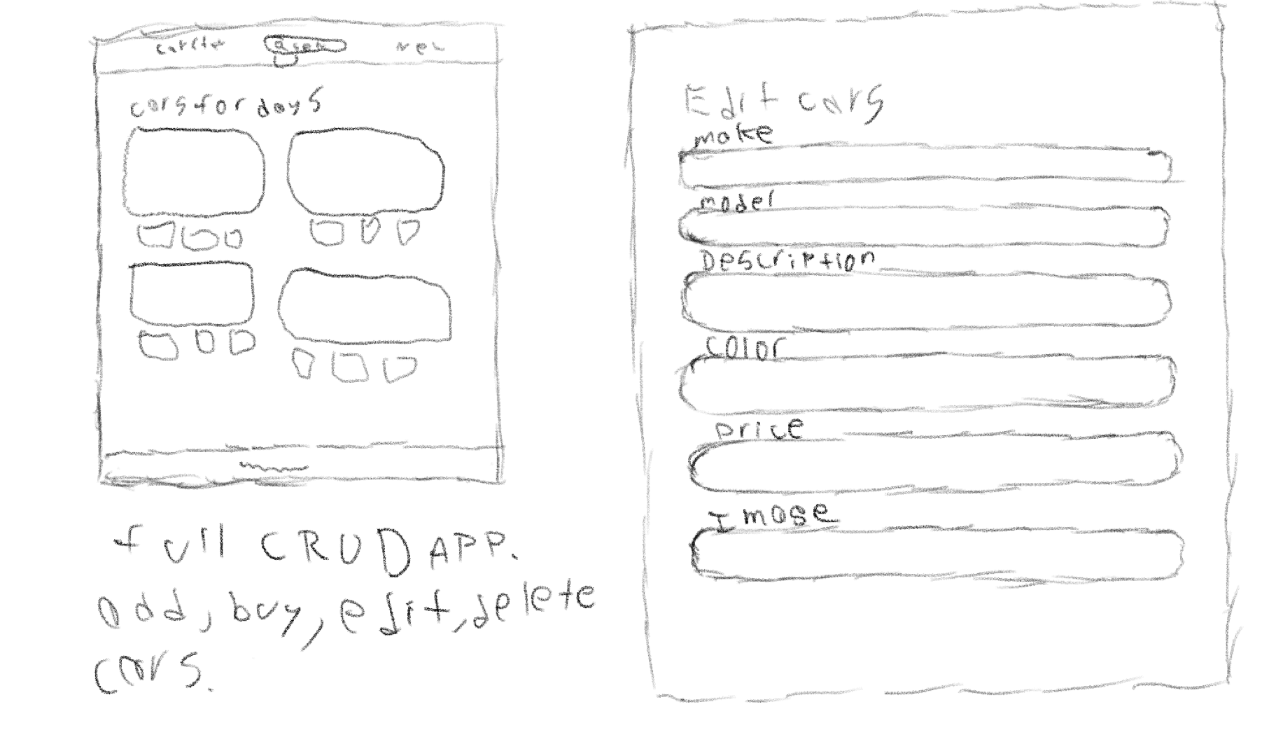
Wire Frame

Slide 4
Favorite Features
Dynamic search bar provides easy searching
Allowing users to post comments

Slide 5
Remaining Challenges
Shopping cart
Confirmation Page
User Authentication

