Slide 1
Street Pal
A web application for social and human services

Slide 2
The Problem
There are many homeless people in America that are in need of human services.
Many people have no idea where to find these services and may not have easy access to that information.
This application provides organized locations and information of services people need.

Slide 3
Current solutions
There are many food drives, public restrooms, services for housing ect.
Concern: an application for users to report problems in the community
These services should be organized into a single place to help anyone find what they are looking for

Slide 4
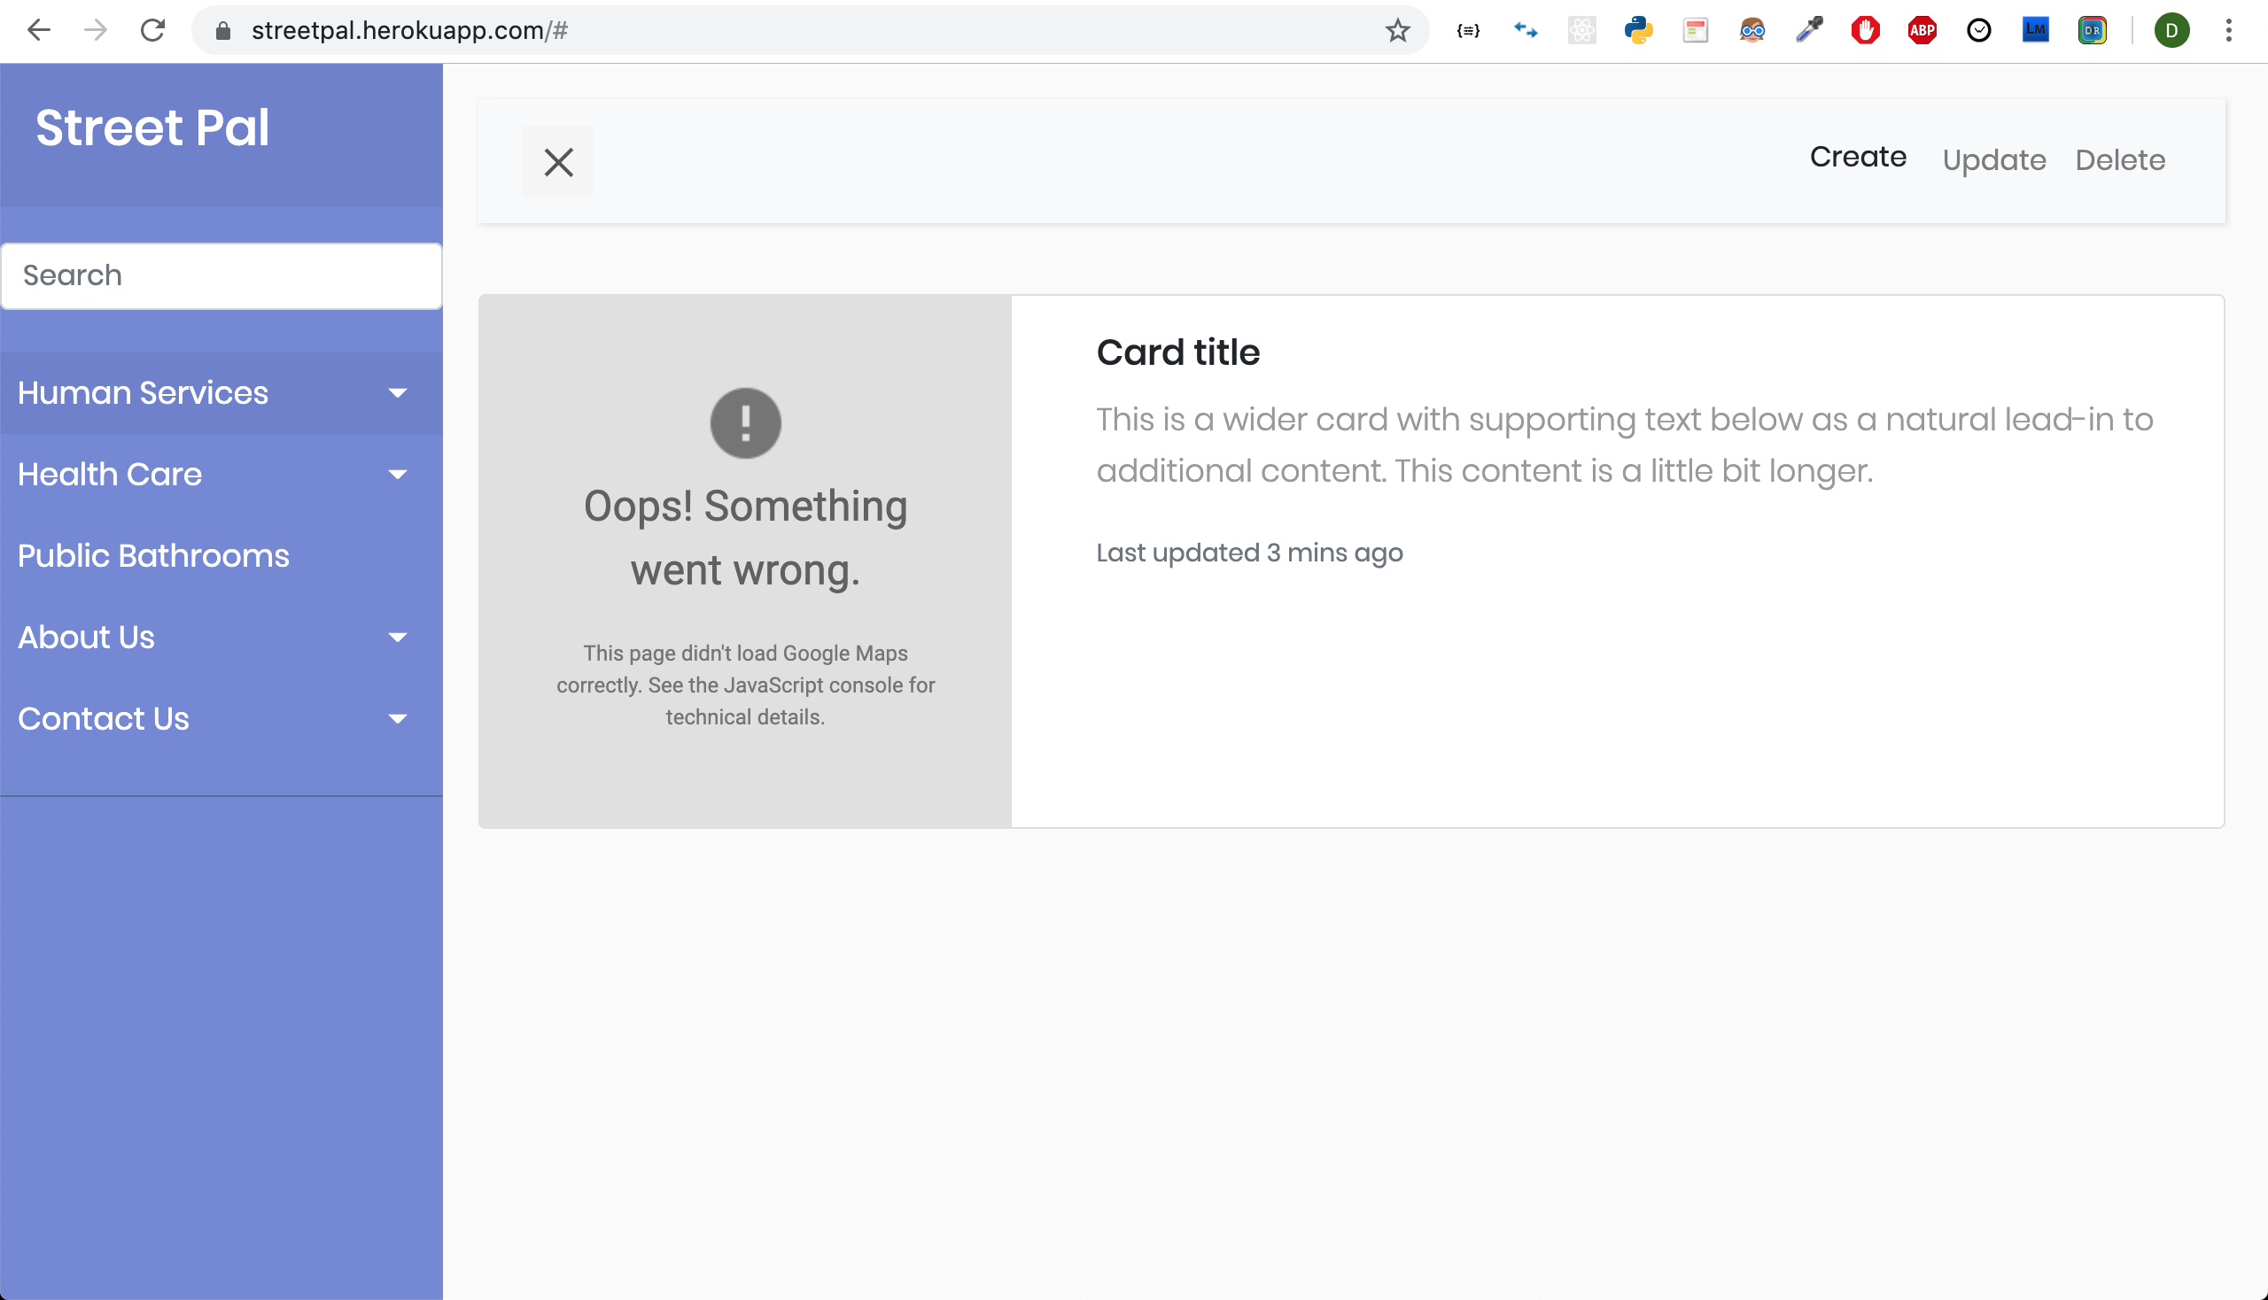
The Homepage

Slide 5
https://streetpal.herokuapp.com/
https://github.com/donaldvallejo/Street-Pal.git

