Slide 1
MODULE-5
Part 2

Slide 2
8051 Addressing Modes
An addressing mode refers to how you are addressing a given memory location. The five different ways of addressing are as follows −
Immediate addressing mode
Direct addressing mode
Register direct addressing mode
Register indirect addressing mode
Indexed addressing mode

Slide 3
Immediate Addressing Mode
Data operand is a constant and it is a part of the instruction itself
The data must be preceded by a # sign.
Eg1:-MOV A, #63H
The data (constant) 63 is moved to the accumulator register
Eg2: MOV DPTR, # 2000H

Slide 4
Direct addressing mode
Only for Internal RAM and the SFRs
Eg:-MOV R1, 42H : Move the contents of RAM location 42 into R1 register
MOV 49H,A : Move the contents of the accumulator into the RAM location 49
MOV 30H,#30H
MOV 01H,00H --------→allowed in MC (not in MP)
MOV A,80H -------------→ A← P0 {SFR}
MOV 30H,A

Slide 5
Register addressing mode
Data operand to be manipulated lies in one of the registers
Eg:-
MOV A,R0 : Move the contents of the register R0 to the accumulator
ADD A,R6 :Add the contents of R6 register to the accumulator
MOV P1, R2 : Move the contents of the R2 register into port 1
Note: MOV R0,R1 (not allowed)
So use MOV A, R1
MOV R0,A

Slide 6
Register Indirect addressing mode
This is for internal RAM & External RAM
To access Int RAM ,8-bit addresses required(R0/R1 only)
To access ext RAM , 16-bit addresses required(DPTR)
Eg:- Internal RAM
MOV A,@ R0 :Move the contents of RAM location whose address is in R0 into A (accumulator)
MOV @ R1 , B : Move the contents of B into RAM location whose address is held by R1
Eg:- External RAM
MOVX A,@DPTR
MOVX DPTR, @A

Slide 7
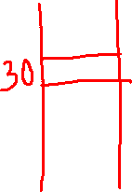
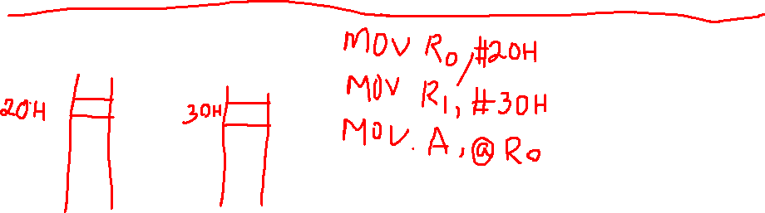
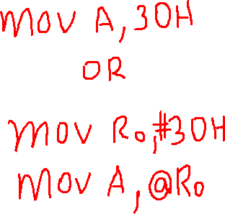
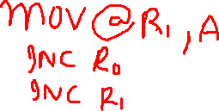

Slide 8
Indexed addressing mode
Only for ROM
Address obtained from two registers
Eg:-
MOVC A, @ A+DPTR
MOVC A, @A+PC

Slide 9
8051 INSTRUCTION SET
1. Instruction Timings
T-state, Machine cycle and Instruction cycle are terms used in instruction timings.
T-state is defined as one subdivision of the operation performed in one clock period.
Machine cycle is defined as 12 oscillator periods. A machine cycle consists of six states and each state lasts for two oscillator periods. An instruction takes one to four machine cycles to execute an instruction.
Instruction cycle is defined as the time required for completing the execution of an instruction. The 8051 instruction cycle consists of one to four machine cycles.

Slide 10
The instructions of 8051
1. Data transfer instructions
2. Arithmetic instructions
3. Logical instructions
4. Branch instructions
5. Subroutine instructions
6. Boolean/Bit manipulation instructions

Slide 11
DATA TRANSFER INSTRUCTIONS
a. Move the contents of a register Rn to A
i. MOV A,R2
b. Move the contents of a register A to Rn
i. MOV R4,A
c. Move an immediate 8 bit data to register A or to Rn or to a memory location(direct or indirect)
i. MOV A, #45H
ii. MOV R6, #51H
iii. MOV 30H, #44H
iv. MOV @R0, #0E8H
v. MOV DPTR, #0F5A2H

Slide 12
d. Move the contents of a memory location to A or A to a memory location using direct and indirect addressing
i. MOV A, 65H
ii. MOV A, @R0
iii. MOV 45H, A
iv. MOV @R1, A
e. Move the contents of a memory location to Rn or Rn to a memory location using direct addressing
i. MOV R3, 65H
ii. MOV 45H, R2

Slide 13
f. Move the contents of memory location to another memory location using direct and indirect addressing
i. MOV 20H, 30H
ii. MOV 45H, @R0
g. Move the contents of an external memory to A or A to an external memory
i. MOVX A,@R1
ii. MOVX @R0,A
iii. MOVX A,@DPTR
iv. MOVX@DPTR,A

Slide 14
h. Move the contents of program memory to A
i. MOVC A, @A+PC
ii. MOVC A, @A+DPTR

Slide 15
i. Exchange instructions :-The content of source ie., register, direct memory or indirect memory will be exchanged with the contents of destination ie., accumulator.
i. XCH A,R3
ii. XCH A,@R1
iii. XCH A,54h
j. Exchange digit:- Exchange the lower order nibble of Accumulator (A0-A3) with lower order nibble of the internal RAM location which is indirectly addressed by the register.
i. XCHD A,@R1
ii. XCHD A,@R0

Slide 16
k.PUSH 25H
SP← SP+1 ,
Then [SP]← [25H]
l.POP 25H
First [25H] ←[SP] ,Then SP ← SP-1

Slide 17
ARITHMETIC INSTRUCTIONS
1.Addition
i. Add the contents of A with immediate data with or without carry.
i. ADD A, #45H
ii. ADDC A, #OB4H
ii. Add the contents of A with register Rn with or without carry.
i. ADD A, R5
ii. ADDC A, R2

Slide 18
iii. Add the contents of A with contents of memory with or without carry using direct and indirect addressing
ADD A, 51H
ADDC A, 75H
iii ADD A, @R0
iv ADDC A, @R1

Slide 19
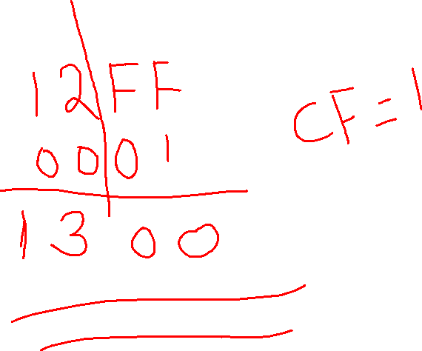


Slide 20
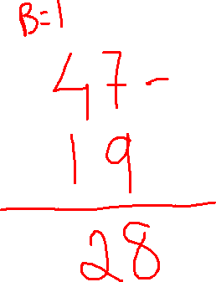

Slide 21
2.Subtraction
i. Subtract the contents of A with immediate data with or without carry.
i. SUBB A, #45H
ii. SUBB A, #OB4H
ii. Subtract the contents of A with register Rn with or without carry.
i. SUBB A, R5
ii. SUBB A, R2

Slide 22
iii. Subtract the contents of A with contents of memory with or without carry using direct and indirect addressing
i. SUBB A, 51H
ii. SUBB A, 75H
iii. SUBB A, @R1
Simple Subtraction also use SBB, so use CLR C instn before subtraction

Slide 23
3.Multiplication
MUL AB.
MOV A,#45H ; [A]=45H
MOV B,#0F5H ; [B]=F5H
MUL AB ; [A] x [B] = 45 x F5 = 4209 ;
[A]=09H, [B]=42H

Slide 24
4.Division
DIV AB.
Eg:
MOV A,#0F5H ;
MOV B,#45H ;
DIV AB ;
A ←----Quotient, B←----Remainder

Slide 25
6. Increment:
INC increments the value of source by 1. If the initial value of register is FFh, incrementing the value will cause it to reset to 0. The Carry Flag is not set when the value "rolls over" from 255 to 0. In the case of "INC DPTR", the value two-byte unsigned integer value of DPTR is incremented. If the initial value of DPTR is FFFFh, incrementing the value will cause it to reset to 0.
INC A
INC R1
INC 25H
INC @R0
INC DPTR

Slide 26
7.Decrement:
DEC decrements the value of source by 1. If the initial value of is 0, decrementing the value will cause it to reset to FFh. The Carry Flag is not set when the value "rolls over" from FFh to 0
DEC A
DEC R0
DEC 25H
DEC @R0
DEC DPTR (Invalid)

Slide 27
5. DA A (Decimal Adjust After Addition).
When two BCD numbers are added, the answer is a non-BCD number. To get the result in BCD, we use DA A instruction after the addition. DA A works as follows. If lower nibble is greater than 9 or auxiliary carry is 1, 6 is added to lower nibble. If upper nibble is greater than 9 or carry is 1, 6 is added to upper nibble.

Slide 28
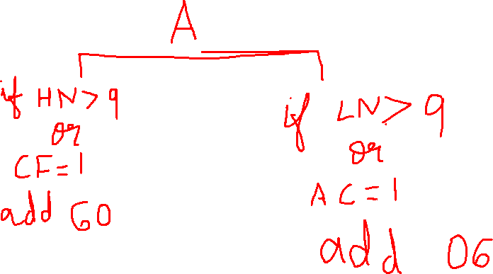

Slide 29
LOGICAL INSTRUCTIONS
Logical AND
ANL destination, source
Eg:-
ANL A,#25 ANL A,@R0 ANL 25H,A
ANL A, R0 ANL A,20H ANL 25H, #25
Note:
Clear LN, Suppose A= 0011 0101 (AND LN with 0’s & HN with 1’s)
ANL A, #0F0H

Slide 30
Logical OR
2.ORL destination, source
Eg:-
ORL A,#25 ORL A,@R0 ORL 25H,A
ORL A, R0 ORL A,20H ORL 25H, #25
Note:
SET LN , Suppose A= 0011 0101 (OR LN with 1’s & HN with 0’s)
ORL A, #0FH

Slide 31
Logical Ex-OR
3.XRL destination, source
XRL A,#25 XRL A,@R0 XRL 25H,A
XRL A, R0 XRL A,20H XRL 25H, #25
Note:
Complement LN, Suppose A= 0011 0101 (XRL LN with 1’s & HN with 0’s)
XRL A, 0FH

Slide 32
4.Logical NOT
CPL A, CPL C, CPL bit address
5.SWAP A – Swap the upper nibble and lower nibble of A.

Slide 33
Rotate Instructions
RR A
This instruction is rotate right the accumulator. Each bit is shifted one location to the right, with bit 0 going to bit 7.
RL A
Rotate left the accumulator. Each bit is shifted one location to the left, with bit 7 going to bit 0
RRC A
Rotate right through the carry. Each bit is shifted one location to the right, with bit 0 going into the carry bit in the PSW, while the carry was at goes into bit 7
RLC A
Rotate left through the carry. Each bit is shifted one location to the left, with bit 7 going into the carry bit in the PSW, while the carry goes into bit 0.

Slide 34
BRANCH INSTRUCTIONS- Unconditional
Branch instruction -2 types JUMP & CALL
There are 3 types of jump instructions. They are:-
1. Short Jump (SJMP radd)
2. Absolute Jump (AJMP sadd)
3. Long Jump(LJMP ladd)
CALL-
LCALL sub
SCALL sub
RETURN instn – 2 types
RET
RETI

Slide 35
.1.Short Jump (SJMP radd)
Radd- 8-bit signed no
Ranges (-128 to +127)
Radd is calculated as the relative distance from the next instn to the branch locn
Telling how far we jump not where we want to jmp
Eg: SJMP 08H
2. Absolute Jump (AJMP sadd)
Here entire 64 KB divided into 32 pages, each page is of 2 KB
As JMP is in the same page ,only 11 bits of address will change

Slide 36
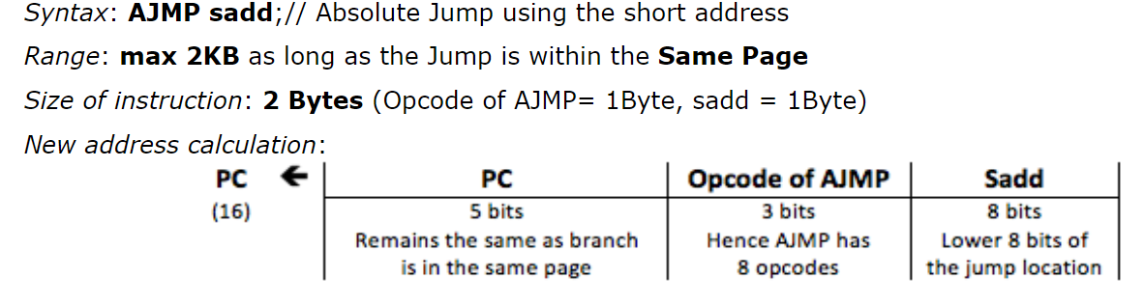

Slide 37
3. Long Jump(LJMP ladd)
ladd- 16 bit address (0000H to FFFFH)
3 bytes (1 byte opcode +2 byte ladd)
Eg: LJMP 5000H
LCALL also like this

Slide 38
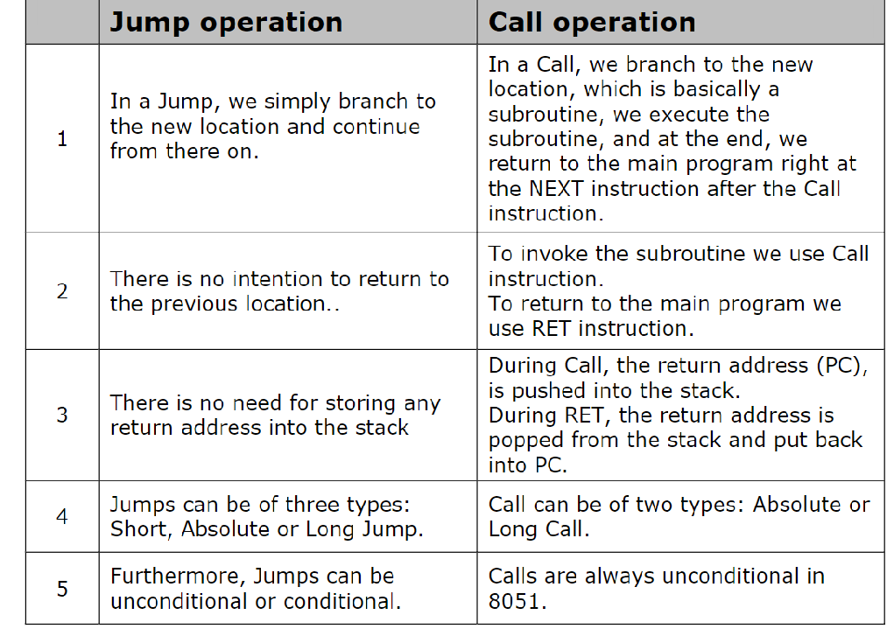

Slide 39
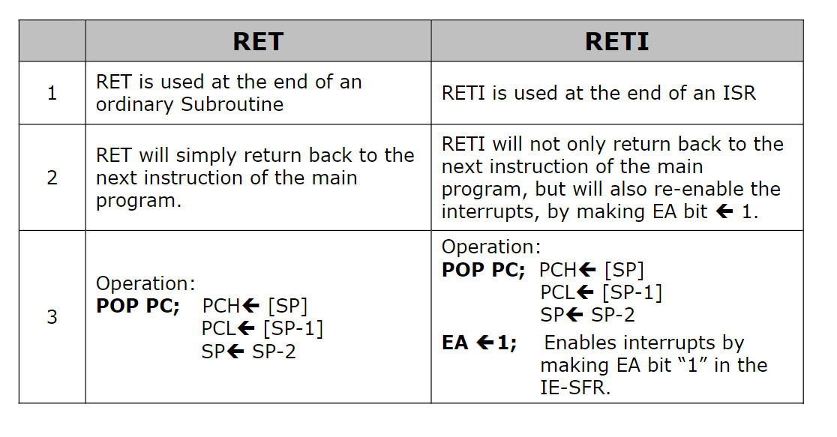

Slide 40
Conditional jump instructions
1.CJNE A,#25H ,label
(Compare & jmp if not equal)
CJNE A,25H ,label
CJNE R0,#25H ,label
CJNE @R0,25H ,label
2. DJNZ count, label (Decrement and jmp if not Zero)
DJNZ R2,BACK
DJNZ 25H,BACK
Notes:
A,#25

Slide 41
JC label
JNC label
JZ label
JNZ label

Slide 42
Bit wise Conditional jump instructions
JB bit,label
Eg: JB P0.2,down
JNB bit,label
Eg: wait :JNB TF0,wait
JBC bit,label ( jmp if bit =1 then goto label ,while jumping clear bit also)
Eg: JBC P0.7,down, (if p0.7=1 jmp to locn down and make po.7=0)
Notes:
JB

Slide 43
CALL /SUBROUTINE INSTRUCTIONS
Subroutines are handled by CALL and RET instructions There are two types of CALL instructions
LCALL address(16 bit)
This is long call instruction which unconditionally calls the subroutine located at the indicated 16 bit address. This is a 3 byte instruction. The LCALL instruction works as follows.
a. During execution of LCALL, [PC] = [PC]+3; (if address where LCALL resides is say, 0x3254; during execution of this instruction [PC] = 3254h + 3h = 3257h
b. [SP]=[SP]+1;
c. [[SP]] = [PC7-0];
d. [SP]=[SP]+1;
e. [[SP]] = [PC15-8];

Slide 44
ACALL address(11 bit)
This is absolute call instruction which unconditionally calls the subroutine located at the indicated 11 bit address. This is a 2 byte instruction. The ACALL instruction works as follows.
a. During execution of ACALL, [PC] = [PC]+2; (if address where LCALL resides is say, 0x8549; during execution of this instruction [PC] = 8549h + 2h = 854Bh
b. [SP]=[SP]+1
c. [[SP]] = [PC7-0]
d. [SP]=[SP]+1; (SP increments again and [SP]=09)
e. [[SP]] = [PC15-8]
With these the address (0x854B) which was in PC is stored in stack.
f. [PC10-0]= address (11 bit); the new address of subroutine is loaded to PC. No flags are affected.

Slide 45
RET instruction
RET instruction pops top two contents from the stack and load it to PC.
g. [PC15-8] = [[SP]]
h. [SP]=[SP]-1
i. [PC7-0] = [[SP]]
j. [SP]=[SP]-1; (SP decrements again)

Slide 46
Boolean/ BIT MANIPULATION INSTRUCTIONS
8051 has 128 bit addressable memory. Bit addressable SFRs and bit addressable PORT pins. It is possible to perform following bit wise operations for these bit addressable locations.

Slide 47
1.LOGICAL AND
a. ANL C,BIT
Eg: ANL C, P0.2
ANL C, 25H
b. ANL C, /BIT;
Eg: ANL C, / P0.3 (C ^/P0.3)
2. LOGICAL OR
a. ORL C,BIT Eg: ORL C, P0.2
b. ORL C, /BIT; Eg: ORL C, /P0.2

Slide 48
3. CLR bit
a. CLR bit Eg: CLR P0.2
b. CLR C (C←-- 0)
4. CPL bit
a. CPL bit Eg: CPL P0.2
b. CPL C
c. CPL 02H

Slide 49
5. SETB C
6. SETB bit eg: SETB PSW.0
7. CLR C
8. CLR bit eg: CLR P0.1
9. MOV C,bit
Eg: MOV C, P0.3
MOV C,25H
10. MOV bit,C

Slide 50
Addition of two 8-bit nos
MOV DPTR, #4200H
MOVX A, @DPTR
MOV B, A
INC DPTR
MOVX A, @DPTR
MOV R0, 00H
ADD A, B
JNC L1
INC RO
L1 : INC DPTR
MOVX @DPTR, A
INC DPTR
MOV A, R0
MOVX @DPTR, A
HERE : SJMP HERE

Slide 51
Subtraction of two 8-bit nos
MOV DPTR, #4200
MOVX A, @DPTR
MOV B, A
INC DPTR
MOVX A, @DPTR
MOV R0, 00H
CLR C
SUBB A, B
JNC L1
CPL A
INC A
INC Ro
L1 : INC DPTR
MOVX @DPTR, A
INC DPTR
MOV A, Ro
MOVX @DPTR, A
HERE : SJMP HERE

Slide 52
Multiply two 8-bit nos
MOV DPTR, #4200H
MOVX A, @DPTR
MOV B,A
INC DPTR
MOVX A, @DPTR
MUL AB
INC DPTR
MOVX @DPTR, A
MOV A, B
INC DPTR
MOVX @DPTR, A
HERE : SJMP HERE
[4200] =FF
[4201]=FF
FF x
FF
FE 01

Slide 53
DIVIDE TWO 8-BIT NOS
MOV DPTR, #4200H
MOVX A, @DPTR
MOV Ro , A
INC DPTR
MOVX A, @DPTR
MOV B, A
MOV A,Ro
DIV AB
INC DPTR
MOVX @DPTR, A
MOV A, B
INC DPTR
MOVX @DPTR, A
HERE : SJMP HERE

Slide 54
Find the largest no in the array
MOV DPTR ,#5000H
MOVX A, @DPTR
MOV Ro, 05H
L1 : MOV B, A
L3:DJNZ R0,L2
SJMP L4
L2: INC DPTR
MOVX A, @DPTR
CJNE A,B ,NEG
SJMP L3
NEG: JC L3
SJMP L1
L4: MOV A, B
INC DPTR
MOVX @DPTR,A
HERE : SJMP HERE

Slide 55
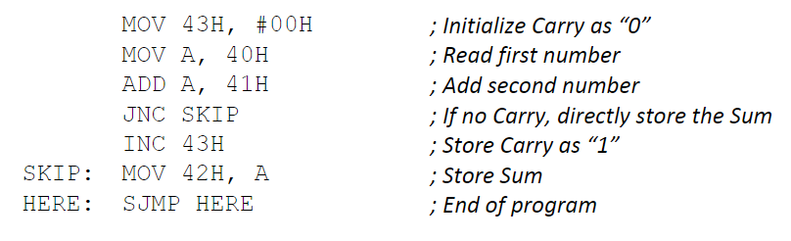

Slide 56
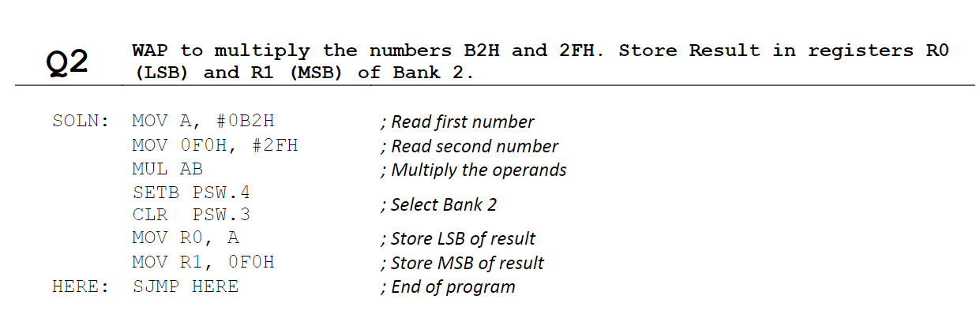

Slide 57
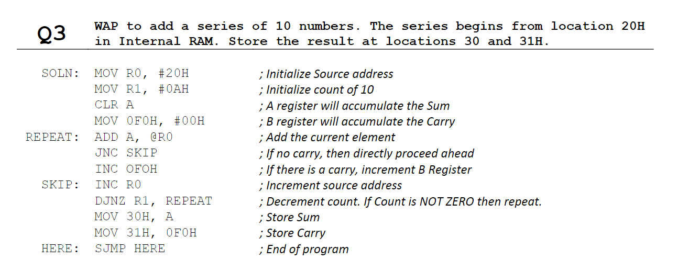

Slide 58
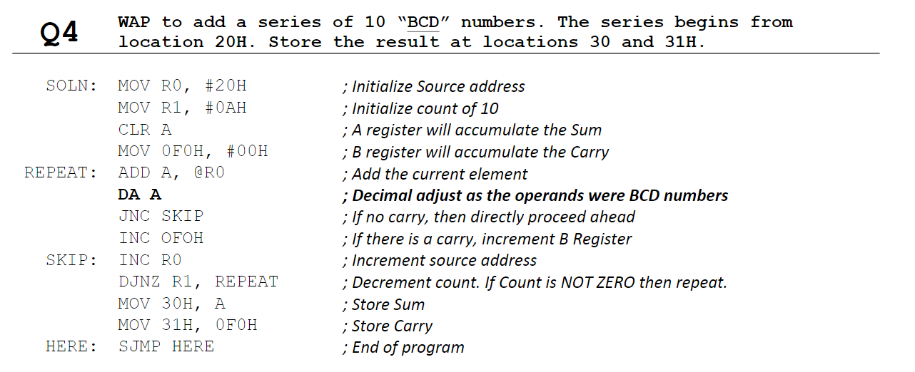

Slide 59
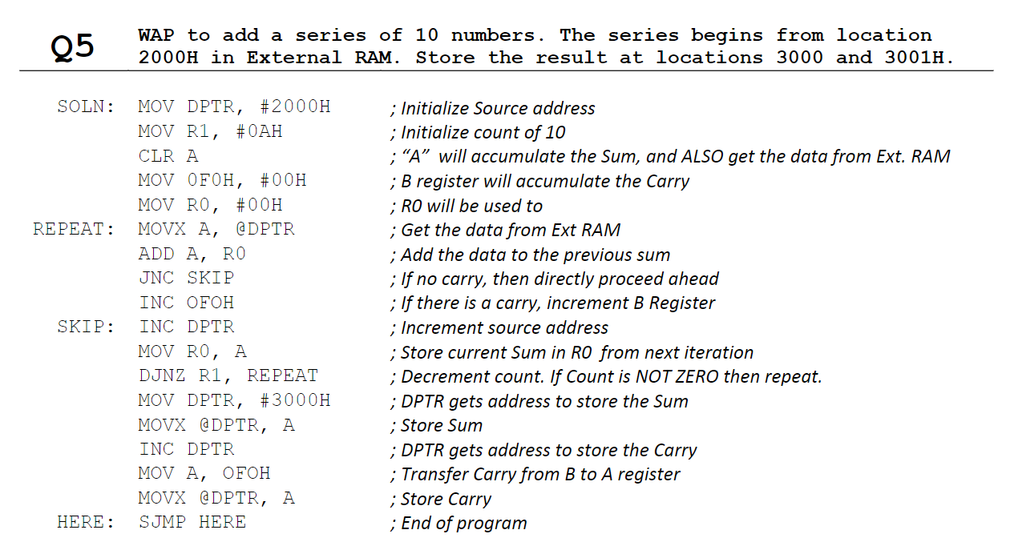

Slide 60
