Slide 1
MODULE 4
8255 PPI

Slide 2
Programmable Input-Output Port (PIO)Intel 8255
Parallel data transfer between processor and slow devices
Designed for used with 8-bit,16-bit and higher capacity MP’s
Consists of three 8-bit bidirectional I/O ports - Port A, Port B, and Port C
It provides 3 modes of data transfer: Simple I/O, handshake I/O, and Bi-directional Handshake
Additionally it has Bit Set Reset mode to alter individual pins of Port C

Slide 3
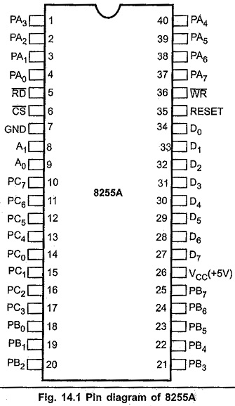

Slide 4
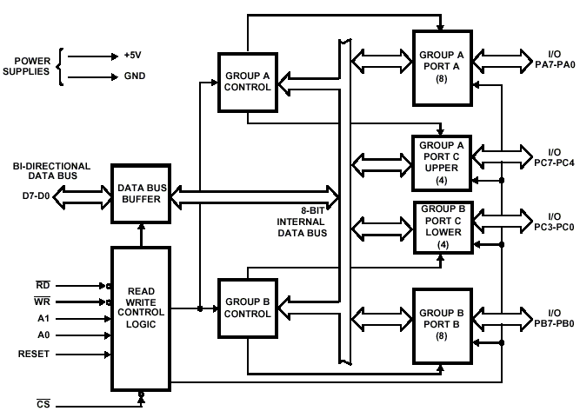

Internal Block Diagram of 8255

Slide 5
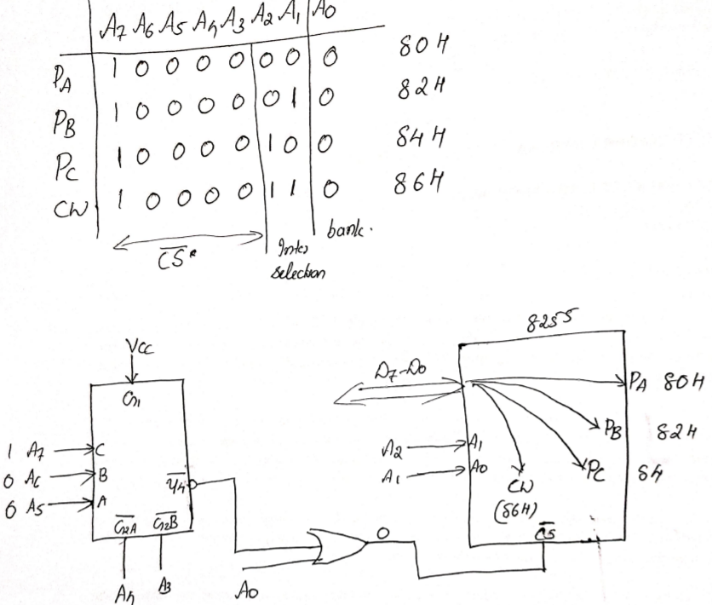


Slide 6
Blocks of 8255 architecture
Architecture can be divided in to
1)Data bus buffer
8-bit bidirectional buffer used to interface the internal data bus of 8255 with external (system)data bus
MP transfer data to and from the 8255 through this buffer
2) Read/Write control logic
It accepts address & control signals from the MP
Control signals determine whether it is a read/write operation and also select or reset the 8255 chip
Address bus (A1,A0) are used to select the Ports or Control word register as shown

Slide 7
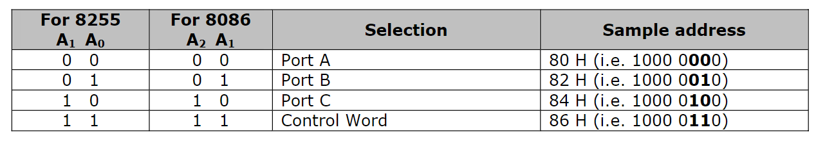

Slide 8
3) Group A control
This control block controls Port A and Port C_{upper} ie PC₇ –PC₄
It accepts control signals from control word and forwards them to the respective ports
4)Group B control
This control block controls Port B and Port C_{lower} ie PC₃ –PC₀
It accepts control signals from control word and forwards them to the respective ports

Slide 9
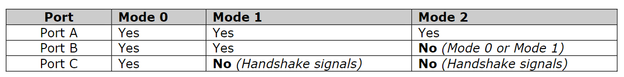
5) Port A, Port B, Port C
These are the 8-bit bi-directional ports
They can be programmed to work in the various modes as follows
Only port C can be programmed to work in BSR mode to manipulate its individual bits.

Slide 10
1)Control word of 8255-I/O mode
To do 8-bit data transfer using ports A,B or C, 8255 needs to be in the I/O mode
The bit pattern for the control word in the I/0 mode is shown in the next slide

Slide 11
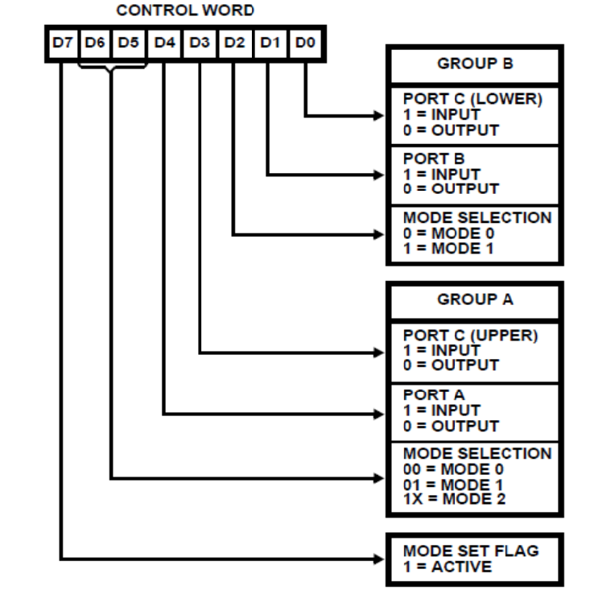
I/O mode control word register format

Slide 12
2)Control word of 8255-BSR mode
This mode is only used for Port C
Individual bits of Port C can be set/reset
It is very useful as it provides 8 individually controllable lines
BSR operation will not affect D₇ bit of BSR
The bit pattern for the control word is shown in the next slide

Slide 13
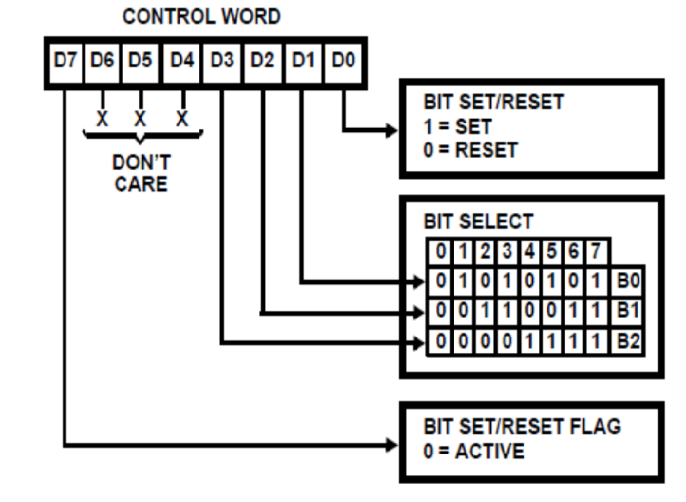
BSR mode control word register format

Slide 14
Data Transfer modes of 8255
Mode 0(Simple I/O or Basic I/O)
Port A, Port B used as 2 simple 8-bit I/O ports
Port C is used as 2 simple 4-bit I/O ports
Each port can be programmed individually as input or output port
Ports do not have handshaking or interrupting capability
Hence, slower devices cannot be interfaced

Slide 15
Mode 1 (Handshake I/O or Strobbed I/O)
Handshake signals are exchanged between the devices before the data transfer takes place
Port A and Port B are used as 2 8-bit ports that can be programmed in input or output mode
Each port uses 3 lines from port C for handshake. The remaining lines are used for simple I/O
Interrupt driven data transfer possible
Hence, slower devices can be interfaced

Slide 16
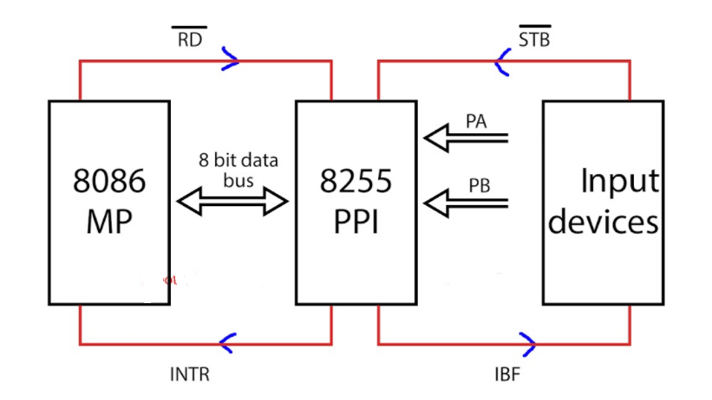
Mode 1- Handshake I/O

Slide 17
Input device gives STB signal ( active low ) to 8255 before sending data. If 8255 already has some data, then it doesn’t allow the Input device to send data.
8255 accepts data and stores it in the input buffer register. As soon as it receives the data, it gives an IBF signal ( input buffer is full ) . If IBF = 1, it does not allow any other data to enter 8255 PPI.
Now 8255 has data that should be sent to 8086. It makes INTR high, which means it is interrupting the processor.
Whenever the processor is free, it services this INTR. Then the Processor sends an RD ( active low ) signal and makes data transfer via data bus.
As soon as the RD signal is given , INTR gets low.

Slide 18
Complete stepwise handshaking :
STB ( active low ) goes low.
IBF goes high.
INTR goes high.
RD ( active low ) goes low.
INTR goes low.
RD ( active low ) goes high.
IBF goes low.

Slide 19
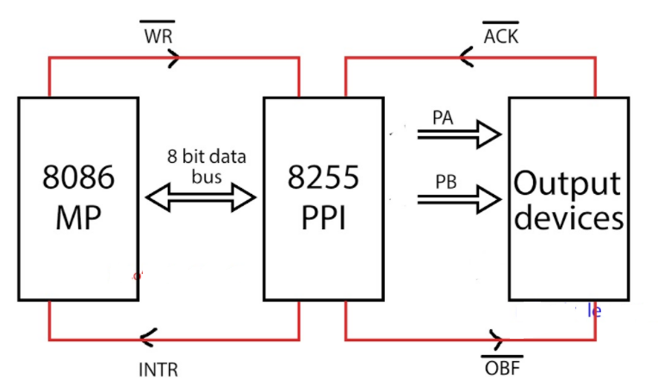
Mode – 1 [ Output Handshaking ]

Slide 20
8255 sends an interrupt whenever it is ready to accept data from the processor.
Whenever 8086 needs to send a signal ( condition provided INTR is active ), then 8086 sends WR ( active low ) signal. If 8255 has some data in it, then INTR will be low, and 8086 will not send data to 8255 PPI.
As 8255 receives data it resets OBF ( output buffer is full ( it is an active low signal ).
Then the Output device acknowledges the received input.

Slide 21
Complete stepwise handshaking
WR signal is activated.
INTR is set to low. [ now 8086 cannot send data again ]
OBF goes low [ Output buffer is full ]
ACK goes low ( it is an active low signal )
OBF goes back to high
ACK goes back to high
Data transfer is successful, so INTR goes back to high.

Slide 22
Mode 2 [ Bidirectional Handshaking ]
In this mode, two-way handshaking can be done
For normal input handshaking, we require 3 pins for handshaking
Similarly 3 pins for output handshaking
For bidirectional handshaking, we need 5 pins ( because one INTR is enough )
If PA is in mode 2, which means it is utilizing ⅝ pins of port C for handshaking.
So there are 3 remaining pins of port C, so definitely port B cannot be operated in mode-2, but while port-A is in mode-2, port-B can be operated in Mode – 0 or mode – 1.

Slide 23
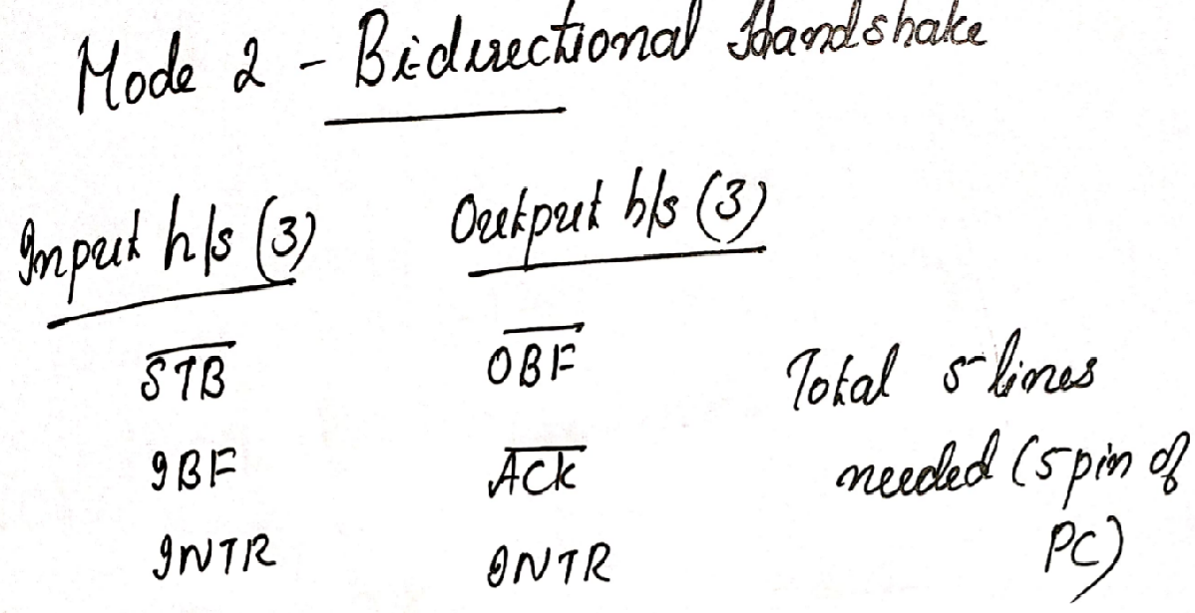

Slide 24
