Slide 1
MODULE 4
8257 DMAC

Slide 2
DMA Controller 8257
DMA stands for Direct Memory Access.
Transfer data at the fastest rate.
It allows the device to transfer the data directly to/from memory without any interference of the CPU.
Using a DMA controller, the device requests the CPU to hold its data, address and control bus, so the device is free to transfer data directly to/from the memory. The DMA data transfer is initiated only after receiving HLDA signal from the CPU.

Slide 3
Features of 8257
It has four channels which can be used over four I/O devices.
Each channel has 16-bit address and 16-bit counter.
Each channel can transfer data up to 64kb.
Each channel can be programmed independently.
Each channel can perform read transfer, write transfer and verify transfer operations.
It generates MARK signal to the peripheral device that 128 bytes have been transferred.
Its frequency ranges from 250Hz to 3MHz.
It operates in 2 modes, i.e., Master mode and Slave mode.

Slide 4
DRQ₀−DRQ3
These are the four individual channel DMA request inputs, which are used by the peripheral devices for using DMA services. When the fixed priority mode is selected, then DRQ₀ has the highest priority and DRQ₃ has the lowest priority among them.
DACK_{o} − DACK₃
These are the active-low DMA acknowledge lines, which updates the requesting peripheral about the status of their request by the CPU. These lines can also act as strobe lines for the requesting devices.

Slide 5
D_{o} − D₇
These are bidirectional, data lines which are used to interface the system bus with the internal data bus of DMA controller. In the Slave mode, it carries command words to 8257 and status word from 8257. In the master mode, these lines are used to send higher byte of the generated address to the latch. This address is further latched using ADSTB signal.
IOR
It is an active-low bidirectional tri-state input line, which is used by the CPU to read internal registers of 8257 in the Slave mode. In the master mode, it is used to read data from the peripheral devices during a memory write cycle.

Slide 6
IOW
It is an active low bi-direction tri-state line, which is used to load the contents of the data bus to the 8-bit mode register or upper/lower byte of a 16-bit DMA address register or terminal count register. In the master mode, it is used to load the data to the peripheral devices during DMA memory read cycle.
CLK
It is a clock frequency signal which is required for the internal operation of 8257.
RESET
This signal is used to RESET the DMA controller by disabling all the DMA channels

Slide 7
A_{o} - A₃
These are the four least significant address lines. In the slave mode, they act as an input, which selects one of the registers to be read or written. In the master mode, they are the four least significant memory address output lines generated by 8257.
CS
It is an active-low chip select line. In the Slave mode, it enables the read/write operations to/from 8257. In the master mode, it disables the read/write operations to/from 8257.
A₄ - A₇
These are the higher nibble of the lower byte address generated by DMA in the master mode.

Slide 8
READY
It is an active-high asynchronous input signal, which makes DMA ready by inserting wait states.
HRQ
This signal is used to receive the hold request signal from the output device. In the slave mode, it is connected with a DRQ input line 8257. In Master mode, it is connected with HOLD input of the CPU.
HLDA
It is the hold acknowledgement signal which indicates the DMA controller that the bus has been granted to the requesting peripheral by the CPU when it is set to 1.

Slide 9
MEMR
It is the low memory read signal, which is used to read the data from the addressed memory locations during DMA read cycles.
MEMW
It is the active-low three state signal which is used to write the data to the addressed memory location during DMA write operation.
ADST
This signal is used to convert the higher byte of the memory address generated by the DMA controller into the latches.
AEN
This signal is used to disable the address bus/data bus.

Slide 10
TC
It stands for ‘Terminal Count’, which indicates the present DMA cycle to the present peripheral devices.
MARK
The mark will be activated after each 128 cycles or integral multiples of it from the beginning. It indicates the current DMA cycle is the 128th cycle since the previous MARK output to the selected peripheral device.
V_{cc}
It is the power signal which is required for the operation of the circuit.

Slide 11
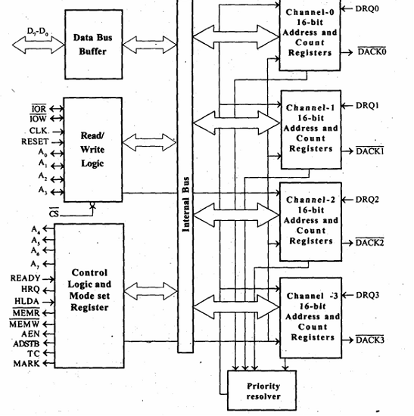
DMA Controller 8257

Slide 12
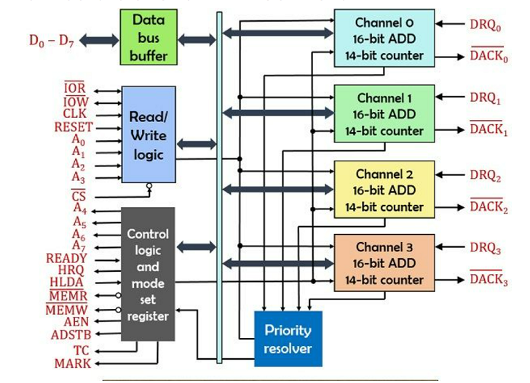
DMA Controller 8257

Slide 13
It contains Five main Blocks.
Data bus buffer
Read/Control logic
Control logic block
Priority resolver
DMA channels.

Slide 14
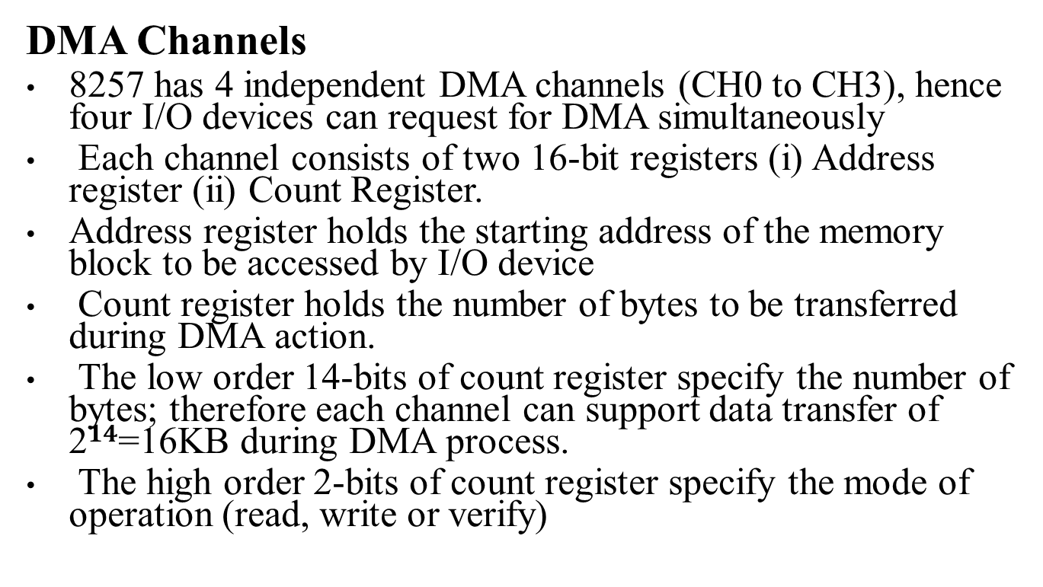
DMA Channels
8257 has 4 independent DMA channels (CH0 to CH3), hence four I/O devices can request for DMA simultaneously
Each channel consists of two 16-bit registers (i) Address register (ii) Count Register.
Address register holds the starting address of the memory block to be accessed by I/O device
Count register holds the number of bytes to be transferred during DMA action.
The low order 14-bits of count register specify the number of bytes; therefore each channel can support data transfer of 2$14$=16KB during DMA process.
The high order 2-bits of count register specify the mode of operation (read, write or verify)

Slide 15
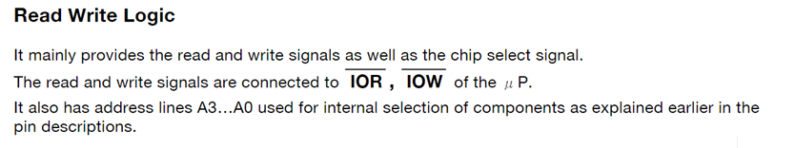
Data Bus Buffer: This 8-bit Bidirectional buffer is used to interface the 8257 to the system Data Bus
It allows the transfer of data and information between 8257 and microprocessors.

Slide 16
Priority Resolver
This logic block determines the priorities of the channels when more than one I/O device request for DMA.
By default the priority resolver work in fixed priority mode. In this mode the CH0 has the highest priority while the CH3 has lowest.
In rotating priority, the priority of the channels has a circular sequence. The channel which has being just serviced move to the lowest priority and channel next to it move to the highest priority, hence each channel achieves the highest priority in rotation.

Slide 17
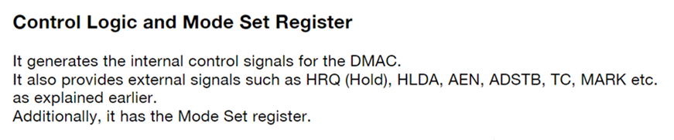

Slide 18
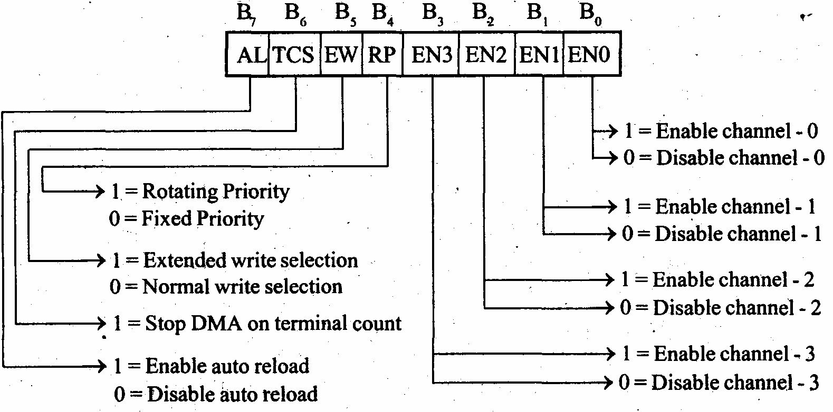
Mode Set Register of 8257

Slide 19
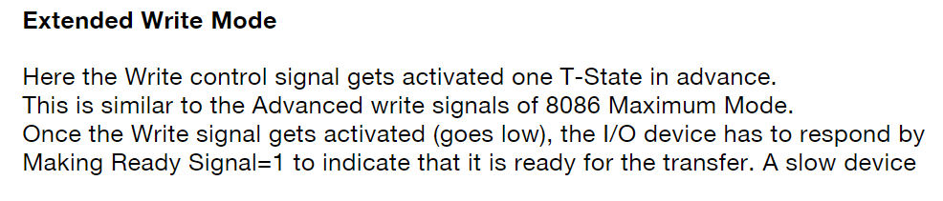
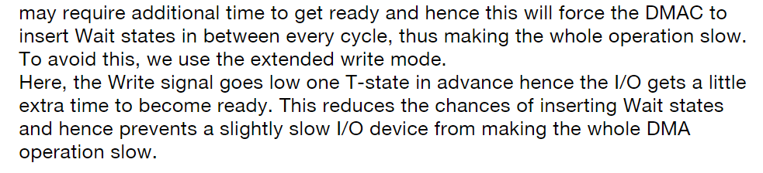

Slide 20
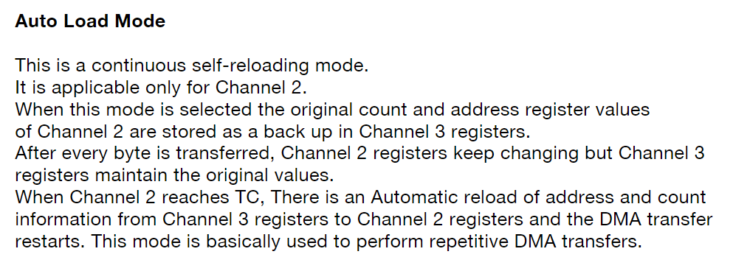

Slide 21
mode set register and status registers are common for all the channels
Thus there are a total of ten registers. The CPU selects one

Slide 22
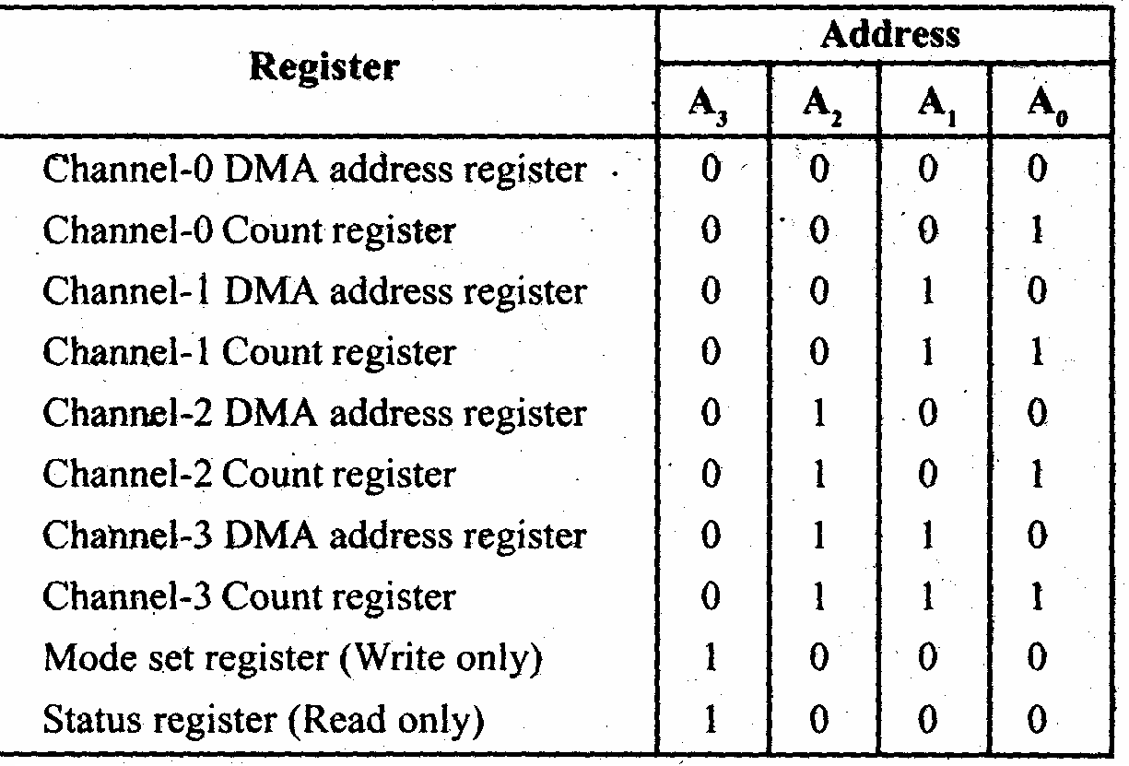
Register Selection

Slide 23
DMA Address Register
Each DMA channel has one DMA address register. The function of this register is to store the address of the starting memory location, which will be accessed by the DMA channel. Thus the starting address of the memory block which will be accessed by the device is first loaded in the DMA address register of the channel.

Slide 24
Terminal Count Register
Each of the four DMA channels of 8257 has one terminal count register (TC).
This 16-bit register issued for ascertaining that the data transfer through a DMA channel ceases or stops after the required number of DMA cycles.
The low order 14-bits of the terminal count register are initialized with the binary equivalent of the number of required DMA cycles minus one.
After each DMA cycle, the terminal count register content will be decremented by one and finally it becomes zero after the required number of DMA cycles are over.
The bits 14 and 15 of this register indicate the type of the DMA operation (transfer).

Slide 25
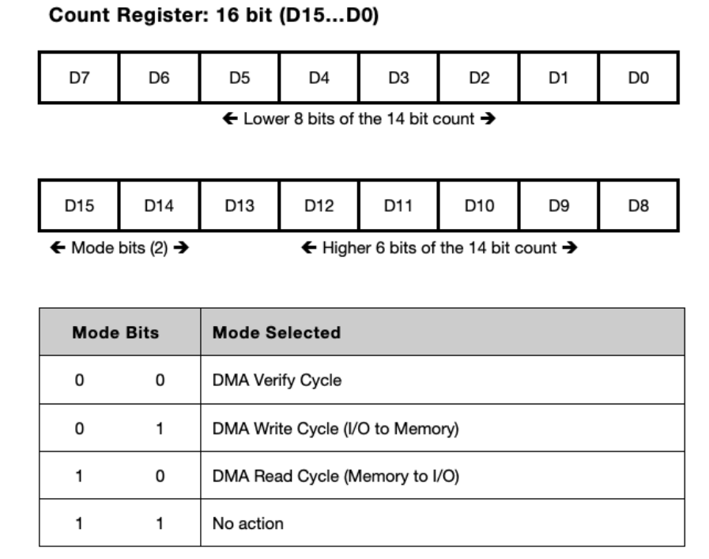

Slide 26
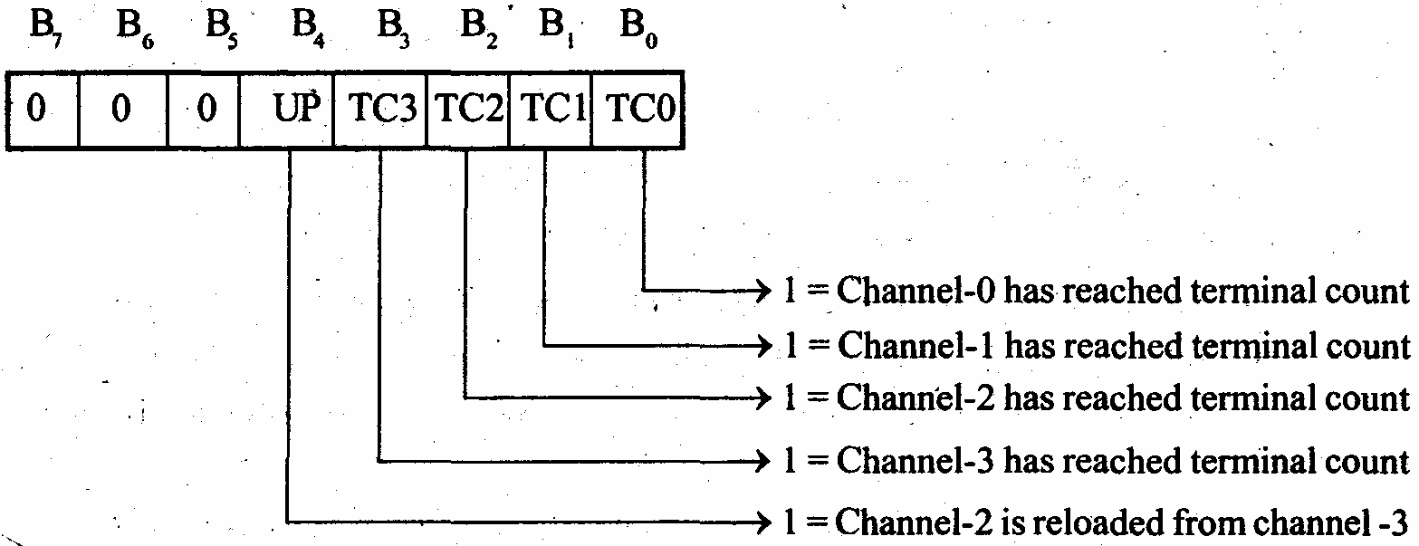
Status Register of 8257

Slide 27
If any of the lower 4 bit is set,it indicates that the specific channel has reached the terminal count condition
The update flag is not affected by the read operation
If UP=1,content of channel 3 are reloaded to channel 2 register
Whenever the channel 2 reaches a TC condition , after transferring one block and the next block is to be transferred using the autoload feature of 8257
UP flag is set every time channel 2 registers are loaded with contents of channel 3 register

Slide 28
Update flag
Update flag is not affected by the read operation.
Flag can only be cleared by resetting 8257 or by resetting the auto load bit of the mode set register
If UP=1,content of channel 3 are reloaded to channel 2 register
UP flag is set every time channel 2 registers are loaded with contents of channel 3 register

