Slide 1


Donal McLaughlin Electronic Engineer – Research Associate UCL Computer Science MSc Student Email: d.mclaughlin2@ulster.ac.uk donal.mclaughlin.17@ucl.ac.uk Mobile: +44 7922129420 GitHub: https://github.com/donalmclaughlin/Nibec.git Project: Development of a high sensitivity CRP lateral flow IoT device using CMOS sensors
Last Updated: 22/06/18
Intended goals:
To design and build an IOT device using an Photon Particle setup to image Lateral Flow Strips using a CMOS camera
To connect the IOT device to a MySQL database within Amazon Web Services (AWS)
To statistically analyse the lateral flow gold colloid strip images using R / Matlab / Python/ Amazon ML within AWS
To build a web interface using web technologies (HTML5, CSS and JavaScript) and server side scripting languages such as PHP to display CRP concentrations and trends.

Slide 2
WEEK 2

Slide 3
Completed - Fri 29/06/18
Create a basic web application on Localhost to query the database using primarily PHP
Alter a web application for SafeWater with
increased logic
Input fields to output .csv files from MySQL database
Connected Arducam (CMOS) to Arduino board and have started imaging lateral flow strips
Using MatLab and Python techniques to isolate coloured regions within the strips

Slide 4
For Next Week - 2/07/18 => 6/07/18
Continued work on SafeWater web application to improve logic
Work on image analysis of lateral flow strips
Connect Github repository of web application to AWS CodeDeploy to automate code deployment

Slide 5
WEEK 1

Slide 6
Completed - Fri 22/06/18
Connection between the photon-particle device and MySQL database on AWS via webhooks, Amazon API Gateway and Amazon Lambda
Photon is currently running a random number generator with no sensors attached
Use of AWS’s Amazon Machine Leaning function to train and test dummy CRP results from a LED-LED detector device.
This function can be used to predict concentrations of the antibody generated within contact of the CRP.
Version Control Setup
Dropbox
GitHub https://github.com/donalmclaughlin/Nibec.git
Lynda Tutorials:
AWS Essential Training
AWS Machine Learning by Example
AWS Machine Leaning Essential Training

Slide 7
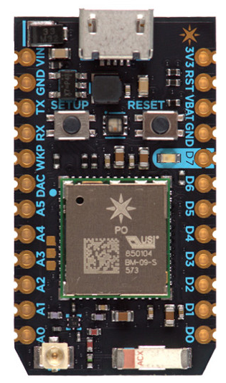







Completed Architecture connections 22/06/18
Data (JSON format) and HTTP Request
Data (JSON format) and HTTP Request
Particle.publish() via WIFI
SQL INSERT statement
Photon Particle
Photon Cloud
Webhook Integration
Amazon API Gateway
AWS Lambda
Amazon RDS
Language used:
C++
Language used: Node.js 6.10
*Soon to be deployed to AWS
NB: As of 22/06/18: the photon is a random generator and only one variable is being published to the Amazon RDS
Languages used: HTML5, CSS, JavaScript and server-side PHP
WAMP Server Local Host to host

Slide 8
For Next Week - 22/06/18 => 29/06/18
Create a basic web application on Localhost to query the database using primarily PHP
Connect temperature and light capturing sensors onto the photon device and upload to the MySQL database on AWS
Design the GUI for the web application dashboard for displaying results from the database and research techniques on displaying optimised results
Publish the web application onto AWS

