Slide 1


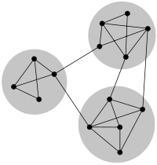
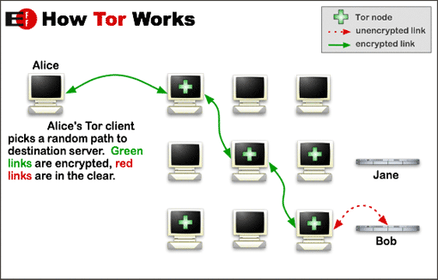

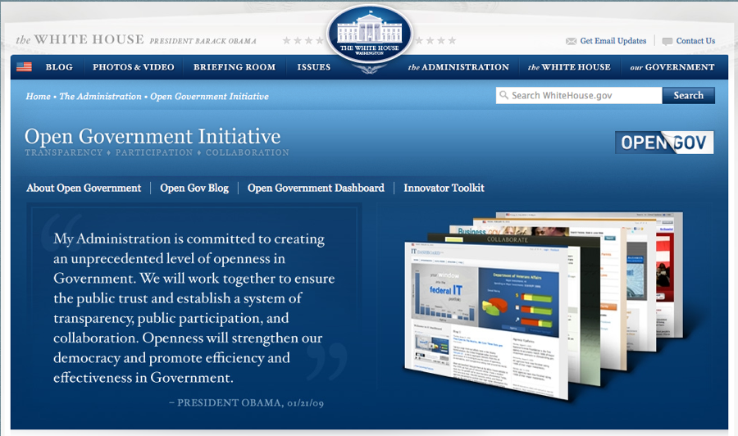

Questions that Annoy Engineers:
Seeking answers through Philosophy
Donal Heidenblad
“the public use of one's reason must be free at all times … the private use of reason may frequently be narrowly restricted” (Kant, 1983)
Value-laden Technology
Commercial Bias in OSS Discourse
Technology designed with a specific value or set of values explicitly stated as the project motivation
Identify community mechanisms for managing strong voices that may steer community discourse
Using Social Network Analysis tools applied to source control systems and project forums to identify relationships of developers in relation to project technical structes
“Anonymity may buy you time, but it will not buy everyone else justice.” - Jacob Appelbaum (2012)
Within specific community sub-clusters heavy commercial bias may desirable
Evaluating the proposed project value-goals against community participants values to identify project strength and potential sources of conflict
Kernel Version | # of Developers | # of Companies
3.1 | 1,168 | 212
3.2 | 1,316 | 226
All from 2.6.11 | 7,944 | 855
Core
http://en.wikipedia.org/wiki/Tor_(anonymity_network)
Values in Design / Value Sensitive Design
Western Philosophical Tradition
Research Goals
http://go.linuxfoundation.org/who-writes-linux-2012
“Not My Department”
Unintended Consequences
Use philosophy and social research methods to explore value conflicts in technology communities
A commonly heard phrase with conflicting sentiments:
Independently developed technologies combined to provide unplanned functionality
“[Privacy] really should be in the philosophy department.” (Shilton, 2012)
29c3 Keynote and Conference Title:
Image search, internet search, and social networks facilitate the revealing of identity
Once-the.rockets/are-up..who/cares-where.they/come-down.That's
N.O-T/MY-D/E.PA/R.T-ME-N/T.
2.9-C/3
http://knowyourmeme.com/memes/doxing
What are the underlying values systems are central to the conflicts?
Explore potential institutionalization of developer values in non-partisan projects by understanding project participants’ and project consumers’ values
References
Appelbaum, J. (2012, December). Not My Department. Keynote at the 29th Chaos Communication Congress, Hamburg, Germany. Retrieved from http://www.youtube.com/watch?v=QNsePZj_Yks
Kant, I. (1983). An answer to the question: What is enlightenment? (1784). In T. Humphrey (Trans.), Perpetual Piece and Other Essays on Politics, History, and Moral Philosophy (pp. 41-48). Hackett.
Shilton, K. (2012). Value Levers: Building Ethics into Design. Science, Technology & Human Values.
http://www.whitehouse.gov/open
Test values-levers (Shilton, 2012) within civic hacking projects to
http://hackforchange.org/

