Slide 1

Ọ̀ṣun
A Smart Water Bottle
GitHub Repository

Slide 2
More than 144 million people depend on surface drinking water
Contaminated drinking water estimated to cause
485,000 Diarrhoeal deaths each year
Waterborne infections affects 20–50% of
all travellers or about 10 million people per year
Source: www.who.int

Slide 3


Our Solution
A smart device which acts as a first line of defense and helps the user decide in real time, whether the water in the bottle is fit for drinking.
Real Time Analysis Quickly analyse the quality of the water and process the results
User Friendly Output Processed results displayed on the consumer’s mobile app or smart watch
Consumption Tracking Day to day tracking of water consumption to help the consumer make more conscious decisions about their water intake

Slide 4
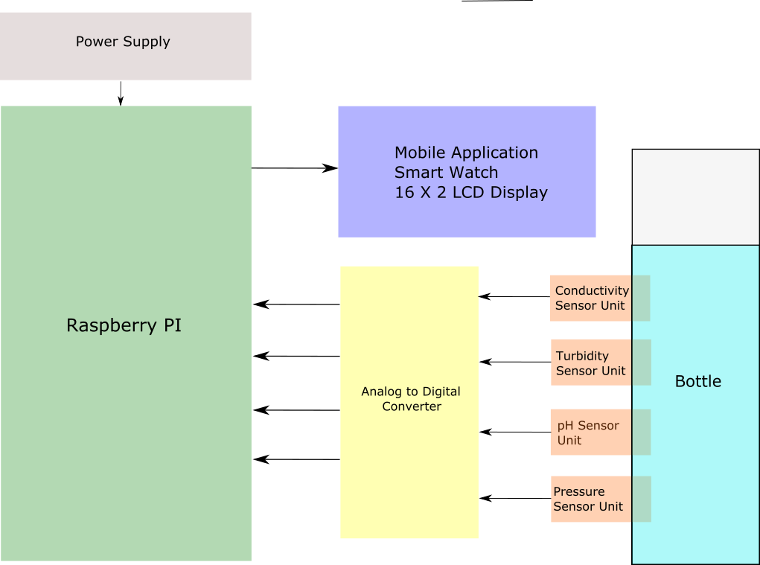

Slide 5
